Slide 1


PART2 Three-Phase Full Bridge Rectifier (Power Diode)
yuzihui
2023.10.17
1

Slide 2
C
ONTENTS
01
Principle
02
Simulation
03
Result and analysis

Slide 3
01
Principle
3

Slide 4
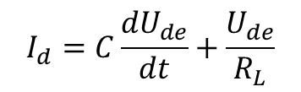


Principle
$$U_{l max}=Asin\left(w+t\right)={max\{U}_{ab}U_{ac}U_{ba}U_{bc}U_{ca}U_{cb}\text{\}}$$
${If U}_{de}<U_{l max}$ , ${then U}_{de}=U_{l max}$
$$I_{d}=C\frac{{dU}_{de}}{dt}+\frac{U_{de}}{R_{L}}$$
$If U_{de}>U_{l max} , then C\frac{{dU}_{de}}{dt}+\frac{U_{de}}{R_{L}}$=0
${ U}_{de}$= $U_{l max}(t_{0})e^{−\frac{t−t_{0}}{CR_{L}}}$
$$I_{d}=0$$

Slide 5
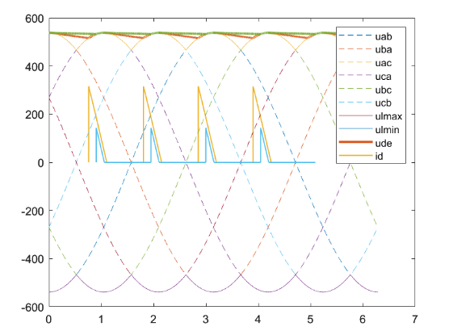

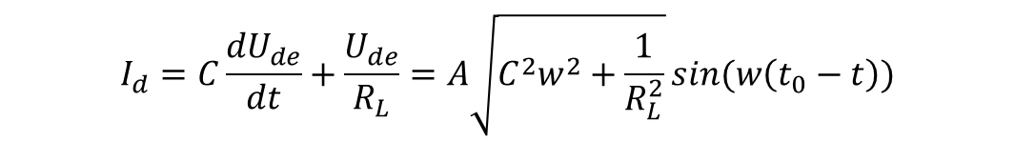

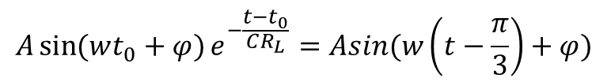
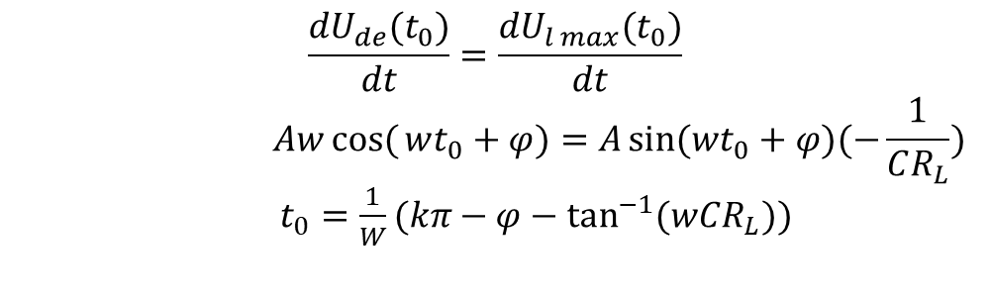
Scope of $I_{d}$
Determination of $t_{0}$
$$\frac{{dU}_{de}(t_{0})}{dt}=\frac{{dU}_{l max}(t_{0})}{dt}$$
$$Awcos({wt_{0}+φ)=A\sin{(wt_{0}+φ)(−\frac{1}{CR_{L}})}}$$
$t_{0}=\frac{1}{W}(kπ−φ−\tan^{−1}{(wCR_{L}))}$
添加文本
添加文本
添加文本
Determination of $t_{1}$
$${A\sin{(wt_{0}+φ)}e}^{−\frac{t−t_{0}}{CR_{L}}}=Asin(w\left(t−\frac{π}{3}\right)+φ)$$
$$I_{d}=C\frac{{dU}_{de}}{dt}+\frac{U_{de}}{R_{L}}=A\sqrt{C^{2}w^{2}+\frac{1}{R_{L}^{2}}}\sin{(w\left(t_{0}−t\right))}$$
$t_{1}<t<$ $t_{0}$

Slide 6
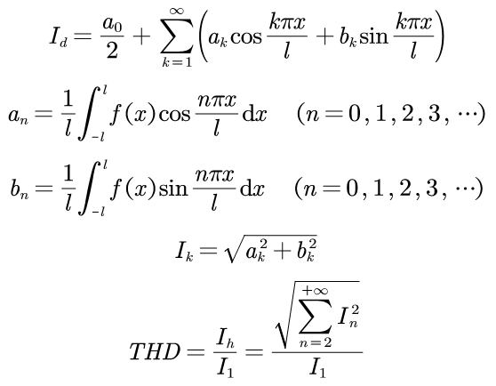
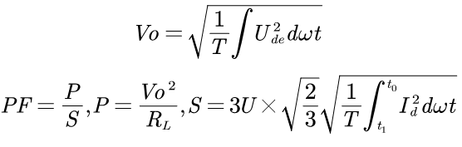
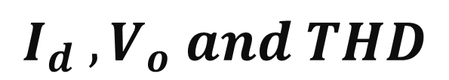
$$I_{d} ,V_{o} and THD$$
添加文本
添加文本
添加文本

Slide 7
02
Simulation

Slide 8
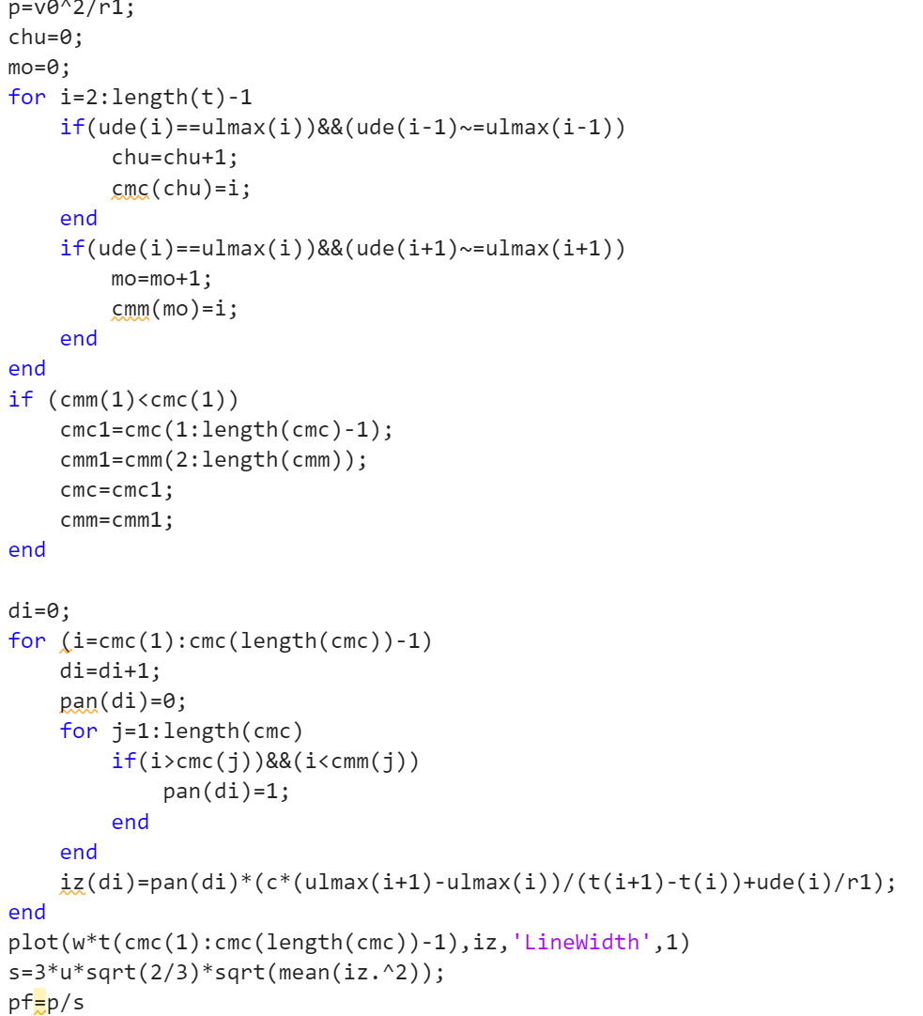
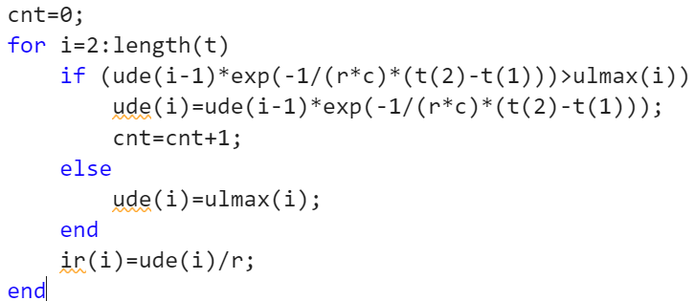
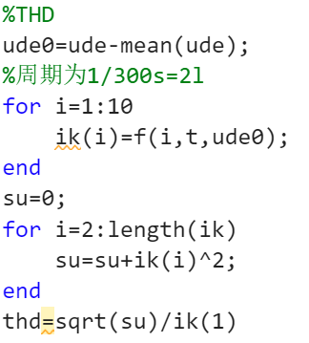
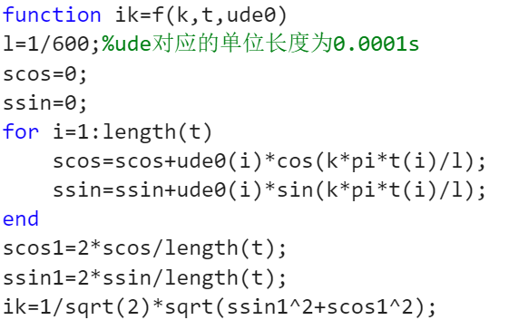
simulation
PF
$U_{de}$
THD
添加文本
添加文本
添加文本

Slide 9
03
Result and analysis

Slide 10
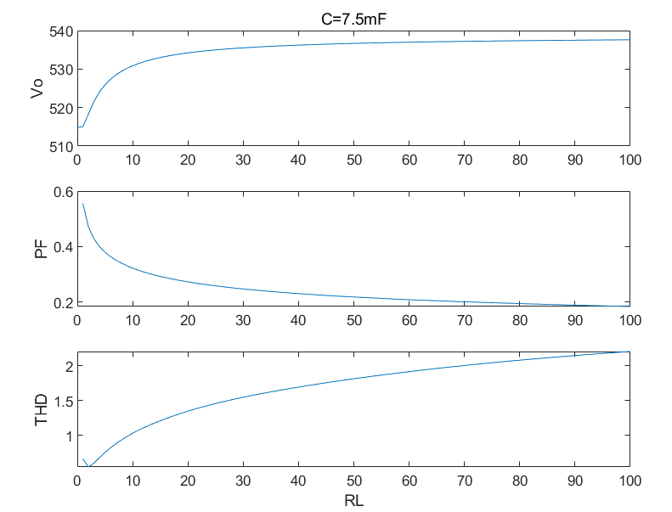
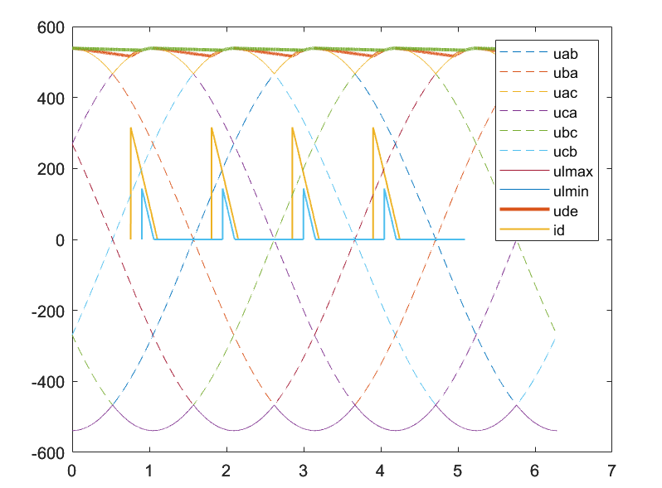

Output voltage
添加文本
$$t_{0}=\frac{1}{W}(kπ−φ−\tan^{−1}{(wCR_{L}))}$$
$$R_{L} ↑$$
$$t_{0} ↓$$
$$t_{1} ↑$$
$$U_{de}↑$$
$$V_{o}=\sqrt{\frac{1}{T}\int{U_{de}^{2}dwt}} ↑$$
添加文本

Slide 11
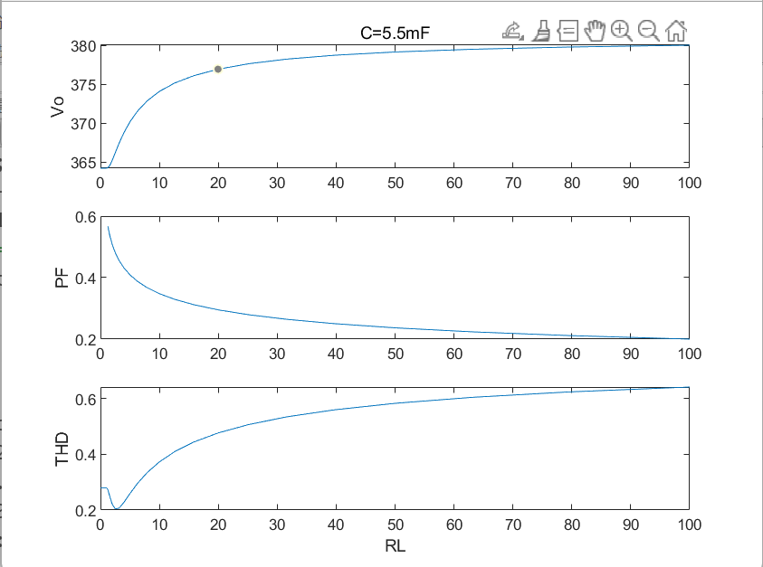
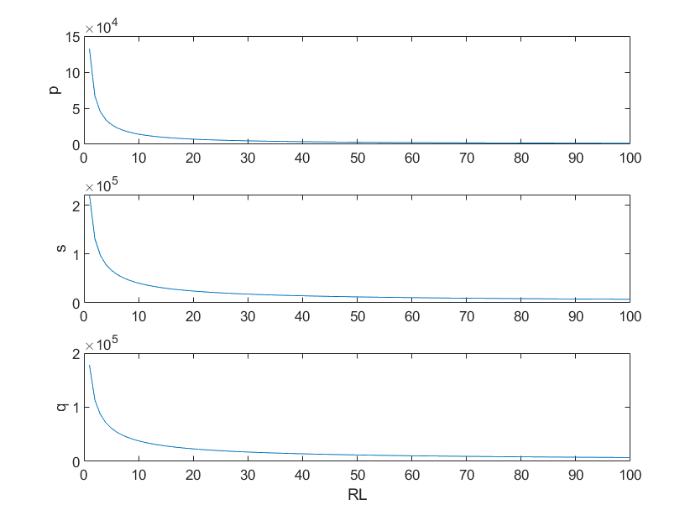

Power factor
$$PF=\frac{P}{S}=\frac{P}{P+Q}$$
$$R_{L} ↑$$
$$P↓↓ S↓$$
$$PF ↓$$
添加文本
添加文本
添加文本

Slide 12
THD
添加文本
添加文本
THD$↓ V_{o}$fluctuates greatly, resulting in high THD.
THD$↑$ discharge time $↑$
id is closer to a narrow pulse$→$contains more harmonic components

Slide 13
Thanks

