Slide 1


Seminar2
Presentation
Group member:
Suo Dingyang ; Yu Zihui
2023.10.17
1

Slide 2
C
ONTENTS
01
Rectification Mode
02
Active Inversion Mode
03
Principle of Capacitive filtering
04
Simulation
05
Results and Analysis
2

Slide 3
01
Rectification Mode
Three-Phase Full Bridge Rectifier (Thyristor)
3

Slide 4
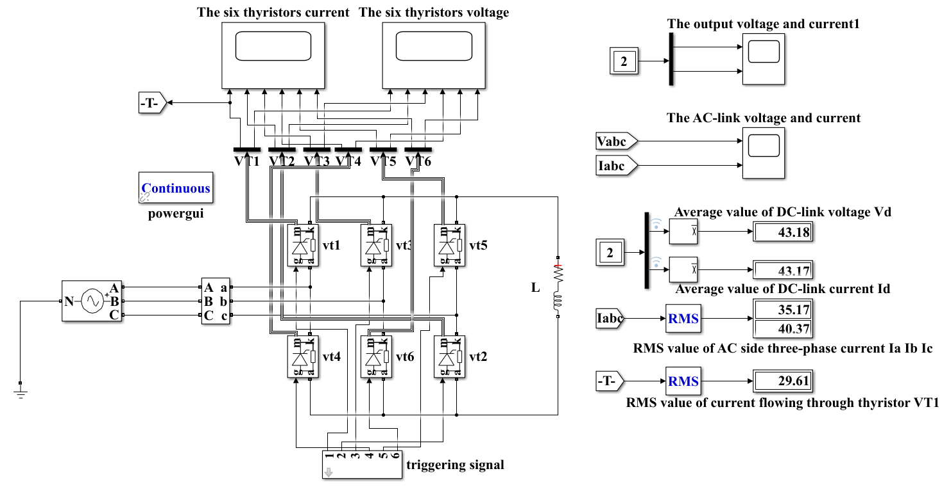

Simulation Model
$α_{1}$=85°
R=1Ω
L=5mH
• Six thyristors
• Signal generator
• Three-phase power supply
4

Slide 5
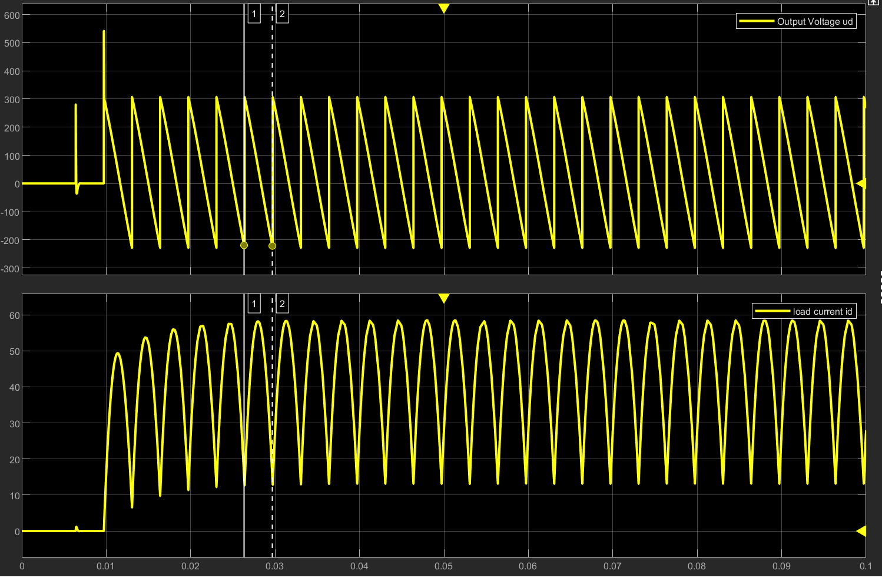

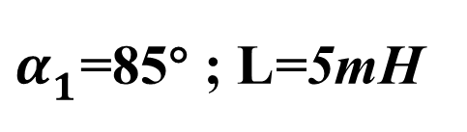

Simulation results
The DC-link Voltage $u_{d}$
Cross the zero point
$α_{1}$=85° ; L=5mH
The Load Current $i_{d}$
Consecutive current
5

Slide 6
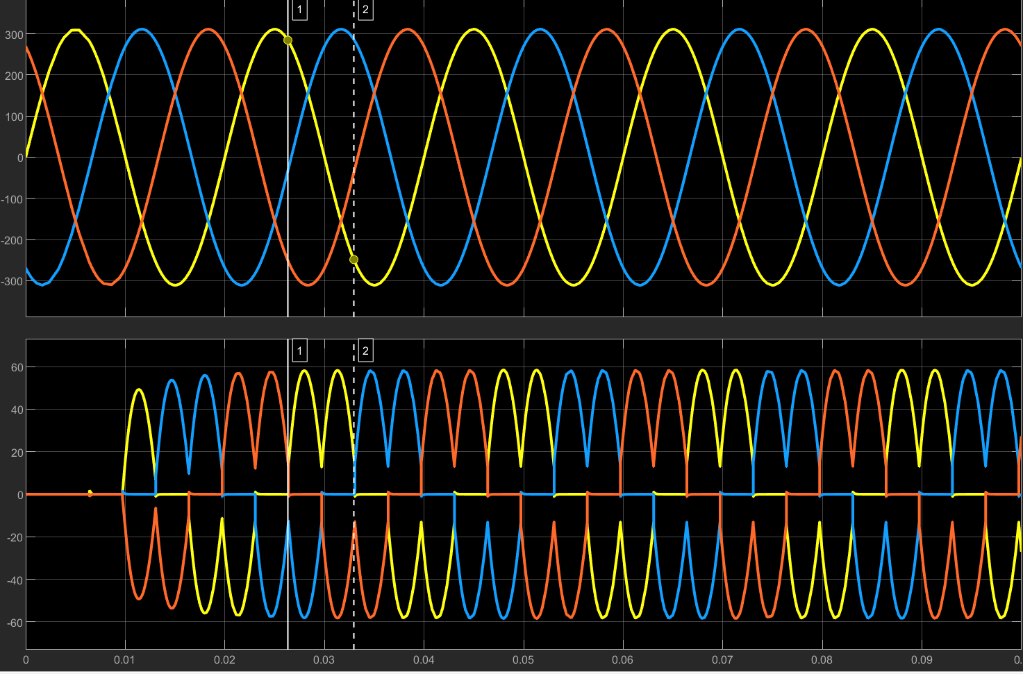


Simulation results
The AC-link voltage $u_{a}$, $u_{b}$, $u_{c}$
Phase voltage
Three-phase alternating conduction
Current $i_{a}$, $i_{b}$, $i_{c}$
Periodic current
yellow line: phase-a
blue line: phase-b
red line: phase-c
6

Slide 7
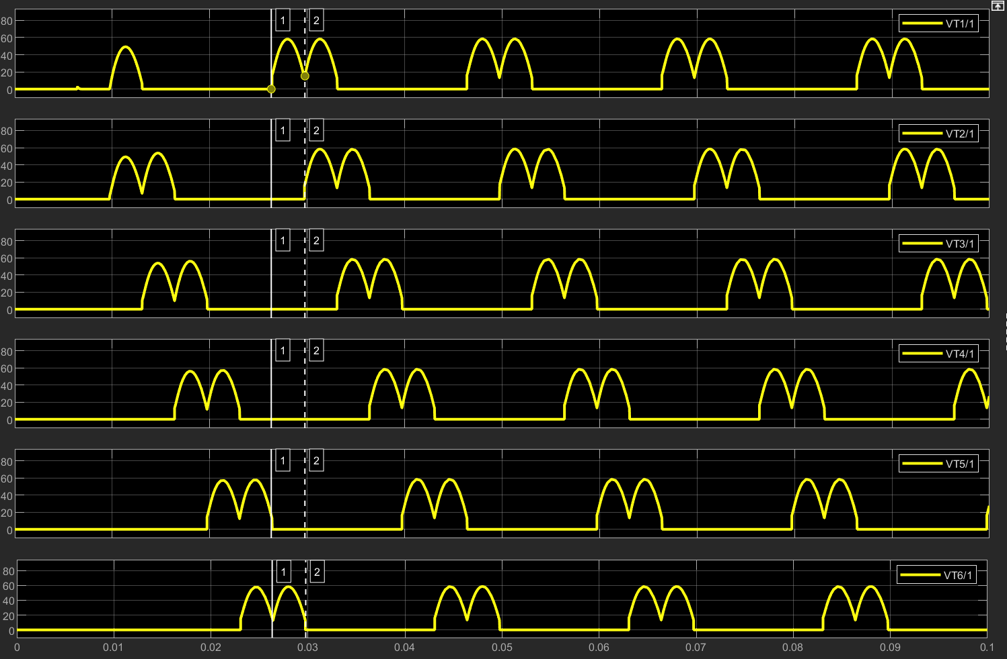

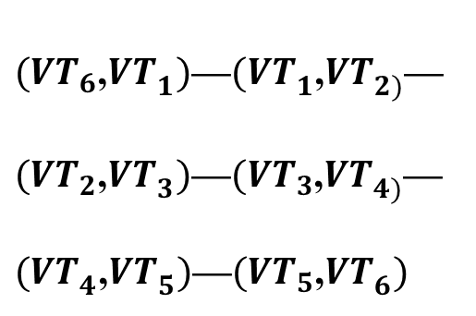
Simulation results
The six thyristors current $i_{{VT}_{1}}$ $i_{{VT}_{2}}$ $i_{{VT}_{3}}$ $i_{{VT}_{4}}$ $i_{{VT}_{5}}$ $i_{{VT}_{6}}$
6 thyristors alternating conduction
$({VT}_{6}$,${VT}_{1})$—${(VT}_{1}$,${VT}_{2)}$—$({VT}_{2}$,${VT}_{3})$—$({VT}_{3}$,${VT}_{4)}$—${(VT}_{4}$,${VT}_{5})$—$({VT}_{5}$,${VT}_{6})$
7

Slide 8
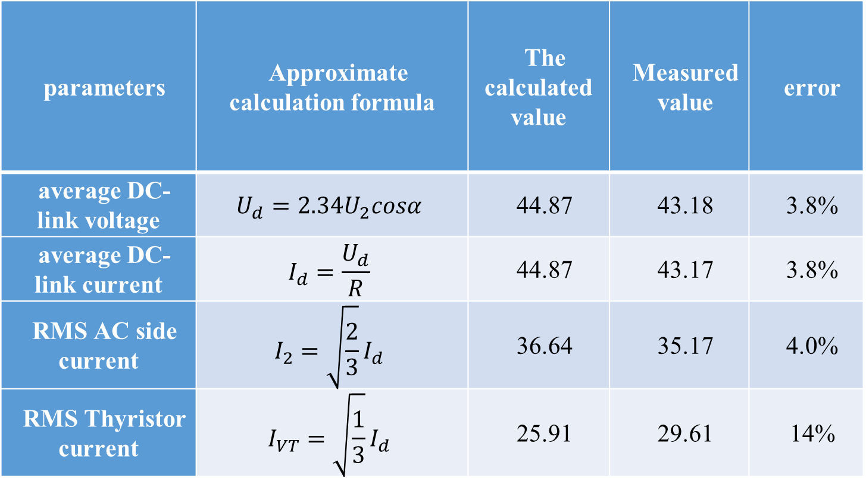
Comparison of theory and simulation
parameters | Approximate calculation formula | The calculated value | Measured value | error
average DC-link voltage | $$U_{d}=2.34U_{2}cosα$$ | 44.87 | 43.18 | 3.8%
average DC-link current | $$I_{d}=\frac{U_{d}}{R}$$ | 44.87 | 43.17 | 3.8%
RMS AC side current | $$I_{2}=\sqrt{\frac{2}{3}}I_{d}$$ | 36.64 | 35.17 | 4.0%
RMS Thyristor current | $$I_{VT}=\sqrt{\frac{1}{3}}I_{d}$$ | 25.91 | 29.61 | 14%
The six thyristors cur
Main reasons
Steady state
Finite inductance value
8

Slide 9
02
Active inversion Mode
Three-Phase Full Bridge Rectifier (Thyristor)
9

Slide 10
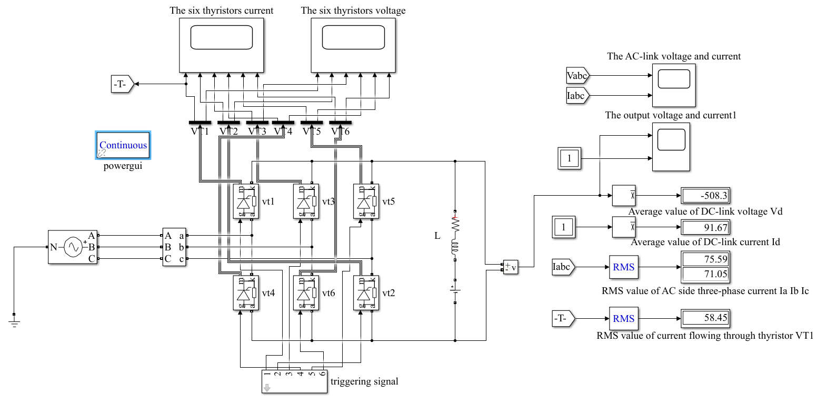
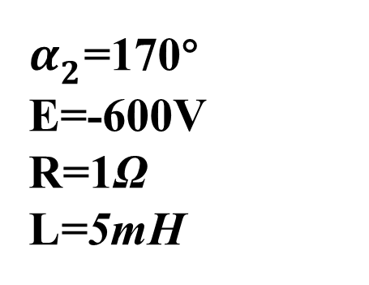
Simulation Model
$α_{2}$=170°
E=-600V
R=1Ω
L=5mH
10

Slide 11
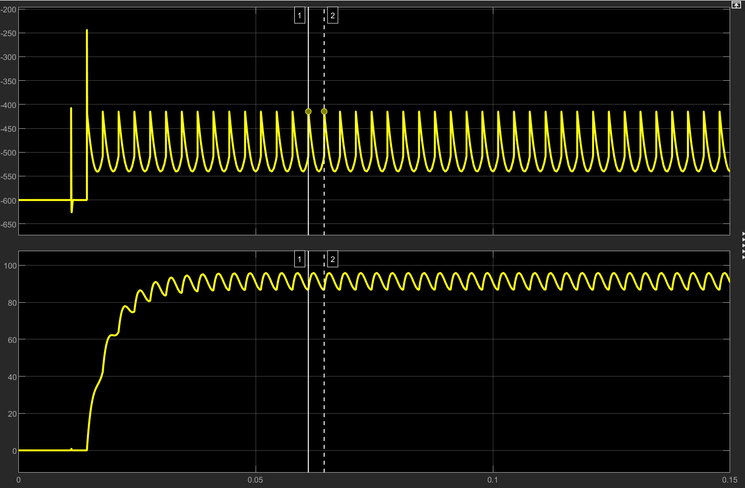

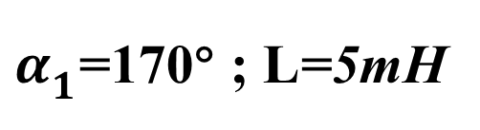

Simulation results
The DC-link Voltage $u_{d}$
Always negative
$α_{1}$=170° ; L=5mH
The Load Current $i_{d}$
Consecutive current
Maintain positive
11

Slide 12
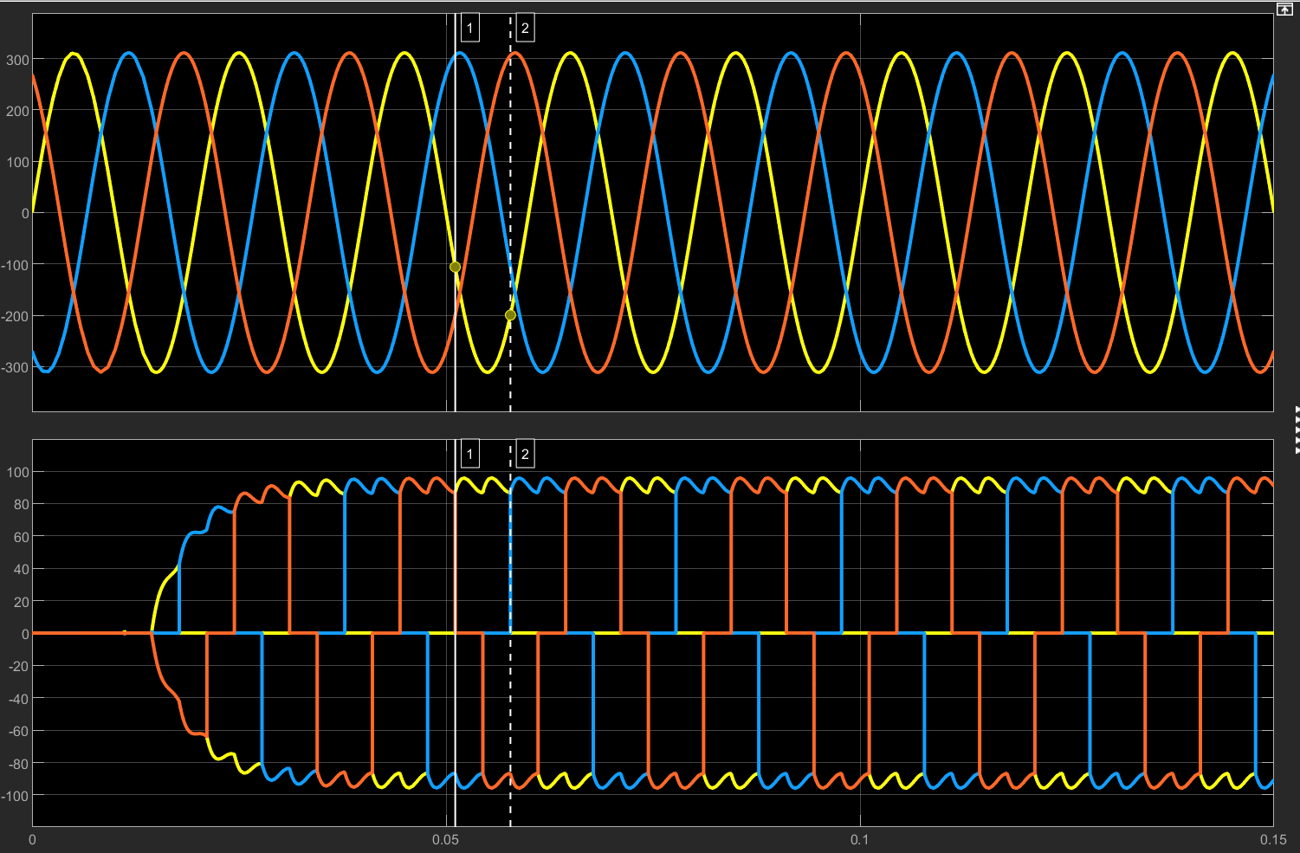


Simulation results
The AC-link voltage $u_{a}$, $u_{b}$, $u_{c}$
Phase voltage
Three-phase alternating conduction
Current $i_{a}$, $i_{b}$, $i_{c}$
Consecutive current
yellow line: phase-a
blue line: phase-b
red line: phase-c
12

Slide 13
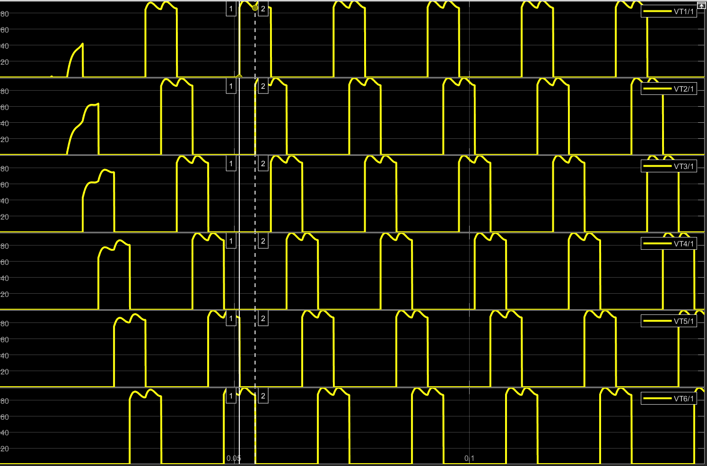
Simulation results
The six thyristors current $i_{{VT}_{1}}$ $i_{{VT}_{2}}$ $i_{{VT}_{3}}$ $i_{{VT}_{4}}$ $i_{{VT}_{5}}$ $i_{{VT}_{6}}$
6 thyristors alternating conduction
$({VT}_{6}$,${VT}_{1})$—${(VT}_{1}$,${VT}_{2)}$—$({VT}_{2}$,${VT}_{3})$—$({VT}_{3}$,${VT}_{4)}$—${(VT}_{4}$,${VT}_{5})$—$({VT}_{5}$,${VT}_{6})$
13

Slide 14
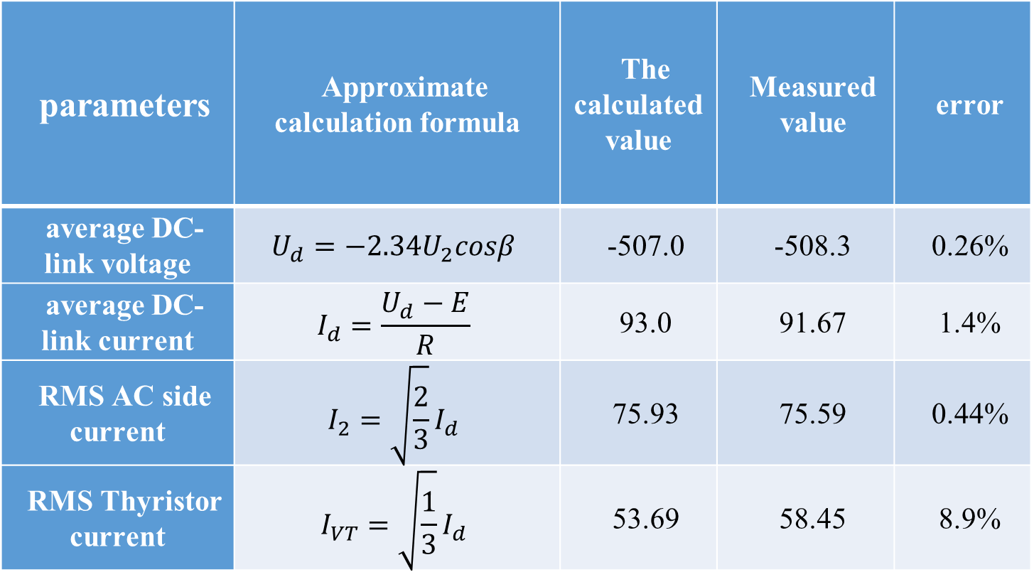
Comparison of theory and simulation
parameters | Approximate calculation formula | The calculated value | Measured value | error
average DC-link voltage | $$U_{d}=−2.34U_{2}cosβ$$ | -507.0 | -508.3 | 0.26%
average DC-link current | $$I_{d}=\frac{U_{d}−E}{R}$$ | 93.0 | 91.67 | 1.4%
RMS AC side current | $$I_{2}=\sqrt{\frac{2}{3}}I_{d}$$ | 75.93 | 75.59 | 0.44%
RMS Thyristor current | $$I_{VT}=\sqrt{\frac{1}{3}}I_{d}$$ | 53.69 | 58.45 | 8.9%
The six thyristors cur
Main reasons
Steady state
Finite inductance value
14

Slide 15
03
Principle
Capacitive filtering in diode bridge
15

Slide 16
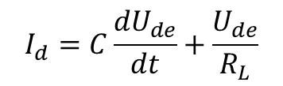


Principle
$$U_{l max}=Asin\left(w+t\right)={max\{U}_{ab}U_{ac}U_{ba}U_{bc}U_{ca}U_{cb}\text{\}}$$
${If U}_{de}<U_{l max}$ , ${then U}_{de}=U_{l max}$
$$I_{d}=C\frac{{dU}_{de}}{dt}+\frac{U_{de}}{R_{L}}$$
$If U_{de}>U_{l max} , then C\frac{{dU}_{de}}{dt}+\frac{U_{de}}{R_{L}}$=0
${ U}_{de}$= $U_{l max}(t_{0})e^{−\frac{t−t_{0}}{CR_{L}}}$
$$I_{d}=0$$
16

Slide 17
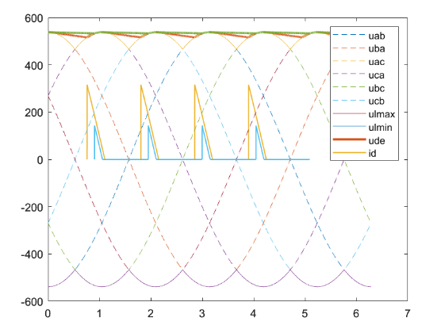

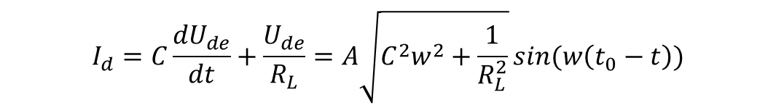

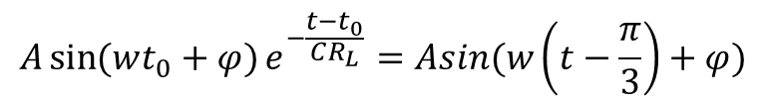
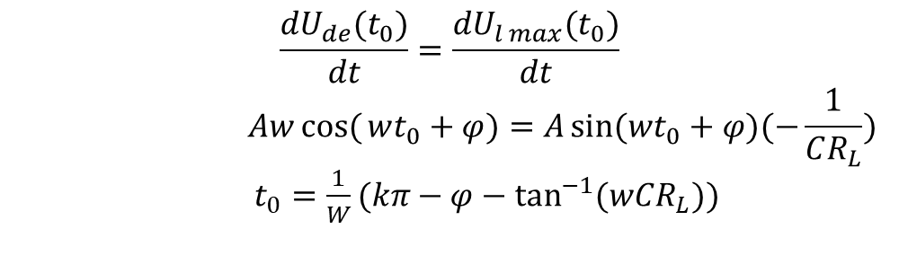
Scope of $I_{d}$
Determination of $t_{0}$
$$\frac{{dU}_{de}(t_{0})}{dt}=\frac{{dU}_{l max}(t_{0})}{dt}$$
$$Awcos({wt_{0}+φ)=A\sin{(wt_{0}+φ)(−\frac{1}{CR_{L}})}}$$
$t_{0}=\frac{1}{W}(kπ−φ−\tan^{−1}{(wCR_{L}))}$
添加文本
添加文本
添加文本
Determination of $t_{1}$
$${A\sin{(wt_{0}+φ)}e}^{−\frac{t−t_{0}}{CR_{L}}}=Asin(w\left(t−\frac{π}{3}\right)+φ)$$
$$I_{d}=C\frac{{dU}_{de}}{dt}+\frac{U_{de}}{R_{L}}=A\sqrt{C^{2}w^{2}+\frac{1}{R_{L}^{2}}}\sin{(w\left(t_{0}−t\right))}$$
$t_{1}<t<$ $t_{0}$
17

Slide 18
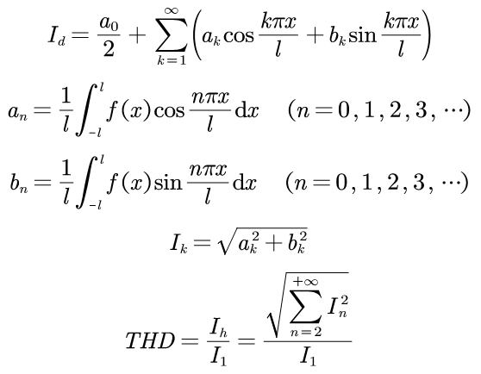
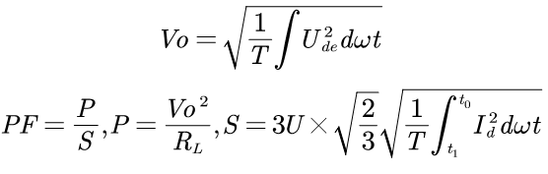
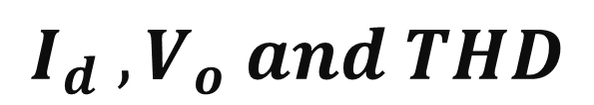
$$I_{d} ,V_{o} and THD$$
添加文本
添加文本
添加文本
18

Slide 19
04
Simulation
Diode bridge capacitive load
19

Slide 20
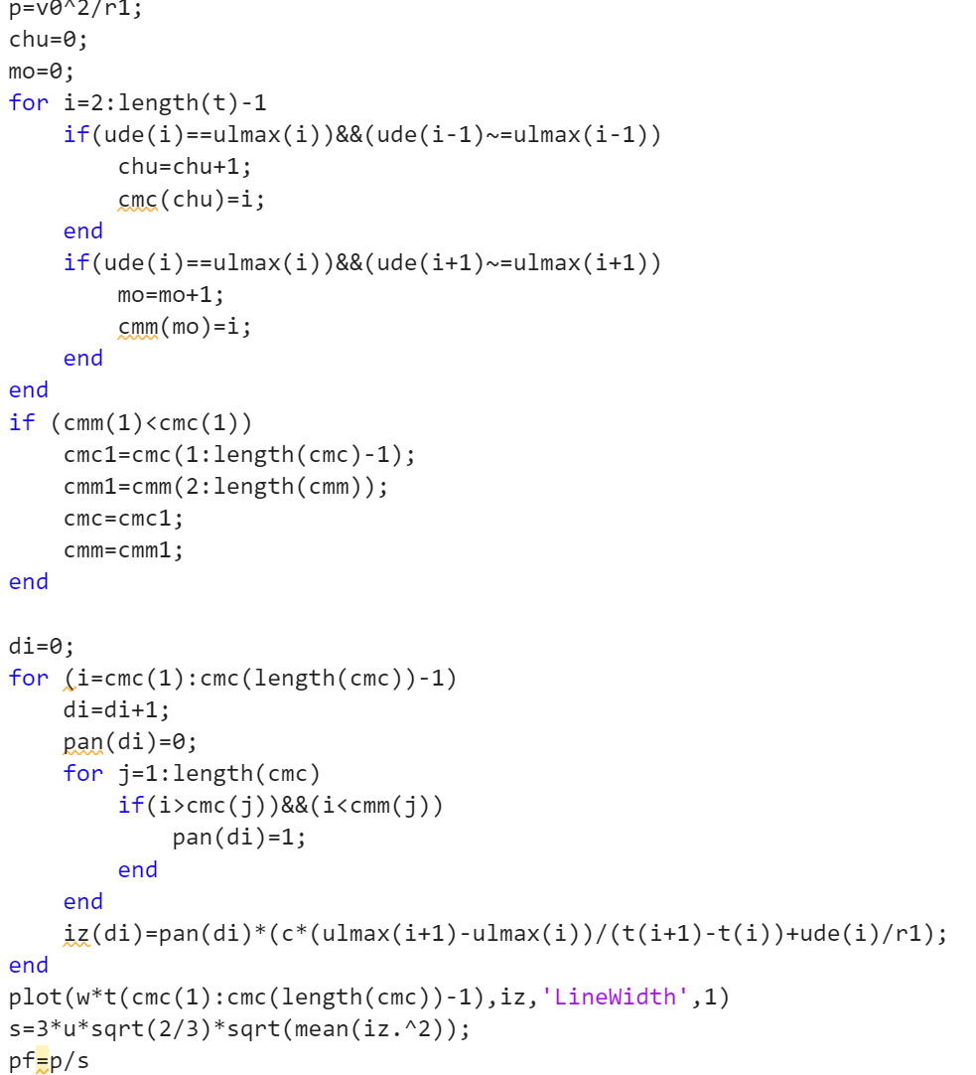
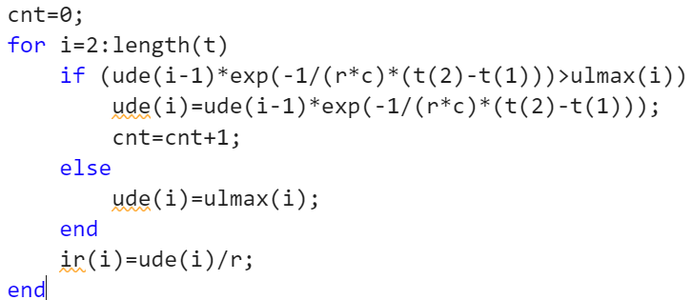
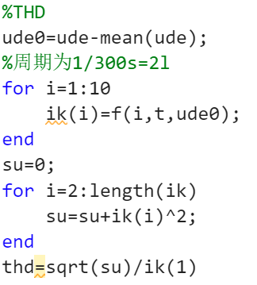
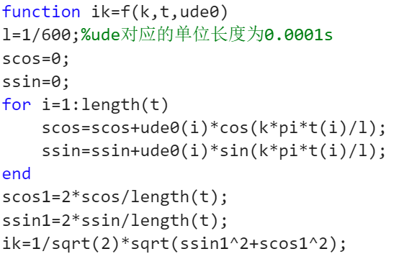
simulation
PF
$U_{de}$
THD
添加文本
添加文本
添加文本
20

Slide 21
05
Results and analysis
Diode bridge capacitive load
21

Slide 22
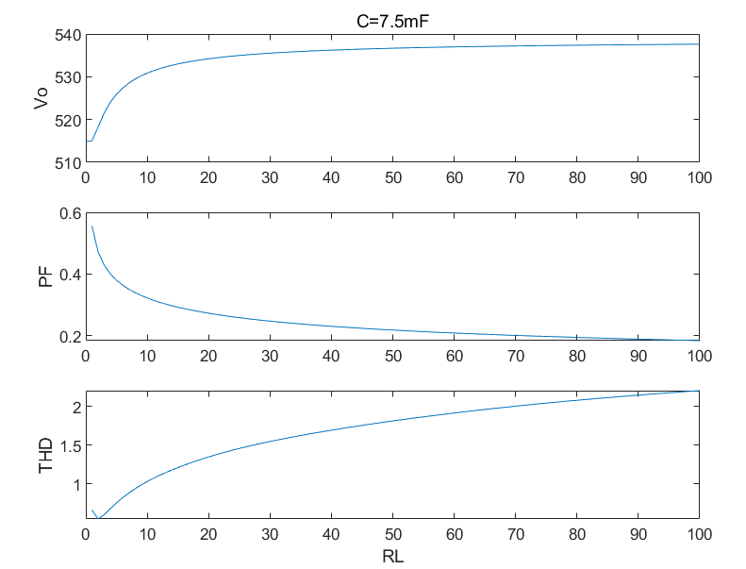
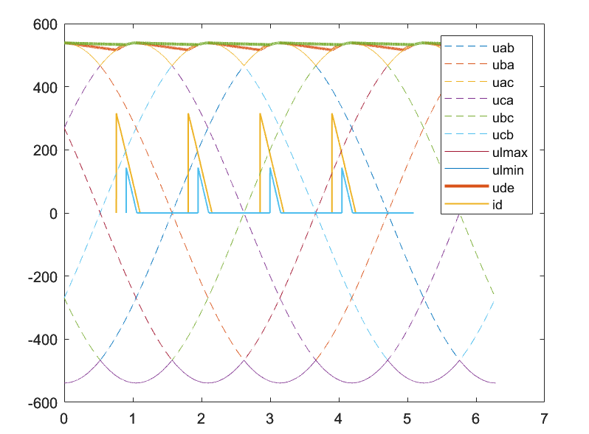

Output voltage
添加文本
$$t_{0}=\frac{1}{W}(kπ−φ−\tan^{−1}{(wCR_{L}))}$$
$$R_{L} ↑$$
$$t_{0} ↓$$
$$t_{1} ↑$$
$$U_{de}↑$$
$$V_{o}=\sqrt{\frac{1}{T}\int{U_{de}^{2}dwt}} ↑$$
添加文本
22

Slide 23
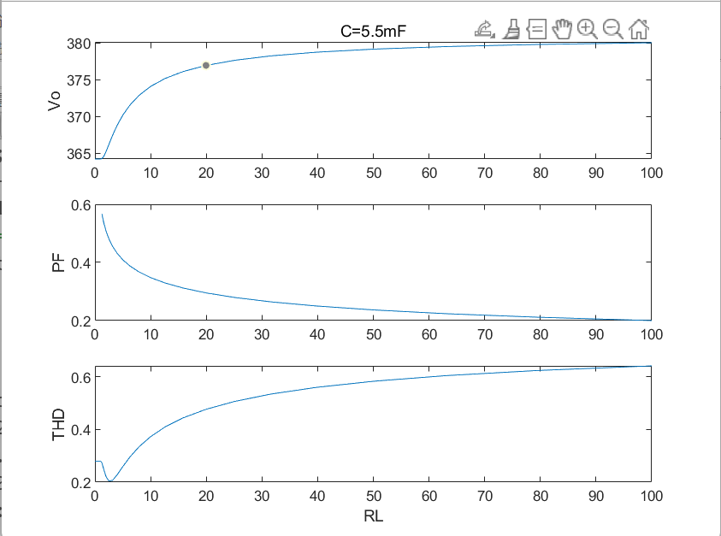
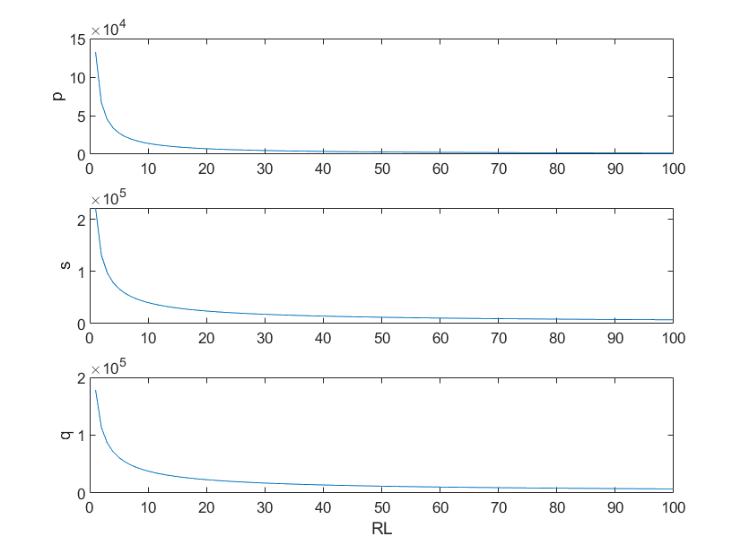

Power factor
$$PF=\frac{P}{S}=\frac{P}{P+Q}$$
$$R_{L} ↑$$
$$P↓↓ S↓$$
$$PF ↓$$
添加文本
添加文本
添加文本
23

Slide 24
THD
添加文本
添加文本
THD$↓ V_{o}$fluctuates greatly, resulting in high THD.
THD$↑$ discharge time $↑$
id is closer to a narrow pulse$→$contains more harmonic components
24

Slide 25
Thanks
2023.10.17
25

