Slide 1


Seminar 1
presentation
group member: Ni Zhewen
Suo Dingyang
Zhao Kaitai
2
0
2
3

Slide 2

Desk Lamp
LTspice Simulation:
Power MOSFET
content

Slide 3

01
Desk Lamp
Notes:
Here for topic 1, I’m gonna introduce a desk lamp to you.

Slide 4

Topic1. Desk Lamp
A Brief Introduction to the Desk Lamp
Just like a normal lamp, but with powerful function:
* Equipped with 64 LED light beads to achieve a rated power of 3.84W;
* Equipped with a touchscreen that can display the time and adjust the brightness;
* Equipped with wireless network connectivity;
* Controlled remotely through a smartphone app.
Notes:
So here is a brief introduction to the desk lamp. Read.

Slide 5
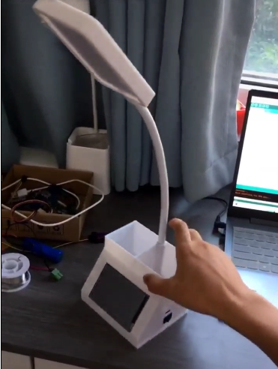
Topic1. Desk Lamp
64 LED light beads;
A touchscreen;
Wireless network connectivity;
Smartphone app Controlled.
Appearance of the desk lamp

Slide 6
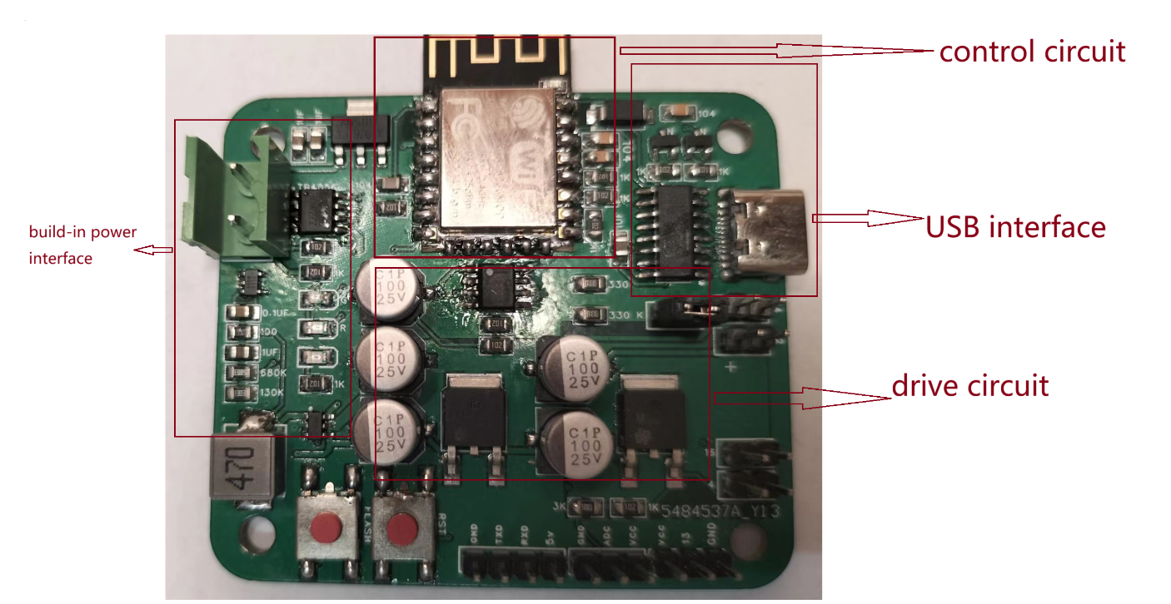
Topic1. Desk Lamp
Boost converter
Working circuit diagram
Notes:
Here is the PCB board of this appliance.
On the left side is the power stage, where the build-in power interface is used for plugging in the 5W power input.
Below it, there is a chip with six pins. This is a boost converter. As the name suggests, is used to increase the input voltage. We will learn about it in our future study in this course.
On the top of the PCB is the control circuit. It is used to generate duty cycle of PWM signal. The largest chip is used for wi-fi connectivity.
The USB interface on the right side is used for connecting to the power source and importing information.
In the middle of the PCB board is our driver circuit. The simplified equivalent circuit diagram of the driver circuit is as follows:

Slide 7
Topic1. Desk Lamp
the working circuit diagram of the lamp
*PWM: pulse width modulation
Dc input; *duty.
Notes:
Here (point) we have a PWM signal input. PWM stands for pulse width modulation.
PWM stands for Pulse Width Modulation, which is a technique that uses a square-shaped waveform. It is equivalent to a DC input, and by adjusting the duty cycle, it can replicate changes in the equivalent DC input, thereby controlling the brightness level of a light bulb.

Slide 8
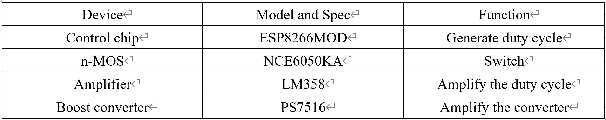
Topic1. Desk Lamp
P.E. devices and components
Notes:
This table lists some of the devices used in the appliance, as well as its specifications and functions.
In the former part we have already introduced the functions of each devices, so I won't repeat the explanation.

Slide 9
02
LTspice simulation

Slide 10
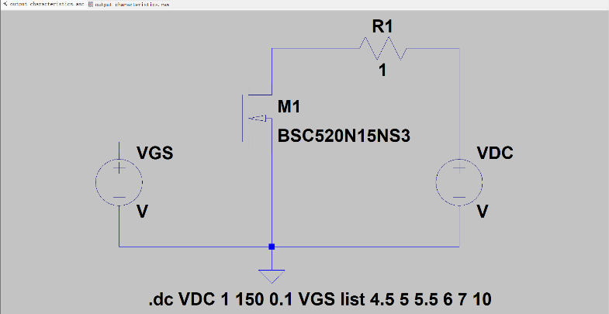
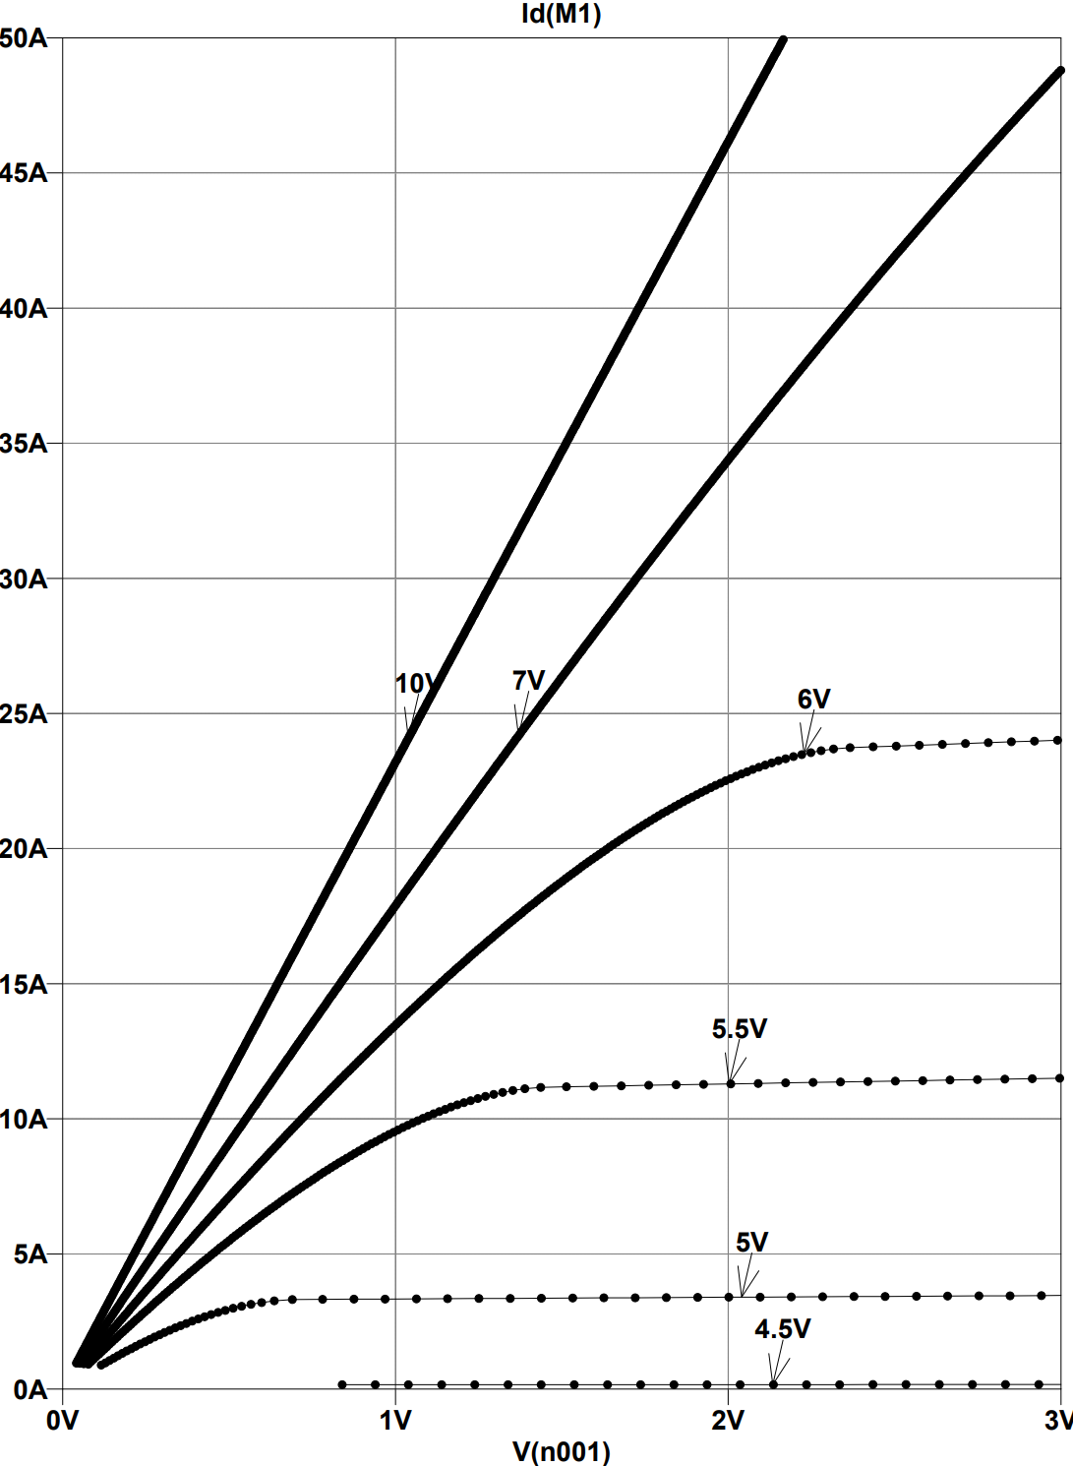
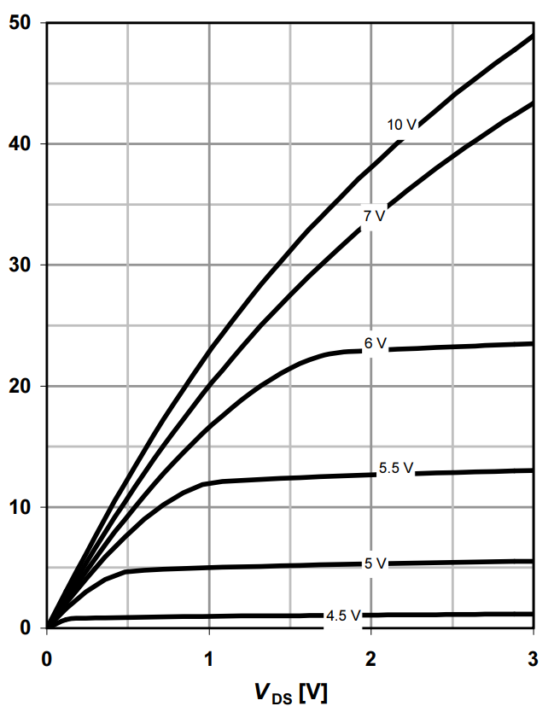
Topic 2. LTspice simulation
1.Output characteristics ( under different )
With the increase of parameter , the slope of the image coordinates increases larger and higher saturation values.
This is determined by the internal structure of the MOSFET.
Notes:
We can see from the figure that the simulation fits well with the reference curve. The figure indicates that as Vds increases, Id also increases. When Vgs increases, the positive correlation coefficient between a and b increases.

Slide 11
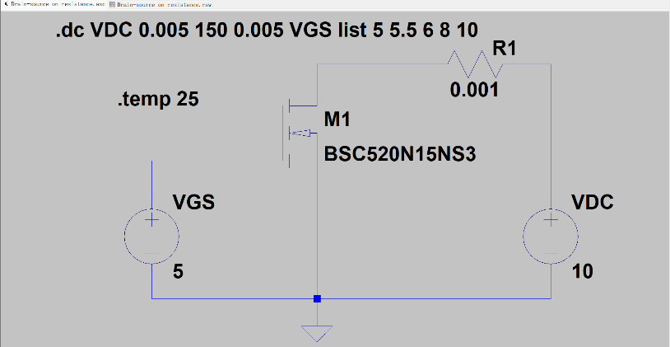
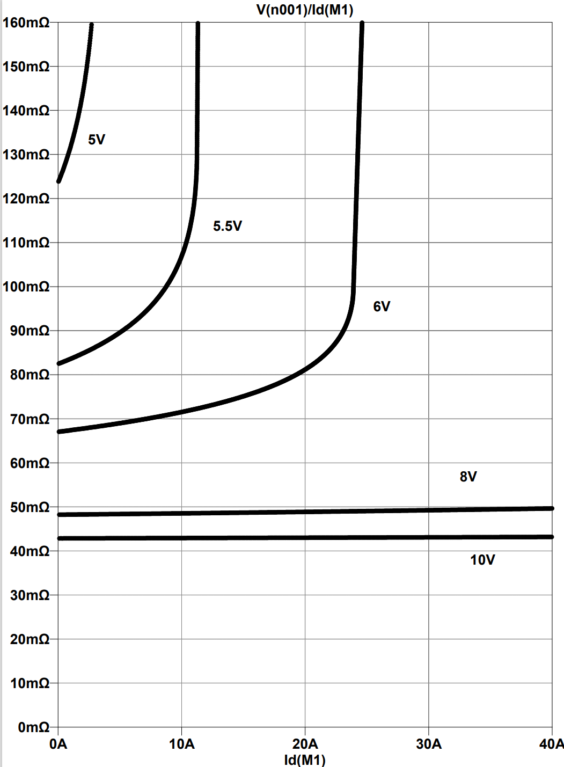
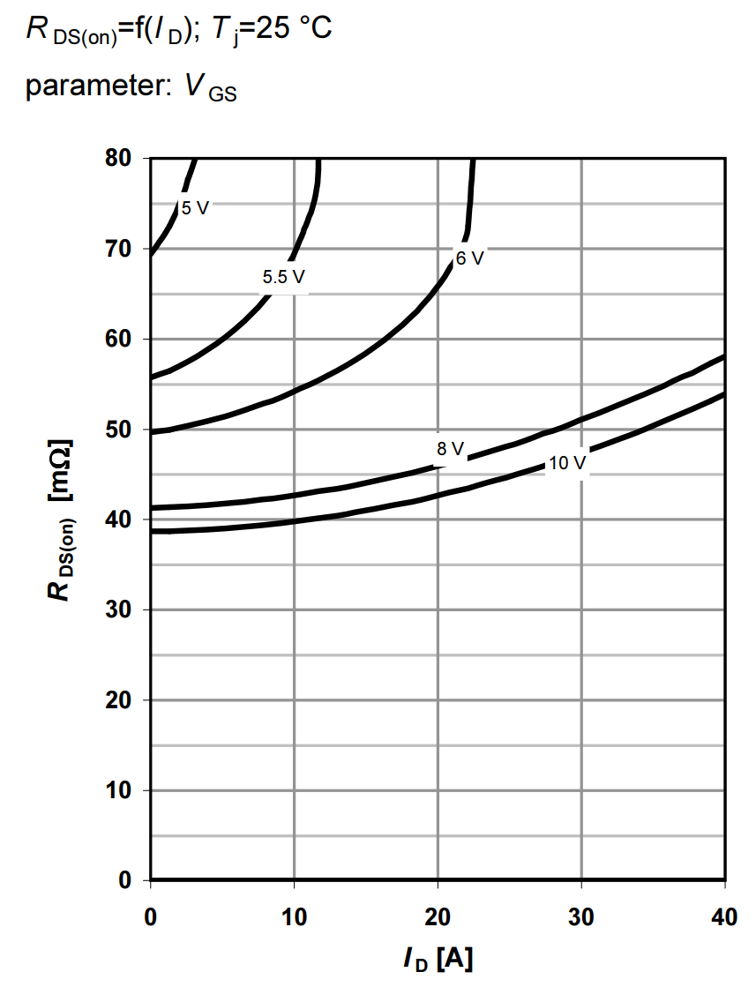
Topic 2. LTspice simulation
2.Drain-source on resistance ( under different )
With the increase of parameter , the values of lower.

Slide 12
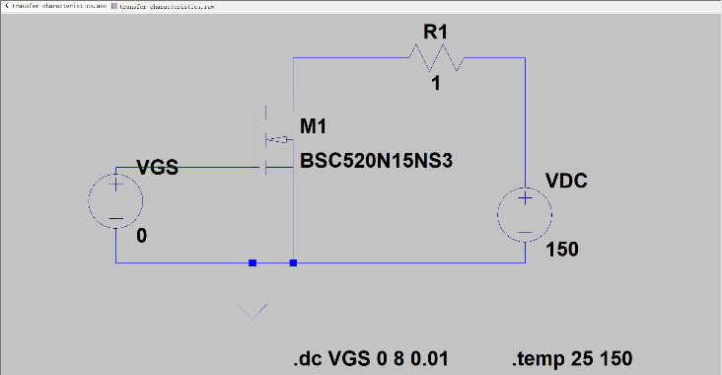
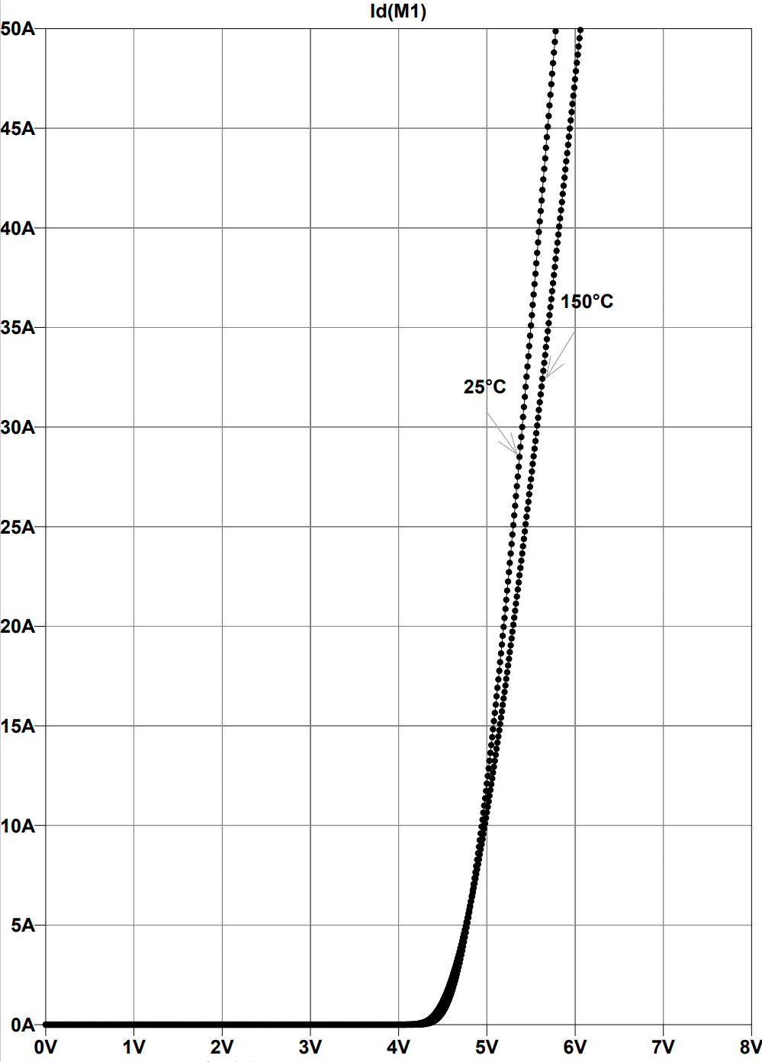
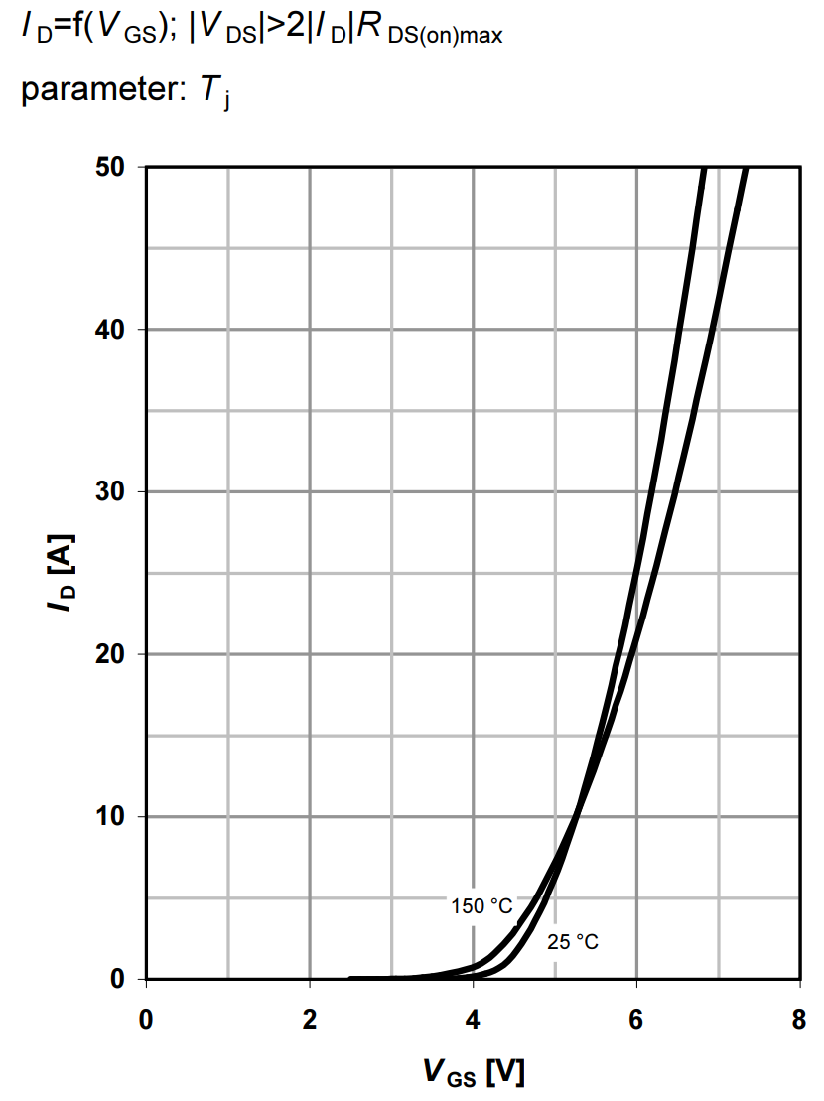
Topic 2. LTspice simulation
3.Transfer characteristics ( with fixed )
negative feedback
positive temperature coefficient region
intersection
threshold
Large slope
Linear characteristics

Slide 13
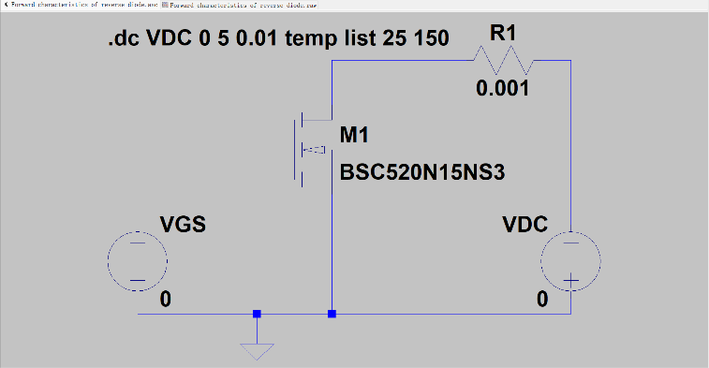
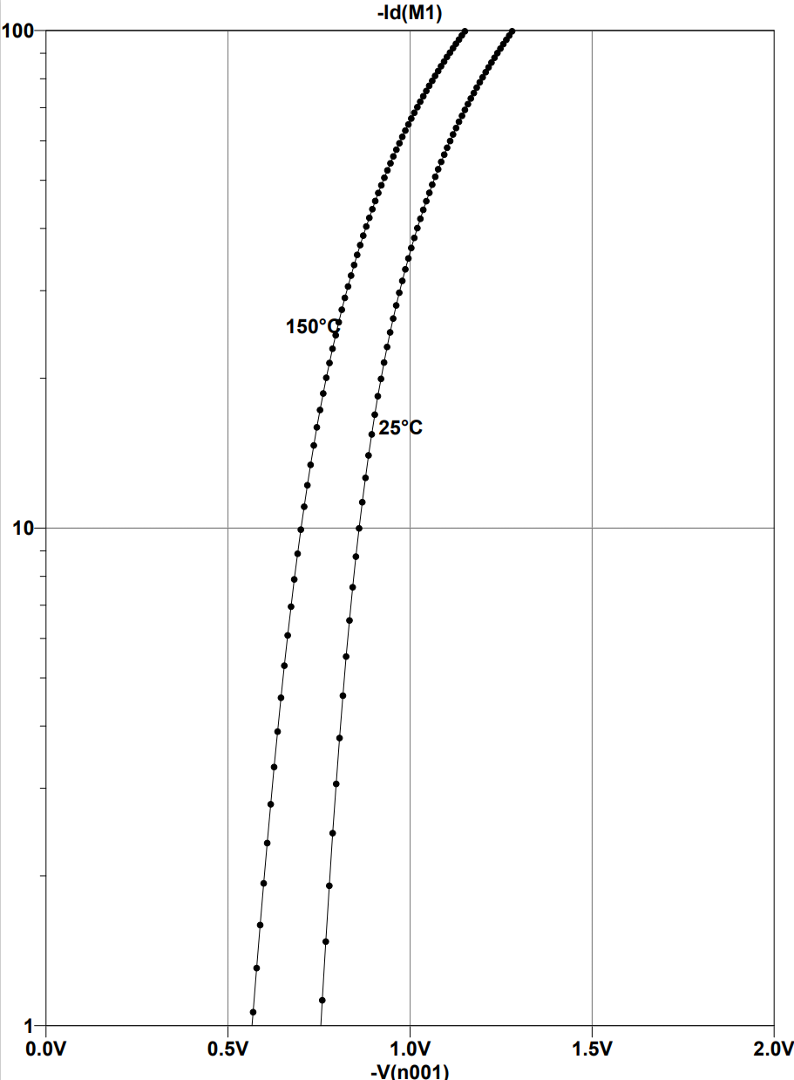
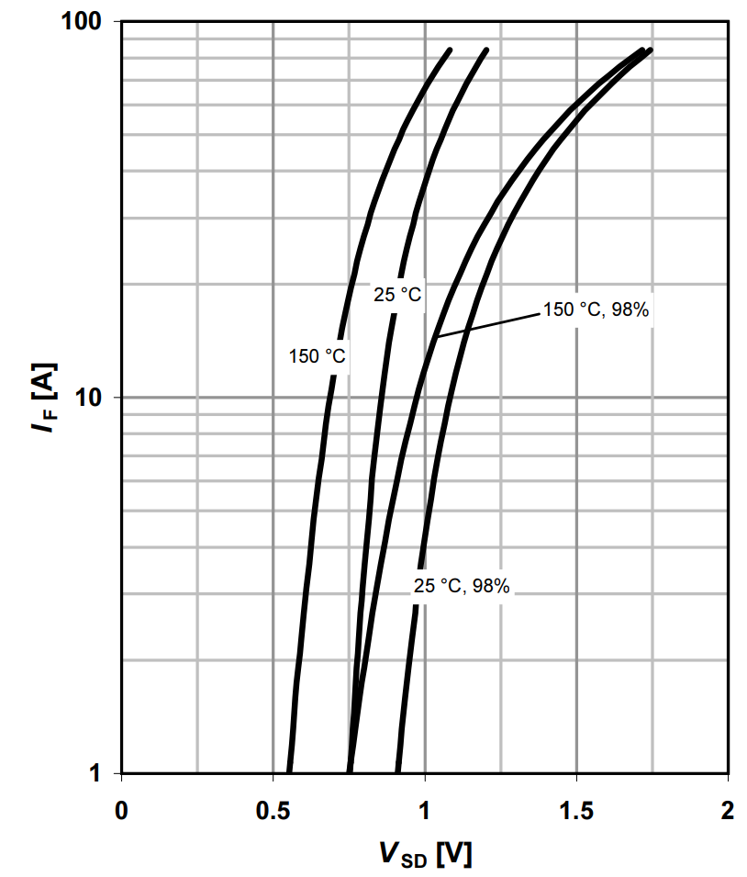
Topic 2. LTspice simulation
4.Forward characteristics of reversed diode( )
The higher the temperature
The larger the humidity,
The greater the IF
The greater the temperature and humidity, the greater the movement speed of semiconductor electron and holes, so the greater the positive guide current.
Notes:
From the graph, it can be observed that as the temperature increases from 25 degrees to 150 degrees, the characteristic curve shifts to the left. Additionally, with the application of reverse voltage in the circuit, due to the presence of the body diode, the reverse voltage can conduct as long as it exceeds the threshold voltage of the body diode. This behavior is consistent with that of a typical diode.

Slide 14
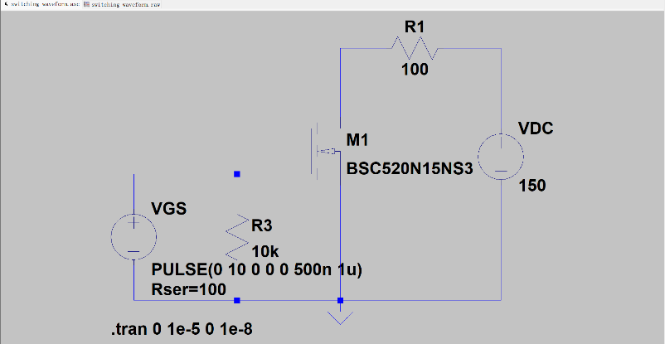
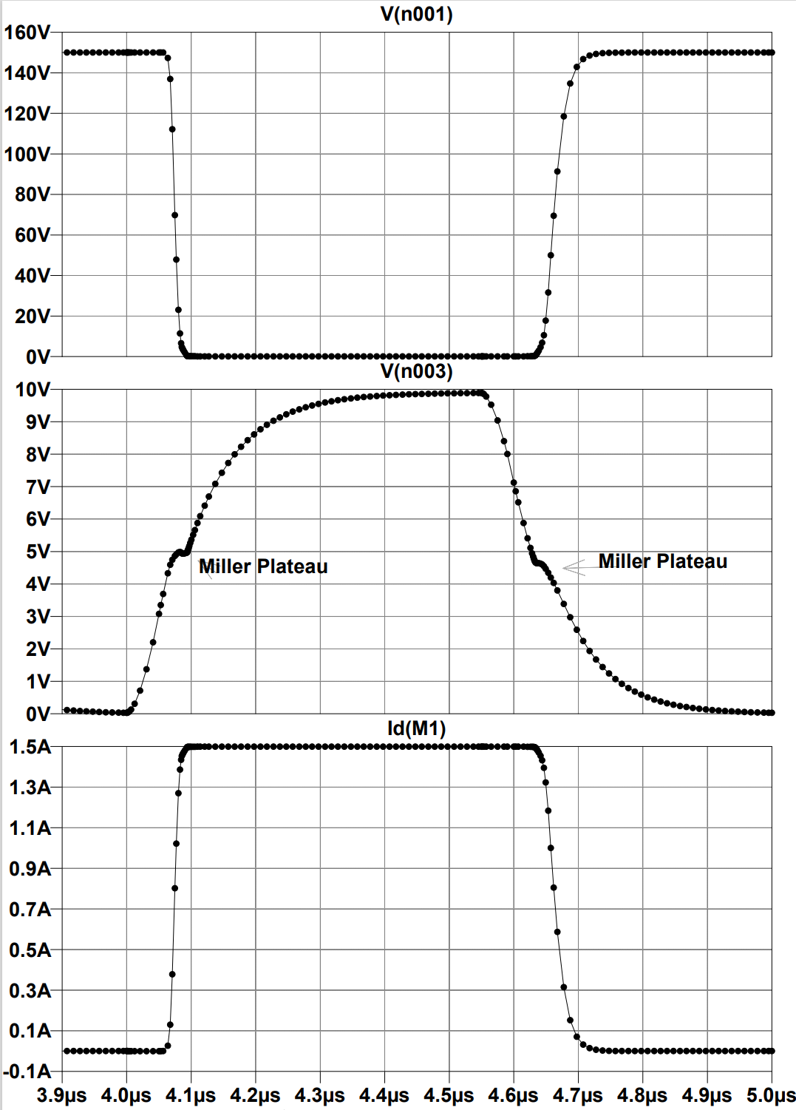
Topic 2. LTspice simulation
5.Switching waveform (real-time simulation , being pulsating signal)
Miller Plateau
The Miller capacitance Cgd of the MOS tube causes the Miller effect
Notes:
We have connected a large resistor in parallel with the power supply, considering the resistors of the gate-source and gate-drain as equivalent impedance. The power supply will be divided between the internal resistance of the power supply and the equivalent impedance. Due to the effect of capacitance, the voltage will not change abruptly, so the gate voltage will gradually increase.

Slide 15
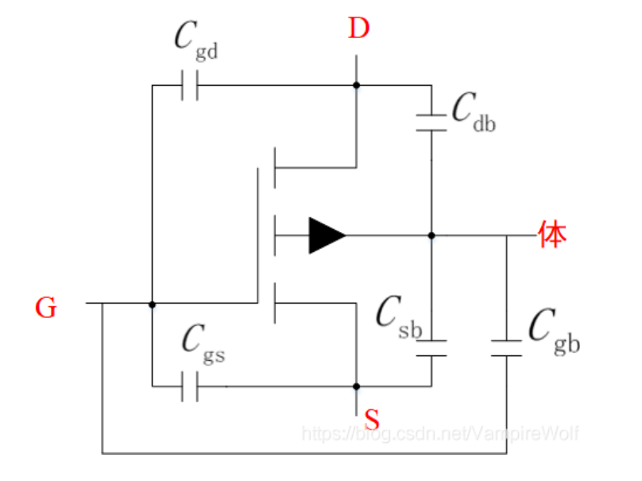
Topic 2. LTspice simulation
5.Switching waveform (real-time simulation , being pulsating signal)
There will be a parasitic capacitance between any two poles of the MOSFET, namely, Cgs, Cgd, and Cds.
Notes:
We have connected a large resistor in parallel with the power supply, considering the resistors of the gate-source and gate-drain as equivalent impedance. The power supply will be divided between the internal resistance of the power supply and the equivalent impedance. Due to the effect of capacitance, the voltage will not change abruptly, so the gate voltage will gradually increase.

Slide 16
Thanks!
2
0
2
3

