Slide 1

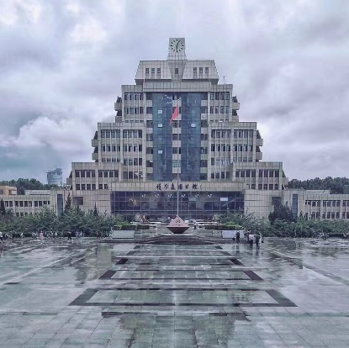
Seminar 1
presentation
group member：李祖琦、詹浩
2
0
2
2

Slide 2

Inventer
LTspice simulation
目 录

Slide 3

01
Inventer

Slide 4

Topic1. Three-phase Half-bridge Inverter
Fuction of Three-phase Half-bridge Inverter
The three-phase half-bridge inverter can convert the DC power into the required AC power.
And within a certain time can make the switch device to get on, off, and can output, but also can play a role in protecting the circuit.

Slide 5
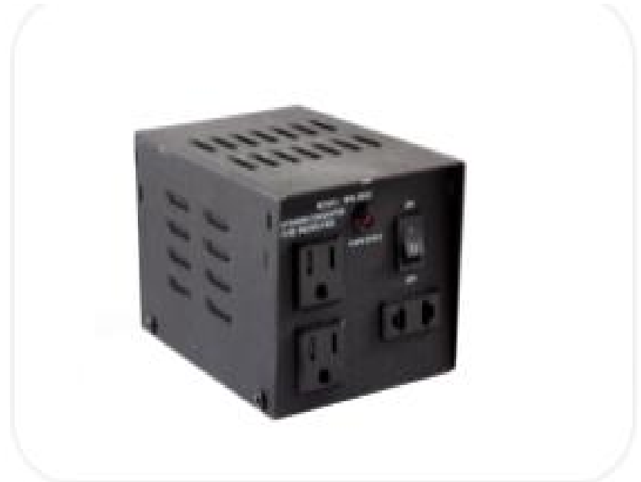
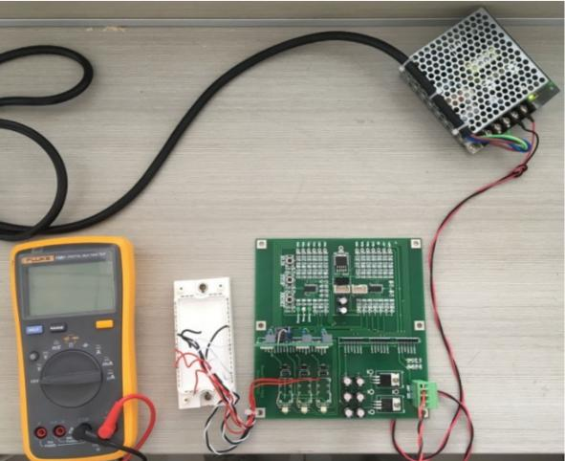
Topic1. Three-phase Half-bridge Inverter
Experimental circuit diagram
Physical picture

Slide 6
Topic1. Three-phase Half-bridge Inverter
Input and Output of Three-phase Half-bridge Inverter
OUTPUT:AC
INPUT:DC
Three-phase Half-bridge Inverter

Slide 7
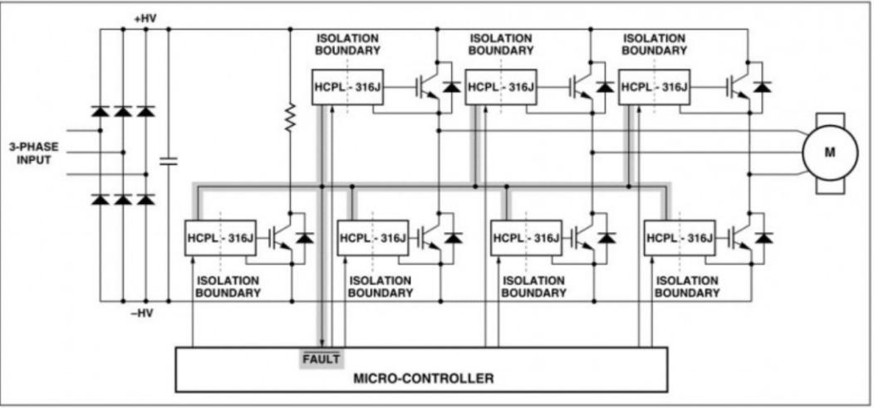
Topic1. Three-phase Half-bridge Inverter
the circuit diagram of three-phase half bridge inverter

Slide 8
Topic1. Three-phase Half-bridge Inverter
In this example, HCPL-316J chip is the driving circuit of IGBT, and TMS320F2812 is the control circuit.

Slide 9
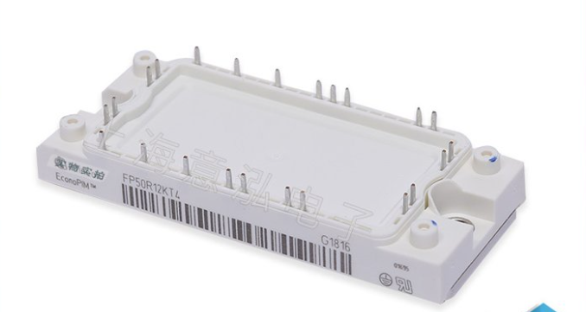
Topic1. Three-phase Half-bridge Inverter
Infineon FP50R12KT4 IGBT

Slide 10
Topic1. Three-phase Half-bridge Inverter
Infineon FP50R12KT4 IGBT
Technical parameters | Rated power | 280W
 | Dissipation power | 280W
 | Working temperature(MAX) | 150℃
 | Working temperature(MIN) | -40℃
 | Dissipation power(MAX) | 280000mW
Encapsulation parameters | Installation | Screw
 | Pin number | 23
 | Encapsulation | AG-ECONO2-4
Shape parameter | Length | 107.5mm
 | Width | 45mm
 | Height | 17mm
 | Encapsulation | AG-ECONO2-4
Physical parameters | Working temperature | -40℃~150℃
The specific parameters of FP50R12KT4 IGBT are as follows:

Slide 11
02
LTspice simulation

Slide 12
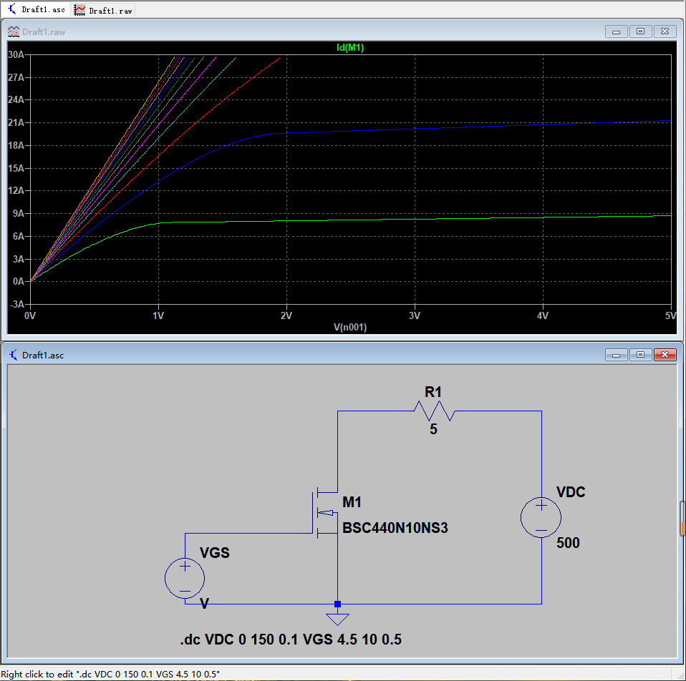
Topic 2. LTspice simulation
1.Output characteristics ( under different )
With the increase of parameter , the slope of the image coordinates increases larger and higher saturation values.
This is determined by the internal structure of the MOSFET.

Slide 13
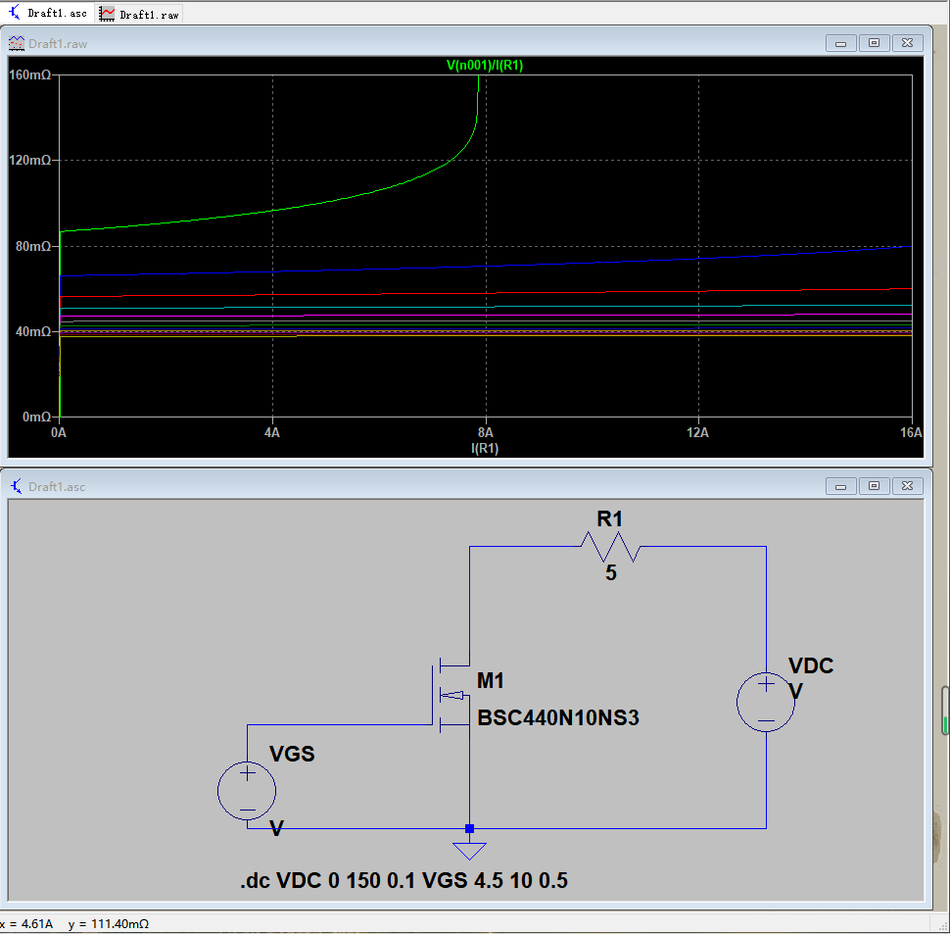
Topic 2. LTspice simulation
2.Drain-source on resistance ( under different )
With the increase of parameter , the values of lower.

Slide 14
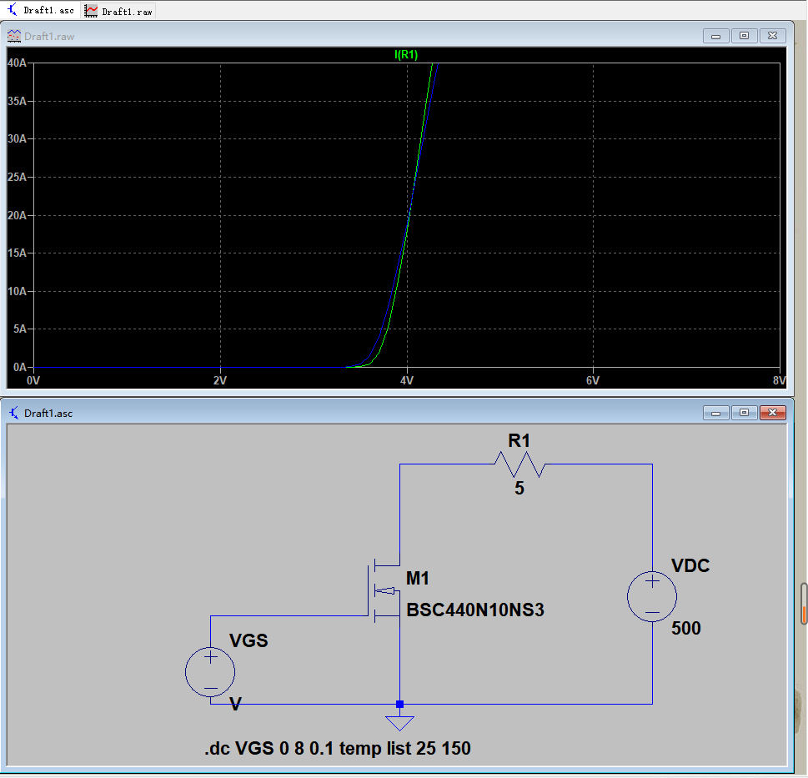
Topic 2. LTspice simulation
3.Transfer characteristics ( with fixed )
negative feedback
positive temperature coefficient region
intersection
positive feedback
negative temperature coefficient region

Slide 15
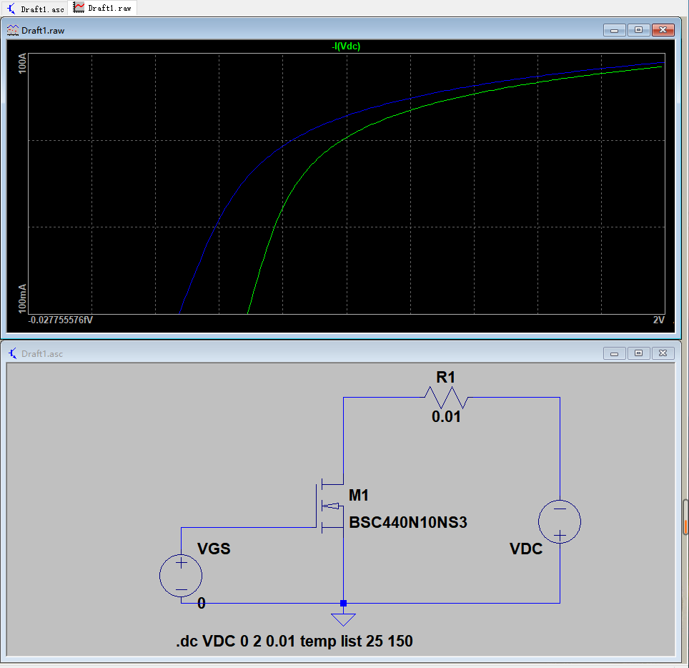
Topic 2. LTspice simulation
4.Forward characteristics of reversed diode( )
The higher the temperature
The larger the humidity,
The greater the IF
The greater the temperature and humidity, the greater the movement speed of semiconductor electron and holes, so the greater the positive guide current.

Slide 16
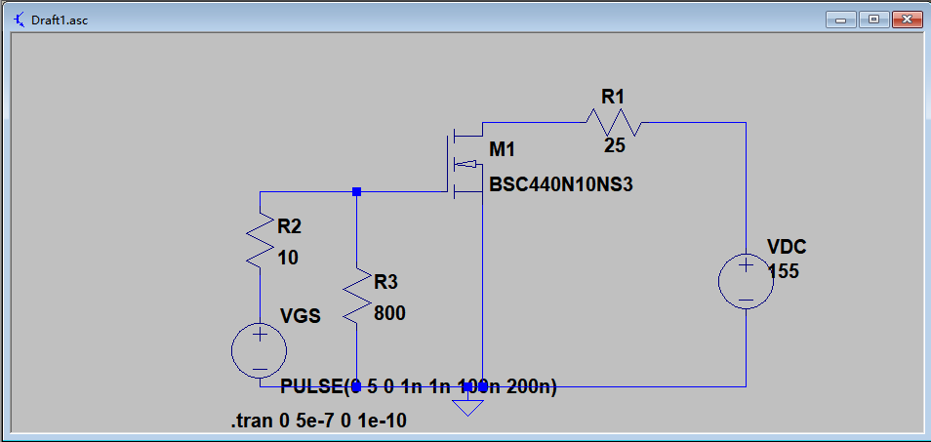
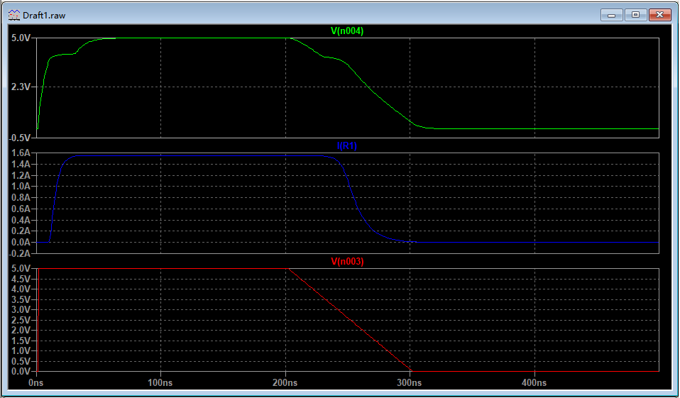
Topic 2. LTspice simulation
5.Switching waveform (real-time simulation , being pulsating signal)
The Miller capacitance Cgd of the MOS tube causes the Miller effect
Miller Plateau

Slide 17
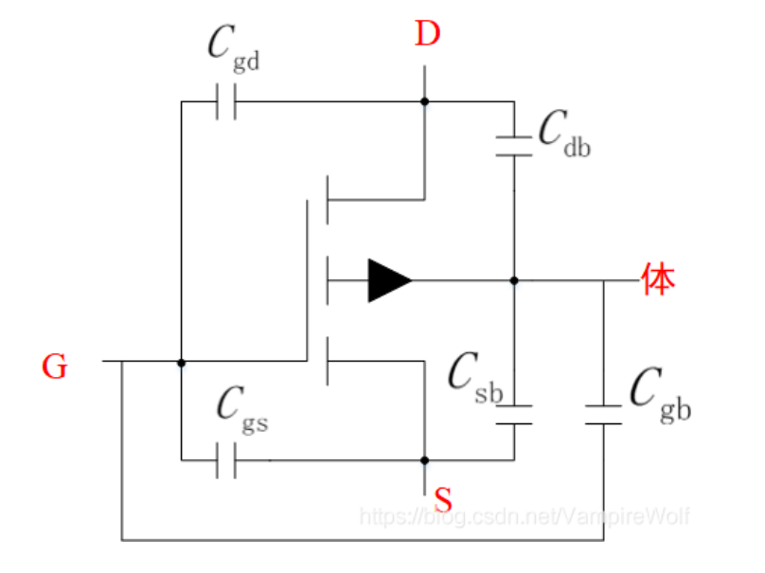
Topic 2. LTspice simulation
5.Switching waveform (real-time simulation , being pulsating signal)
There will be a parasitic capacitance between any two poles of the MOSFET, namely, Cgs, Cgd, and Cds

Slide 18
Thanks!
2
0
2
2

