Slide 1

Notes:
![bg right](https://picsum.photos/720?image=1) ![bg](https://picsum.photos/720?image=20)

Slide 2


Slide 3
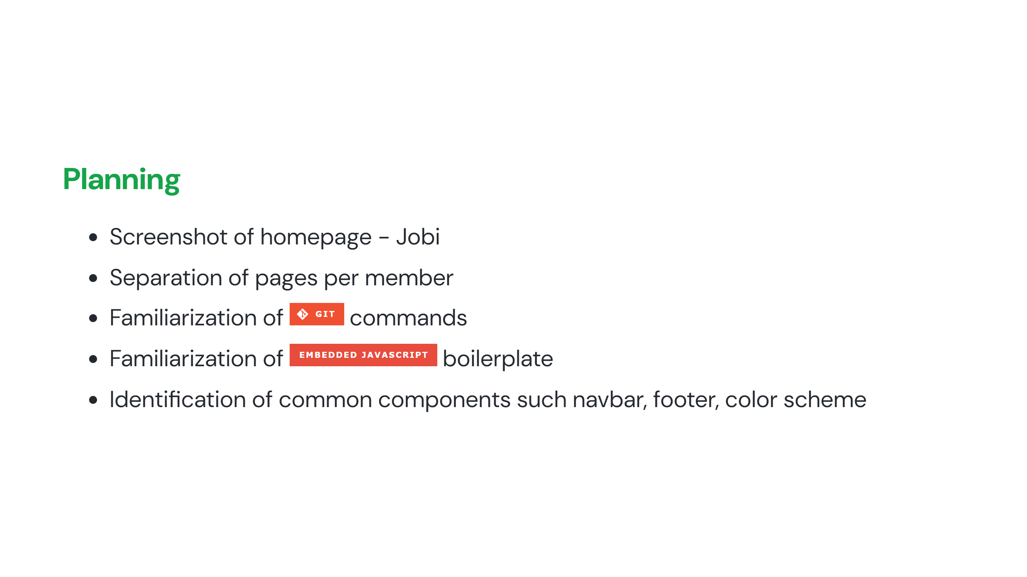

Slide 4


Slide 5
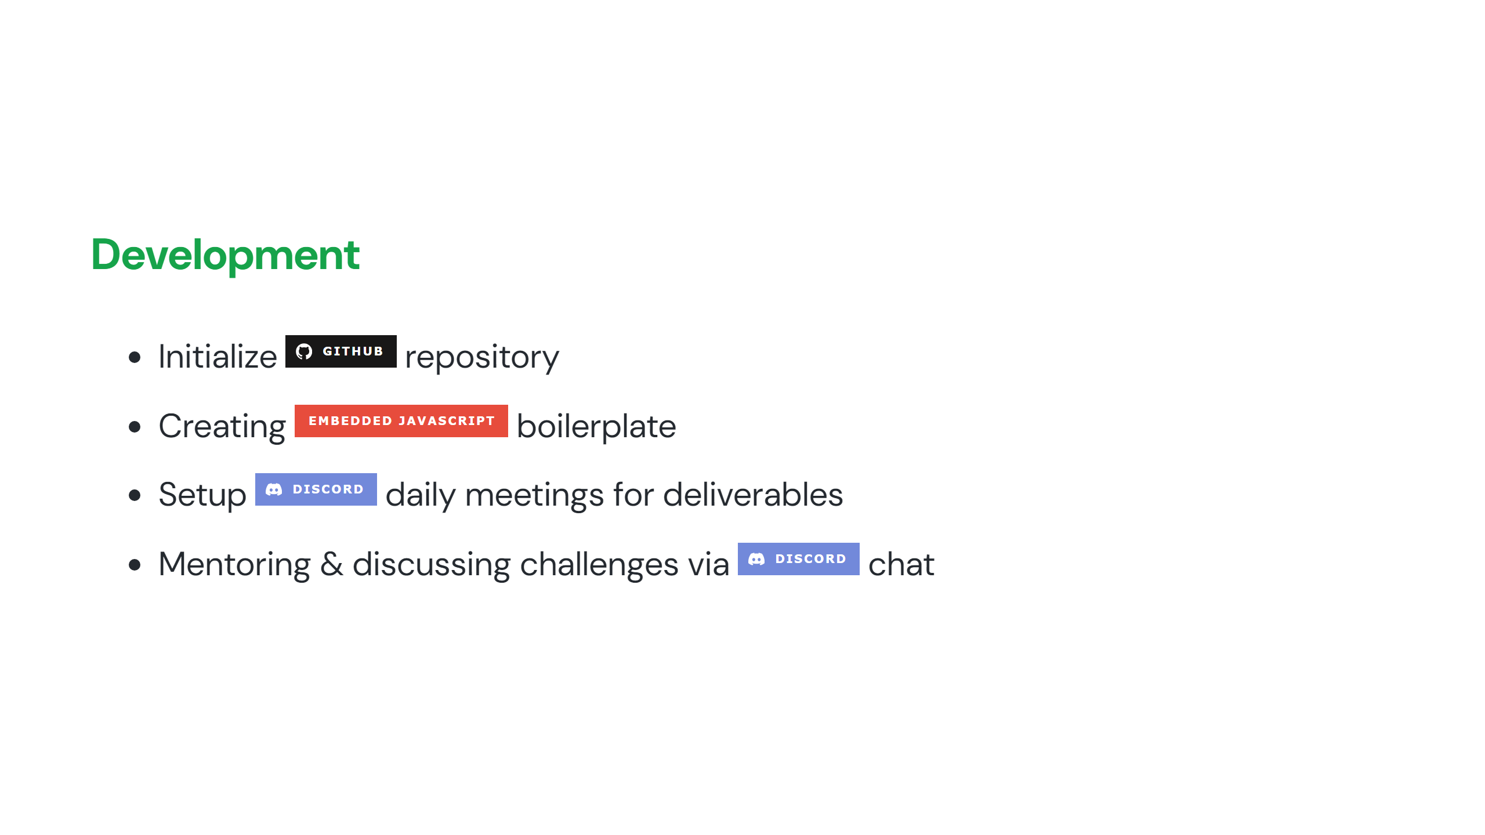

Slide 6
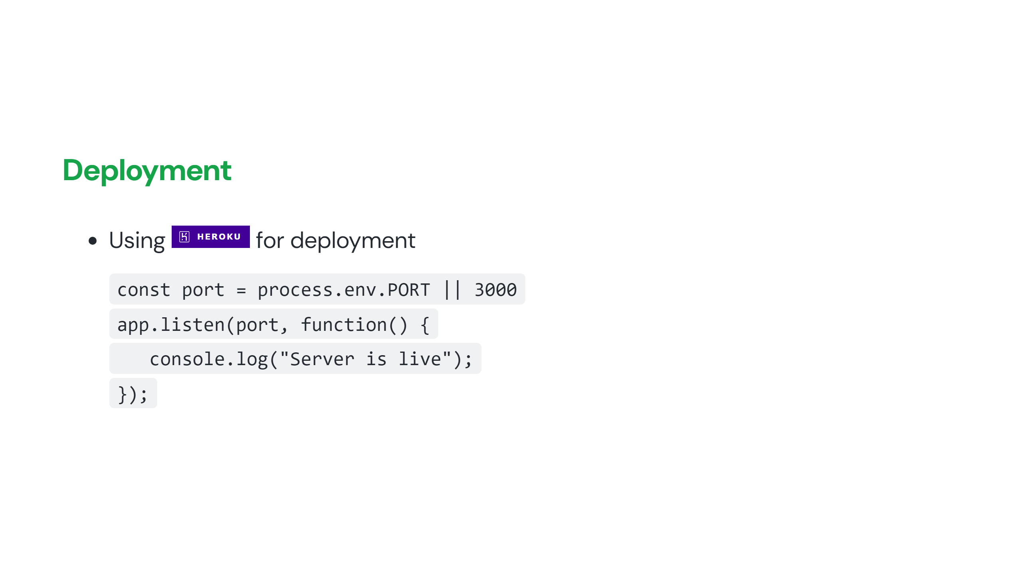

Slide 7


