Slide 1
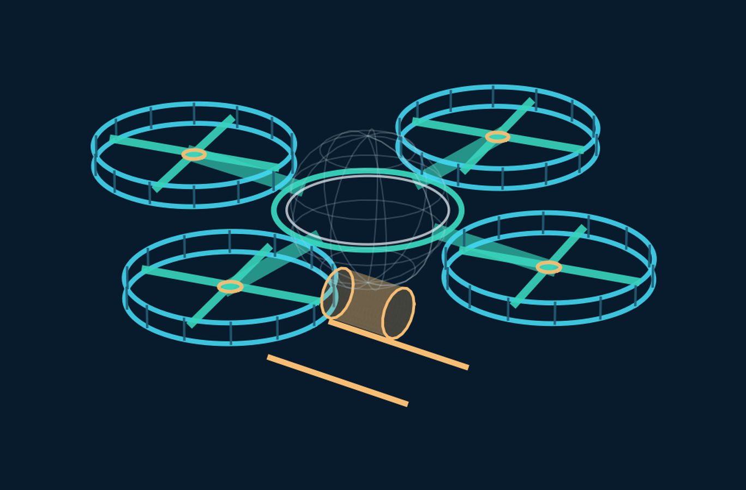
ENGINEERING PROTOTYPE / ISSUE A
P0–V1
SPHERICAL VTOL
FOUR DUCTED ROTORS
TWO-AXIS GIMBAL CABIN
Full-scale conceptual engineering layout
with exploded component studies,
load paths and matched mass ledger.
30 OCT 2026 / VTX-P0-V1
ISOMETRIC CONCEPT STUDY / VERTICAL PACKAGING NOT CONTROLLED

Slide 2
VTX / P0-V1
01 / DESIGN BASELINE
Frozen prototype architecture
All dimensions and mass allocations reference the same P0-V1 register.
EMPTY MASS
TEST TAKEOFF
ENVELOPE SPAN
TOTAL DISK AREA
671 kg
901 kg
7.607 m
16.00 m²
PROTOTYPE CONFIGURATION
BASELINE TEST ENVELOPE
P01 M250-C30P-class Jet A-1 turbine
P02 Four Ø2.257 m variable-pitch fans
P04 Ø1.900 m laminated spherical cabin
P05 Two-axis passenger-cabin gimbal
P06 Central structural ring + stiffened arms
27 km at 100 km/h • 500 m equivalent turns
200 m stress-turn scenario
60 kg fuel and 170 kg combined occupants
Uncrewed tethered test before free flight
Actual aerodynamic and engine maps pending
CONCEPT ENGINEERING • NOT A FABRICATION / FLIGHT CLEARANCE DRAWING
P0-V1 / ISSUE A 02

Slide 3
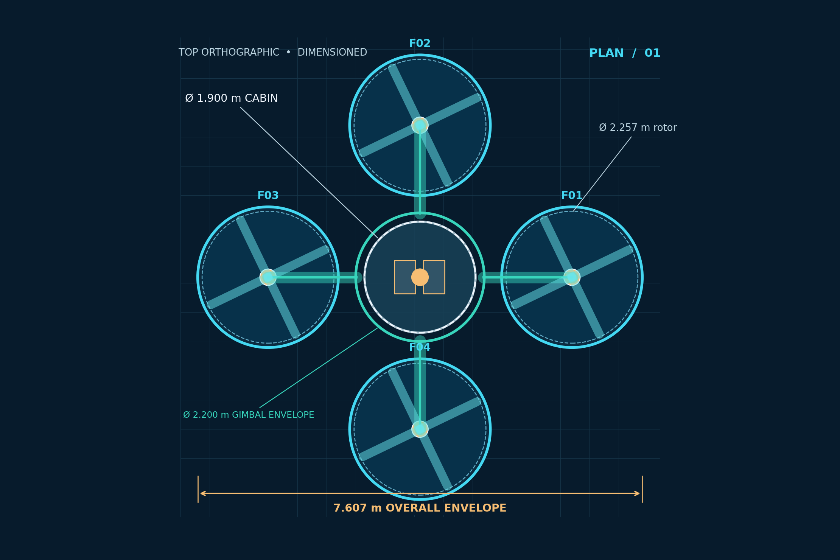
VTX / P0-V1
02 / PLAN BLUEPRINT
Orthographic top view
Planform dimensions are parametric; rotor/cabin interference checks are included.
CONTROLLED DIMENSIONS
Rotor disk Ø 2.257 m
Duct outside Ø 2.407 m
Cabin outside Ø 1.900 m
Gimbal envelope Ø 2.200 m
CLEARANCE CHECK
Hub radius: 2.600 m
Static duct-to-gimbal gap: 296.6 mm
Dynamic growth & travel NOT verified
Overall envelope: 7.607 m
CONCEPT ENGINEERING • NOT A FABRICATION / FLIGHT CLEARANCE DRAWING
P0-V1 / ISSUE A 03

Slide 4
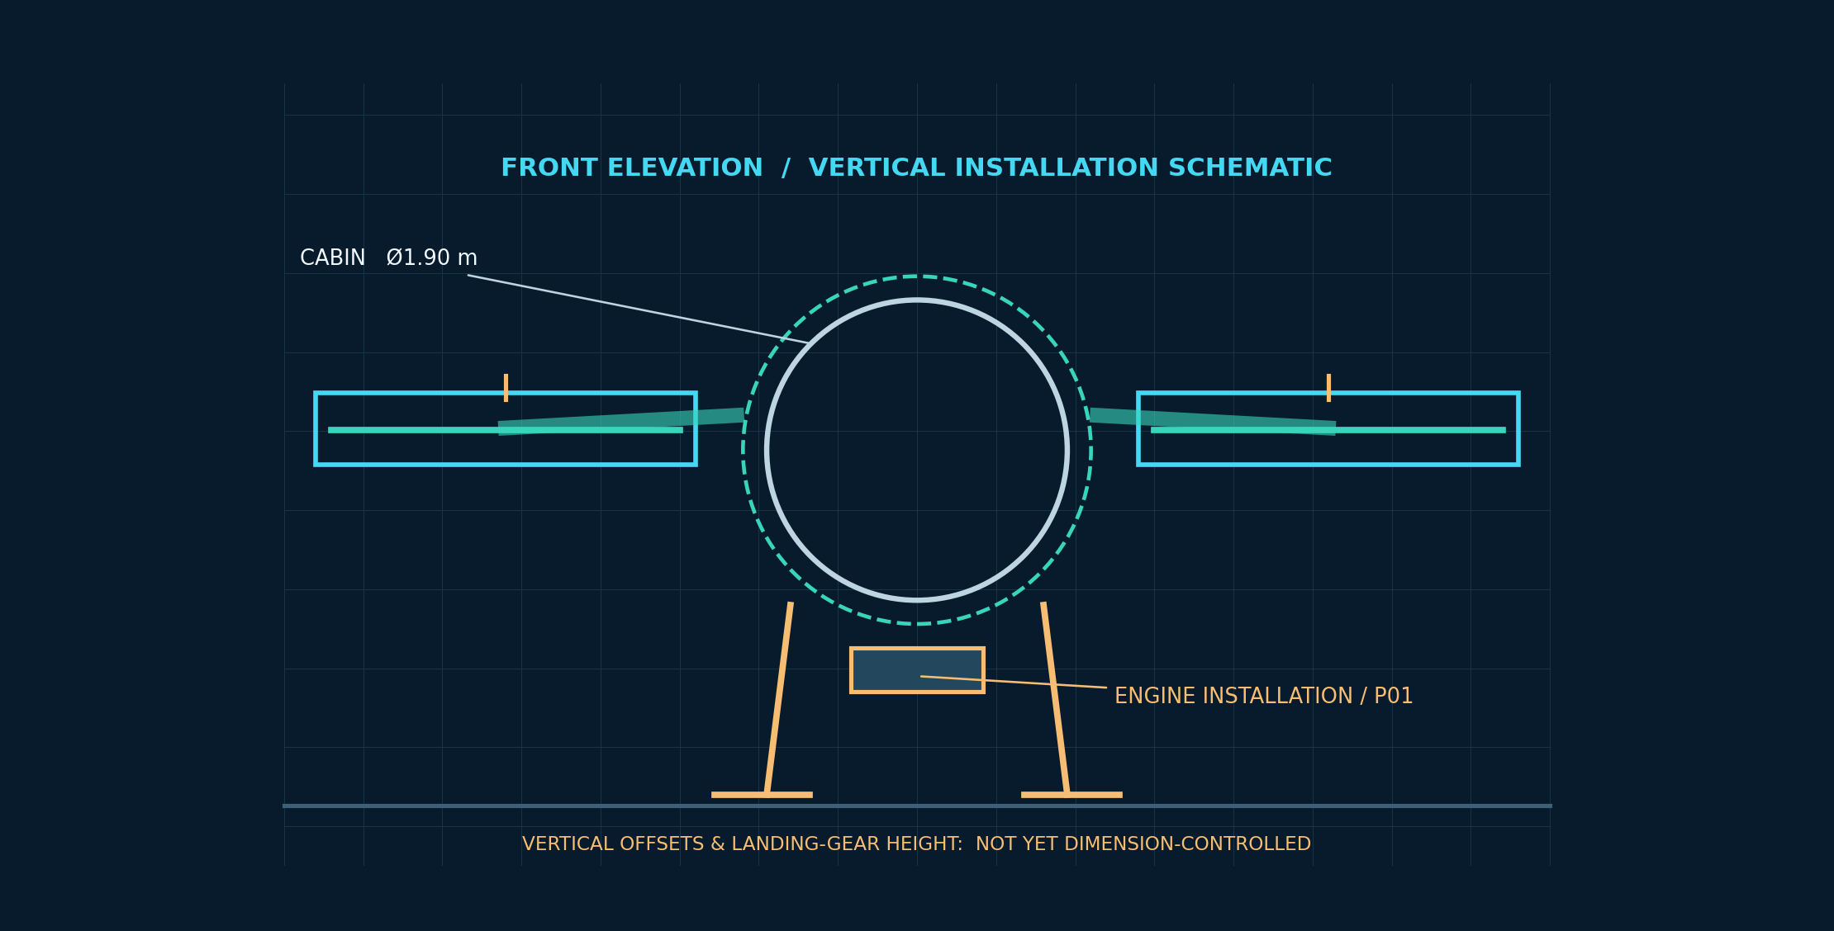
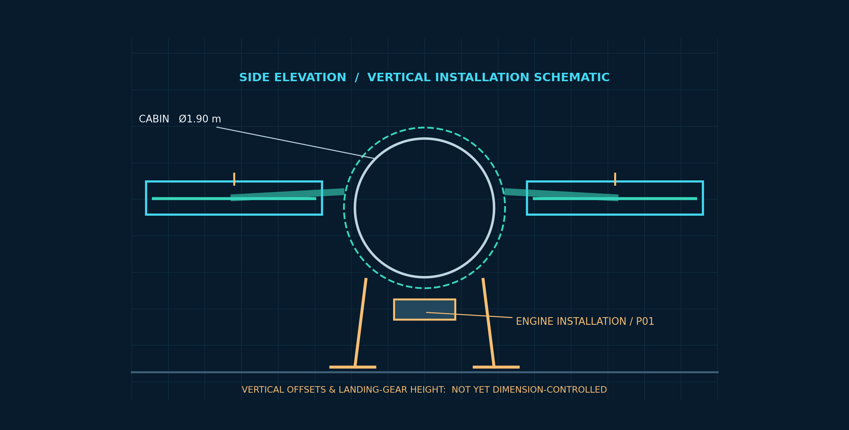
VTX / P0-V1
03 / ORTHOGRAPHIC
Front and side elevations
Schematic vertical stack only; final height, landing-gear stroke and engine mount position remain TBD.
FRONT ELEVATION / UNDIMENSIONED Z
SIDE ELEVATION / UNDIMENSIONED Z
CONCEPT ENGINEERING • NOT A FABRICATION / FLIGHT CLEARANCE DRAWING
P0-V1 / ISSUE A 04

Slide 5
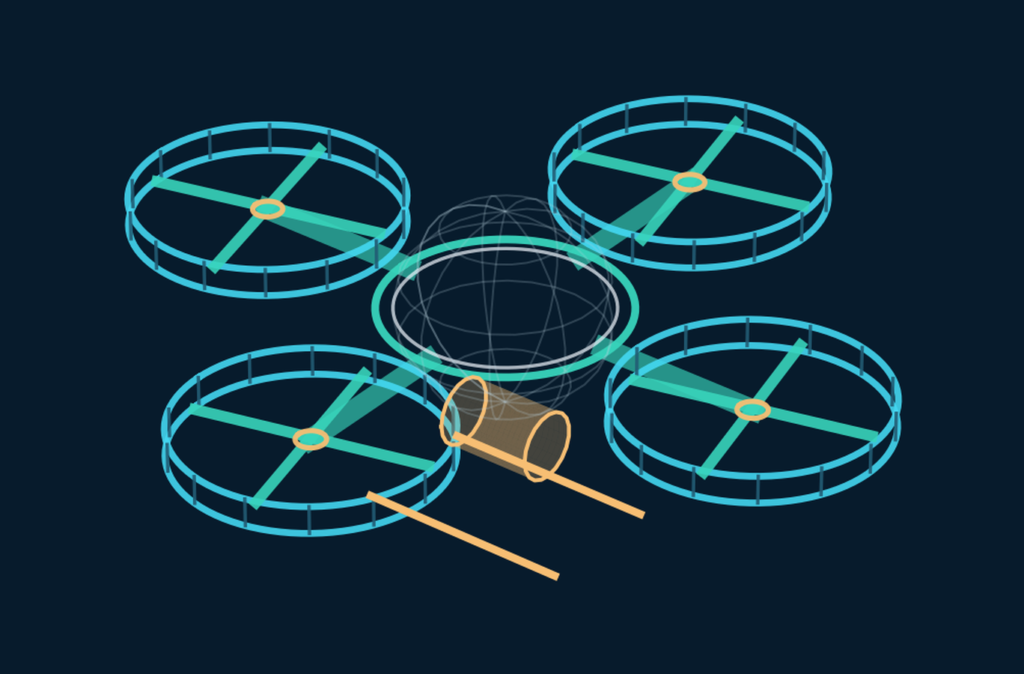
VTX / P0-V1
04 / ISOMETRICS
Isometric perspectives
The views show spatial arrangement, not a finished installation or interference-cleared CAD assembly.
FORWARD OBLIQUE / 3D STUDY
REAR OBLIQUE / 3D STUDY
CONCEPT ENGINEERING • NOT A FABRICATION / FLIGHT CLEARANCE DRAWING
P0-V1 / ISSUE A 05

Slide 6

VTX / P0-V1
05 / EXPLODED 3D
Full airframe exploded assembly
Component separation shows assembly hierarchy; exploded offsets are illustrative.
ESSENTIAL BUILD STACK
P02 Four variable-pitch fan units
P06 Load-bearing ring/arms
P04 Spherical composite cabin
P05 Cabin gimbal and bearings
P01 Turboshaft power unit
P03 Four-way mechanical drive
P10 Energy-absorbing landing gear
CONCEPT ENGINEERING • NOT A FABRICATION / FLIGHT CLEARANCE DRAWING
P0-V1 / ISSUE A 06

Slide 7

VTX / P0-V1
06 / CABIN ASSEMBLY
Exploded cabin, glazing and gimbal
No entire glass load-bearing sphere: CFRP shell carries primary loads; laminated glazing is segmented.
P04 CABIN / 88 KG
Outer diameter 1.900 m
~35% glazed area target
Laminated panels + CFRP sandwich
PEI or equivalently qualified trim
P05 GIMBAL / 35 KG
Two active axes: pitch and roll
Coordination in 500/200 m turns
Bearings, stops and actuation TBD
Occupant + fuel CG model required
CONCEPT ENGINEERING • NOT A FABRICATION / FLIGHT CLEARANCE DRAWING
P0-V1 / ISSUE A 07

Slide 8
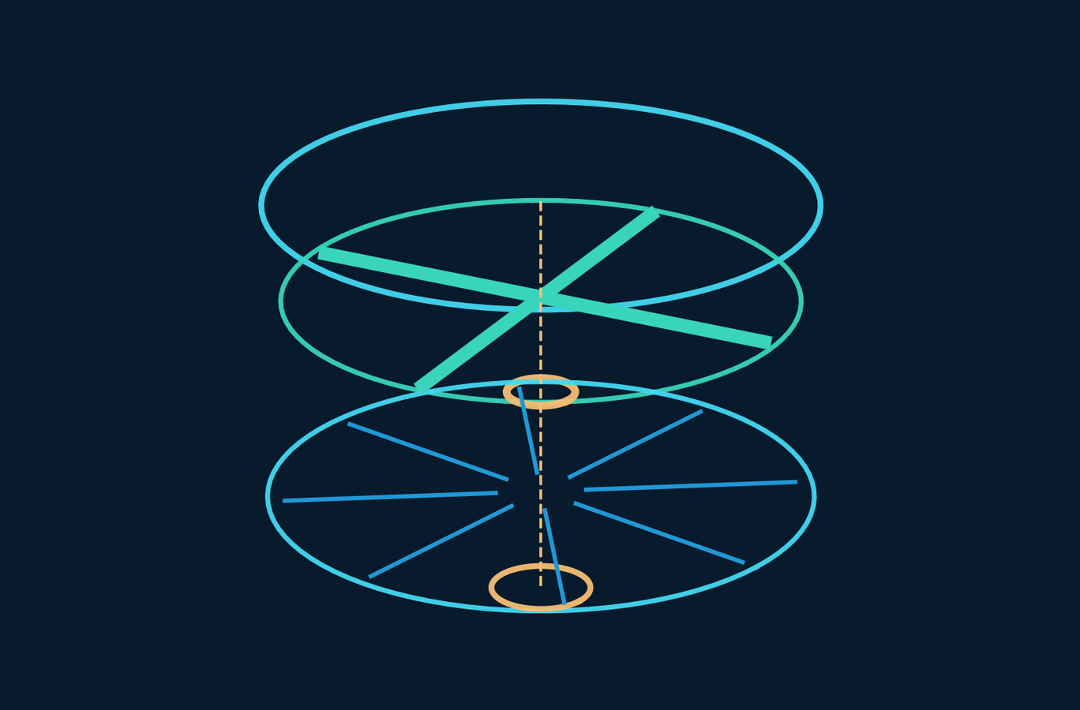
VTX / P0-V1
07 / PROPULSION ASSEMBLY
Exploded single ducted-fan module
Four identical reference modules; design blade count and speed are provisional study inputs.
P02 FOUR FANS / 119 KG
Independent collective pitch per fan
Each nominal disk area: 4.000 m²
Rotor diameter: 2.257 m
Outer duct diameter: 2.407 m
Design-point rotor speed: 800 rpm
ENGINEERING TO VERIFY
Pitch-actuated hub, stator, tip clearance
Inlet distortion at edgewise flight
Rotor thrust/torque and containment
800 rpm tip speed: 94.5 m/s
4-blade passing frequency: 53.3 Hz
CONCEPT ENGINEERING • NOT A FABRICATION / FLIGHT CLEARANCE DRAWING
P0-V1 / ISSUE A 08

Slide 9

VTX / P0-V1
08 / POWERTRAIN
Exploded drivetrain and power distribution
Single prime mover; four independent variable-pitch fan hubs enable differential thrust; engine redundancy absent.
P01 + P03 / 204 KG
P01: 132 kg engine installation
P03: 72 kg transmission allocation
Engine reference: 650 shp takeoff
Output to four radial branches
DRIVETRAIN CHECKS
Illustrative 6016 to 800 rpm: 7.52:1
Shaft critical speed and coupling loads
Gearbox lubrication and thermal capacity
Common engine / gearbox failure risk
CONCEPT ENGINEERING • NOT A FABRICATION / FLIGHT CLEARANCE DRAWING
P0-V1 / ISSUE A 09

Slide 10
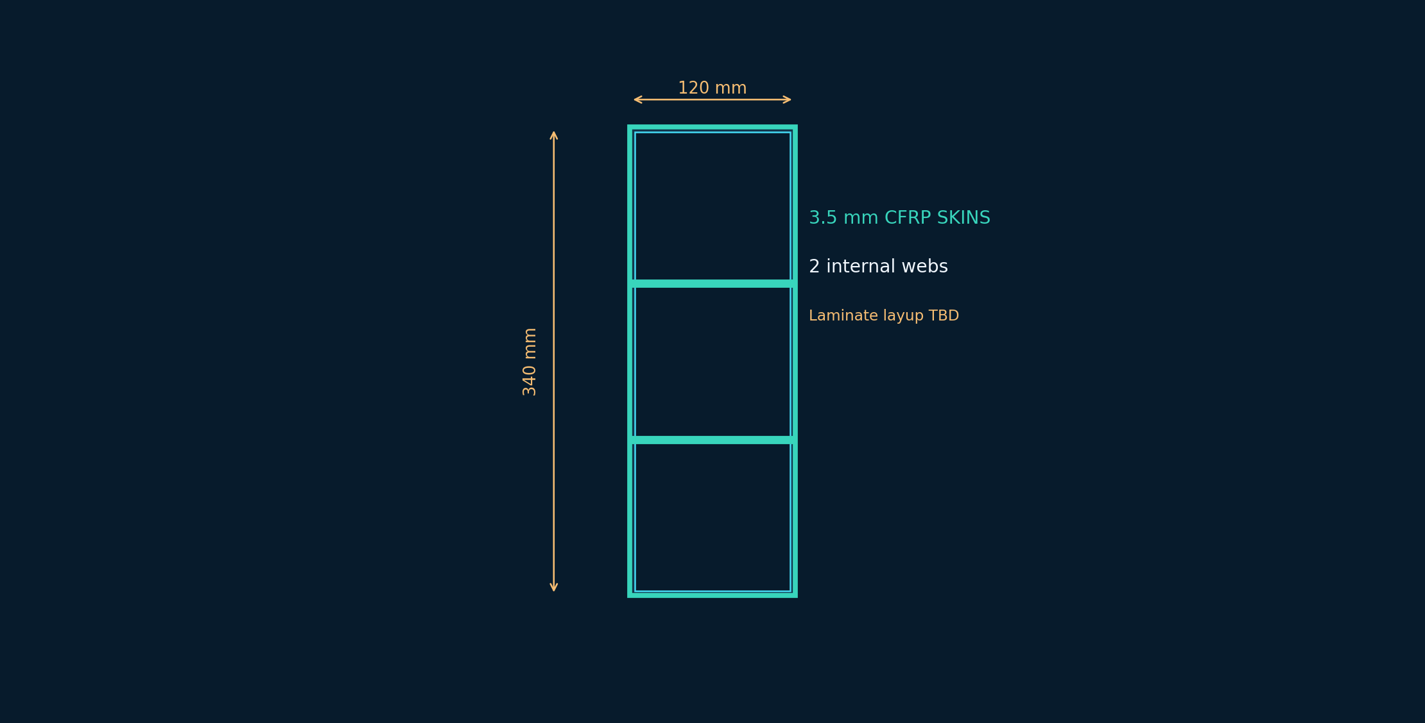
VTX / P0-V1
09 / STRUCTURAL DETAIL
Composite spar and load-path study
Stiffness is controlled by geometry, laminate architecture, joints and local buckling.
P06 75 KG FRAME TARGET
40 kg central-ring study allocation
Four ~8.76 kg stiffened radial arms
340 × 120 mm example CFRP box
Two internal webs, 3.5 mm skins
ILLUSTRATIVE 1.5g SCREEN
1.50 m support: ~1.4 mm tip deflection
~0.33° twist / ~43.9 Hz first bending
Local buckling & joint crush: UNVERIFIED
Orthotropic, fatigue and impact tests required
CONCEPT ENGINEERING • NOT A FABRICATION / FLIGHT CLEARANCE DRAWING
P0-V1 / ISSUE A 10

Slide 11
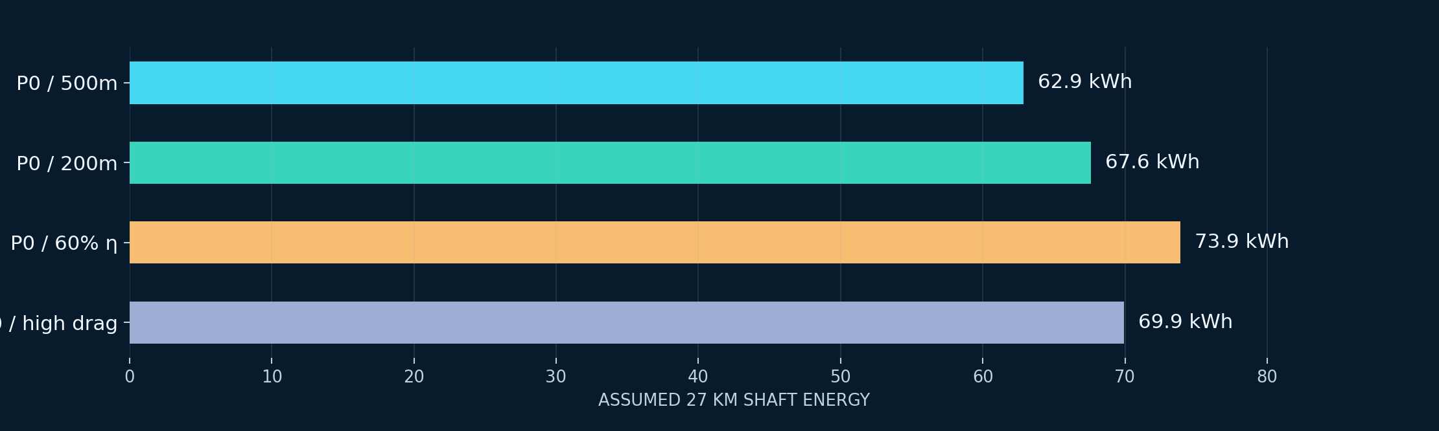
VTX / P0-V1
10 / PERFORMANCE
Analytical mission and performance
These are low-order estimates; speed is a test point, not a certified maximum or economic cruise.
MISSION SHAFT ENERGY
FUEL ESTIMATE
FUEL COST / 27 KM
HOVER POWER
62.88 kWh
25.15 kg
£45.58
184.3 kW
TURN & POWER LOADS
500 m: 0.157 g / 8.94° nominal bank
200 m: 0.393 g / 21.47° bank
1.5g collective induced power: 338.7 kW
+28.9 kW modelled forward drag
Full 110 kg fuel: 951 kg takeoff
CONCEPT ENGINEERING • NOT A FABRICATION / FLIGHT CLEARANCE DRAWING
P0-V1 / ISSUE A 11

Slide 12
VTX / P0-V1
11 / SYSTEMS
Flight control, gimbal and monitoring
Conceptual block hierarchy; redundancy, timing and fault responses are not designed.
IMU / air-data
P08
FLIGHT ECU
P08
GEARBOX + FOUR
PITCH SERVOS
P02 / F01-F04
ROTOR RESPONSE
CABIN GIMBAL
P05
TELEMETRY +
FAULT LOGGING
Vehicle attitude and cabin angle are distinct control objectives; coordinated turns may require the cabin to bank.
CONCEPT ENGINEERING • NOT A FABRICATION / FLIGHT CLEARANCE DRAWING
P0-V1 / ISSUE A 12

Slide 13
VTX / P0-V1
12 / HAZARDS
Open failure modes / no flight clearance
No unsupported claims of survivability or active redundancy.
FM01
One rotor / branch failure
Control-allocation rank drops from 4 to 3
OPEN
FM02
Single engine failure
All nominal lift power may be lost
OPEN
FM03
Duct/rotor strike
Containment and structural clearance unknown
OPEN
FM04
Gimbal lock/overload
Cabin attitude and passenger loads affected
OPEN
FM05
Composite structural loss
Buckling, debond and impact insufficiently tested
OPEN
FM06
Crosswind / inlet distortion
Rotor performance map absent
OPEN
CONCEPT ENGINEERING • NOT A FABRICATION / FLIGHT CLEARANCE DRAWING
P0-V1 / ISSUE A 13

Slide 14
VTX / P0-V1
13 / PROGRAMME COST
Parts and non-recurring R&D
One-off 2026 GBP planning estimates; no supplier quotes and no hard development ceiling.
COMPONENTS / FABRICATION
R&D / TEST PROGRAMME
+25% CONTINGENCY
£1.07–3.11m
£3.97–12.05m
£6.30–18.95m
HIGHEST-COST COMPONENTS
EXPENDITURE FOR VALIDATION
P01 Turbine: £220–650k
P04 Cabin composite & glazing: £120–400k
P03 Mechanical transmission: £130–350k
P06 Structural ring & arms: £120–350k
Rotor/stator rig + wind tunnel + FEA
Gearbox/transient turbine integration
Controls hardware-in-loop and drop tests
Instrumented tethered and uncrewed tests
CONCEPT ENGINEERING • NOT A FABRICATION / FLIGHT CLEARANCE DRAWING
P0-V1 / ISSUE A 14

Slide 15
VTX / P0-V1
14 / STAGE GATES
How P0 becomes a substantiated prototype
A gate only closes with recorded evidence and independently checked calculations or tests.
G0
Geometry & interface freeze
G1
Laminate, joints, FEA & structural coupons
G2
Rotor, duct and engine drivetrain test maps
G3
SIL/HIL controls with fault injection
G4
Full-vehicle static, landing & containment
G5
Tethered uncrewed hover
G6
Uncrewed 500 m and 200 m circuit evaluation
G7
Measured performance and next revision
CONCEPT ENGINEERING • NOT A FABRICATION / FLIGHT CLEARANCE DRAWING
P0-V1 / ISSUE A 15

Slide 16
VTX / P0-V1
15 / PROVENANCE
Evidence, limitations and configuration control
All three documents share P0-V1 mass, geometry, mission assumptions and component IDs.
EXTERNAL ENGINEERING EVIDENCE
DATA MATURITY / RELEASE LIMITS
Rolls-Royce M250 directory / Bell 206L-4 specifications
Hine et al. 2025 — liftfan rotor/stator design
Hu et al. 2021 — duct efficiency vs mass tradeoff
Akturk & Camci 2014 — duct tip clearance
Critchfield & Ning 2026 — mission optimisation
Liu et al. 2024 — composite crashworthiness
DIMENSION CONTROLLED: planform, nominal rotor area
TARGET: 671 kg empty and component allocations
ANALYTICAL: power, turns, fuel and time
UNVERIFIED: aerodynamics, engine map, FEA and CG
OPEN: common engine failure and rotor-out controls
ISSUE A: no manufacturing or flight test clearance
Source details and live URLs: full research bibliographies appear in both companion PDFs.
CONCEPT ENGINEERING • NOT A FABRICATION / FLIGHT CLEARANCE DRAWING
P0-V1 / ISSUE A 16

