Slide 1

The Climate Menace.
Luke shead, Luke Bruni, Joe Williams, Matthew Sides,
Sam Dearing

Slide 2


Slide 3
The Application – what is it for?
More aware of the issues of climate change,
The effects of greenhouse gases,
What the main causes of these are,
Be able to motivate them,
For people to engage with each other,
To have fun,

Slide 4
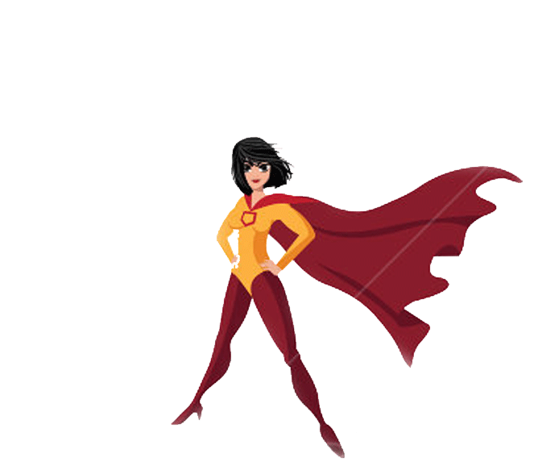
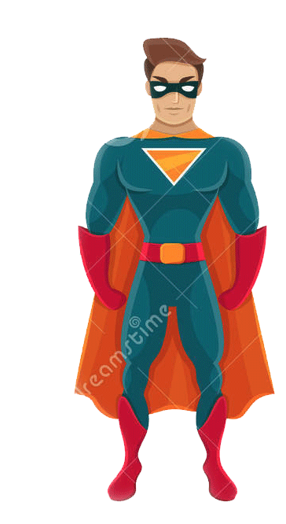
How does it work?
Menu enabled access to any order,
Allow any order for the tables,
Follow and play through a story,
Hero vs villain storyline,
Comic book theme animations,
Tell the story to user,
Show villain ruining landscape,
Your job to fix it,
The interactive side of things,
Identify the problems for solutions,
Pledges will be offered,
End of app offers,

Slide 5

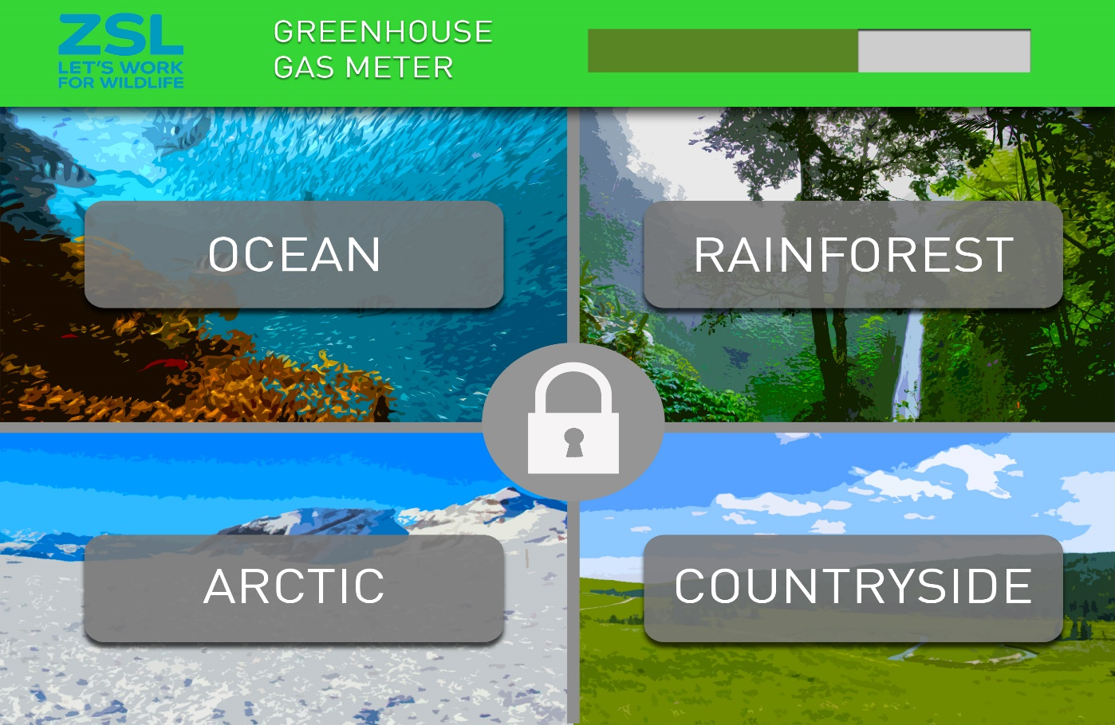
Concept art (explanation) insert below: menu - annotations

Slide 6
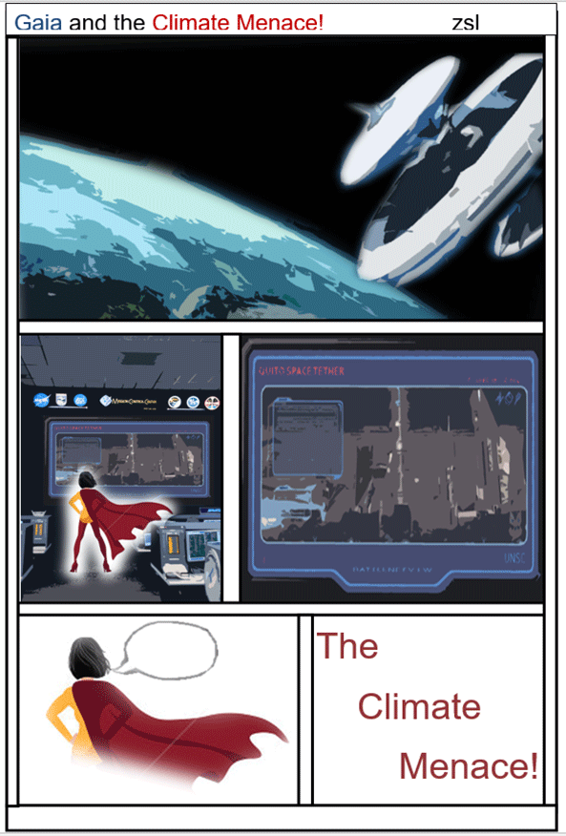
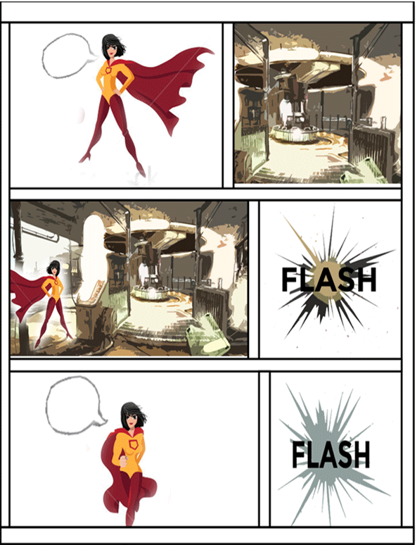
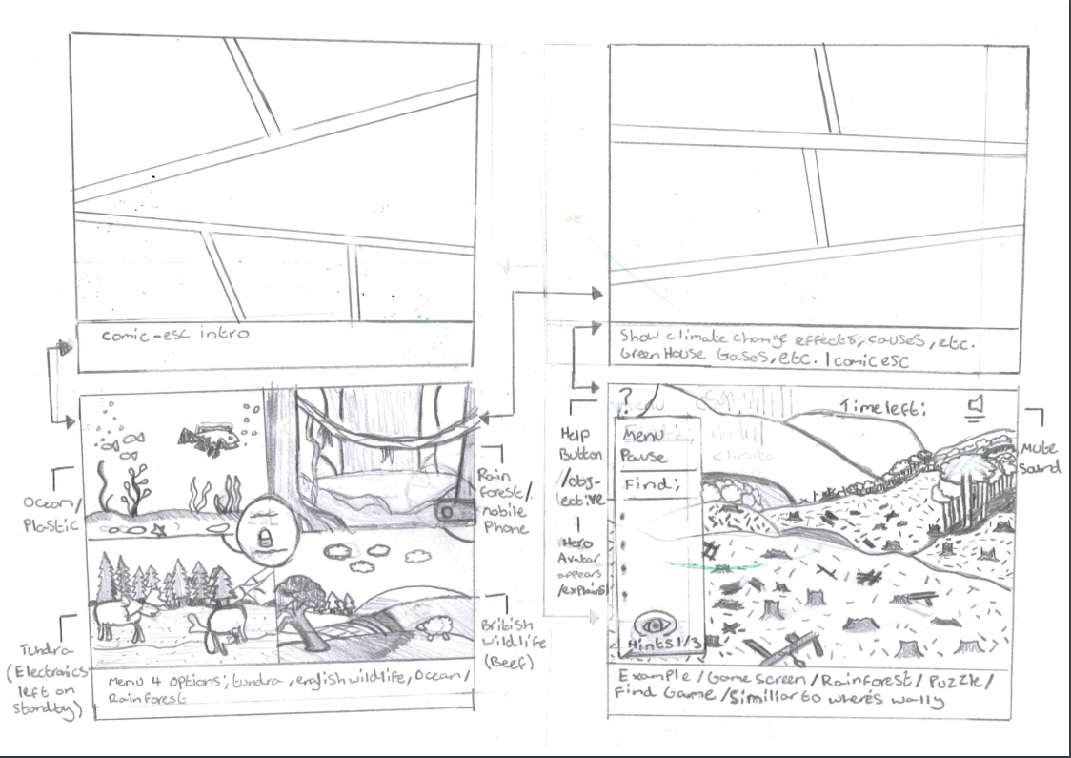
Concept art (explanation) insert below: comic/story -

Slide 7
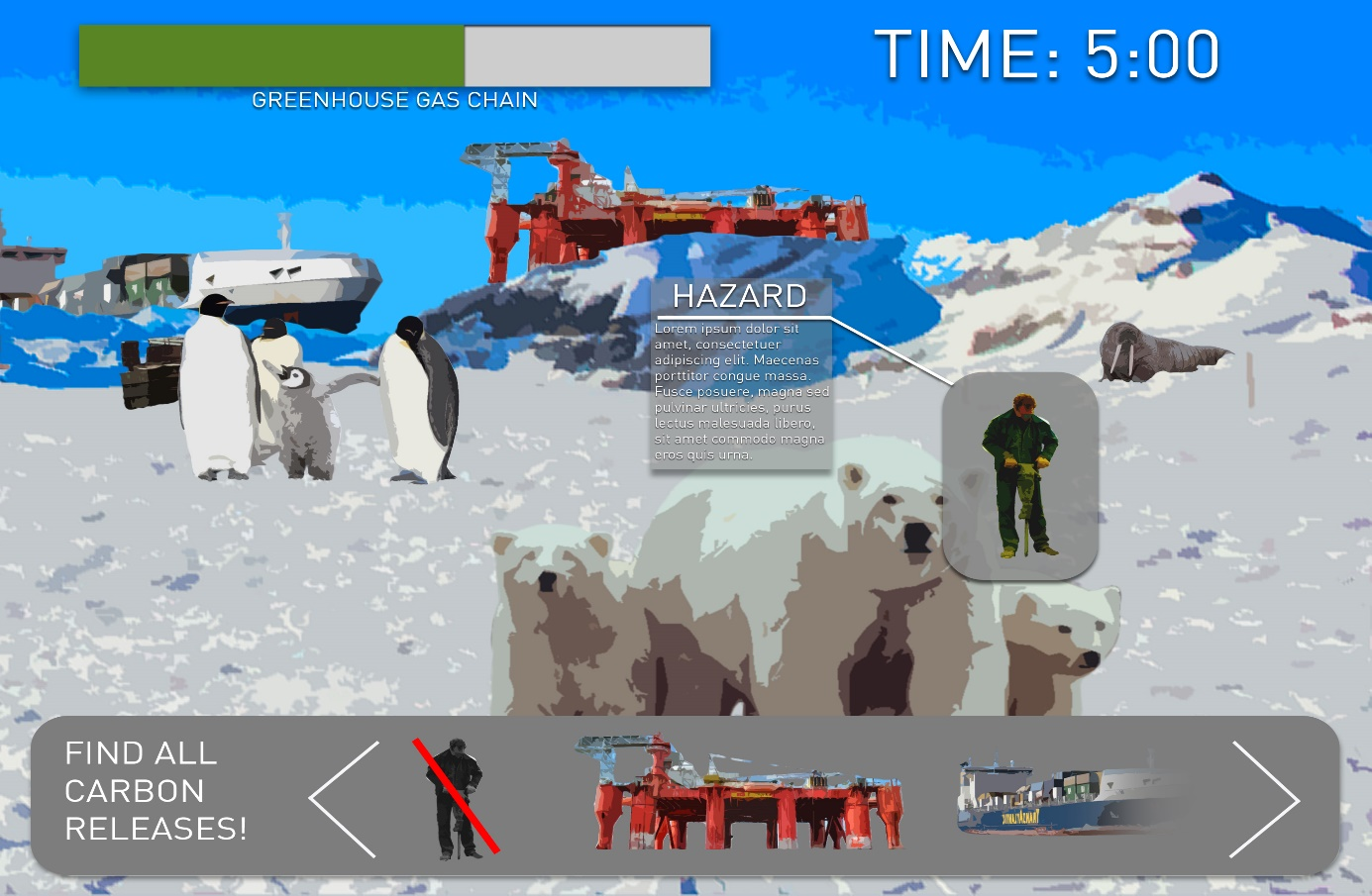
Concept art (explanation) insert below: interactive game -

Slide 8
What is the message?
Visual representations for problems,
It isn’t difficult,
What could happen,
Give other options,
Topic for discussion,
Not too late to help,

Slide 9


