Slide 1


England’s Crime Files,
Insights from the Numbers.
Success Attoni
Data 606 – Actionable Visualization and Analytics

Slide 2

OUTLINE
Introduction and Guiding Questions
Datasets
Methodology
Results and Discussion
Conclusion and Further Work
2

Slide 3

Introduction And Guiding Questions
AIM
Investigation to unearth possible insights on Crime in England in relation to the guiding questions.
Guiding Questions
What are the headline stats on crime in England and how is it distributed?
What period within the year had the most crime reports?
Which 3 police stations made the most and the least crime reports?
Is there a relationship between crime rate and socioeconomic factors (e.g. average pay, availability of schools), Demographic and Geographic factors (e.g.: age, ethnicity, population density, urbanization level)?
What are the significant predictors of crime rate?
Motivation
Recent experience by a friend in the UK.
3

Slide 4
Datasets
1
Main Data set
8
Total Data Sets
7
LAD = Local Authority District (Administrative areas in the UK that have local government responsibilities. Used for governance, statistical analysis, and public service delivery.). TOTAL LAD = 374
MSOA = Middle Layer Super Output Area (geographic unit used for statistical and census purposes. Sits between LSOA and LAD. TOTAL MSOA = 6,791
LSOA = Lower Layer Super Output Area (geographical unit used in the UK for statistical analysis. TOTAL LSOA = 32,844
Complementary Data set
Main Dataset
CSV files with street-level crime, outcome, and stop and search information, broken down by police force and 2021 lower layer super output area (LSOA).
Hosted on UK Police website (https://data.police.uk/data/) reported at LSOA Level
12 files, 1 for each month in 2024 – consolidated into a single dataframe in python
Rows
Columns
Each row is a
5.8M
10
Crime Record
Supplementary Dataset
Data Set | Link | Desc
Population Estimates at LAD | https://www.ons.gov.uk/filters/b963dd0f-7993-4aea-a143-a4763a0cf66b/dimensions/ltla#get-data | For population and related data at LAD level
Population Estimates at MSOA | https://www.ons.gov.uk/filters/b963dd0f-7993-4aea-a143-a4763a0cf66b/dimensions/ltla#get-data | For population and related data at MSOA level
Income Estimates at LAD | https://www.ons.gov.uk/employmentandlabourmarket/peopleinwork/earningsandworkinghours/datasets/placeofresidencebylocalauthorityashetable8 | For Income and Related Data at LAD Level
Income Estimates at MSOA | https://www.ons.gov.uk/employmentandlabourmarket/peopleinwork/earningsandworkinghours/datasets/smallareaincomeestimatesformiddlelayersuperoutputareasenglandandwales | For Income and Related Data at MSOA Level
Postcode to OA (2021) to LSOA to MSOA to LAD (August 2023) Best Fit Lookup in the UK | https://geoportal.statistics.gov.uk/datasets/3770c5e8b0c24f1dbe6d2fc6b46a0b18/about | Enable the linking of Datasets between from LSOA to MSOA to LAD
UK Geojson file | https://martinjc.github.io/UK-GeoJSON/ | Used for the creation of online crime map
Schools Data with LSOA and MSOA | https://get-information-schools.service.gov.uk/Downloads | List of Schools in the UK
4

Slide 5

Methodology
Clean and wrangle the data
e.g. convert datatypes, handle missing values, engineer futures, Filter to subset, etc.
Python, MS Access, Excel
Transform, manipulate to answer guiding questions and unlock insights.
Python
Source for the relevant data to address the end game.
Office of National Statistics
Gov.uk
Define
Purpose
Acquire
Prepare
Explore
Analyze
Visualize
Extract Insights
Write Blog post on Medium
Data
What’s the end game. Why do this?
Develop guiding questions;
Driven by Interest
Interrogate dataset.
Summary stats,
Feature Profiles feature distribution. Feature ranges, etc.
Python
Present insights in suitable visuals to enhance understanding & engagement
Python, Power Bi
Folium 4 Online Mapping
Acquire the Data.
Download data
5

Slide 6
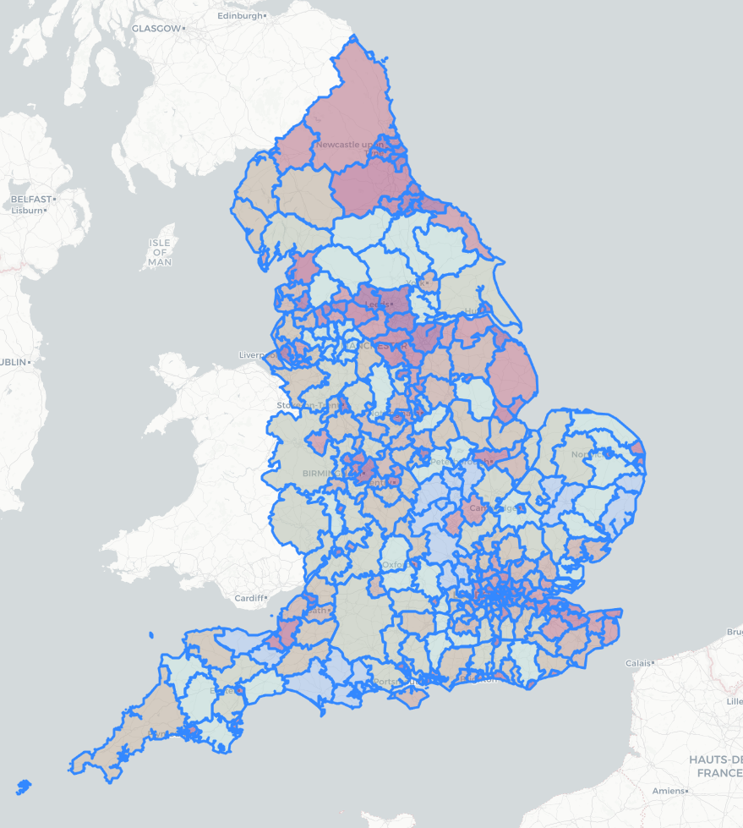
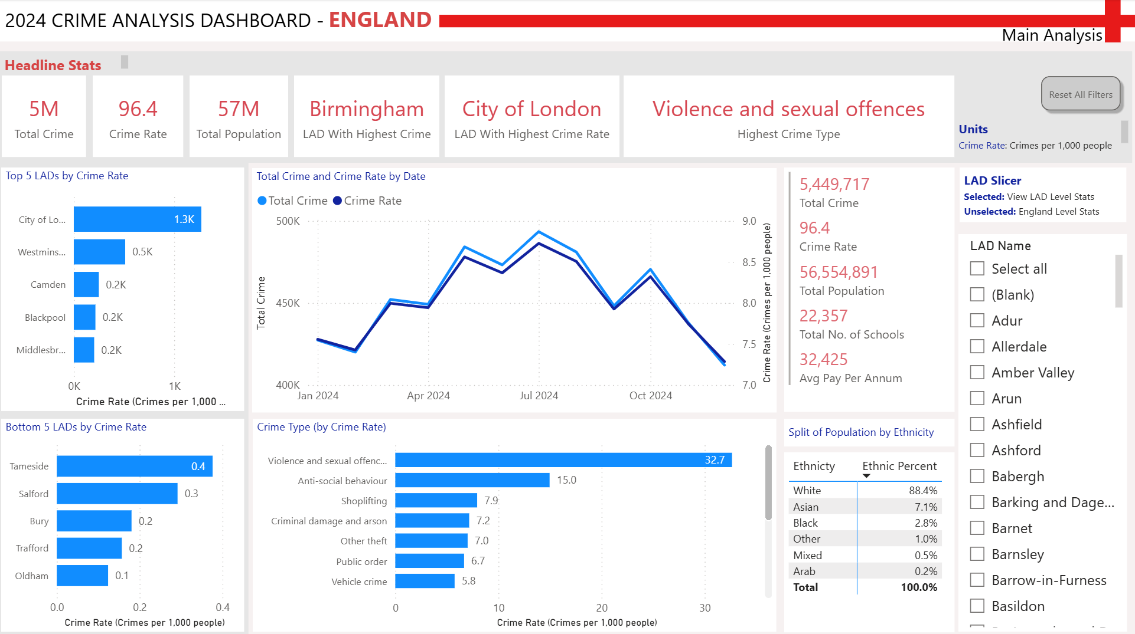
Results and Discussions [1/4]
What are the headline stats on crime in England and how is it distributed?
What period of the year had the most crime reports ?
May
Aug
Click to Open Map
6

Slide 7

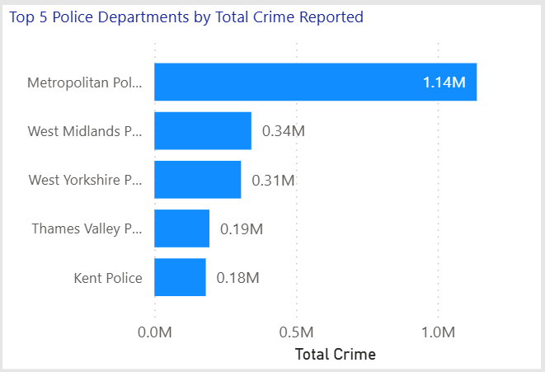
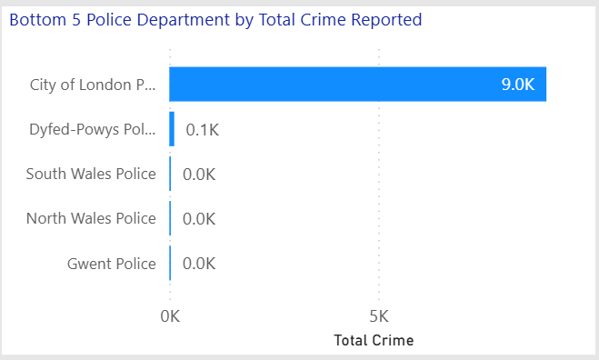
Results and Discussions [2/4]
3) Which 3 police stations made the most and the least crime reports?
7

Slide 8
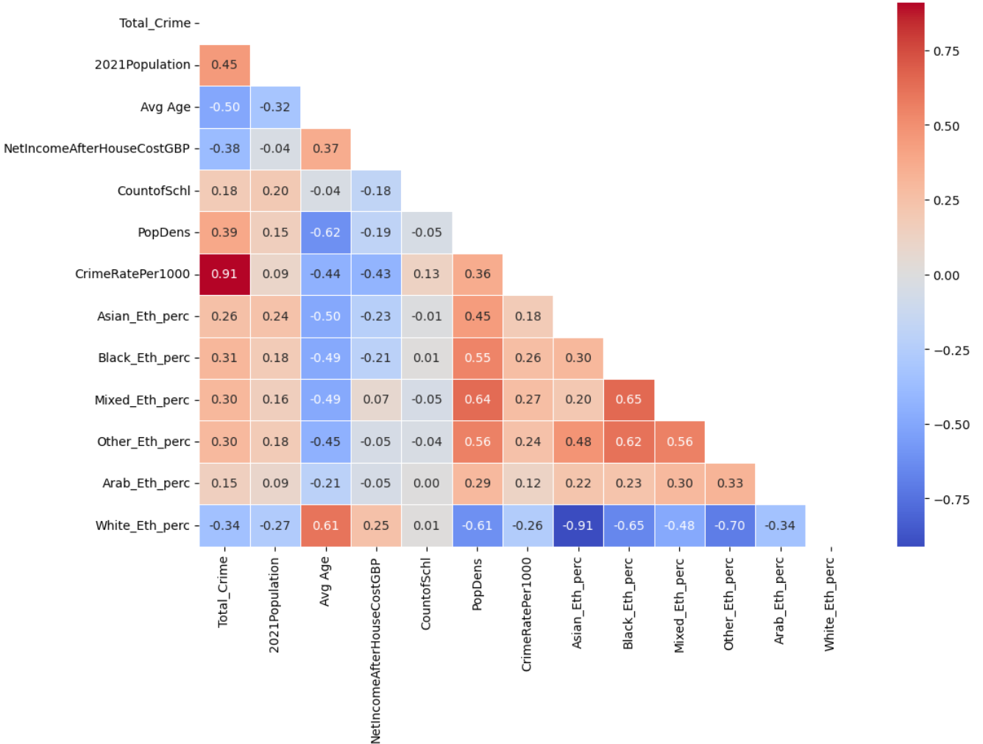
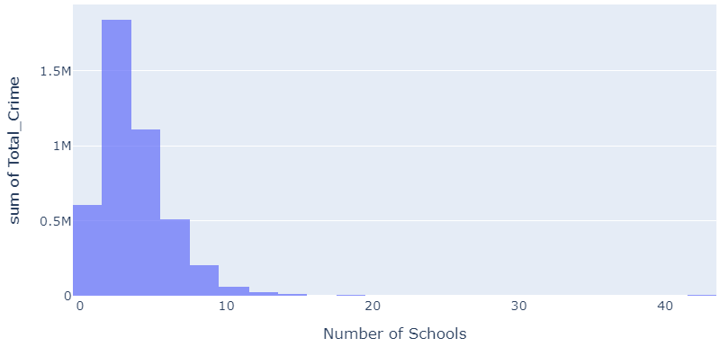
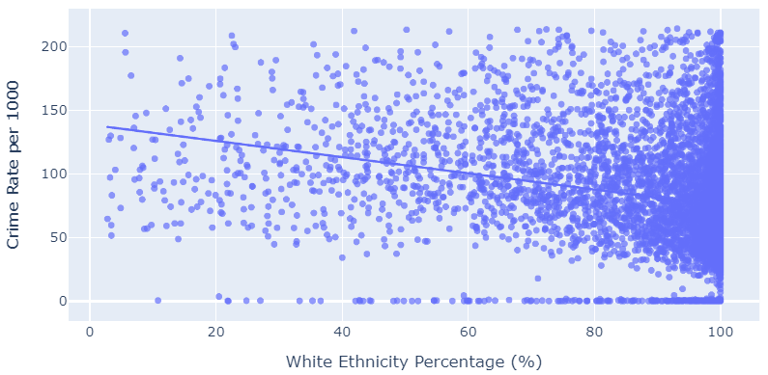
Results and Discussions [3/4]
4) Is there a relationship between CRIME RATE and socio-economic factors (e.g. average pay, availability of schools), Demographic and Geographic factors (e.g.: age, ethnicity, population density, urbanization level)?
+ve Relationships (Direct variation):
Population Density (PopDens)
Number of schools in the area
Population size
All Ethnicity (except white)
-ve Relationships (Inverse Variation):
Average age,
Net income
White Ethnicity
Total Crime vs No of Schools
Crime Rate vs White Ethnicity
8

Slide 9
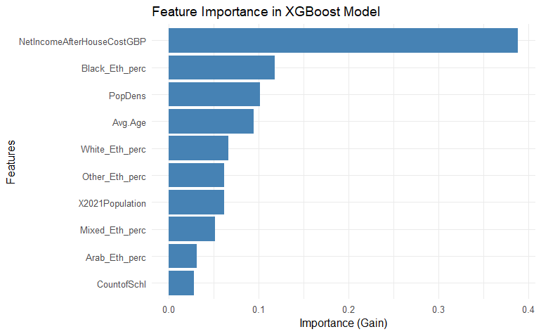
Results and Discussions [4/4]
4) What are the significant predictors of crime rate?
Significant Predictors
Net Income
Black Ethnicity
Population Density
Top 3 Predictors
Least predictor
No of Schools in the Area
 | Linear Regression | Random Forest | XGBoost
RMSE: | 37.38 | 35.26 | 35.13
R-squared: | 0.30* | 0.38 | 0.39
* Same as Adj R-Squared
9

Slide 10

Conclusion
Investigation illuminated key patters in crime rates across England
Highlighted the impact of socio-economic and demographic factors.
Identified the critical predictors of crime rate given the dataset/features
Findings will serve as a call to action…
driving policy makers, law enforcement and all stakeholders to make informed decisions
Further Work
Incorporate Educational level,
Gender distribution (male to female ratio)
Number of Police Officers per Capita, etc and…
Improve Model quality
10

Slide 11

Thank you
Questions
11

