Slide 1
FBS
User Research
(Keyword(s) search)
Feb 2020
Anubhav Mittal

Slide 2
Who we tested with
12 Online un-moderated test sessions, with Userzoom panel, for usability testing
Male – 6 / Female – 6
Region – UK

Slide 3
What we were trying to find out
We explored the following things:
Their views about the search functionality using different word(s) and if the search results were relevant
How easy or difficult was it to use this function
Likes and dislikes of the search and any areas for improvement

Slide 4
FBS keyword(s) search
Keyword(s) users used to test the search functionality:
1 | 2 | 3 | 4 | 5
funding | training | research
employment | merger | merge | buyout
Expanding in to Europe | Finding new staff | Developing the business | Obtaining a grant | Funding staff training
International | Funding | Hiring
Funding | Equipment | Printing
hiring | growth | innovation
legal | start | concerns
Recruiting staff | Raising money | Set up business in international market
hiring | international | funding
Website | Website building | Brexit | payroll | employee benefits
Hiring | Staff | Funding | Raising money
Digital marketer

Slide 5
FBS keyword(s) search
Some specific feedback around each keyword(s) search result(s):
Relevant results Growth Employee Funding Innovation Hiring Buyout Set a new international market Digital marketing Website Website building Raising money Payroll – but only 1 result Training Self-help guides International funding hiring Funding for equipment International Funding a project Develop new systems Raise money funding Hiring staff (“the search engine is not pairing results, it is listing hiring results and then staff results”) | Mixed results Employment – does it cover recruitment or employing people? Find new staff Expand in to Europe Expand in to France | No results Merger Merge – only 1 relevant result Hiring new staff – 1 or 2 relevant result Raise money + filter = funding *These keywords feature in our top 20 searches analytics report

Slide 6
FBS keyword(s) search
Top 3 things users liked and disliked about the search results:
1 | 2 | 3
very comprehensive | easy to digest | showed how many options there were
Simple | Clear | Sensible sort options
Simple answers | Relevant answers | An option to explore the answers further
Relevant | The small description | Size of text, easy to read
Clear wording | Seemed helpful and relevant | Providing events and courses
the ease of information | relevance | breadth of information
loads of options | easy preview to read | nice layout
Good Database | Good number of search results | very informative
Suggested words helps | Clear layout | Clear function to filter
It did it quick | you could see the amount of results easily | you can enter more than one word
All results were easy to see | Information was clear | Access more info on them was simple, just click a button
simple to use | Good result | user friendly
1 | 2 | 3
the layout | the grey text didn’t stand out | time taken to load
Too basic | Not inspiring | Results not ’joined up’
Irrelevant answers | Answers that I cannot understand | Too few answers
Lack of matching my keywords | Lack of categories | no indicator of how popular result is, trends are important
No further details than normal provided following search | No highlighting of search terms | No suggestion of similar terms to search for,
boring layout | wordy | no color
too many options to scroll through | not having a quick contents bar of options | too much text
Sorting feature is unavailable. | Number of results are very high to select relevant. | disorganized
Didn’t grab my interest | Slow when going back to search | Events I missed until the end.
I think it would be nice to give examples as you start typing
Some were not relevant | Maybe more info could be added | Design could be improved, such as adding more photos
there is not enough categories | Not enough topic on marketing | Not enough result

Slide 7
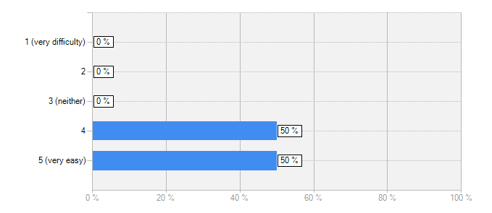
FBS keyword(s) search
How easy or difficult was it to use the keyword search option on the website?
Answer | Count | Percent
1 (very difficulty) | 0 | 0%
2 | 0 | 0%
3 (neither) | 0 | 0%
4 | 6 | 50%
5 (very easy) | 6 | 50%
answered question | 12
A really good search engine
Easy to use, but a bit primitive. Would expect predictive search
An easy to use function which answered most of my questions, though some need more developing. A ’live chat’ option would be good here as it could be used to ask questions when answers on the search page could not be found. Plenty of relevant answers to all but one of the questions I asked.
I see very little flaws in the website besides proof that it helps businesses
The lack of a search function on the home page could be corrected to make things easier, but once you found the search function it was easy and intuitive to use.
Very easy to find and utilize this.
It was easy to search but I would put a search button in after the keyword instead of scrolling down to apply filters
Search option is very simple to use.
I found it very easy, had no problems
Easy to use overall
It was is straight forward

Slide 8
FBS keyword(s) search
When we about suggestions to improve the search results, following comments were made:
1 | 2 | 3 | 4 | 5
Make the search results detail page more user friendly | Ditch the grey! | Improve load time | Think about things from the user view | Don’t look so corporate!
Related search terms | Use of icons | Have a ranking of useful info | It would be good to start giving examples as you start typing
More details on specific answers & questions | Certain questions did not have any relevant answers, needs updating regular | Keep it simple with answers, do not over complicate things | A live chat to answer questions that cannot be found using the search feature | More filters
I want to know what events are trending | I want to know popular search terms | I want to know or be notified of newest funds for businesses | I want to know which of your partners work with which support types | I want to expand the search results for more information
Add sorting feature | Add more filters to narrow down search | Show less results | Date when result was posted | Date when result was updated
I would put events into a different catagory | I would maybe use more colour or images to engage with the applicant | Add costs into the search filter | More categories | More search result
More relevant searches | Maybe a voting function where other people who have found this info can vote on its usefulness | Search engine is not stringing multiple words together, just singular words. | More specific filter options | Add sub categories

Slide 9
Summary – keyword(s) search
Search function worked very well across the board and users liked that it was simple, easy to use and that the search results were comprehensive in most cases
Some dislikes included the layout, lack of sub-categories, predictive text not being available and irrelevant or no results for some search keyword(s) (slide 5 has more details)
Following suggestions were made to improve the search results: (please be aware that there are no strong themes coming out, these could be small incremental changes that we could look at)
- show less but more relevant results (mentioned on the back of irrelevant results)
- more specific filter options
- add sub-categories
- have predictive text
- have related search terms
- keyword(s) against each search result
- search bar on homepage
“Search engine is not stringing multiple words together, just singular words”
“Certain words did not have any relevant answers, needs updating regularly”
“It would be good to start giving examples as you start typing”

Slide 10
Thank you!

