Slide 1
SEP
User Research
(Events map functionality)
Jan 2020
Anubhav Mittal

Slide 2
Who we tested with
10 Online un-moderated test session, with Userzoom panel, for usability testing
Male – 2 / Female - 8

Slide 3
What we were trying to find out
We explored the following things:
Users likes and dislikes about the events map functionality
If the map icons were easy to understand
If they felt there was anything missing
How easy was it to locate a specific event in Glasgow city

Slide 4
SEP Events map
When we asked the users if they were able to locate the events map easily, they mentioned the following things:
I was able to locate the map easily once I found the events tab
It was where I expected to see it
Fairly easy, I located events by looking in the services offered and maps was an option along with a list view of results
It was reasonably straightforward given that the site content was so low. I don’t see why specific links to the event map aren’t given on the homepage
The map was easy to locate. It was clearly labelled with list next to it so you could alter the view you wanted to use
I was very pleased to see the icons I just wasn’t aware what the numbers within the icon illustrated. I was further delighted when I clicked on the icon and was met with lots of very useful information which I wasn’t expecting at this stage
There was no indication towards events from the homepage

Slide 5
SEP Events map - likes
When we asked the users to share top things they liked about the map, following feedback was shared:
Uses ’Google Maps’ style functions - click and hold to drag and zoom in and out Can still use filters to narrow down search uses numbers system on tab to show how many events in a location which filters as you narrow down with zoom
Easy to use, Well laid out, Functioning tabs
Google maps, easy to scroll easy to move and change locations
I liked that you could zoom in and see the exact location of the event. It was like Google maps in that way. I liked the number of events showing up on the map. I liked that you could zoom in on the different events and see where they were being held
It was clear and easy to use, and being able to filter by category was essential to find relevant results
The fact that it displayed cost, opening times and a brief description of the event
Clean block / tile layout. The ability to filter. (Perhaps) an indication of where events are and how many.
Ease of looking for events near you easy to use attractive
It was bold you can zoom in and out it was clear

Slide 6
SEP Events map - dislikes
Following are some comments about what they disliked about the map:
No indication what the difference between red and blue means. The numbering system was not always accurate. Could be difficult to see all events if there was a long list of them a have to scroll across horizontally
Not much explanation, Number on pin not same as number of events displayed, Not very easy to find events tab but easy enough
I don’t believe there was a contact number next to the address. Aside from that the map was very impressive and very informative
Arrive at the page and there are no supportive comments about the page, how to navigate it, what it contains in terms of clickable information. No rollover on map icons / why different colours? Page bland, no continued theme with ’success’ photos, dynamic content, upcoming events list etc
The zoom could get a bit out of control at times. If you weren’t used to this type of map you might think all of the events were manly in Glasgow and Edinburgh. The Isle of Man was included and isn’t part of Scotland.

Slide 7
SEP Events map – Glasgow event
Majority (8 out of 10) were able to find the specific Glasgow event and most users found it easy to find it on the map:
Able to find through zooming in on Glasgow and also using the filter tools to narrow down to countrywide ’GDPR’ events
I found this very easily
It was among six other locations
As GDPR was not listed under the categories I used the search field at the top, and I also set the location to Glasgow
I found it difficult. You click on the city on the map and if you get the wrong event coming up it was difficult to go back using the map. I had to use search instead and with that I found the event right away
I struggled immensely due to the map option zooming in several times and no option to return back to the initial map screen with the icons as a result I had to use a workaround by selecting the list option and then reselecting the map
It was not clear as the information was missing
Impossible to find, very messy

Slide 8
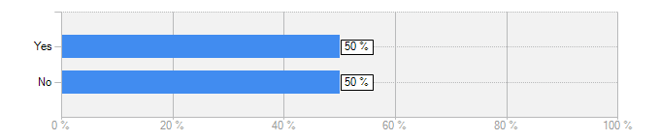
SEP Events map – scroll bar
When asked the following question, users shared the following views:
Did you notice the scroll bar while browsing through different events on the map?
Yes. It was as expected.
Six different events were separated by the white line - would be useful to have a filter tool here if a long list of events were presented
The scroll bar at the bottom of the display page was easy to find.
But it did take me a while to figure it out
Initially I failed to see it. However, I located it very quickly.
I didn’t notice it.
Answer | Count | Percent
Yes | 5 | 50%
No | 5 | 50%
answered question | 10

Slide 9
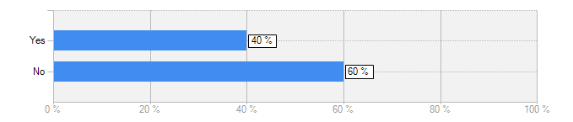
SEP Events map - icons
When asked the following question, users shared the below comments:
Were you able to understand different icons used in the map?
The icons were numbered for amount of events - still unsure of colour coding used
There was different colours of markings but no explanation what means what
No this still remains a mystery the use of the different colours the numbers make a little sense however do not correspond well at all times with the information that is actually displayed.
There was no guide
Possibly red was area and blue an event
There was no indication what they were until clicked on
The icons were as expected
Yes, I understand that the icons represent events or individual locations on the map
Answer | Count | Percent
Yes | 4 | 40%
No | 6 | 60%
answered question | 10

Slide 10
SEP Events map – missing?
When we asked if there was anything missing from the map, they said:
Filtering events when you have narrowed down to a location e.g. by price or start time
The event selected was fully booked, but there was no indication of this from the detail on the map view, I only found out when I clicked through for more information, this was disappointing
A return button to return back to the ’starting page’ of the map
The building event is in
The maps are okay but can be tricky if you haven’t used them before
How to use the maps, what the icons represented, how to filter etc
A guide/list to say what event each number and colour represented
A key to show the meaning of the red and blue icons

Slide 11
Summary – Events map
Users were easily able to locate the events and the map feature; however, some were expecting an events tab / button on the homepage.
A number of them mentioned that the map uses “google maps” style functions, zoom in and out was easy while using the map, event information and details were also welcomed by most users.
When asked what they disliked – the red and blue icons confused most users, the event numbers were not always accurate, there was no reset option to go back to the original map display if stuck finding an event. Some also mentioned that it could be difficult to see all events if there was a long list of them.
Majority (8 out of 10) were able to find the specific Glasgow event and most users found it easy to find it on the map.
Only half of the users saw the scroll bar for viewing multiple events.
Specifically talking about the icons 4 out 6 found it difficult to understand what the different icons meant – users were unsure about the colours, they wanted a key / legend.

Slide 12
Summary – Events map (continued)
When asked if there was anything missing, following comments came on top:
A guide/list to say what event each number and colour represented
A key to show the meaning of the red and blue icons
The event selected was fully booked, but there was no indication of this from the detail on the map view, I only found out when I clicked through for more information, this was disappointing
A return button to return back to the ’starting page’ of the map.
The building event is in

Slide 13
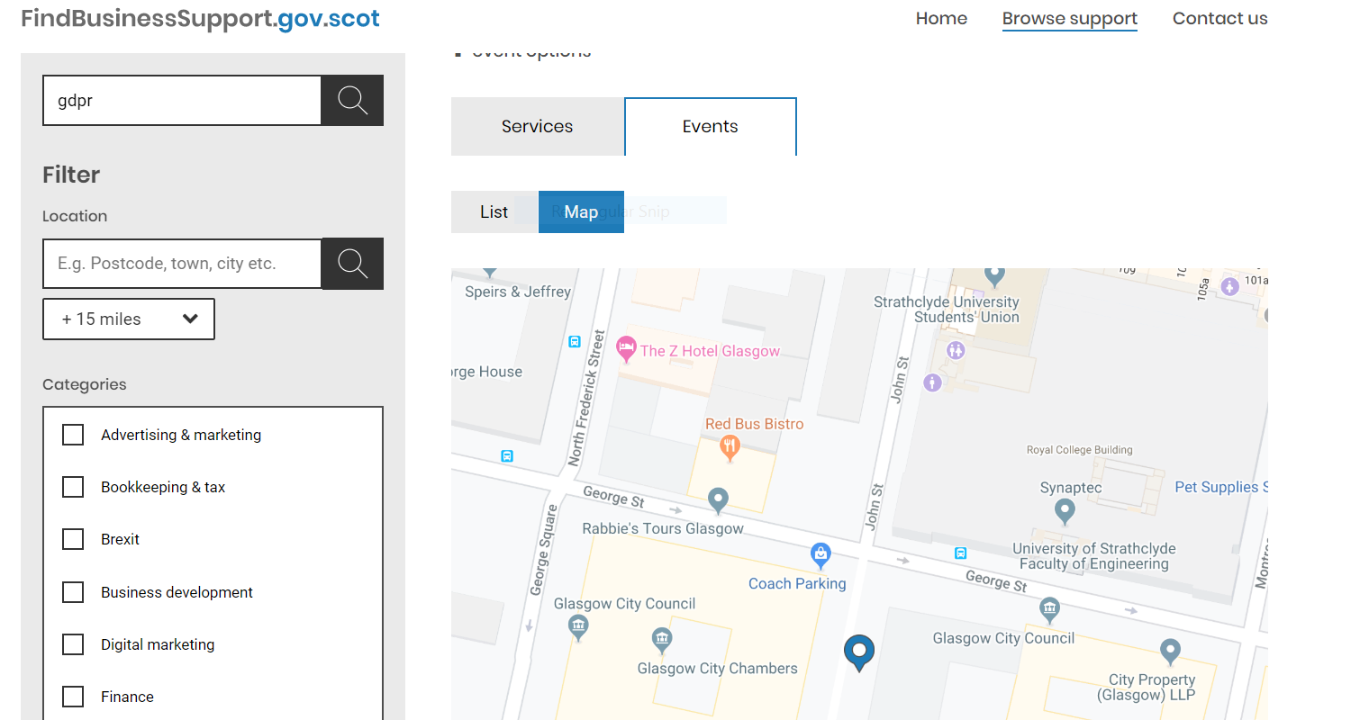
UR observation 1
If the user searches for an event using keyword then it’s confusing to locate the event on the map (see below image)

Slide 14
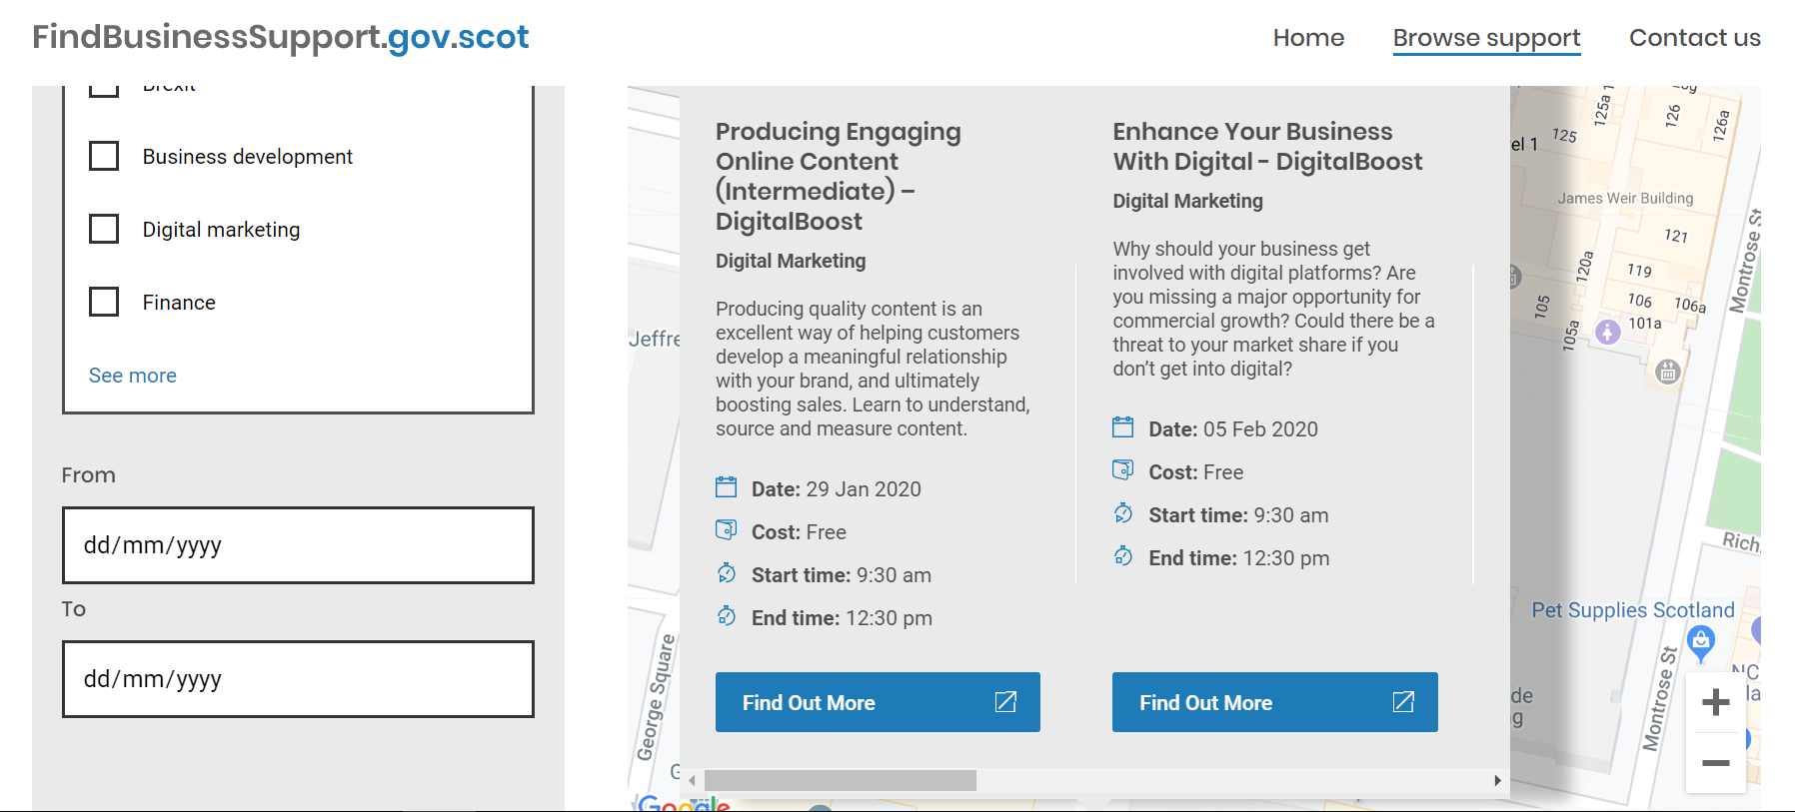
UR observation 2
If the browser display is 100% then it is difficult for the user to scroll and keep an eye on the number of results in the display screen (see below image)
No of events not visible

Slide 15
Thank you!

