Slide 1
SEP New Enquiry Forms Testing
Sept 2019
Anubhav Mittal
Martin Kerr

Slide 2
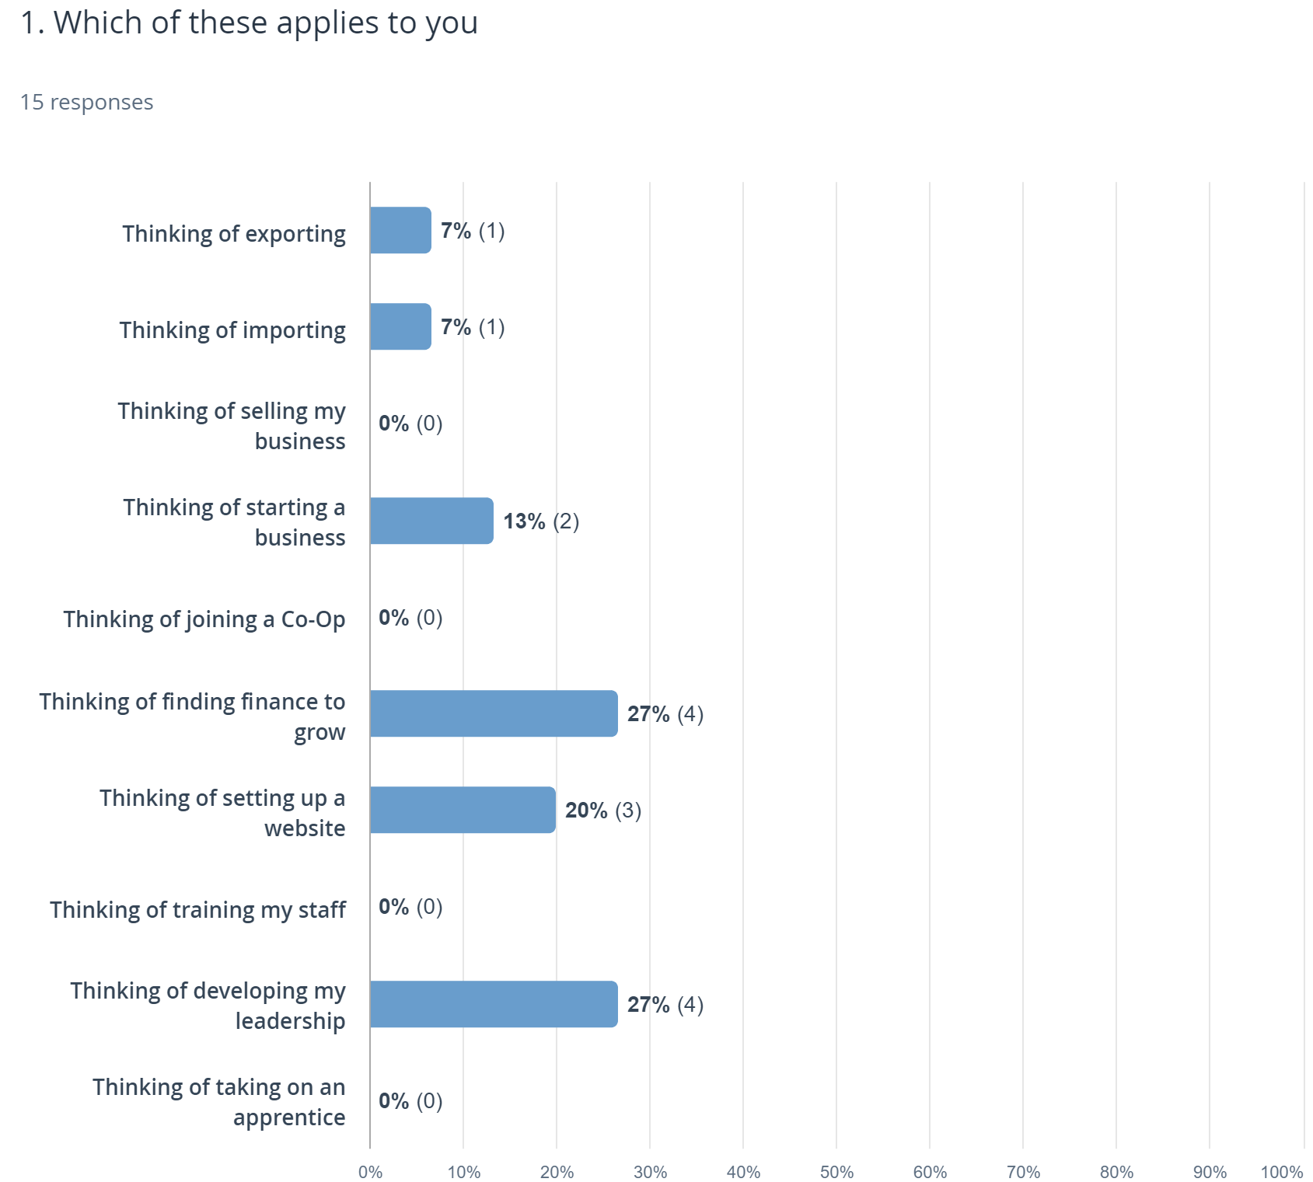
Who we tested with
15 Online un-moderated test sessions, with Userzoom panel, for usability testing
These are some demographic details >>
We also tested with 3 pre-start companies from across Scotland

Slide 3
SEP Enquiry Forms Summary
Both the forms are very simple, short and easy to use
There were no issues reported while filling in the form and the data fields
Business address lookup was very well received, however the “edit address” did not test well with one person and needs further testing
Some people would like guidance to complete the message box
Small font size was an issue on the form and thank you pages
All were happy to see the acknowledgement tick on the thank you page
No major frustrations were recorded while filling the forms

Slide 4
What we were trying to find out
We had a very rough Enquiry Form prototype to test.
https://ycq5at.axshare.com
It was intended to allow us to test two sets of enquiry forms (trading and non-trading).
We were interested in:
General impression of the forms (layout, design and language)
Any frustrations that the user might have
Did the form make sense for both Trading & Non Trading customers
We also asked what Pre-Starts were doing to find support

Slide 5
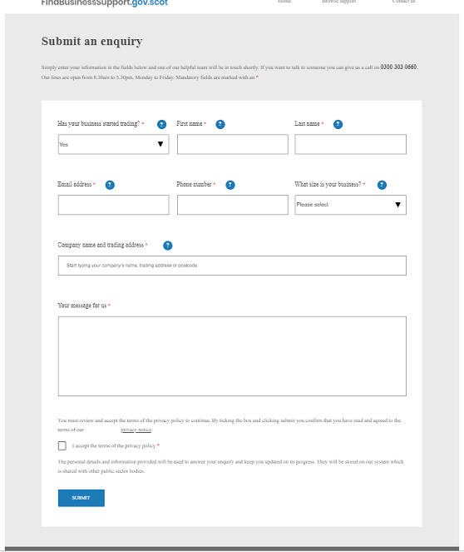
Overall impression
People noticed the change in the form fields when they selected “Yes” to first question
All felt the form was simple, short, easy to fill
Clear and well laid out were some of the other comments
Some felt it was a boring looking form and that it was a bit bland with blue and white colors which was not very eye catching
Overall, the form was simple and does the job well

Slide 6
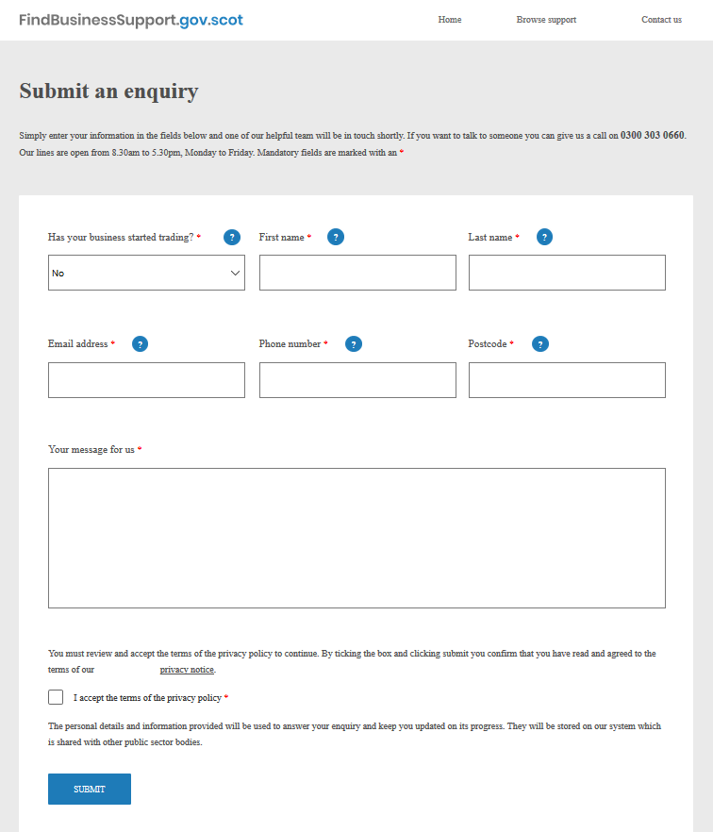
Overall impression
Users noticed the change in the form fields when they selected “No” to first question All were happy to provide their basic details including the postcode
No frustrations were recorded

Slide 7
Overall impression
The tab key worked well to go backwards and forwards between text boxes and it was good to save some time
Some felt that the help “?” feature was good to have as if they were stuck at a field
One person felt that it was unnecessary to have “?” on First and Second name fields as it was obvious. There were also comments that the tooltip text was insultingly obvious.
Some commented on the size of the text on the form and said that it was too small to read and that text size should be enlarged for the options listed at the bottom of the page (such as home, browse support, contact us ..)

Slide 8
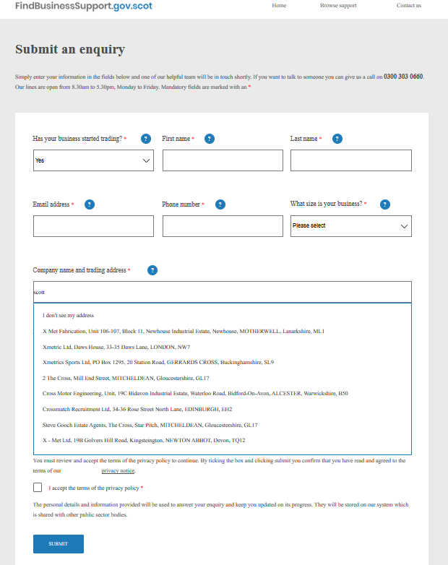
Overall impression
All were comfortable providing their details including the business size
One person made a comment about renaming Email.. to Business Email.. , Phone.. to Business Phone.. and Home Phone.. as they were trading already and it felt appropriate
The business auto finder was easy to use, displayed the address neatly, BUT the “I don’t see my address” was not always obvious as being a clickable call to action (CTA)
One person highlighted that it was difficult to go back to the address auto find box if they had to “edit” their displayed address if they selected an address in error

Slide 9
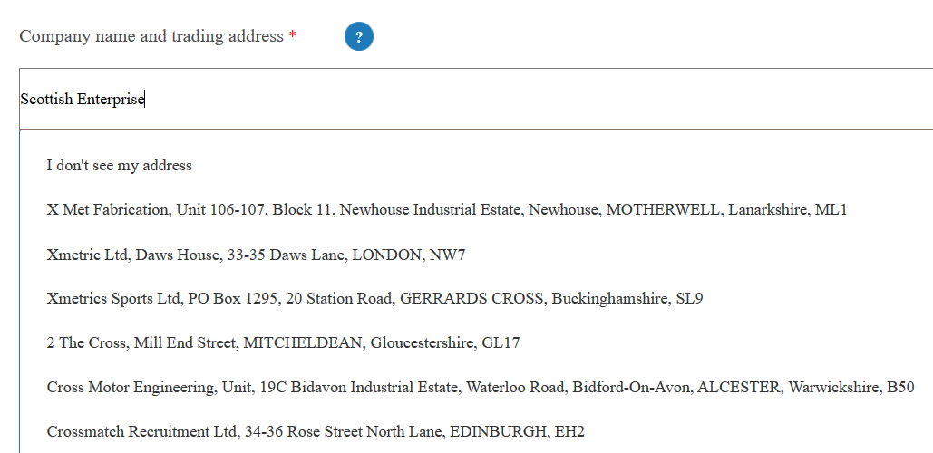
Overall impression
“I don’t see my address” was not always obvious as being a clickable call to action (CTA)

Slide 10
Overall impression
With regards to the message box, a few people felt unsure of what message to put and would like some guidance
People also noticed that upon clicking the box the cursor was center aligned and not top left. This caused some initial confusion
All were happy to simple click and accept the privacy tick box. “no one looks at it and it tends to be very long”

Slide 11
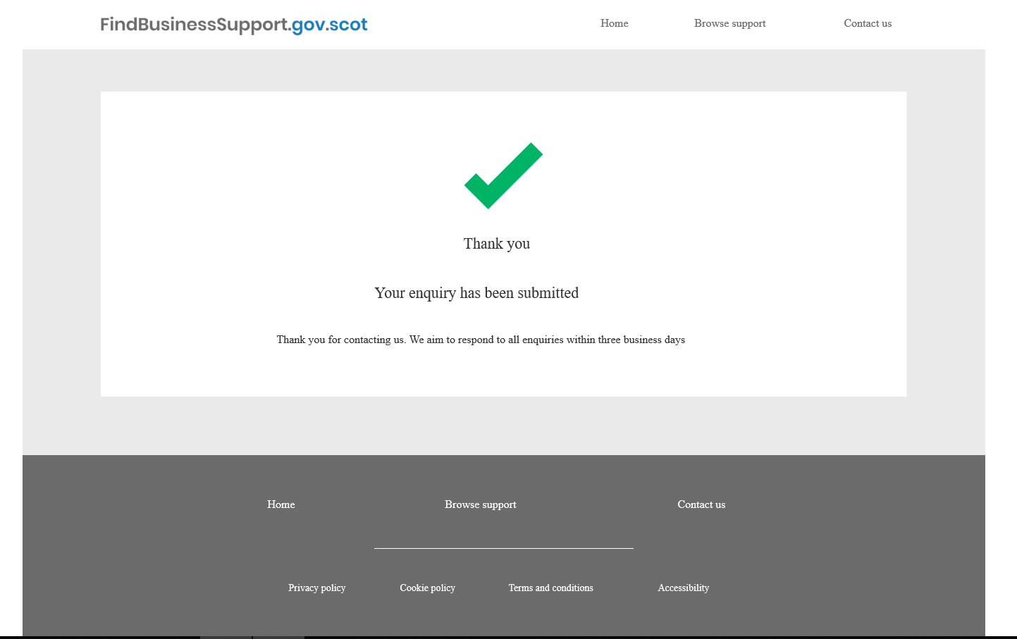
Overall impression
All people liked the green tick on the thank you page
People felt that it was good to know that the time frame and that it’s been acknowledged
“I like the tick and it tells me when I should expect a response and shows that my enquiry is actually submitted”
Again, some people commented on the small text font while reading the content

Slide 12
Quotes
Simple form, does the job
? is for dummies I guess, First name and Last name – not necessary to have ? we know this..
Form is clear, simple and can’t think of anything else to needs to be added in
It’s an enquiry form for business support
I was mentored by a small business owner that I used to work for
It’s a bit bland, only two different colours blue and white, not incredibly eye catching so it’s not very easy on the eye I guess!
Simple form, it is clear and not too long

Slide 13
Quotes continued ..
Address lookup - It’s a brilliant addition here – the auto find. This should be on every form.
Message to us – I wonder what I will put there ..
The only problem is when it comes to the message box as I will not know what to write as there is no guidance on what you would like me to include
I weight Peer over recommendation’s over online ones
On Thank you page –
“I like the tick and it tells me when I should expect a response and shows that my enquiry is actually submitted”
The text is quite small – I am wearing my glasses but if I was not then I might struggle to read that

Slide 14
Answers to our Research Questions
We asked:
General impression of the forms (layout, design and language)
Any frustrations that the user might have
Did the form make sense for both Trading & Non Trading customers
We also asked what Pre-Starts were doing to find support
We learned:
The form is well received and has no major issues
The form does not raise any major frustrations
The form did make sense for both Trading & Non-Trading customers
People vary greatly and there is no predominant learning journey.
People tend to go back to named individuals once they have a relationship with them
Peer group and Mentoring relationships have great weight with people when they exist
Size of business and geography influence how people search for support
These are born out by previous research

Slide 15
Thank You

