Slide 1
SEP
Research
18th October 2019
Martin Kerr
Anubhav Mittal
Lorna Hayton

Slide 2
Who & What
We tested with
87 UserZoom online unmoderated test sessions with people from their panel narrowed down by screener questions where appropriate.
We tested
Home page images
Interface content

Slide 3
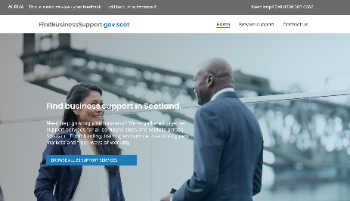
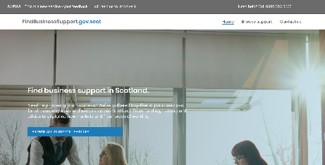

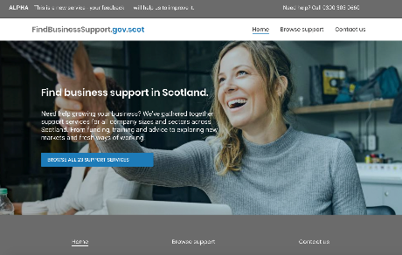
Home page Image Testing - 1
Image Version | Score out of 7 | Notes
 | 4.4 | No changes to the new images
 | 2.8 | No changes to the new images
 | 4.67 | No changes to the new images
 | 5.2 | Original image
Notes:
This version tested the 3 new images as well as the original image.
No adjustments were made to the images. This means that they are a bit too square and push the footer down below the fold.
The question is which image is preferred.
Option 3 is the best of the rest.
BUT
The original image is still favourite at this point.

Slide 4
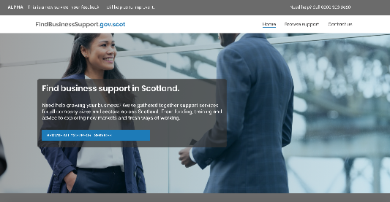
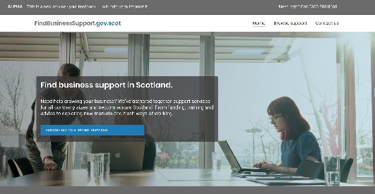
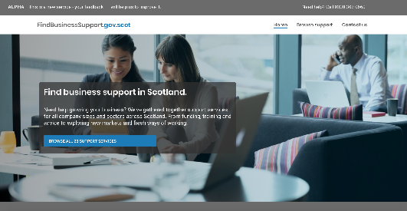
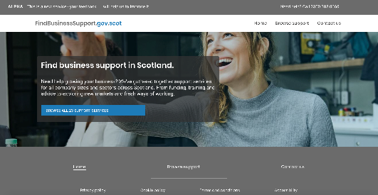
Home page Image Testing - 2
Image Version | Score out of 7 | Notes
 | 4.5 | Height limited Transparent box behind the text
 | 4.25 | Height limited Transparent box behind the text
 | 5.5 | Height limited Transparent box behind the text
 | 4.25 | Original image
Notes:
This version tested the 3 new images as well as the original image.
Images now have two alterations:
- The image has a height limit.
A Transparent box is put behind the text to make it more readable
The question is which image is preferred.
Option 3 is now the favourite

Slide 5
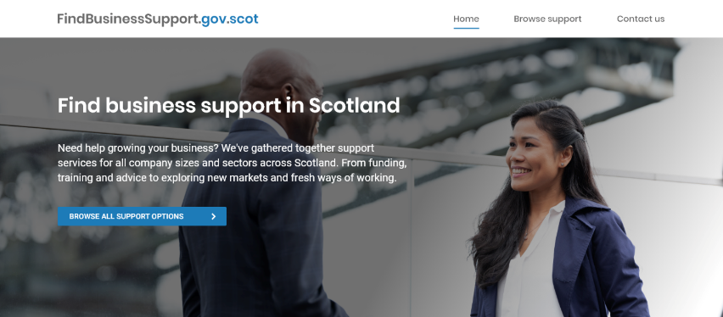
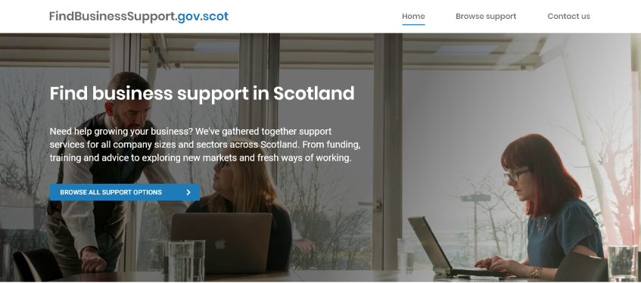
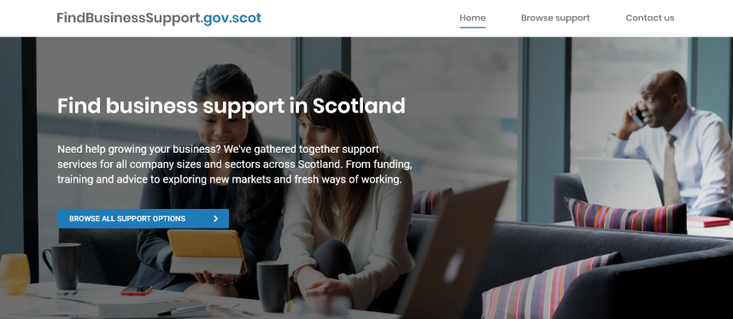
Home page Image Testing - 3
Image Version | Score out of 7 | Notes
 | 4.13 | Colour wash to make text easier to read on top of image
 | 4.5
 | 5.13
Notes:
This version tested the 3 new images.
The question is which image is preferred.
A colour graduated colour wash was applied to the image to make the text easier to read on top of the image.
Option 3 Still has a narrow lead.

Slide 6
Home page Image Testing
There is not a huge amount in it but Option 3 (C) is the preferred image.

Slide 7
Interface Content Testing - 1
We tested 4 section of content with 15 UserZoom panel members using a screener to get Business Owners or Decision Makers.
Content
1. Interface – Connecting businesses to academics
2. Funding for the advanced innovation Voucher
3. Funding to develop a new product, process or service
4. Funding to develop your workforce practices

Slide 8
Interface Content Testing - 2
Interface – Connecting businesses to academics https://scotentsd.github.io/screenshots/Interface%20%20-%20About%20Interface%20-%20Original%20Text.pdf
Thoughts
- Looks like a WORD document
- Too much small writing
- Not sure what the List at the top with a Tick meant
- Too much information and quite confusing
- Language was nice and simple
- Overly technical language
Suggestions
- Case studies
- Pictures
- Contact phone number
- Simpler
- An indicative Time Frame

Slide 9
Interface Content Testing - 3
Funding for the advanced innovation Voucher https://scotentsd.github.io/screenshots/Interface%20-%20Advanced%20Innovation%20Voucher%20-%20Original%20Text.pdf
Thoughts
- Looks like a word document
Mostly easy to read but some confusion
Simple layout
Easy to understand
Suggestions
Case Studies
Visuals
Larger Text
A diagram of the process
Observation
- The summary is shorter

Slide 10
Interface Content Testing - 4
Funding to develop a new product, process or service (Standard Innovation Voucher
https://scotentsd.github.io/screenshots/Interface%20-%20Standard%20Innovation%20Voucher%20-%20Original%20Text.pdf
Thoughts
Confusing about the actual offering
Needs contact details
There were a lot of Terms that needed to be explained
I liked that it was more condensed than the others
Easier to read as it was shorter
Suggestions
Add links to funding for larger projects
Make summary better and higher on the page
Add pictures or graphice

Slide 11
Interface Content Testing - 5
Funding to develop your workforce practices
https://scotentsd.github.io/screenshots/Interface%20-%20Workforce%20Innovation%20Voucher%20-%20Original%20Text.pdf
Thoughts
Easy to read
Simple language
Nice layout
Short ☺
Suggestions
Who to contact
Super simple summary
Case studies

Slide 12
Interface Content Testing - Categories
We also asked this question:
We are currently categorising our support as one of these: - Self-Help Guides - Programmes - Research and Information - Consultancy and Advice - Funding - Training
The response was:
These pretty much cover everything
I thought it was all mainly Funding
Add Contact information
Add Case studies
Some of the categories overlap and this could be confusing

