Slide 1
Shared Entry Point Usability Testing
22nd May
Martin Kerr
Anubhav Mittal

Slide 2
Who we did research with
5 face to face lab test sessions
1 x Manufacturing
1 x Health & Beauty
1 x Finance
1 x Voluntary Sector
1 x Design

Slide 3
Summary of Issues observed
Major Issues
Address lookup is a major issue for most people
Search is a major issue for most people
Issues
Trust is still an issue with people being unsure who the site is. The .gov subdomain helps a lot but it is till not there.
Location is the top filter/personalisation requested
Company stage/size is the next most suggested
Information density is too low on the Listings page

Slide 4
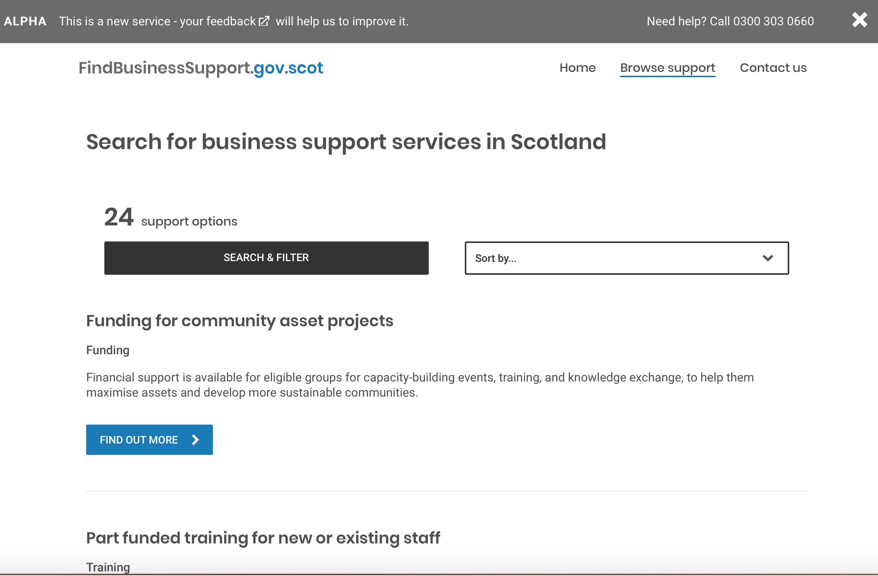
Low information density on listings page
Typically a user can only see
1 to 1.5 listings per page

Slide 5
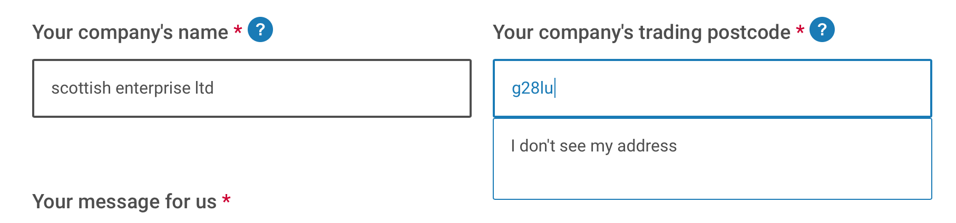
Address lookup
Address lookup is still an issue

Slide 6
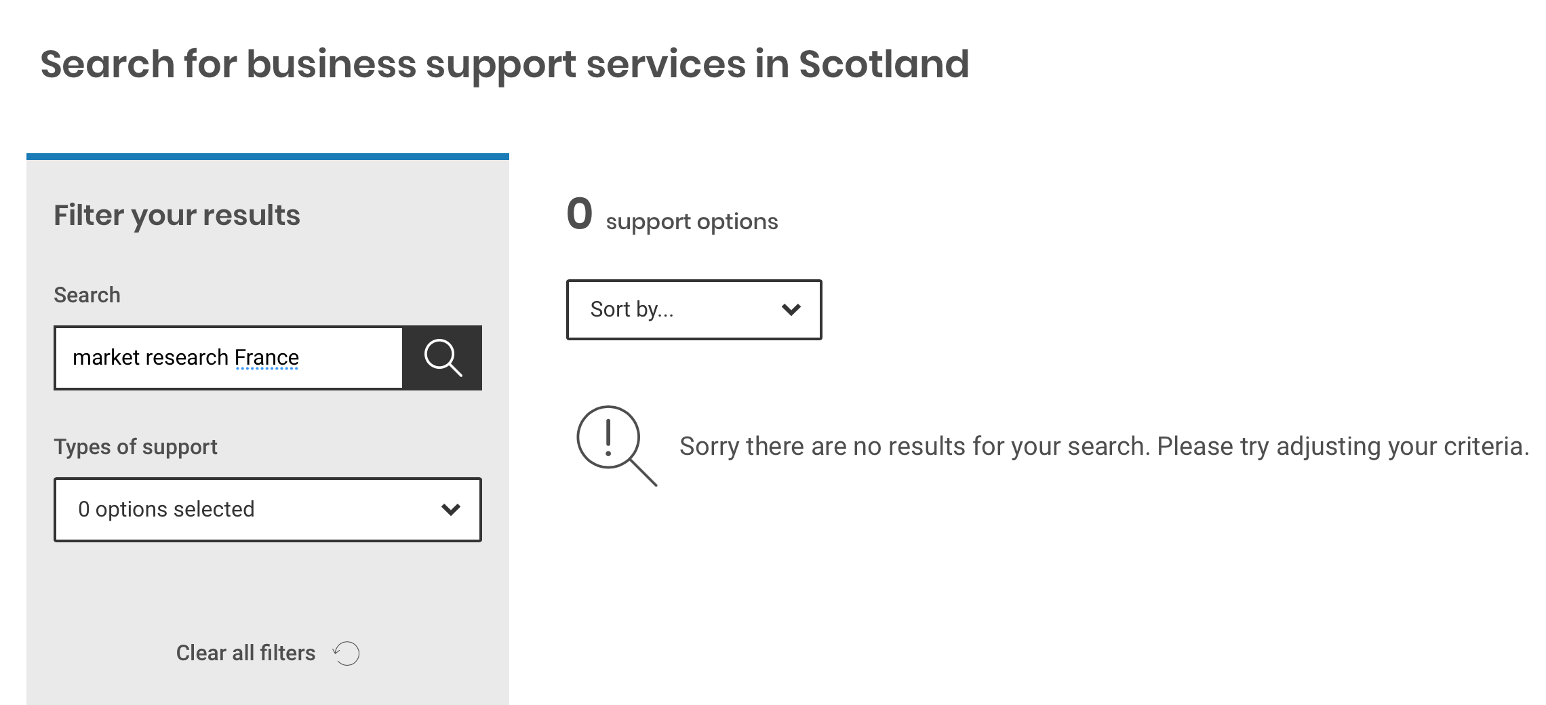
Search not returning Partial Match’s
Search is not returning
“Partial Match” results

Slide 7
Quotes
Website
“Needs a Search Bar”
“I would just do a Google Search”
Listings
“I don’t like this listing. It is making me scroll too much.”
“Eligibility could be a bit clearer”
Form
“I would expect something a bit more personal”
“An email or phone number would be better”
“The perception of forms like this is that you will literally never hear back”
“Offer phone number on the page before.
“It is a really straightforward form”
“It would be good to see a copy of the enquiry. Email me a copy and give me an enquiry number”

