Slide 1
SEP
User Research
(Events waiting list prototypes)
Feb 2020
Anubhav Mittal

Slide 2
Who we tested with
9 Online un-moderated test sessions, with Userzoom panel, for usability testing
Male – 8 / Female – 1
Region – UK wide

Slide 3
What we were trying to find out
We explored the following things:
Users likes and dislikes about the homepage of findbusinesssupport.gov.scot website
If they felt there was anything missing
Their views on 3 versions of the events waiting list designs:
Version 1 - https://xd.adobe.com/view/86d6ef08-f67a-4685-6d76-7723cb766896-f0e7/?fullscreen&hints=off
Version 2 - https://xd.adobe.com/view/2be1ccae-8dfd-4842-4bf6-658116b60291-5dd0/?fullscreen&hints=off
Version 3 - https://xd.adobe.com/view/2bcce824-a064-4898-6ac9-eb46fb95baf7-5dfd/?fullscreen&hints=off

Slide 4
SEP homepage – likes and dislikes
When we asked the users about their likes and dislikes upon looking at the homepage following things were mentioned:
Top 3 likes Top 3 dislikes
1) | 2) | 3)
The colour of the font | There was a contact telephone number visible at the top | Each hyperlink was clear to see
Liked how there is not too many buttons | Very simple to use | Everything you might want to click on, on one page
Informative | Simple | Appealing
short | brief | clear
Nice welcoming picture | ability to browse the services and events from the main page directly | Minimalist feel - not overloaded with information
The colour | The details | Everything being on one page
Nice big image | clear | clean
Easy to find items | Search facility | Background image
Simple categories on home page | The general clean and easy to read presentation of results page | Excellent contact us section
The amount of information | The filters to narrow down searches | The fonts and spacing of the text
1) | 2) | 3)
There was minimal information on the homepage | Too many hyperlink without descriptions | The main square box overpowered the rest of the homepage
How you cannot add your location to find the closest events to you. | I would like to see more friendly photos of the types of support you offer. | No scottish flags
maybe not enough information | Don’t include examples | Layout a bit poor
the black text box is a bit obscuring | I didn’t look at the map feature, I didn’t see one | The lack of ’Back to top’ buttons
you can’t get a full screen for the map | if you scroll, you will scroll down the page and not zoom in | The imagery
Pop up | The details | I would like to see telephone number open hours displayed better
Doesn’t say much about the purpose | Image unrelated to purpose

Slide 5
SEP waiting list version 1
When we asked the users about their likes and dislikes upon looking at the version1 of the waiting list option following things were mentioned:
https://xd.adobe.com/view/86d6ef08-f67a-4685-6d76-7723cb766896-f0e7/?fullscreen&hints=off
Top 3 likes Top 3 dislikes
1) | 2) | 3)
The layout of the list of events | The information about each event | Prior warning if the event is sold out
The colour of the waiting list text | The font | How it is not too intrusive
Very clear about event been fully booked | Liked the colours | Easy to find out
obvious | different colour | clear
All info seem to be given (even the end time!!) | it is indicated when the events is sold out | The title of the event is clearly listed
Detailed | Accuracy | Informative
a list was available | good idea to have | highlighted
Box to click on to add name to waiting list | Easy to use | Below headline
It is consistent and doesn’t change the page too much | The orange colour is a new addition to the page and perfect for standing out | The text is easy to understand
The layout | the font | The lack of images
1) | 2) | 3)
Inconsistency of font size, type and colour of highlighting of text | The title of each event could be more eye catching | The use of a picture or logo for each event could make the waiting list more interesting
too small | small text | small button
Font size may be a bit too small | there should be a book button next to find out more
Font too small | Too much words | Page looking dull
Didn’t stand out at first | Re position possibly | Non uniform font
The text is too small | I would like the option to put my name on list next to the warning | And I would like information to know if the event is annually or monthly
The blandness | The lack of dynamism | Too much white

Slide 6
SEP waiting list version 2
When we asked the users about their likes and dislikes upon looking at the version2 of the waiting list option following things were mentioned:
https://xd.adobe.com/view/2be1ccae-8dfd-4842-4bf6-658116b60291-5dd0/?fullscreen&hints=off
Top 3 likes Top 3 dislikes
1) | 2) | 3)
Similar layout to Version 1 | Clear information about each event | Clear layout of the list
I love the box icon that people can that people can click to go straight to the waiting page | Everything is concise and displayed on one box | N/A
Easy to understand is fully booked | You can see that there is a waiting list | Layout is great
blue underline | says ’ add name to waiting list | different colour
there is a add to waiting list button | there is still all info expected | still a find more button
hyperlink | clear | test highlighted to say sold out
Easy to use click on boxes | Stood out better than version 1 | liked the coloured box to add name
This more follows my expectation of a sold out notification | I like the use of colour | I like that my solution is directly next to the problem
The colours | The Text and it’s font | The spacing of the sections of text
1) | 2) | 3)
Different language in description of each event | Inconsistent font used for the "Waiting List" option | No photos for logos of each event
It was perfect
small print | very small | not obvious
font size is stil too small | event currently sold out should be right under the title of the workshop rather than at the end | n/a
Less stand out | Is it prioritised in date order | less clear
Different versions | Didn’t like the colour of the box | Perhaps use a larger font
I prefered the orange background with white/black text | I would like problems to have bigger text` | Give me information about the next available date of event if there is one.
The buttons colours | The lack of images | The whiteness

Slide 7
SEP waiting list version 3
When we asked the users about their likes and dislikes upon looking at the version3 of the waiting list option following things were mentioned:
https://xd.adobe.com/view/2bcce824-a064-4898-6ac9-eb46fb95baf7-5dfd/?fullscreen&hints=off
Top 3 likes Top 3 dislikes
1) | 2) | 3)
Colour of the page | Clear layout | Clear information
How the waiting list text is bold and clearly visible | How you can click to be added to the waiting list via the box icon | How it is very clean and concise.
Clear on the messages | The layout is great | Very informative
nothing to say there is a waiting list | liked box showing event sold out, it’s obvious
all info expected | find out more button | event sold out right under title and highlighted
Informative | Detailed
event sold out clear | clean | clear
Clearer than version 1 and 2 | Liked coloured box version | Liked separate box to add name to list
Better representation of a sold out event | Good colour use | Excellent size of ’’sold out’’ text
The title at rhe top | The calendar icons | The colours
1) | 2) | 3)
Font size | No photos, lack of colours | Number of events
I don’t know what ’category tag’ means | nothing to say there is a waiting list | event sold out doesn’t imply there is a waiting list
font size too small | no booking button next to find out more or add to waiting list | Didn’t like colour of box
Too small a font | too much to read | The imagery
in consistent colours for add to waiting list | less visible than other options | The whiteness
No follow up option or solution | No follow up information of next event | No recommended event

Slide 8
SEP waiting list design
When we asked the users to provide their preferred option upon looking at all the 3 versions following feedback was shared:
Version 2 - I thought this version had the most clear layout of all 3 versions
Version 1 is the best as it’s simple and easy to follow, the general layout was good. The other versions didn’t really add anything else.
Version 1 as it’s detailed, accurate and informative
Version 3 as I can see event sold out at top and then can add to waiting list and I think that bit it the clearest for me. I don’t like the orange button colour maybe green would be better.
I like version 3 as you identify that there is a problem and then you offer a solution straightaway and it’s good customer service.
Version 3 - I actually like the hyperlink as its recognisable as a hyperlink that will prompt a further action i.e. to bring up the list to add your name to
Like version 3 - the event currently sold out is right under the title and is highlighted to attract attention to customers. The category tag is also available which is good as people can directly relate to that.
Version 3 explains better and has the best layout and is clear to tell if the event is sold out or not and how to get added to the waiting list
3 as the waiting list text is bold and visible, the design is clean and concise. It was simply perfect and there is no further improvements in my opinion.

Slide 9
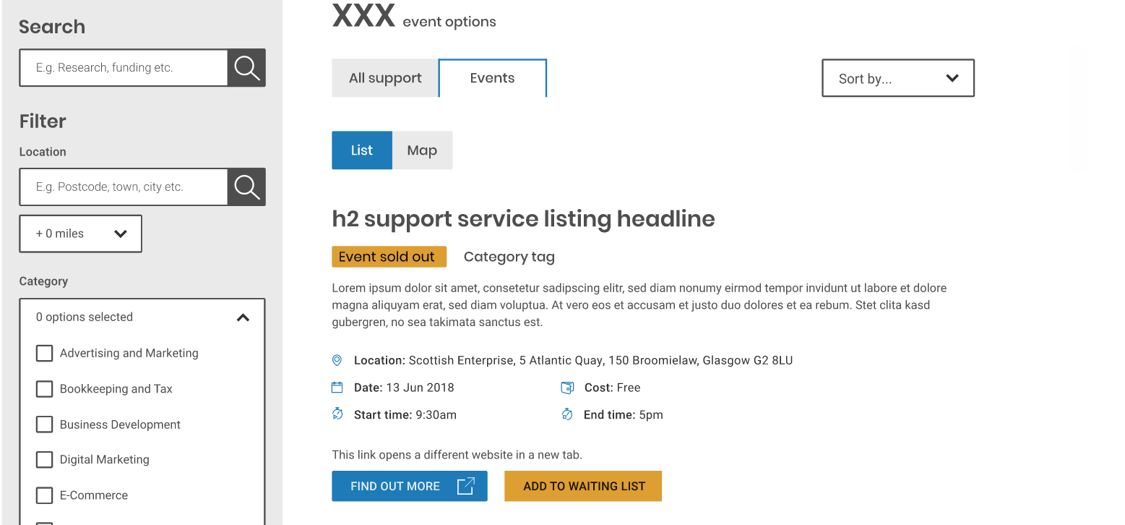
SEP waiting list design
Preferred design option:
However, one user shared the following feedback which we could consider incorporating in this design:
I don’t know what ’category tag’ means
Nothing to say there is a waiting list
Event sold out doesn’t imply there is a waiting list

Slide 10
SEP waiting list design
Following recommendation were provided when reviewing the design options:
Option to remove sold out events using filter
Recommendation on similar events
Contact the organizer

Slide 11
Thank you!

