Slide 1
SEP
User Research
(News and updates section)
Jan 2020
Anubhav Mittal

Slide 2
Who we tested with
10 Online un-moderated test sessions, with Userzoom panel, for usability testing
Male – 4 / Female - 6

Slide 3
What we were trying to find out
We explored the following things:
Users likes and dislikes about the homepage of findbusinesssupport.gov.scot website
If they felt there was anything missing
Their views about the “News and updates” section and if they would like to have such section on this website
Get feedback on an example of the news section and understand if anything is missing

Slide 4
SEP - News and updates discovery
When we asked the users their top 3 likes and dislikes about the homepage they mentioned the following things:
Likes Dislikes
1 | 2 | 3
The graphic is just right | easy to read font | Basic icons well laid out
Uncluttered | Easy to click on the link to find support | Easy to see where to contact them for help
casual but formal | simple and informative | easy to move around and look at various things
modern | simple | professional
Simple | Clear Messaging | Good use of colors
The girl shown gives it a human context | the task bar giving you options and the telephone number | the browse through I didn’t go into it
Simple layout | Information | Colors
eye catching | well laid out - not cluttered | approachable - friendly and informative
The image is clear and gives a good impression of the intended audience | It’s helpful to have the contact number in the top right hand corner where it is clearly visible | The button to browse support is very obvious in the middle of the page
The color palette was light and welcoming | Business-like theme | Minimalist - not cluttered with necessary info
1 | 2 | 3
Not much to the site | Not sure how much phone would cost | Not much info on who the site is run by
picture clarity | picture look a little out of place with rest of the content | more content
the photo shown is not very representative | n/a | n/a
Image was obscured | Maybe overly simple...nothing below main image | No real "logo"
a large cookie bar that came up | it didn’t indicate cost or if free | nothing else
maybe could do with a little more info | news and updates should be available | unsure
It doesn’t really tell me anything about what the website is intended for | The homepage seems a bit like a place holder and doesn’t have any real functionality or information beyond a way to access the support page | It’s a bit formulaic
The banner image was distracting underneath the transparent box | The text within the main box was harsh | Grey box at the base of the page was much too large

Slide 5
SEP - News and updates discovery
When we asked the following question all users said Yes.
Is it helpful to have an "News and updates" section?(a "news and updates" section will provide service updates and ’what’s new’ e.g. new partners on-boarded, new products/events etc.)
Yes, particularly in terms of listing new products or events. A diary or calendar type display of upcoming events on the homepage would be really useful too
It is helpful, as it improves the website contents to more current and relevant information
I think you learn more about the business providing the support and learn more about the businesses being supported
Yes, some media and news option would be great as it would show users events going around
It will include opportunities for investment or grants or new regs that businesses should be aware of
This would add to the depth of the page and allow browsing of the latest from the website
Gives more insight into what this is for.
This keeps things up to date and relevant - would be a good way to let visitors know that this is an active service and not a redundant one

Slide 6
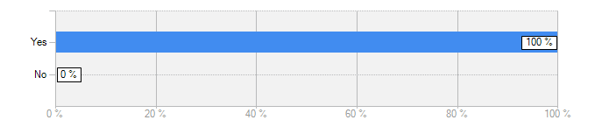
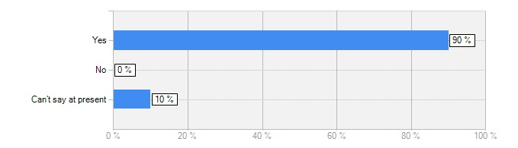
SEP - News and updates discovery
Is it helpful to have an "News and updates" section?(a "news and updates" section will provide service updates and ’what’s new’ e.g. new partners on-boarded, new products/events etc.)
Answer | Count | Percent
Yes | 10 | 100%
No | 0 | 0%
answered question | 10
Would you like to have a “News and updates" section on this website?
Answer | Count | Percent
Yes | 9 | 90%
No | 0 | 0%
Can’t say at present | 1 | 10%
answered question | 10

Slide 7
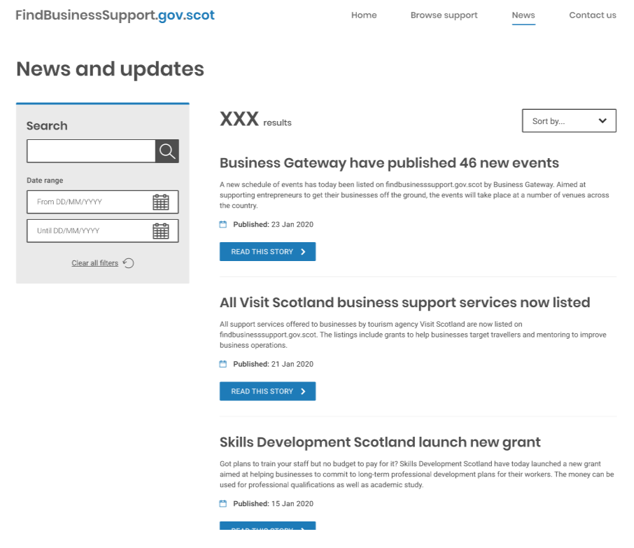
SEP - News and updates example
The following example was shown to the users for their initial thoughts: https://xd.adobe.com/view/1787b5f4-5ba6-412e-47fd-ce83949f777c-61b6/
?fullscreen&hints=off
Really plain looking but informative
Loved it, it makes the website more credible
I like and it looks exactly what I was expecting
Clean design though lacking on imagery and date of the news
The page is simple and quite welcoming
The search function and dates are helpful, and ‘read this story’ separates the sections well and easy to see where to click
I think the sections are good and search bars. it gives lots of information on business help available
Straight to the point includes useful news informative
Clean design Easy to read Clear calls to action
The filter function. The layout. The information on offer is good
It looked a bit boring and plain
Very bland with small font.
Very plain page - not inspiring any engagement. Needs to be more about the content than the search function
The principle is sound but the headlines listed are all too generic and require me to read the entire story of each one to have any sense of whether it is relevant to my business.

Slide 8
SEP - News and updates example
When we about if there was anything missing from this example, they said:
Graphics, search by location option
A filter tab would be good for category of the news or location in Scotland
Add categories filter in the filter tab for people with a specific interest
Some images to brighten it up a bit and make the reader want to click on stories
Date of the event/news
’Featured’ articles with images and comments - make it an engaging experience
The snippets displayed don’t provide any sense of whether any of these stories are actually relevant to me or my business.

Slide 9
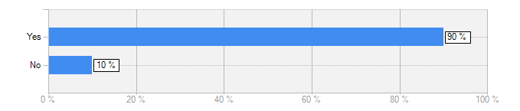
SEP - News and updates example
If this “news and updates” section was there on the website would you use it?
Answer | Count | Percent
Yes | 9 | 90%
No | 1 | 10%
answered question | 10
It would give me relevant and current information. It would keep me updated on what is going on
It is always essential for people to know what’s going on currently and what activities are undertaken by the website /business etc
I personally find it important to keep up to date with news and updates
I do think it’s informative and gives you a range of options for searching, specific dates, sorting results etc to find what’s most relevant
The stories shown are too generic and I don’t really have time to read through all of them in hopes of finding something which might be valuable for my particular business. I’d be more inclined to skim read through an email newsletter of these stories, but if they were presented with similar headlines I probably would be put off doing that as well.

Slide 10
Summary – SEP - News and updates
All users found the “news and updates” section helpful
9 of them would like to see this section on the website
The following feedback was shared:
This would add to the depth of the page and allow browsing of the latest from the website
Gives more insight into what this is for.
This keeps things up to date and relevant - would be a good way to let visitors know that this is an active service and not a redundant one
Yes, particularly in terms of listing new products or events.

Slide 11
Summary – SEP - News and updates example
The users were shown an example design of the “news and updates” section and the users liked it for it’s simplicity and clean design.
They felt that it will make the website more credible.
Users liked the search and date function and that this section was easy to read.
Lake of imagery, no graphics, bit bland, missing date of news, small font size were some negative comments.
It looked a bit boring and plain
Very bland with small font
Very plain page - not inspiring any engagement. Needs to be more about the content than the search function
The principle is sound but the headlines listed are all too generic and require me to read the entire story of each one to have any sense of whether it is relevant to my business

Slide 12
Summary – SEP - News and updates example
When asked if anything was missing from this section the following were suggested:
Graphics, search by location option
A filter tab would be good for category of the news or location in Scotland
Add categories filter in the filter tab for people with a specific interest
Some images to brighten it up a bit and make the reader want to click on stories
Date of the event/news
’Featured’ articles with images and comments - make it an engaging experience
The snippets displayed don’t provide any sense of whether any of these stories are actually relevant to me or my business.

Slide 13
Thank you!

