Slide 1
SEP
User Research
(Covid-19 info on live website)
March 2020
Anubhav Mittal

Slide 2
Who we tested with
11 Online un-moderated test sessions, with Userzoom panel, for usability testing
Male – 7 / Female – 4
UK wide

Slide 3
What we were trying to find out
We explored the following things:
Users likes and dislikes about the homepage of findbusinesssupport.gov.scot website
If they felt there was anything missing
Their views about the Covid-19 information on FBS website and their likes and dislikes
If the users were able to complete the set task and how efficient the website was to handle this task

Slide 4
FBS homepage – likes and dislikes
When we asked the users about their likes and dislikes upon looking at the homepage following things were mentioned:
Top 3 likes Top 3 dislikes
1 | 2 | 3
Key points written in bold | Clean design | Comprehensive information
Simple menu | Clear email sign up
The clear and coherent layout. | No distracting colour of theme; only light grey background, therefore making the bold black pointers more appealing and clear. | Clear business info and points about which business can stay open during the virus; marked out in bold black wording.
Straight to the point | Buttons clearly marked | Clearly marked header
very easy to read | has a lot information | very useful site
I liked the top banner | I liked the image relating to Scottish businesses | I liked that the information was concise and well laid out
The page was clean and professional | The link to sign up for updates was very helpful and reassuring | The list of links felt immediate (no nonsense, information straight away)
Short and simple | professional | user-friendly
simple | easy to use | lots of information
free phone number | Email to keep up to date | nice layout
1 | 2 | 3
Not enough colour | Information not bullet pointed | Hyperlinks not in bold
color | layout and lack of design | too much information with small font and blue color
broken text/image | grey background distracts and mutes info | lack of clear categories
Too basic layout | Could contain photographs; be made more visually appealing. | Pointers about virus are not in depth enough.
Very dull colour scheme | Main points on first page do not stand out | Layout of points
very dull | no bright colouring | font could be bigger
The subsections could have been clearer i.e. for clicking on which grant applies to you near the top of the page | Making headings larger could help
The list of links at the top of the page was cluttered and difficult to read through | The top of the page was just text on a grey background which felt rushed
colour scheme | really dull layout | a little chat box can be put on the page for help

Slide 5
FBS homepage – anything missing?
Things users mentioned when asked if there was anything missing from the homepage:
Top 5 things that are missing
1) | 2) | 3) | 4) | 5)
Explainer pictures | Categorisation of advice | Bullet points | More space between points | Scot vs. UK wide advice segregation
subheadings/clearer categories | white clearer background | consistent organisation of info. | N/A | N/A
Possible future plans. | Latest news direct from PM. | Photos. | Logos. | Simple slogans and words of memorable advice that people can follow and recite to their children.
More banners to separate points | Change the colour scheme | Less thin font as makes the text nearly blend in with background | Help box I couldn’t find | Live chat option
Just clearer headings and subsections as listed above | A clear structure to the top of the page | a page link to the nhs website for covid-19 information | phone line

Slide 6
FBS Covid-19 advice banner on homepage
Things users mentioned when asked about their views about the covid-19 banner on the homepage:
1. | 2. | 3.
Comprehensive | Helpful | A bit difficult to scan quickly.
Noticeable | Possibly could be larger
A little too basic. | Does not give me much information to recollect and comprehend. | Simple and straight to the point message of staying safe and clean.
Fantastic, as that is the focus of issue | Does not stand out, text too thin and close to colour of background | Not underlayed with a darker banner and then the text is lighter
the advice very good | it’s clear
Clear | Concise | Well communicated
It told me where to look for further information and so was helpful
Informing and well integrated | Good information to know | Alerting
it is accurate | helpful | trying to spread awareness
nice and clear | easy to spot | nice font

Slide 7
FBS Covid-19 – likes and dislikes
When we asked the users about their likes and dislikes upon looking at Covid-19 information following things were mentioned:
Top 3 likes Top 3 dislikes
1) | 2) | 3)
Comprehensive | Compact | Clean
apply for loan | apply for grant | Straight forward
All info. is relevant and welcome | Links to additional info. through separate tab | Concise and simple information
The article layout; simple and distinctive. | No dense text; just simple summary/outlining what each article is about. | Bold blue lettering/tittles to each article, along with the options to select specific reports/articles relevant to my business on left hand side of page.
very clear | has alot information | very help full
The information was clearly laid out | I liked that it was listed by area | I liked that it clearly broke down different help you could receive
Easy to find the links to the most important information resources from other sites | A clear explanation of basic entitlements to some schemes | I found information about self-employment quite quickly
Clear and straightforward | Clarifies details about business closures | Good questions tackling the main issues
information | lots of links | updated email section you can sign up for
easy to use | user friendly | good information
1) | 2) | 3)
Not clear if link takes you to external website | Lack of colour makes text harder to scan quickly | No readily available search function
color of page | lack of information | small font
Not clearly grouped together | Lack of headings/clear categories | Text doesn’t massively stand out but not massive issue
Lack of organisation. | Lack of colour, therefore not visually appealing. | Some wording could be placed in bold; easier interaction and navigation.
I’d prefer for the links to the articles to be easier to read | I’d like to be able to search for specific questions/terms relevant to covid-19
website’s colour scheme is really dull | less information on self-employed | can be added a chat bubble for more information
needs live chat | bit more colour required | looks a bit depressing in this time of sadness

Slide 8
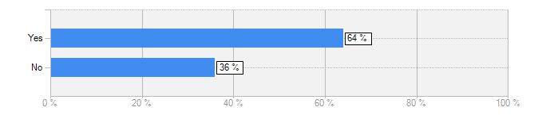
FBS Covid-19 information
Does this website cover everything that you were expecting to see about Covid-19 on this website?
Yes = 7 / No = 4
Fairly comprehensive set of information on homepage regarding my business.
Obviously as info. is changing rapidly, maybe some indication of the last time it was updated, or banner for the latest updates
As a business owner, it provides all the right information i require in a straight to the point fashion and navigates me to the right places to find that info which is great. As the Gov.uk site can be hard to navigate
I was expecting to see more detailed information regarding future plans, or enforcement to be taken action, so that business are more aware of the future plans and help they can receive. But instead all I found out about was Social Distancing rules and implications.
It doesn’t really covers the effects on self-employed people.

Slide 9
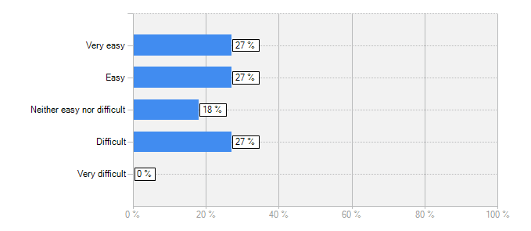
FBS Covid-19 information
How easy was it to read the content?
Answer | Count | Percent
Very easy | 3 | 27%
Easy | 3 | 27%
Neither easy nor difficult | 2 | 18%
Difficult | 3 | 27%
Very difficult | 0 | 0%
answered question | 11
skipped question | 0
More color and variation in text weight would make scanning easier
Grey background mutes the text and it’s not organized or categorized in the clearest way
The bold blue tittles of each article made the website easier to comprehend and summarize overall. However I dislike the lack of color within and throughout the whole page/s, as they are very bland and dis-interesting, therefore making me unlikely to read through all pieces of information.

Slide 10
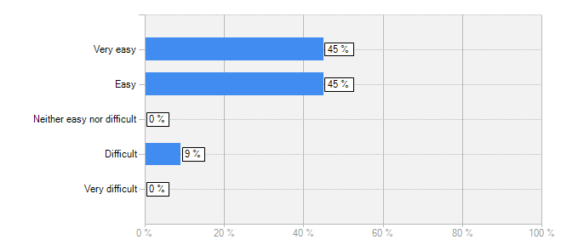
FBS Covid-19 information
How easy was it to understand the content?
Answer | Count | Percent
Very easy | 5 | 45%
Easy | 5 | 45%
Neither easy nor difficult | 0 | 0%
Difficult | 1 | 9%
Very difficult | 0 | 0%
answered question | 11
skipped question | 0
The content uses formal language, and simple sentences to get the main message across; especially about ’Social Distancing within businesses’ as well as being outside in the community.
Easy to read but there was too much information
The content was expressed very clearly and concisely.

Slide 11
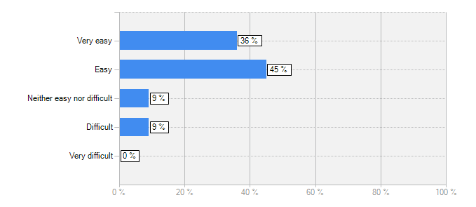
FBS Covid-19 information
How easy was it to navigate the content on this website? (e.g. were you able to go back to the homepage while browsing different sections)
Answer | Count | Percent
Very easy | 4 | 36%
Easy | 5 | 45%
Neither easy nor difficult | 1 | 9%
Difficult | 1 | 9%
Very difficult | 0 | 0%
answered question | 11
skipped question | 0
The overall navigation of the website was a little inconsistent and not coherent enough for me. This is because I was unable to go back to a specific article, as the sections/tabs on the top were too large and broad ranged.
Easy to move around and select drop boxes and navigate
The top bar makes it very easy to navigate, though it would be good to have different subsections on the first page for different advice.

Slide 12
FBS Covid-19 information
How do you feel about being taken to external websites upon clicking on a piece of information? Was it confusing or not and if you are okay with this?
Majority users were okay with them being taken to external websites. See below comments.
1. | 2. | 3.
It was a little confusing but would be fine if you segregated external links.
Not confusing | Fine as it was through external tabs and one can refer back still
It was okay, makes in easier to navigate Gov.uk as that website is difficult to navigate | . | .
I would not like to be taken to another website, as I lose trust in the overall content. | A second reason is because I feel that the info on the external website is more likely to be irrelevant. | A last reason is because in my opinion I find it more time consuming, and inconvenient to be navigated onto another page.
I would be okay with this as long as it’s also a government website
It’s absolutely fine, and was clear from the symbol next to each link what would happen when clicked | It makes sense because then the most useful resources are all in one place without needing to be kept constantly updated
I was okay with this | No single website has all the information in the world | It was also thoughtful
okay with it | they were useful websites | related to the topic covid-19
safe as this main site is a trusted site.

Slide 13
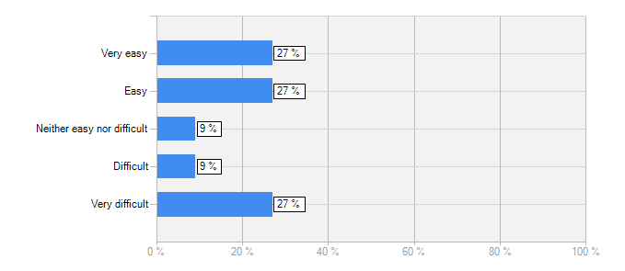
FBS Coid-19 Task
Users were asked to perform the following task on this website: As an employer you are trying to find about “sick pay” how would you go about finding this information?
Were you able to find information about "sick pay"? (Yes = 7, No = 4)
How easy was it to find "sick pay" information on this website?
Answer | Count | Percent
Very easy | 3 | 27%
Easy | 3 | 27%
Neither easy nor difficult | 1 | 9%
Difficult | 1 | 9%
Very difficult | 3 | 27%
answered question | 11
skipped question | 0

Slide 14
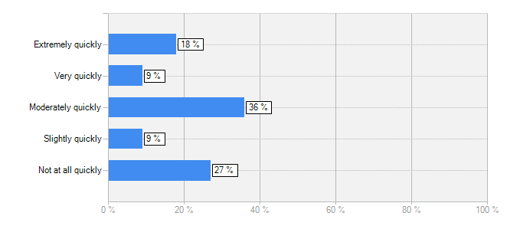
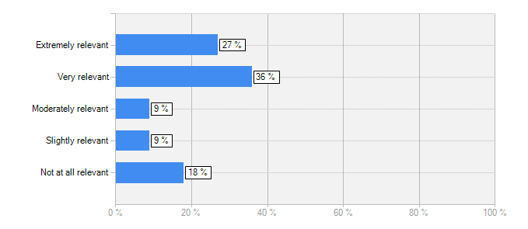
FBS Coid-19 Task
Users were asked to perform the following task on this website: As an employer you are trying to find about “sick pay” how would you go about finding this information?
How quickly were you able to find the "sick pay" information?
How relevant was the "sick pay" information on this website?
Answer | Count | Percent
Extremely quickly | 2 | 18%
Very quickly | 1 | 9%
Moderately quickly | 4 | 36%
Slightly quickly | 1 | 9%
Not at all quickly | 3 | 27%
answered question | 11
skipped question | 0
Answer | Count | Percent
Extremely relevant | 3 | 27%
Very relevant | 4 | 36%
Moderately relevant | 1 | 9%
Slightly relevant | 1 | 9%
Not at all relevant | 2 | 18%
answered question | 11
skipped question | 0

Slide 15
FBS Coid-19 Task
If you were unable to find "sick pay" information, please suggest ways for us to improve the website:
5 of the 11 users went down to the route of clicking on “browse support” and using the keyword search facility then searched for “sick pay” to receive 36 results. They then clicked on few results before looking at “Pay - your obligations as an employer”. 2 of them also used category filter = coronavirus and were disappointed to see only 2 results.
1. | 2. | 3.
Rename ’Browse Support’ search | Make the coronavirus filter pick up more than one result | Make searching for ’sick pay’ using the ’Coronavirus’ filter pick up the relevant results.
Put everything people might need as a category so they can filter their search | Make a good visually appealing design or color for the page | Put more info with bigger font
More indication of content of links | Bulletpoints for each link perhaps
Include a key word search at the top of every page. | Make certain words/mark them out in bold wording. | Highlight specific words in yellow or a bright colour; visually appealing, and eye catching to the reader.
it should be at top of page | key fact

Slide 16
Thank you!

