Slide 1
Why it always rains when I go out?
Team 15
0816057, 0816069, 0816010, 0816028

Slide 2
Outline
Motivation
Development Process
Data Source
Tables
Applications
SQL example
What we learned
Q&A

Slide 3

Motivation
It’s hard to predict the weather if we make our vacation plan several months in advance
Build a website to provide some suggestions
Notes:
It’s hard to predict the weather if we make our vacation plan several months in advance
Ex1.小明計畫春節時出遊，請問1月時去哪裡比較不會下雨？
Ex2.小王有氣喘過敏的症狀，請問暑假出遊去哪個地區為佳？
We build this website to provide some suggestions, including detailed information on more than 5000 tourist attractions, user ratings, weather information and air quality information

Slide 4
Development Process
Install XAMPP
Run Apache web server and MySQL server
Download the government's open data
Create a database through phpMyAdmin
Write SQL
Construct front-end and back-end

Slide 5
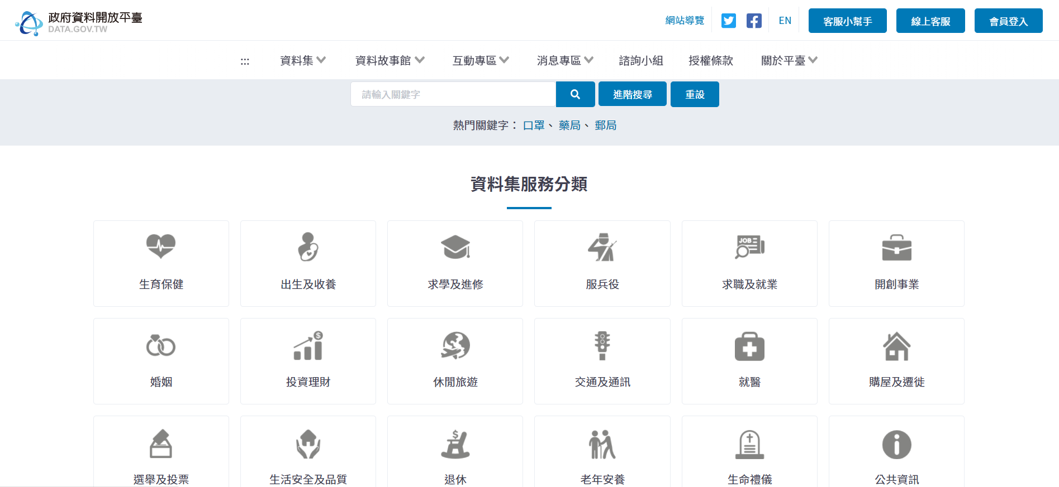
Data Source
https://data.gov.tw/

Slide 6
Tables
one_year
dy_Report
attraction
station
board

Slide 7
one_year
one-year daily observation data of each meteorological station
number of rows: about 270000
data source: https://data.gov.tw/dataset/33029

Slide 8
columns:
station_name
sunshine
station_id
precipitation
date
wind_dir
one_year
pressure
wind_speed
temp
humidity

Slide 9
dy_Report
9-year daily precipitation(降水) data of each meteorological station
number of rows: about 100000
data source: https://data.gov.tw/dataset/9044

Slide 10
columns:
station_id
date
dy_Report
station_name
precipitation

Slide 11
attraction
information of tourist attractions
number of rows: about 5000
data source: https://data.gov.tw/dataset/7777

Slide 12
columns:
id
map
gov
px
py
parking
info
parking
info_Px
parking
info_Py
town
name
travelling
info
zone
open
time
tol
describe
picture
attraction
description
picdescribe
tel
website
add
ticket
info
zipcode
remarks
region
orgclass
class1
class2
class3
level
change
time
keyword

Slide 13
station
the list of meteorological station
number of rows: about 35
data source: https://e-service.cwb.gov.tw/wdps/obs/state.htm

Slide 14
columns:
station_name
station_id
station
px
py

Slide 15
board
Add or delete comments
Rating attractions
Get weather information
Notes:
用來記錄留言的table
可以新增或刪除留言
用留言中的景點和attraction比對(留言的景點必須是資料庫中包含的)
有評分欄位
user對景點的平均評分會在搜尋景點時和天氣資訊一起顯示出來
另外可以儲存空氣品質好壞、天氣好壞可以提供參考

Slide 16
columns:
id
palce
user_id
rating
post_at
comment
board
date
air
city
weather

Slide 17
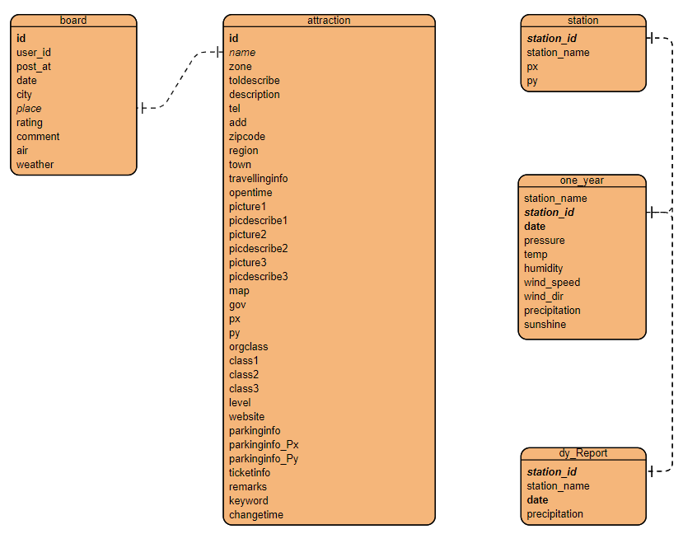
ER diagram

Slide 18
Applications

Slide 19
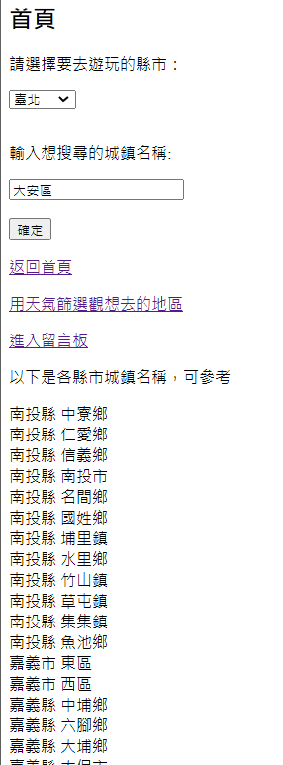
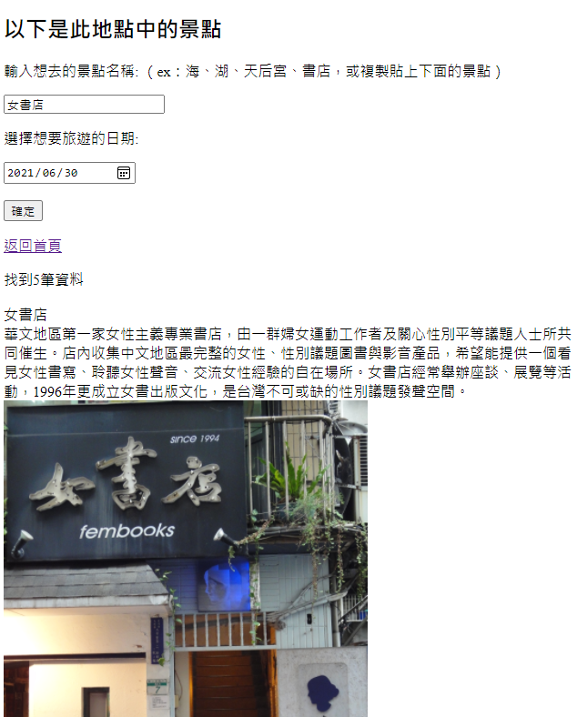
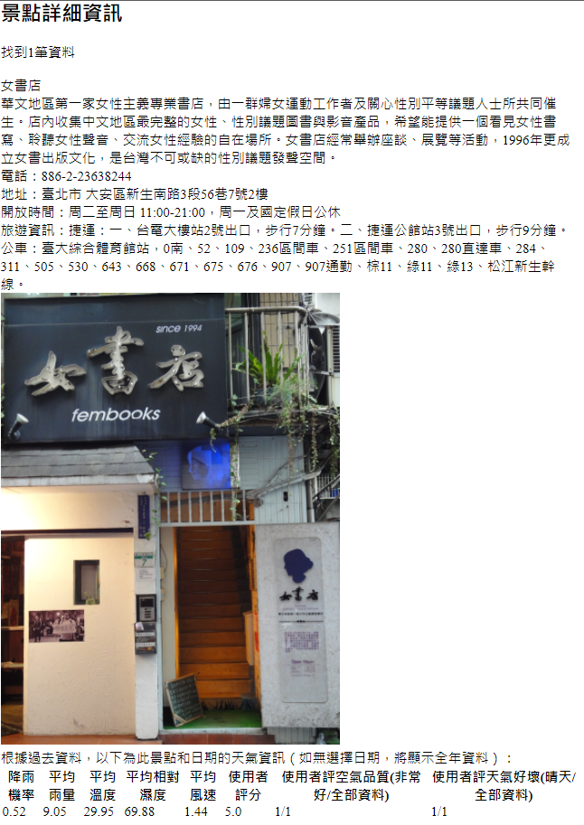

Slide 20
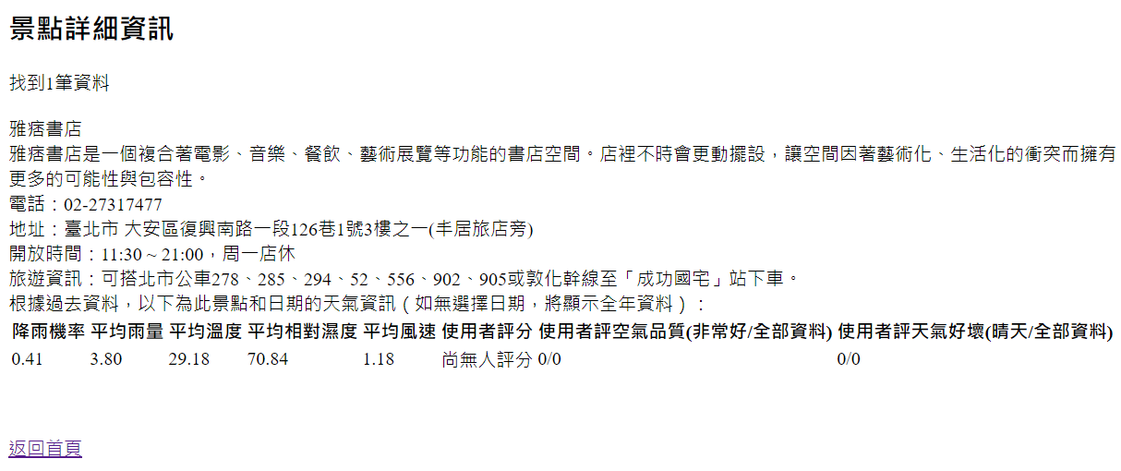

Slide 21
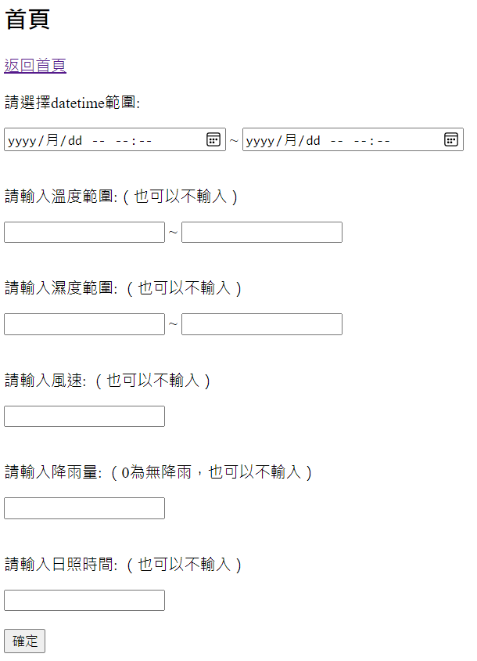
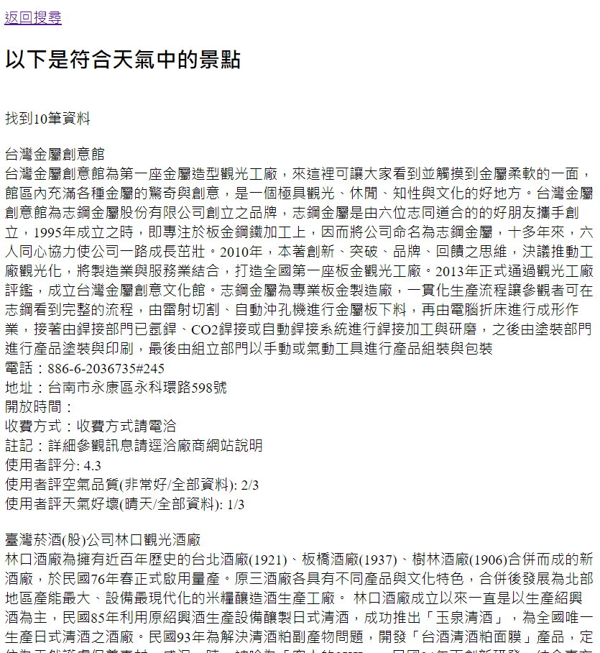

Slide 22
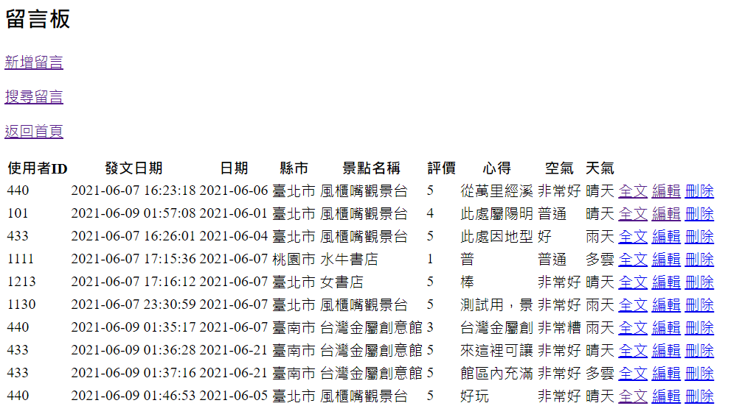

Slide 23
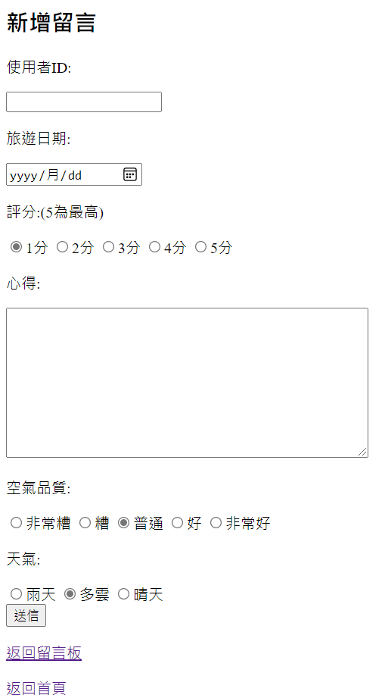
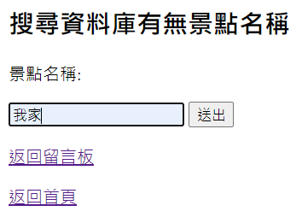
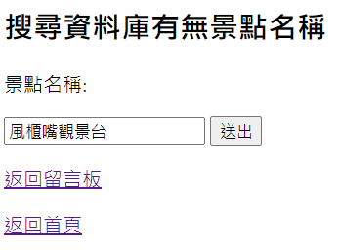


Slide 24

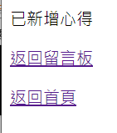

Slide 25
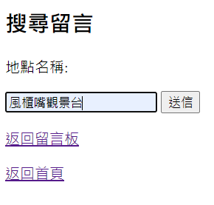
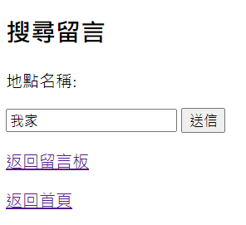
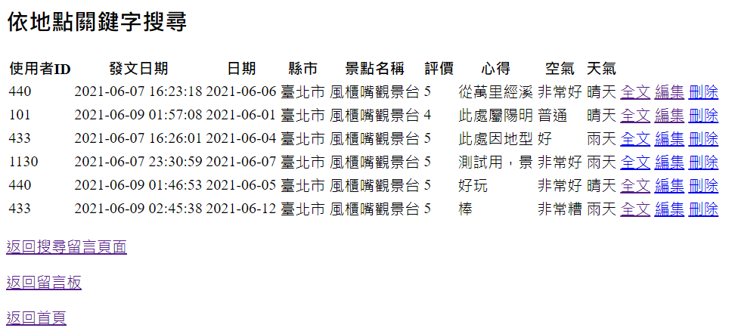


Slide 26
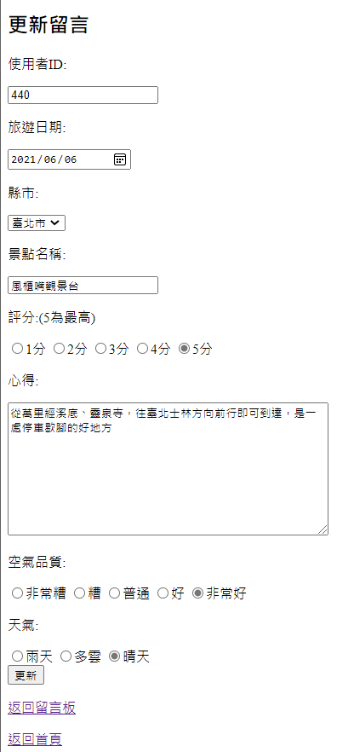
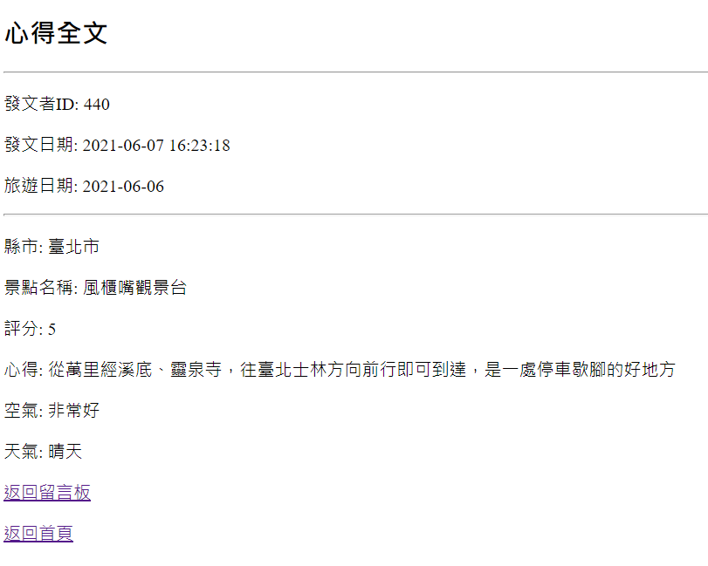

Slide 27
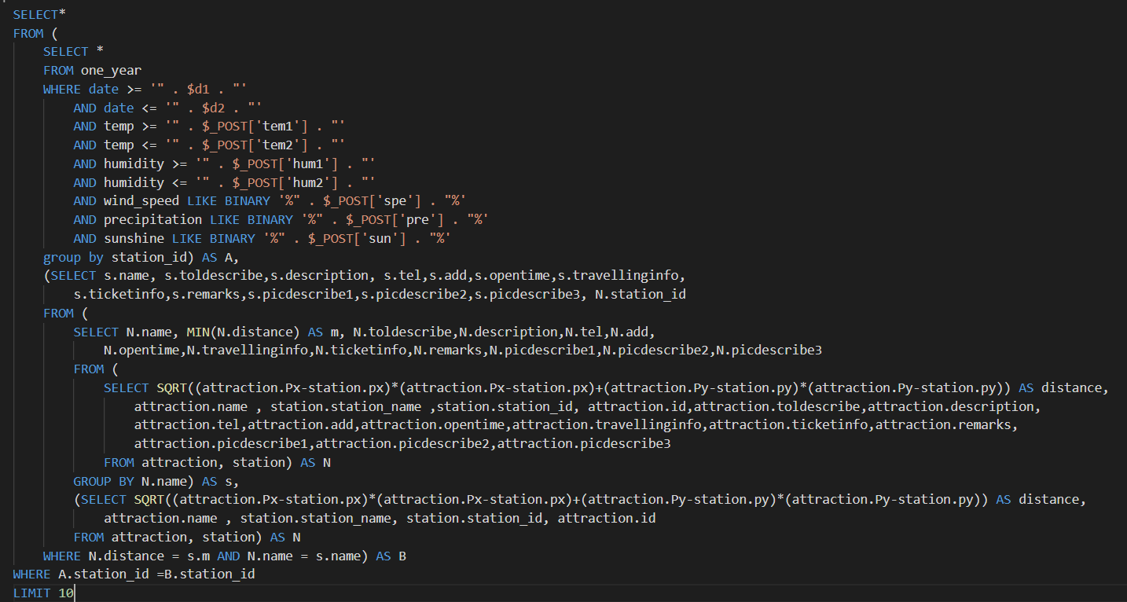
SQL example

Slide 28
What we learned
Know what is front-end and back-end of a website
Learn the basic grammar of PHP and HTML
Learn how to use MySQL in PHP
Combine database and website
Teamwork

Slide 29
Thank you for listening

