Slide 1
Introduction to data Base

Slide 2
MySQL
MySQL is a relational database management system (RDBMS) developed by Oracle that is based on structured query language (SQL).
MySQL is one of the most recognizable technologies in the modern big data ecosystem. Often called the most popular database and currently enjoying widespread, effective use regardless of industry, it’s clear that anyone involved with enterprise data or general IT should at least aim for a basic familiarity of MySQL.

Slide 3
PostgreSQL
PostgreSQL is a powerful, open source object-relational database system that uses and extends the SQL language combined with many features that safely store and scale the most complicated data workloads. The origins of PostgreSQL date back to 1986 as part of the POSTGRES project at the University of California at Berkeley and has more than 30 years of active development on the core platform.

Slide 4
SQL SERVER
SQL Server is Microsoft's relational database management system (RDBMS). It is a full-featured database primarily designed to compete against competitors Oracle Database (DB) and MySQL.
Like all major RBDMS, SQL Server supports ANSI SQL, the standard SQL language. However, SQL Server also contains T-SQL, its own SQL implemention. SQL Server Management Studio (SSMS) (previously known as Enterprise Manager) is SQL Server's main interface tool, and it supports 32-bit and 64-bit environments.
SQL Server is sometimes referred to as MSSQL and Microsoft SQL Server.

Slide 5
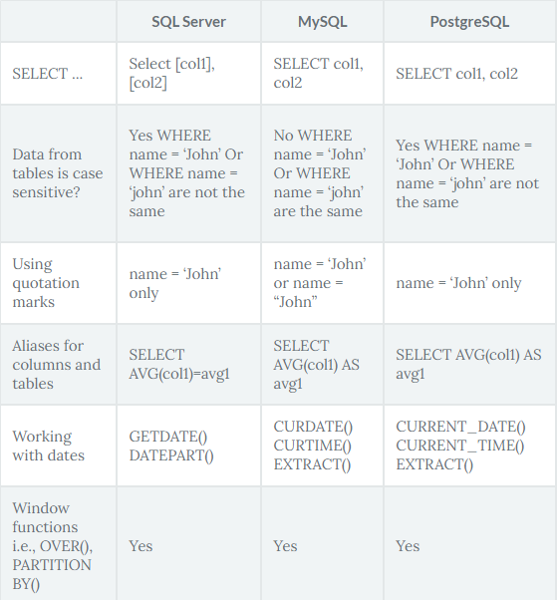
comparison

