Slide 1
Drop Anchor: Anchoring a genome assembly using Chromonomer
Presented by: Will Gammerdinger
UMD Bring Your Own Bioinformatics
April 12th 2016

Slide 2

Written and distributed by Julian Catchen and Angel Amores
Released in the beginning for 2016
Purpose: Using a genetic map, it will quickly anchor a genome assembly and create a new anchored genome assembly
Designed to be implemented from Stacks output, but with work any genetic map will suffice
Web interface for visualization that will not be discussed here
Available for download at:
http://catchenlab.life.illinois.edu/chromonomer/

Slide 3
Under the hood
Observes the markers furthest apart markers on the scaffold
Determines the directionality and prunes the fewest number of markers
Assesses alignment of all mapped markers to look for scaffolds spanning multiple linkage groups and splits them
Needs gaps to split on

Slide 4
Pro Tips
Marker names need to be numeric
Marker names in the genetic map must match the marker name in the FASTA file
Genome FASTA file cannot be line-wrapped
FASTA headers should just be “>scaffold_name”

Slide 5
Requirements
FASTA file of the markers
Genetic map
AGP file of the genome
FASTA file of the genome

Slide 6
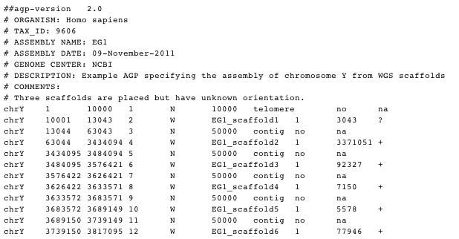
AGP File format
Notes:
Object-> Object Beginning-> Object End->Part number -> Component type (N-> gap, W-> WGS Contig) -> gap length or component id -> type of gap / where on the component sequence does this start ->

Slide 7
Prep Work
Align the markers to the genome
BWA
BLAST
Alignments can be SAM/BAM
May need to produce an AGP file if you genome assembler did not produce one
Not terribly hard to make if you need to script it up yourself

Slide 8
Running Chromonomer
chromonomer -p genetic_map.txt -s markers.sam -a genome.agp -o chromonomer_output_directory/ --fasta genome.fasta
The --fasta option is optional, but if it is provided it will produce a copy of the anchored assembly fasta
Can iterate using multiple genetic maps

Slide 9
Demo TIme

Slide 12
Getting on my pedestal
Linkage map publications need:
A linkage map file
Markers file
Manuscripts without these things should be revised to include them

Slide 13
Questions?

