Slide 1
Abundance estimation and allele-specific expression using kallisto
Kevin Nyberg
Machado Lab
BYOB, 3-1-16

Slide 2

RNA-Seq analyses in highly inbred model organisms is straight-forward
D. pseudoobscura
RAW READS
TopHat2
MAPPED READS
HTSeq-count
READ COUNTS PER LOCUS
Richards et al. 2005

Slide 3
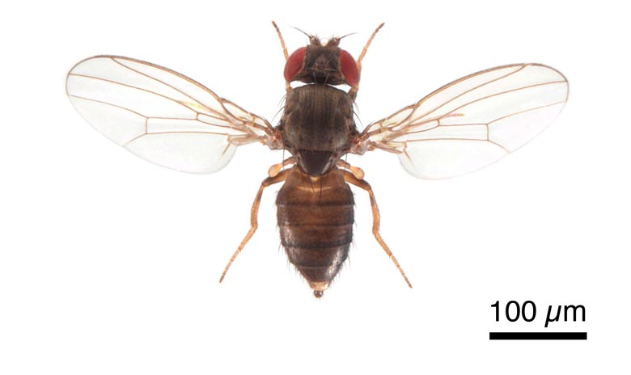
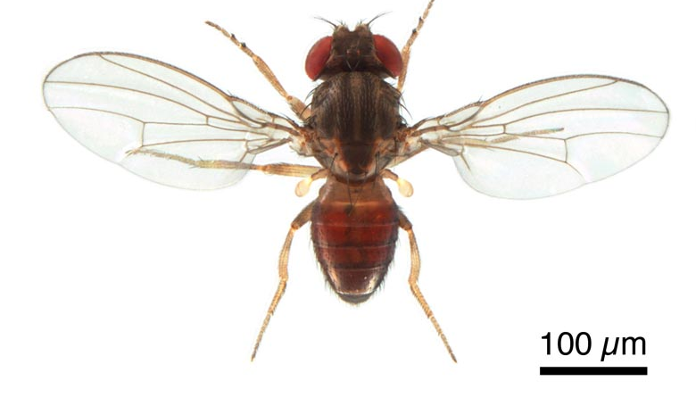
Hybrid analyses require measurement of allele-specific expression (ASE)
X
D. pseudoobscura Female
D. persimilis Male
F₁ Hybrids
Fertile Females
Sterile Males
FlyBase

Slide 4
Calculating ASE can be useful for understanding:
Allelic imbalance in wild (i.e. non-inbred) individuals
Cis/trans regulatory evolution in F₁ hybrids
Genetic imprinting
Nonsense-mediated decay induced by variants that produce premature STOP codons.

Slide 5
Mapping to a species-specific genome greatly reduces any genome-wide reference bias.
% fragments mapped
RNA-Seq:
Genome:
D. pse
D. pse
D. per
D. pse
D. per
D. per
D. pseudoobscura genome = FlyBase reference
D. persimilis genome = Illumina reads mapped to Dpse reference using bwa
Variants IDed using GATK HaploypeCaller
Genome reconstructed using AlleleSeq vcf2diploid
Notes:
)‏

Slide 6
Limitations of ASE using TopHat/HTSeq-count to map to haplotype-specific genomes
RAW READS
Mismatch allowance
Default (n=2 mismatches) or permissive settings won’t accurately partition reads to correct haplotype
Perfect matches don’t allow for errors in reads or genome assemblies
Reads mapping to nonvariant regions in transcripts
Won’t reflect ASE accurately. Ignore them?
TopHat2
MAPPED READS
HTSeq-count
READ COUNTS PER LOCUS

Slide 7
New superfast alignment-free abundance estimation tools (i.e. Sailfish, Salmon, kallisto) may be ideal for ASE
k-mers from reads are counted or pseudoaligned against k-mers from transcriptome (not genome)
k-mers that match to variant regions should be assigned to correct haplotype
k-mers that match to nonvariant regions should be proportionally distributed to correct haplotype using EM algorithm
Only provide abundance estimates, not “alignments” to genome (e.g. can’t view in genome browser for coverage)

Slide 8
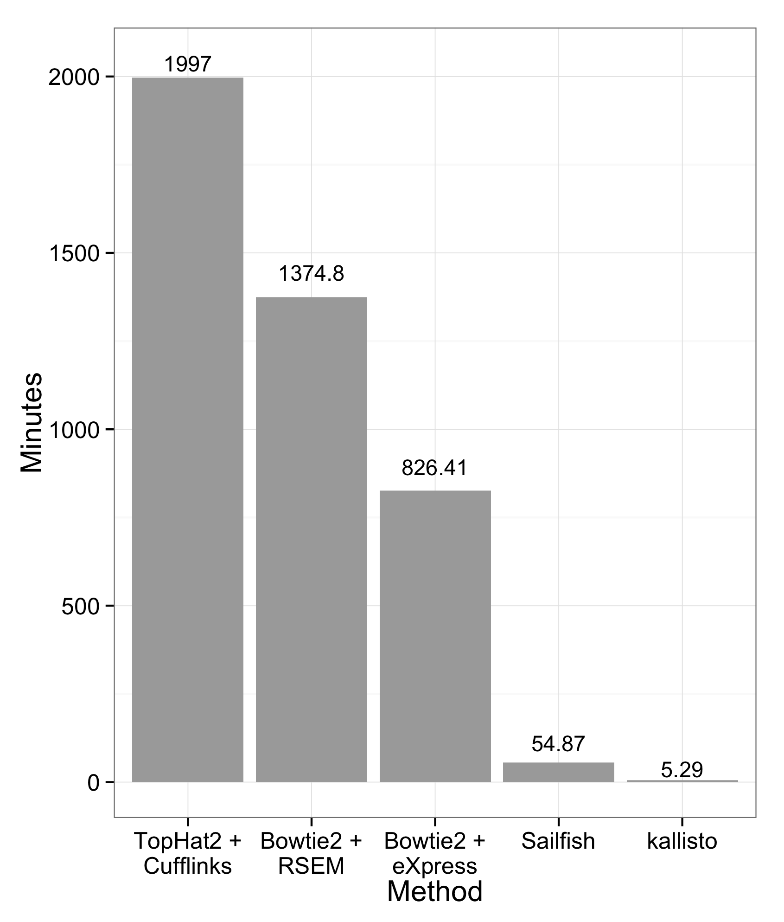
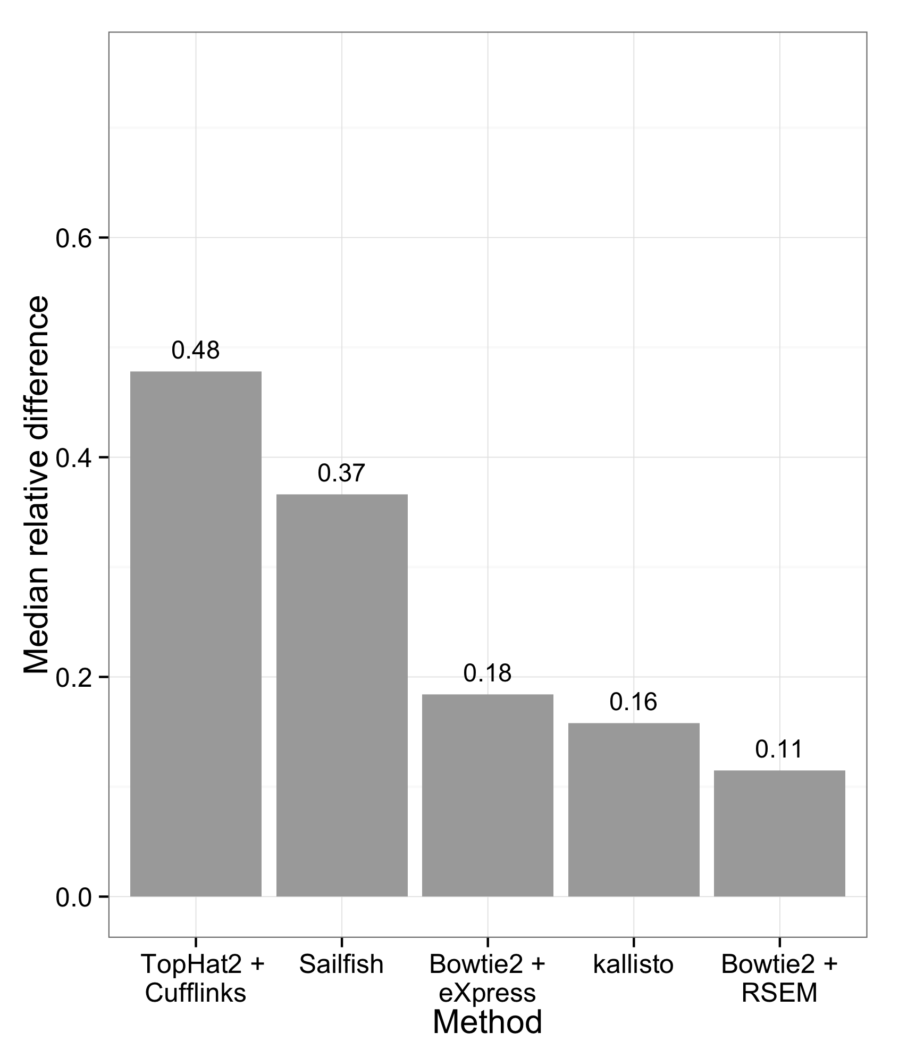
kallisto is both fast and accurate
Simulated reads from RSEM simulator: 20 samples of 30 million reads
https://pachterlab.github.io/kallisto/about.html

Slide 9
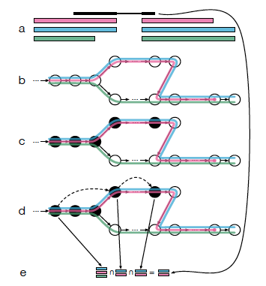
k-mer pseudoalignment using kallisto
Transcript models in txome
Index is created from txome De Bruijn graph
k-mers of a read are hashed to find compatibility
Redundant k-mers are skipped
Compatible transcripts are IDed
Bray et al 2015. http://arxiv.org/pdf/1505.02710v2.pdf

Slide 10
ASE using kallisto
To test kallisto’s suitability for allele specific expression (ASE) quantification, we also simulated reads from a transcriptome with two distinct haplotypes. The median percent error for kallisto was 12.2% vs. 11.3% for RSEM, 14.8% for eXpress and 14.6% for Sailfish, showing that kallisto is suitable for ASE (it is important to note again, that the simulation was based on RSEM, both for generating the parameters and then the data).
Bray et al. 2015. http://arxiv.org/pdf/1505.02710v2.pdf

Slide 11
ASE using kallisto
How does kallisto compare to abundance estimation using TopHat/HTSeq-count?
How accurate is kallisto for calculating ASE?
“Pseudohybrid” dataset = combined unstranded RNA-Seq (20 million mate pairs) from parental species
D. pseudoobscura ovary
D. persimilis ovary

Slide 12
kallisto abundance estimation - commands
Create kallisto indexes
kallisto index -i merged_X234_MV225r3.idx merged_X234_r3.fa
kallisto index -i merged_X234_Math40.idx merged_X234_Mather40.fa
Haplotype-specific transcriptomes
Estimate abundances
kallisto quant –I merged_X234_MV225r3.idx -o kallisto_output -b 100 -t 12 MV225_ovB_sampled.1.fastq MV225_ovB_sampled.2.fastq
kallisto quant –I merged_X234_Math40.idx -o kallisto_output -b 100 -t 12 Math40_ovA_sampled.1.fastq Math40_ovA_sampled.2.fastq
Output: abundance.tsv
target_id length eff_length est_counts tpm
TCONS_00000001 7556 7469.64 189.989 1.16328
TCONS_00000002 21688 21601.6 757.924 1.6047
TCONS_00000003 1323 1236.64 0 0
TCONS_00000004 240 153.702 0 0

Slide 13
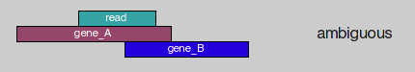
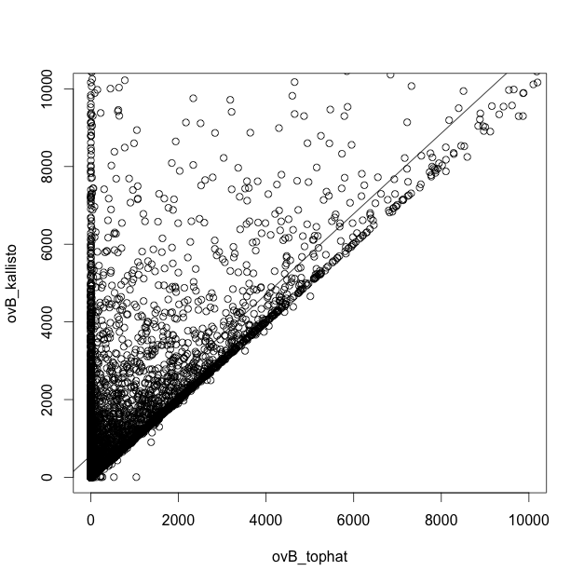
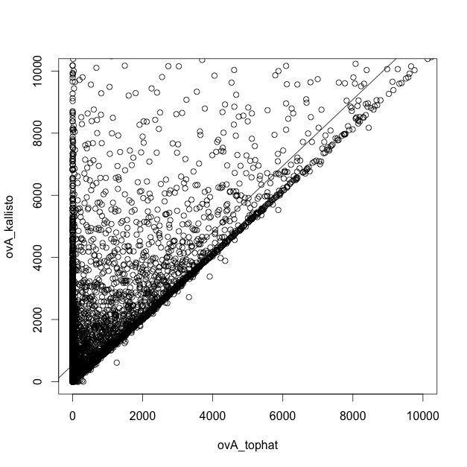
kallisto vs. TopHat/HTSeq-count
Mismatch = 2
Overlap mode = union
D. pseudoobscura ovary
D. persimilis ovary
Kallisto ESTIMATED COUNTS
y=1.037x+565.1
R²=0.5737
y=1.067x+543.7
R²=0.554
TopHat/HTSeq-count COUNTS
kallisto is able to obtain counts for many transcripts that TopHat/HTSeq-count ignores (likely because “ambiguous”)

Slide 14
kallisto ASE
kallisto index -i merged_X234_MV225_Math40.idx merged_X234_MV225_Math40.fa
Single transcriptome file with sequences from both haplotypes
kallisto quant -i merged_X234_MV225_Math40.idx -o kallisto_output_ov -b 100 -t 12 pseudohybrid_ov_1.fastq pseudohybrid_ov_2.fastq
Pseudohybrid RNA-Seq fastq

Slide 15
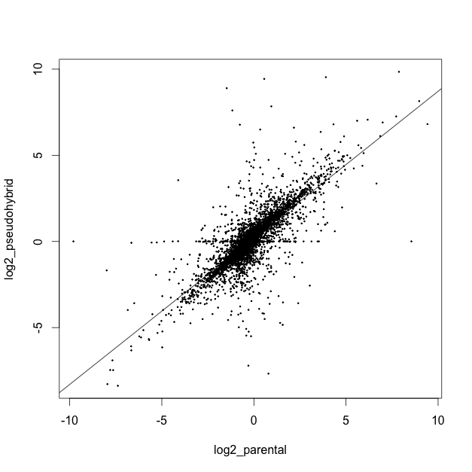
kallisto ASE – only loci with 0TPM in either haplotype removed
Log₂(TPM Dpse/TPM Dper)
Pseudohybrid
m=0.851
R²=0.6489
ASE in parents but not in pseudohybrids. Possible if no sequence variants?
log₂(TPM Dpse/TPM Dper)
Parental

Slide 16
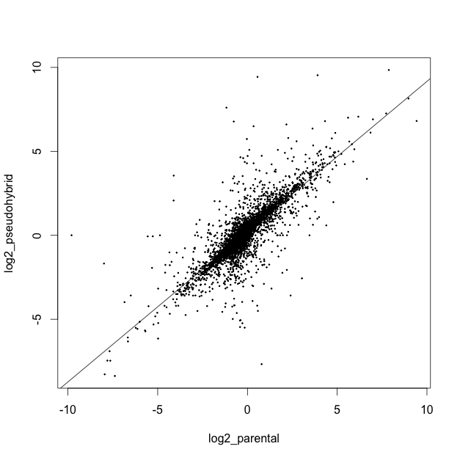
kallisto ASE – only loci with variants and ≥ 5 counts in a single haplotype
Log₂(TPM Dpse/TPM Dper)
Pseudohybrid
m=0.895
R²=0.6975
log₂(TPM Dpse/TPM Dper)
Parental

Slide 17
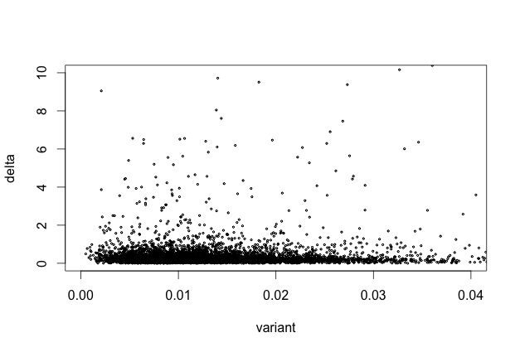
Is ASE accuracy correlated to variant density at a locus?
Abs[1-(pseudohybrid ratio/parental ratio)]
Variant density (variants/bp)

Slide 18
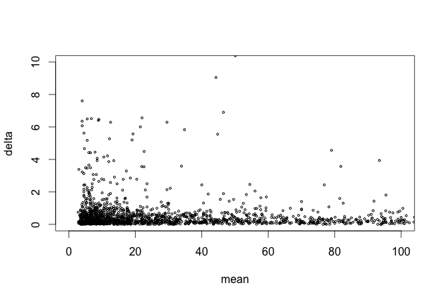
Is ASE accuracy correlated to read depth at a locus?
Abs[1-(pseudohybrid ratio/parental ratio)]
Mean counts

Slide 19
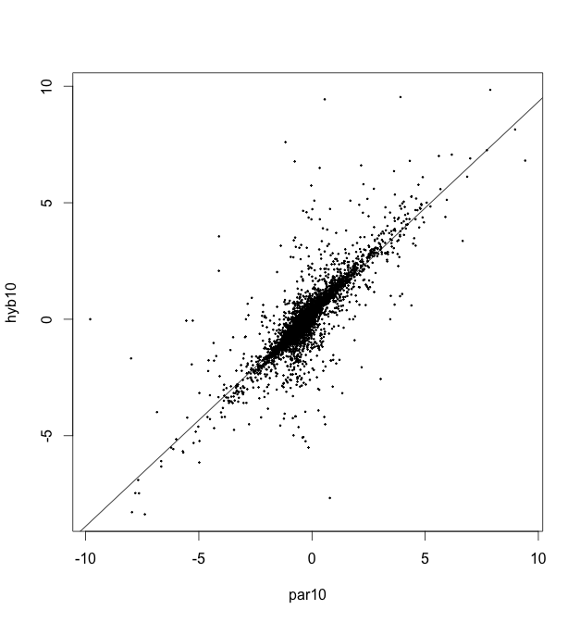
kallisto ASE – only loci with variants and ≥ 10 mean counts
Log₂(TPM Dpse/TPM Dper)
Pseudohybrid
m=0.911
R²=0.6992
log₂(TPM Dpse/TPM Dper)
Parental

Slide 20

kallisto ASE – only loci with variants and ≥ 60 mean counts (Optimal accuracy given data?)
Log₂(TPM Dpse/TPM Dper)
Pseudohybrid
m=0.946
R²=0.6946
log₂(TPM Dpse/TPM Dper)
Parental

