Slide 1

Summarize the requirements
[
0 1
]
[
0 2
]
Proposal description
Process description
[
0 3
]
[
0 4
]
Major modules and
Their functionality
Data Description

Slide 2
Summarize the requirements
[
0 1
]
Proposal description
CCC is a messenger app like any other messenger app especially developed for University Student’s but it has some added functionalities which can be very useful for managing day to day activities.
Talk with your with friend whenever and wherever you want.
Manage your personal schedule.
Share your schedule with your friends.

Slide 3
Summarize the requirements
[
0 2
]
Process description
Tool : Android
Platform Version
: Android 5.1(Lollipop)
Why using android
The available platforms are Android, IOS and Windows phone.
Android is a really friendly platform to launch our application because there is lot of android users and Android application are really easy to build on any kind of system, and android application are very accessible.

Slide 4
Summarize the requirements
[
0 3
]
Major modules and
Their functionality
Messenger
Timetable
Message send & receive
Timetable send & receive
File(video, photo) send & receive
Group talk
Timetable
Lookup class
Schedule
UI
Calendar
Save schedule
login page
registration page
main UI

Slide 5
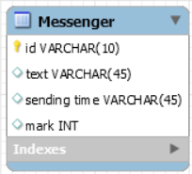
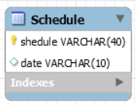
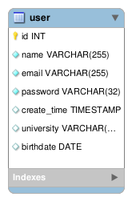
Summarize the requirements
[
0 4
]
Data Description

