Slide 1
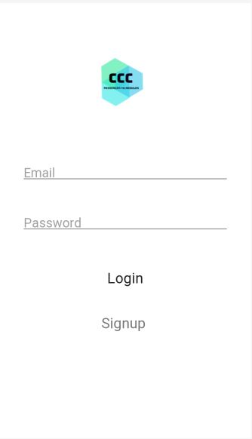
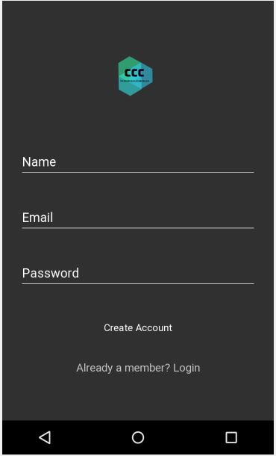
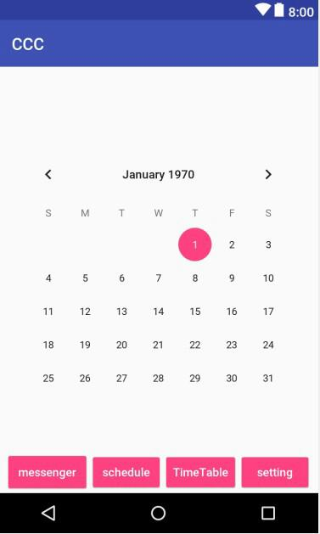
CCC
Design presentation

Slide 2
Design
Login
Registration
Schedule
Main UI
Setting
Time table
Messenger

Slide 3
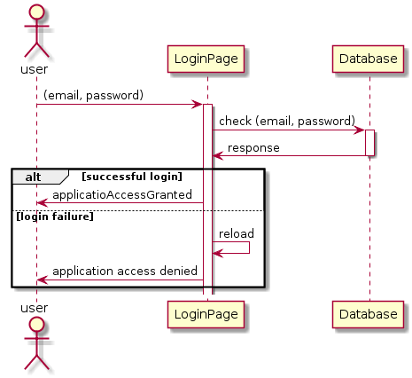
Sequence diagram - UI

Slide 4
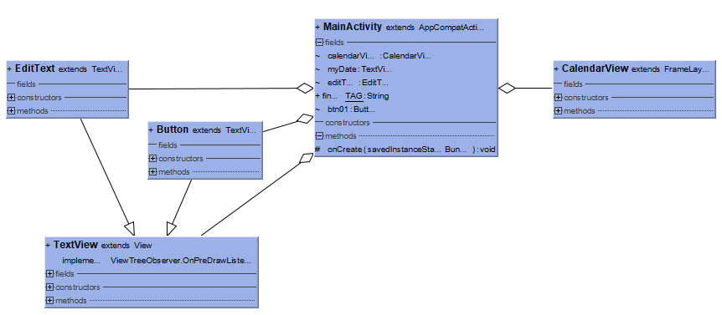
Class diagram - calendar

Slide 5

Sequence diagram - calendar
Android
Application
Database
Click save schedule button
Enter schedule
Save schedule
Click the date
Search for saved schedules
View schedule
Stored schedule output

Slide 6
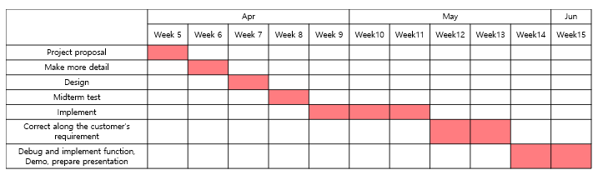
Planning
Whole time line

Slide 7
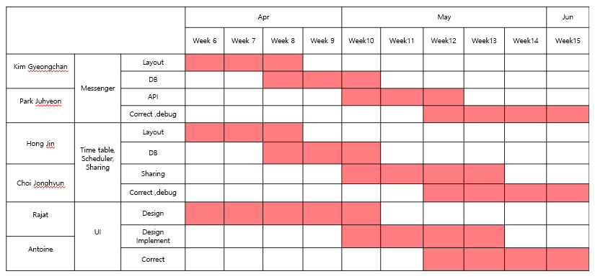
Planning
Part time line

