Slide 1

CCC
Design presentation
Antoine / Jin / Jonghyun
Juhyeon / Kyoungchan / Rajat

Slide 2
Contents
0 1
0 2
[
0 3
[
]
[
]
]
Summarize
the requirements
Planning for the
implementation
Architectural design

Slide 3
Summarize the requirements
[
0 1
]
Proposal description
CCC is a ‘Cau Campus Couple’ application for couples in University. The main functions are messenger, scheduler, and time table. Differ from other couple applications, it provides a special function which help couples to find their date time.
Talk with your lover whenever and wherever you want.
Manage your personal schedule and time table.
Our smart schedule function will help to find a empty time between your lover’s schedule.

Slide 4
Summarize the requirements
[
0 1
]
Proposal description
CCC is also useful to group activities. This app developed like any other applications especially developed for University Student’s but it has some added functionalities which can be very useful for managing day to day activities. Messenger supports group chatting and scheduler supports to choose a date when a time is available to meet group members.
Chatting with your group members and sharing your schedule.
Choose a date when is the best to meet group members.

Slide 5
Summarize the requirements
[
0 2
]
Process description
Tool : Android
Platform Version
: Android 5.1(Lollipop)
Why using android
The available platforms are Android, IOS and Windows phone.
Android is a really friendly platform to launch our application because there is lot of android users and Android application are really easy to build on any kind of system, and android application are very accessible.

Slide 6
Summarize the requirements
[
0 3
]
Major modules and
Their functionality
Messenger
Timetable
Message send & receive
Timetable send & receive
File(video, photo) send & receive
Group talk
Timetable
Lookup class
Schedule
UI
Calendar
Save schedule
login page
registration page
main UI

Slide 7
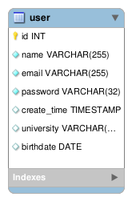
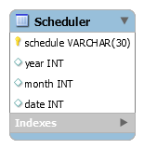
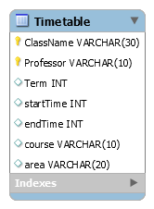
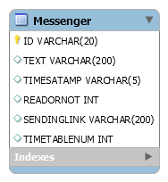
Summarize the requirements
[
0 4
]
Data Description

Slide 8
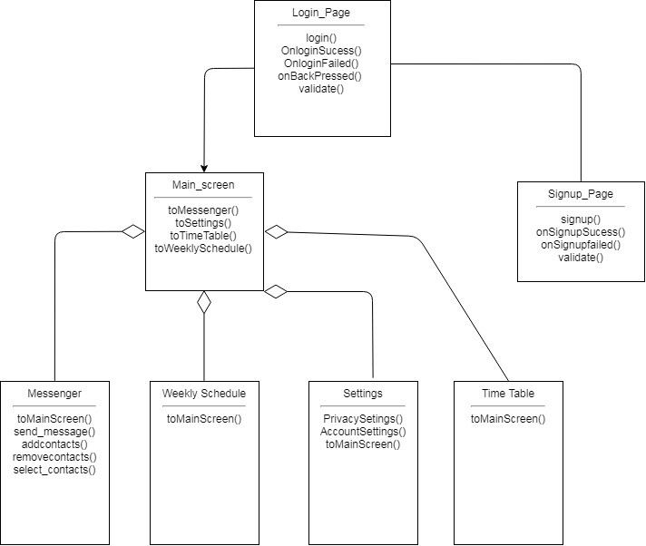
Architectural design
[
]
UI

Slide 9
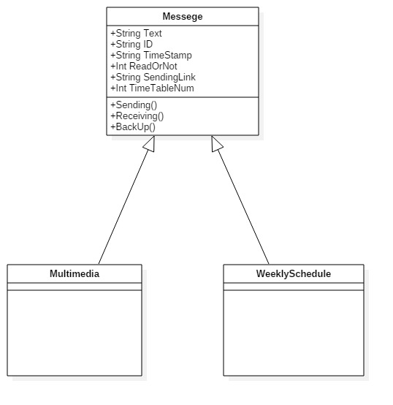
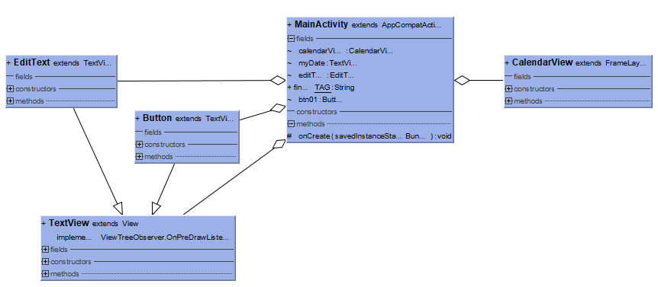
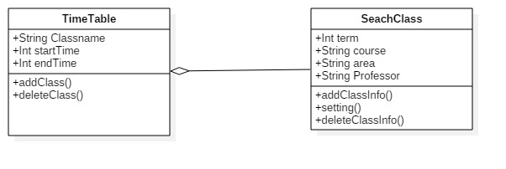
Architectural design
[
]
[
]
Messenger
Scheduler & Time Table

Slide 10
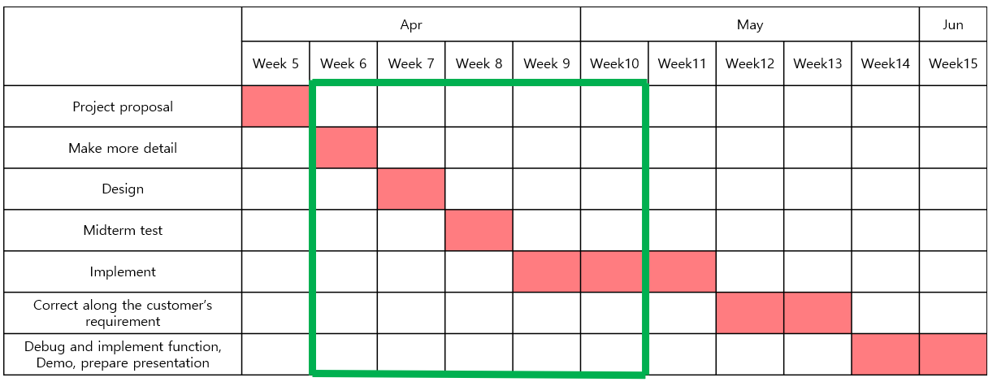
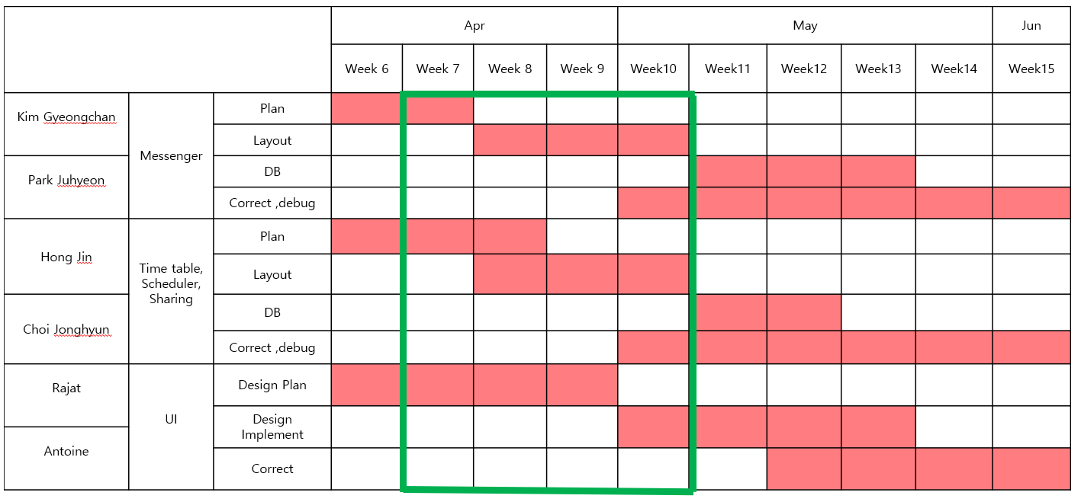
Planning for the implementation
[
]
[
]
Whole time line
Part time line

