Slide 1
MAAM For
E- Exam

Slide 2
Team Members (MAAM Team)
Mohamed Ahmed Salem (SE)
Abdallah reda Rashwan (SE)
Abdallah Magdy Elkhayat (SE)
Mohamed Ahmed Attya (IS)

Slide 3
Overview
Students register to take the exam with their information and picture. Professors are responsible to add the questions of the exam
Admin is responsible to verify students’ documents and starting the exam for students.
Before this system, everything is done manually. The professors prepare questions and print the exams. The correcting students’ answers process takes a long time. Making certificates are done manually for each student (adding student picture, score, and name), so this process also takes a long time then it must take. The students solve the exams in a big hall which eases cheating answers.

Slide 4
1- Student

Slide 5
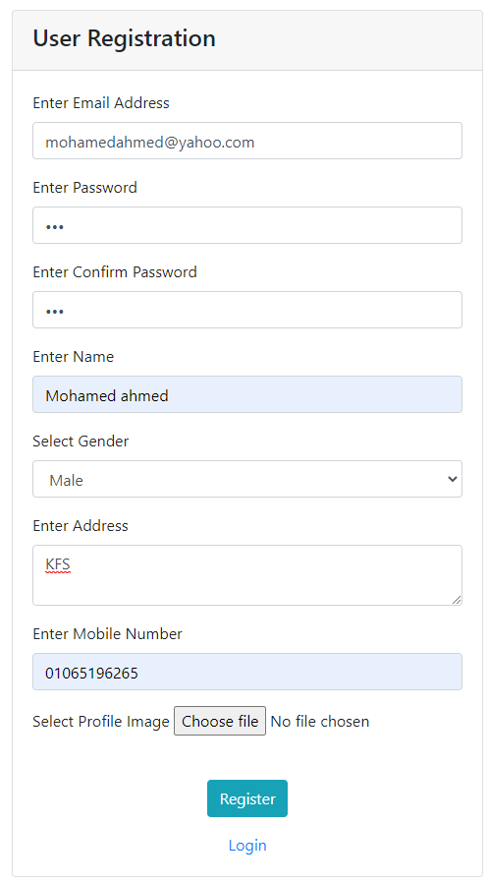
User can Register at this screen

Slide 6
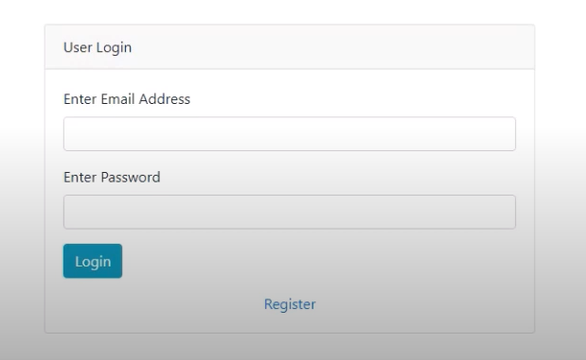
User can login at this screen

Slide 7
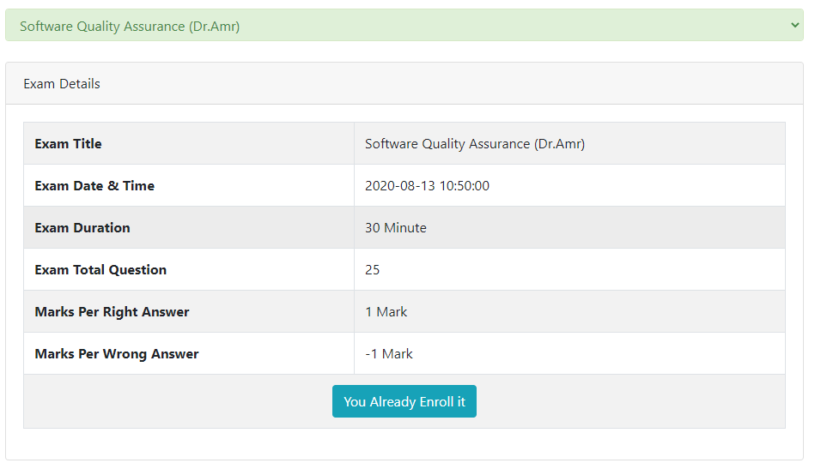
User can enroll in selected exam

Slide 8
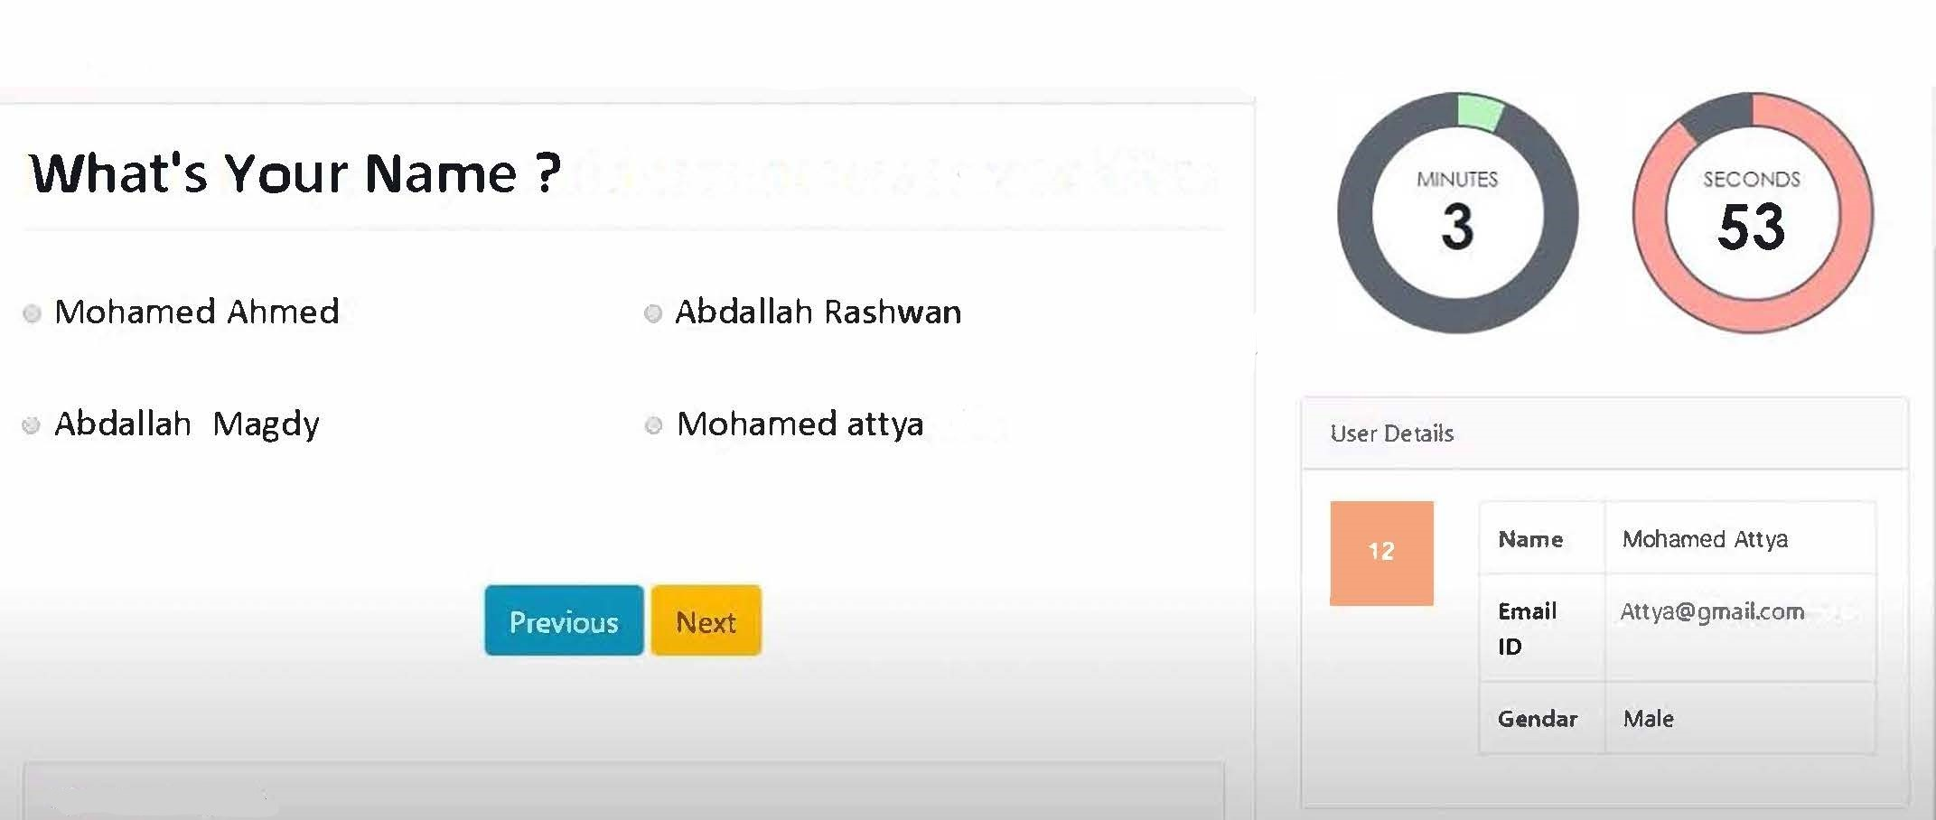
Student can now take the exam when the admin open it

Slide 9
2- Doctor

Slide 10
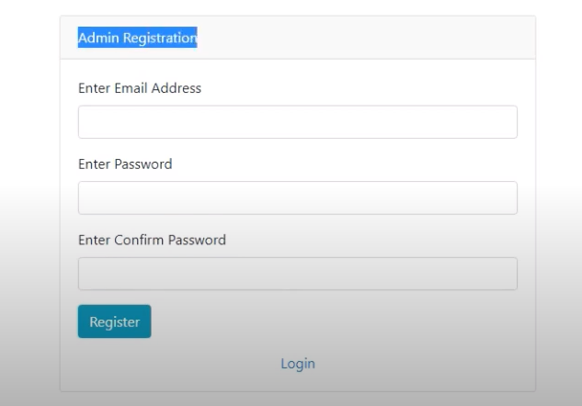
Admin(Doctor) can Register at this screen

Slide 11
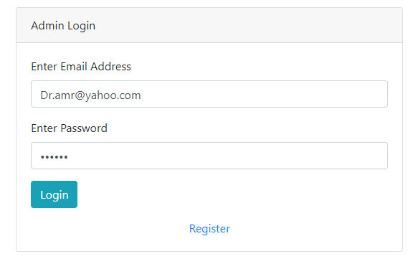
Admin(Doctor) can login at this screen

Slide 12
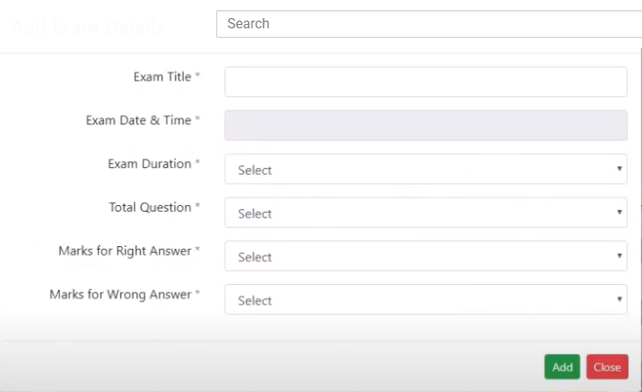
Admin(Doctor) can add exam at this screen

Slide 13
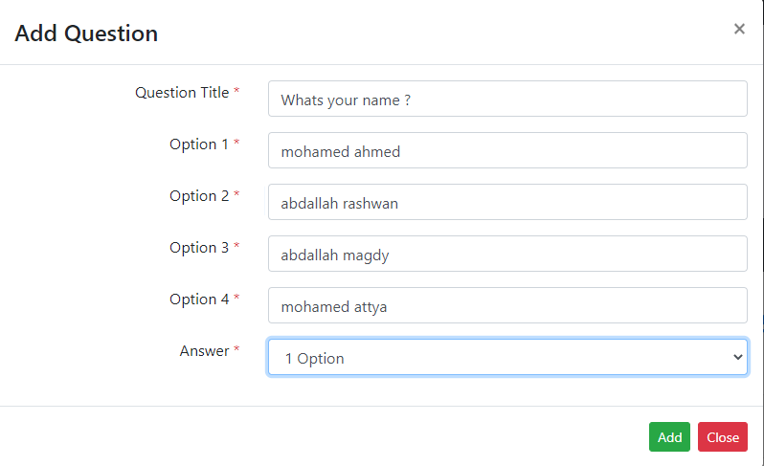
Admin(Doctor) can add question at this screen

Slide 14
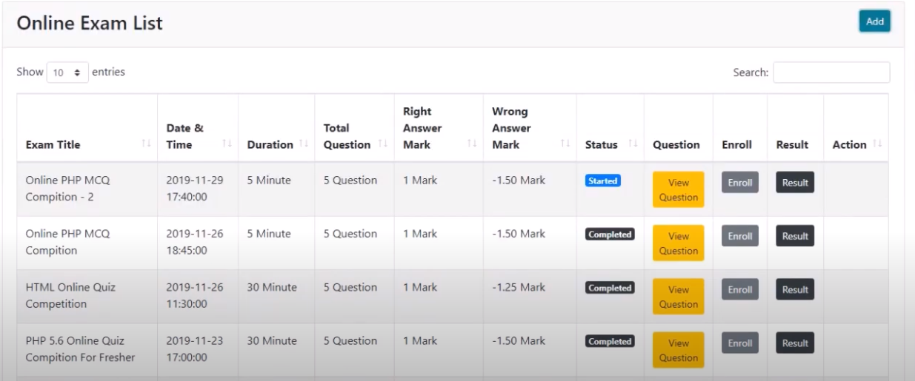
Admin(Doctor) can use a dashboard for Exam

Slide 15
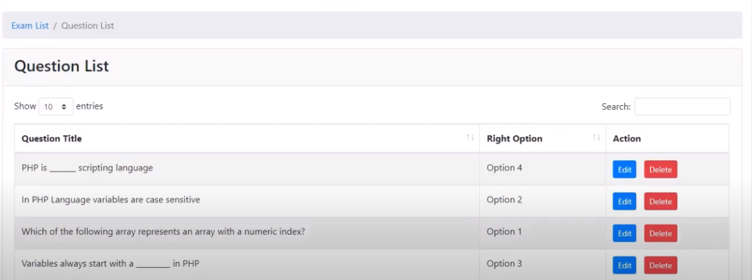
Admin(Doctor) can modify questions at this screen

Slide 16
3- Result

Slide 17
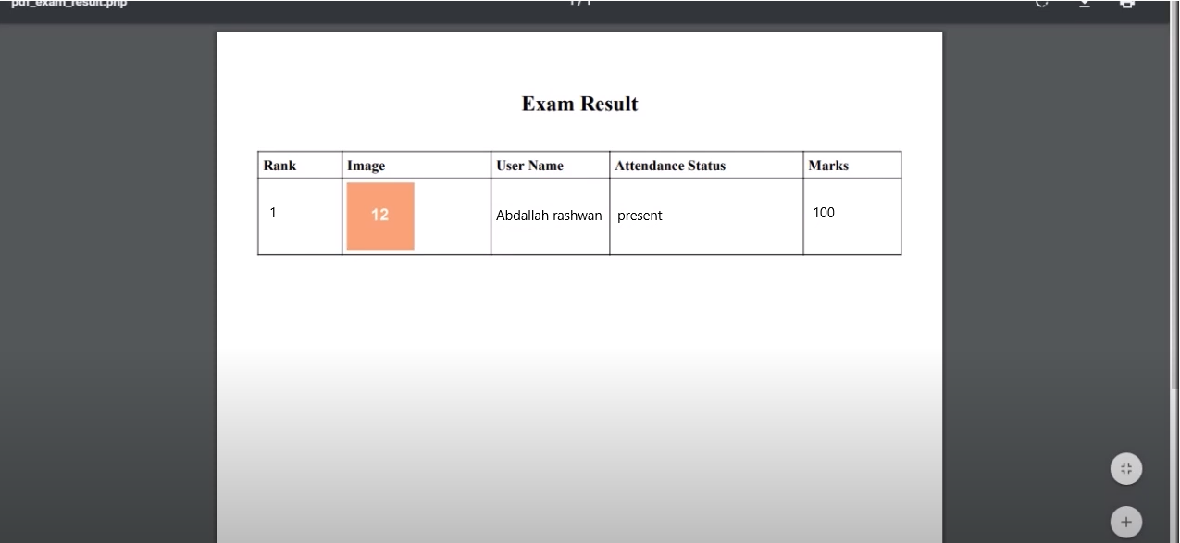
The student result will be printed as PDF file

Slide 18
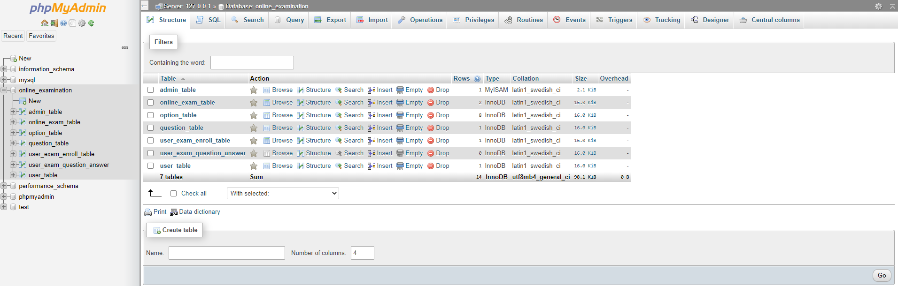
E-Exam Database

Slide 19
GitHub Link
https://github.com/SE-MohamedSalem/E-Exam

