Slide 1
XSTAMPP4.0
Short System Overview

Slide 2
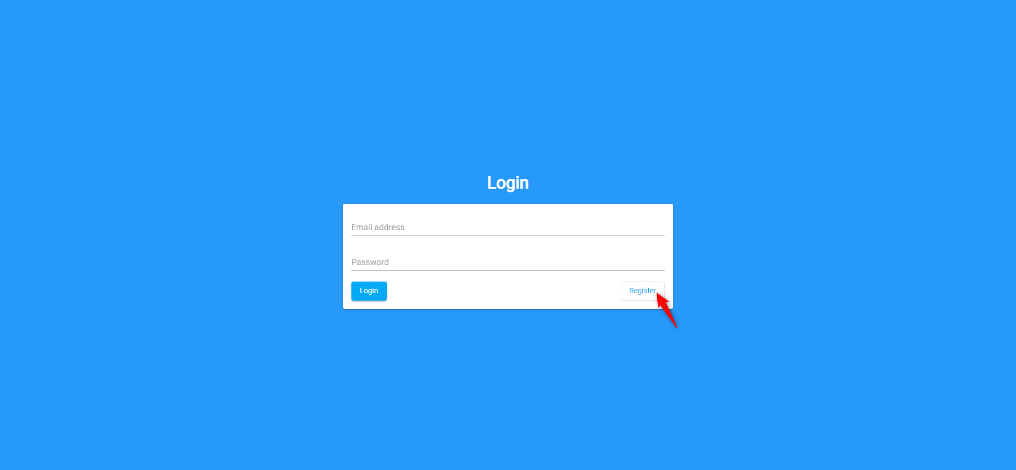
Start Page

Slide 3
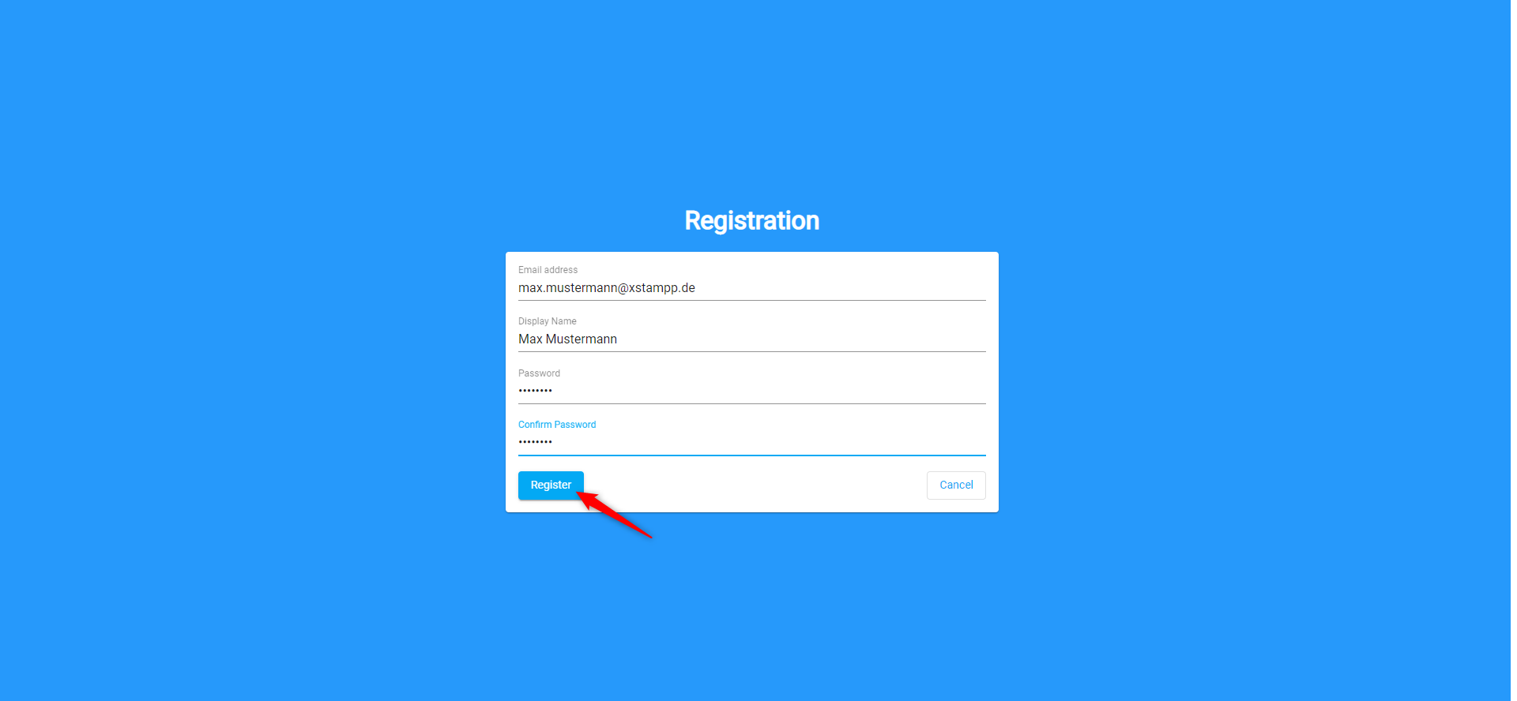
Registration

Slide 4
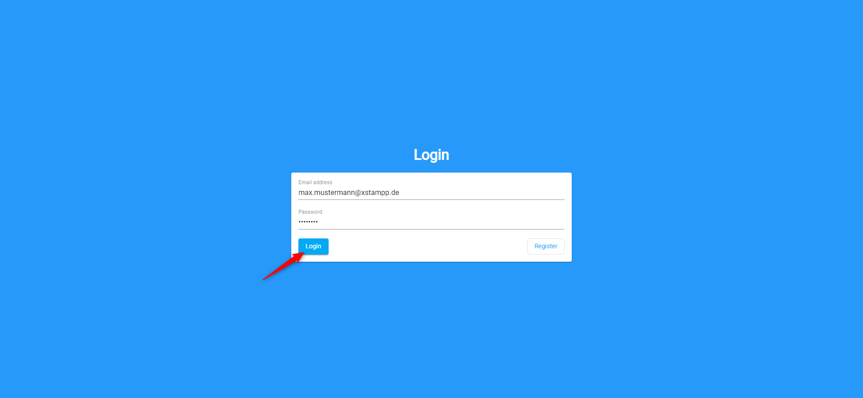
Login

Slide 5
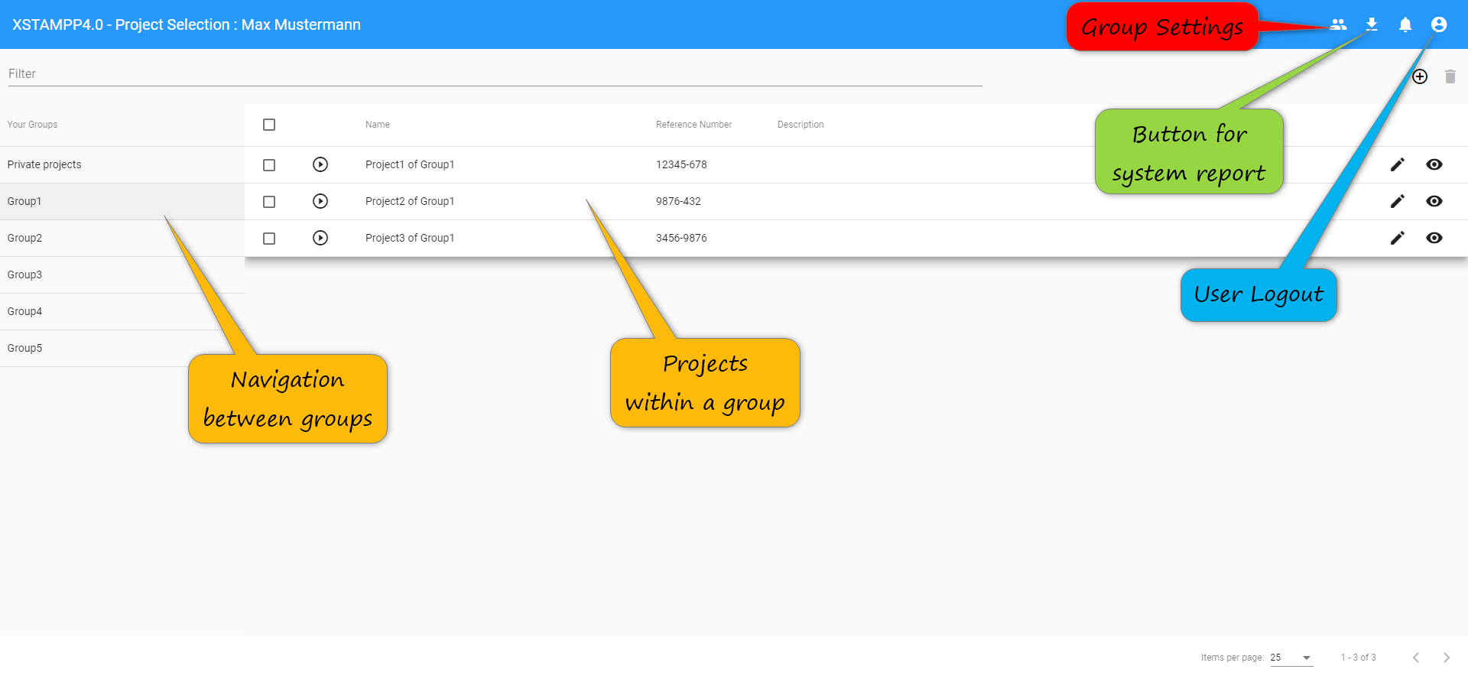
Project Selection
Click

Slide 6
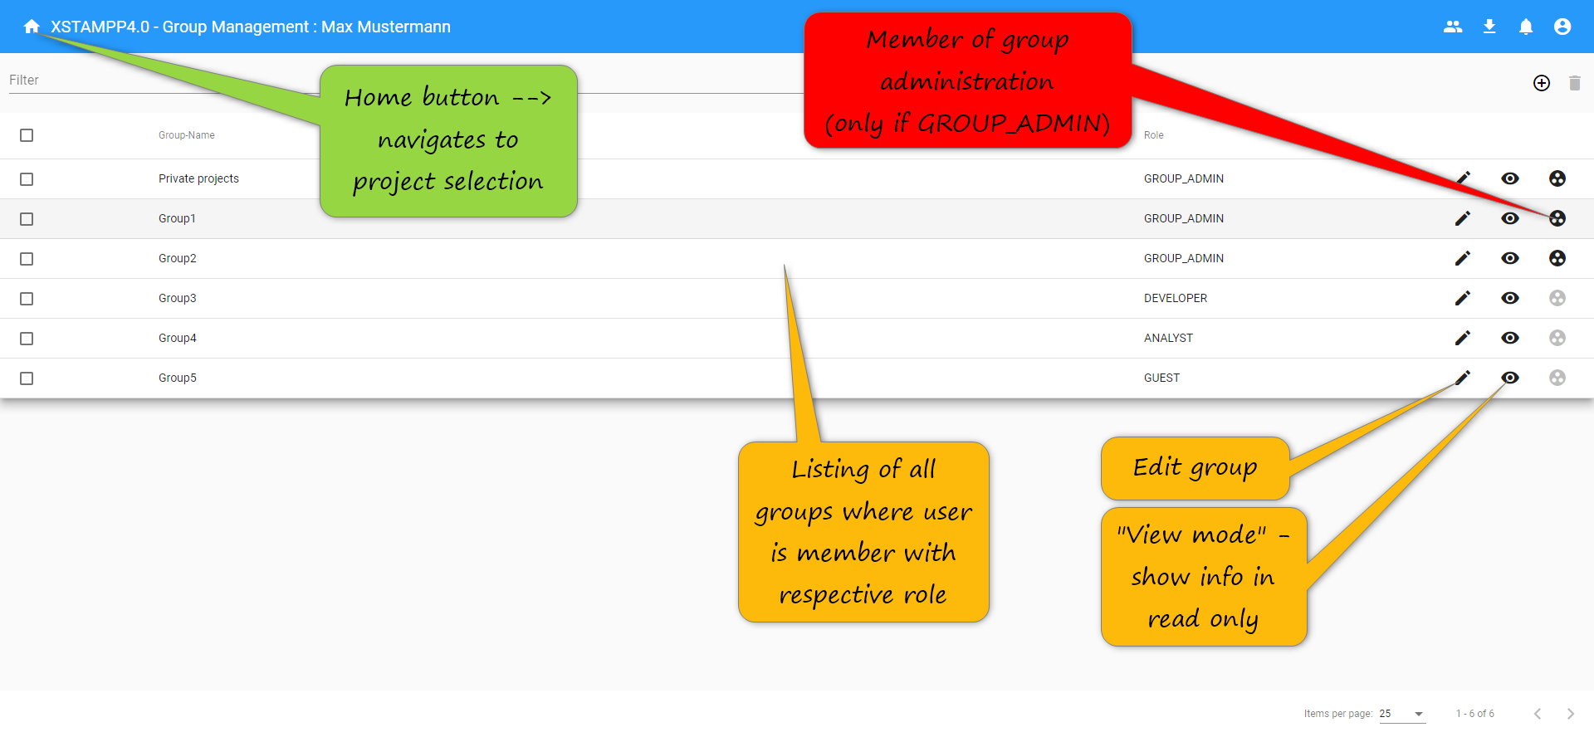
Groups View
Click

Slide 7
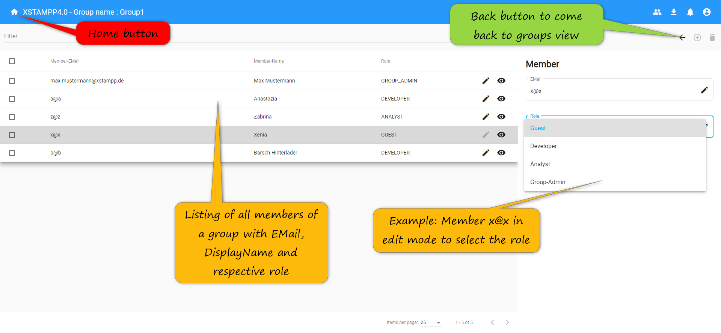
Members View
Click

Slide 8
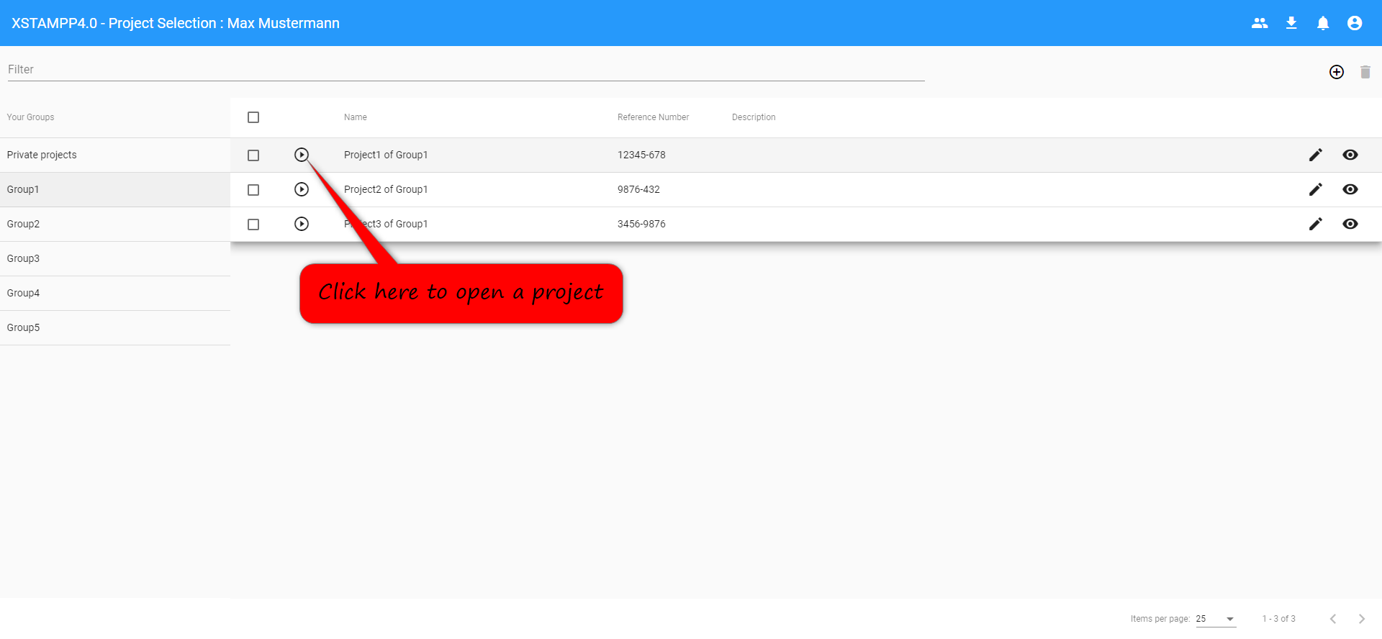
Project Selection – Open Project
Click

Slide 9
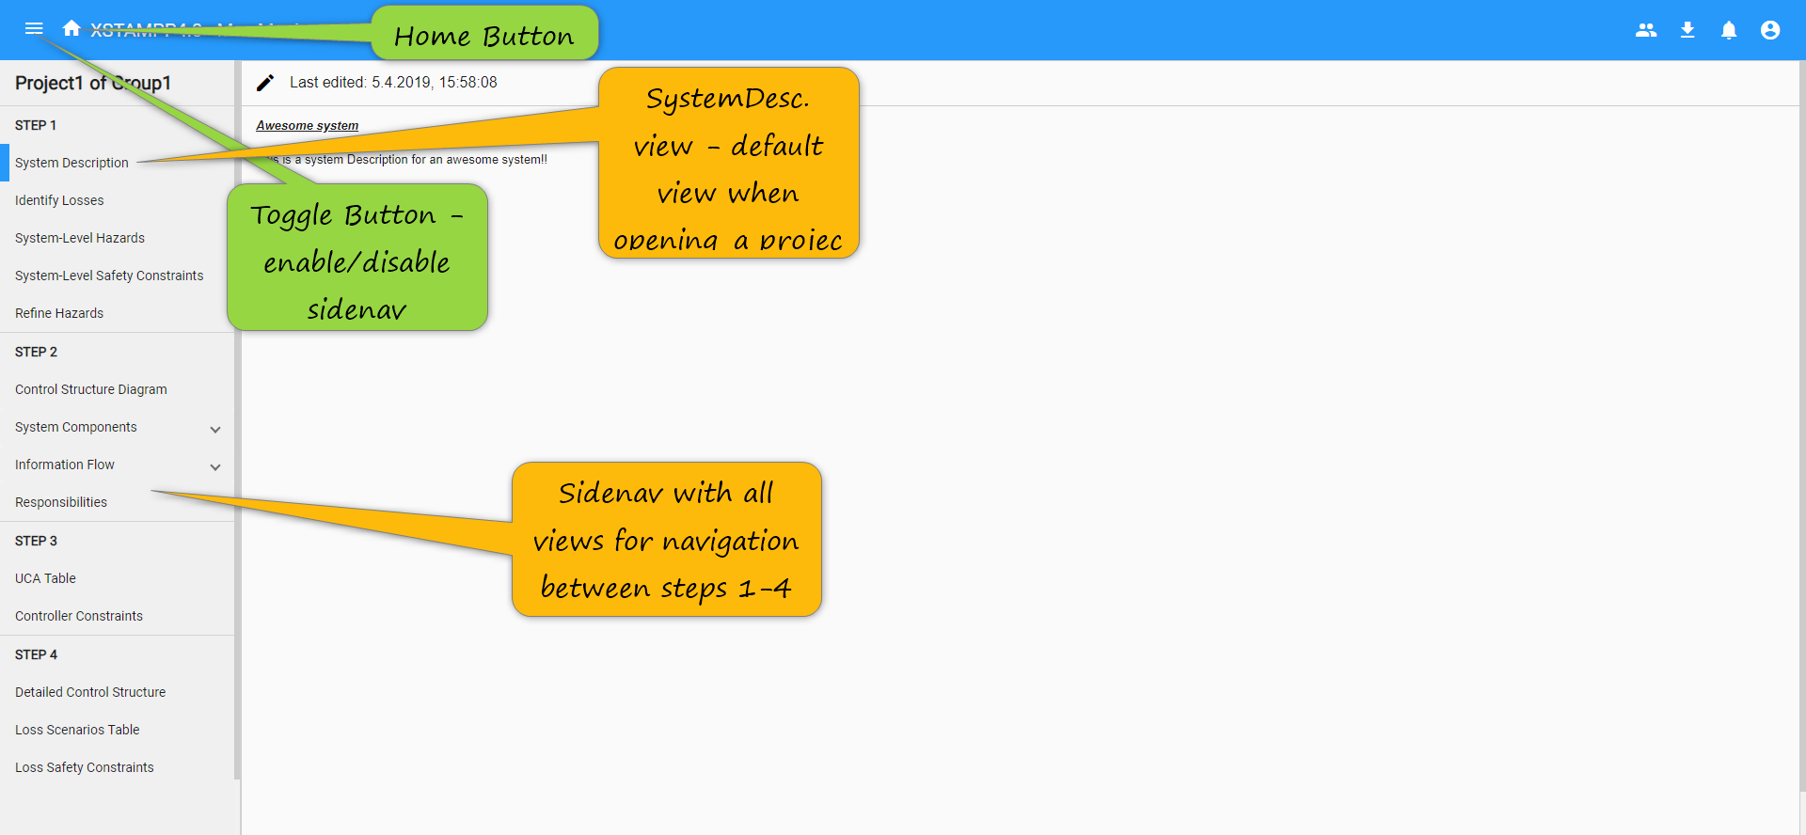
Project Default

Slide 10
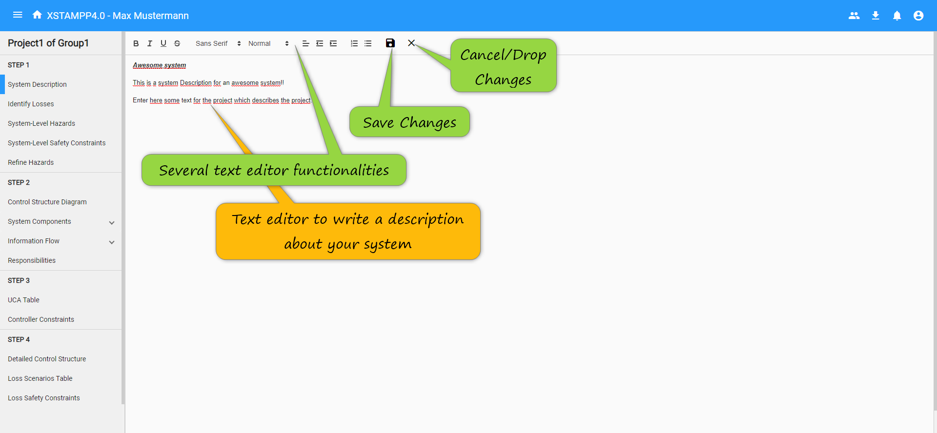
System Description
Click

Slide 11
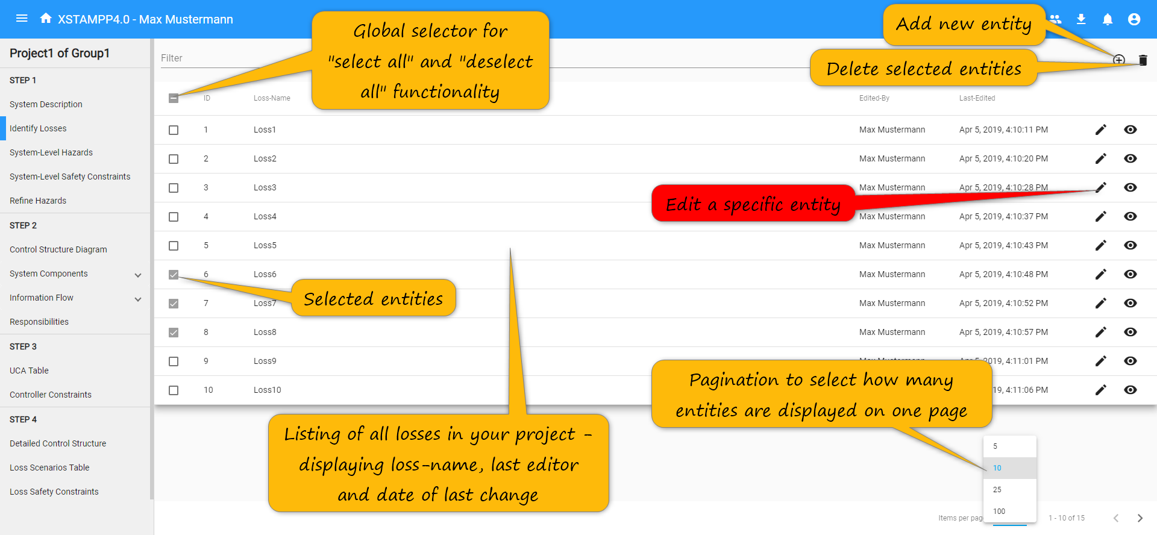
Identify Losses View
Click

Slide 12
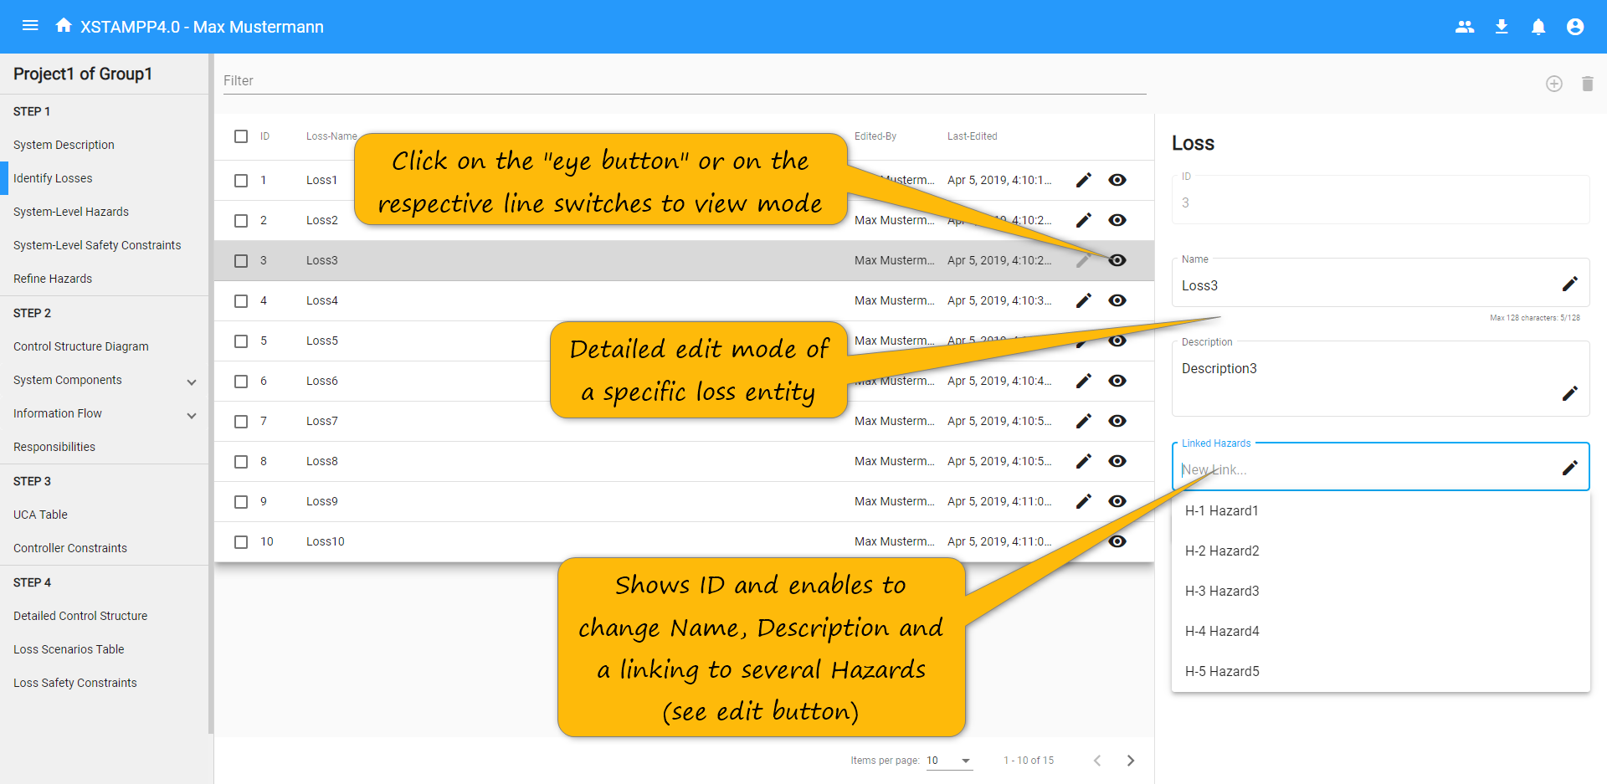
Identify Losses View – Detailed-Sheet
Click

Slide 13
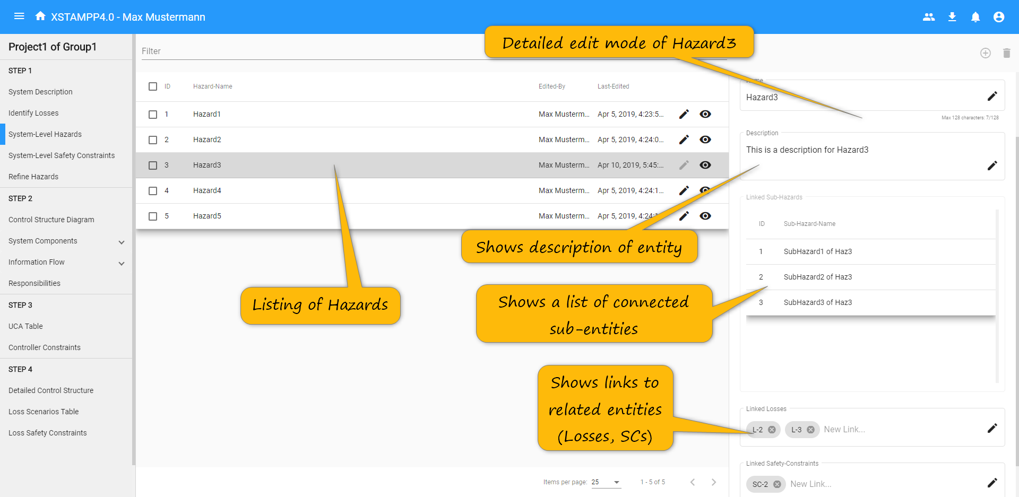
System-Level Hazards View – Detailed Sheet
Click

Slide 14
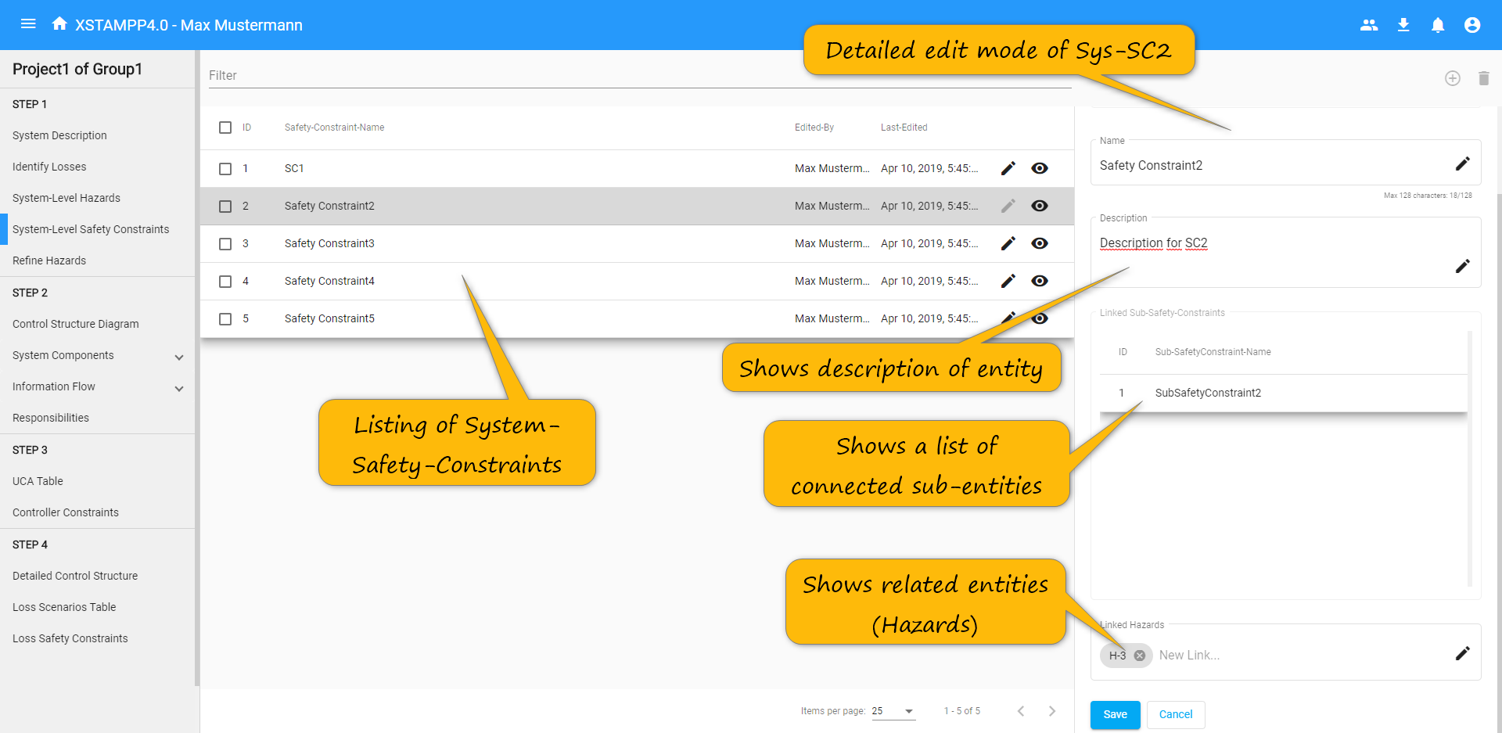
System-Level Safety Constraints View – Detailed Sheet
Click

Slide 15
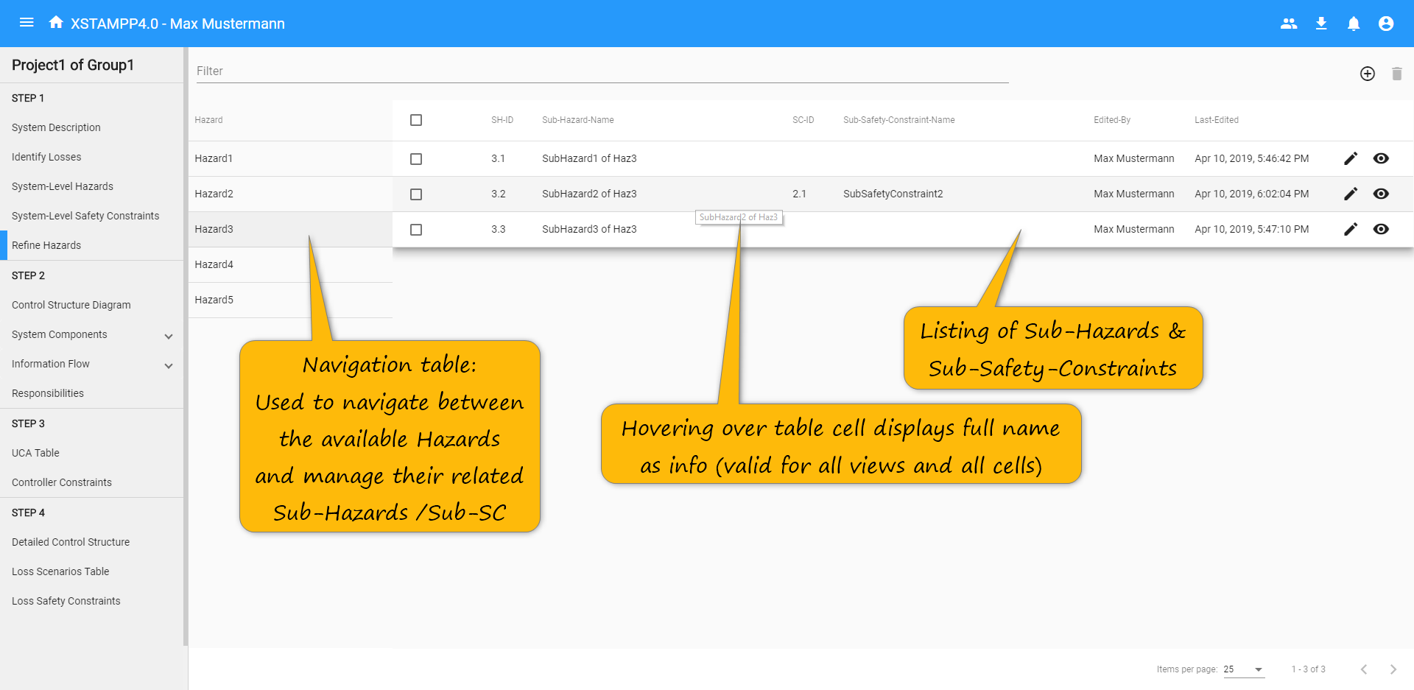
Refine Hazards View
Click

Slide 16
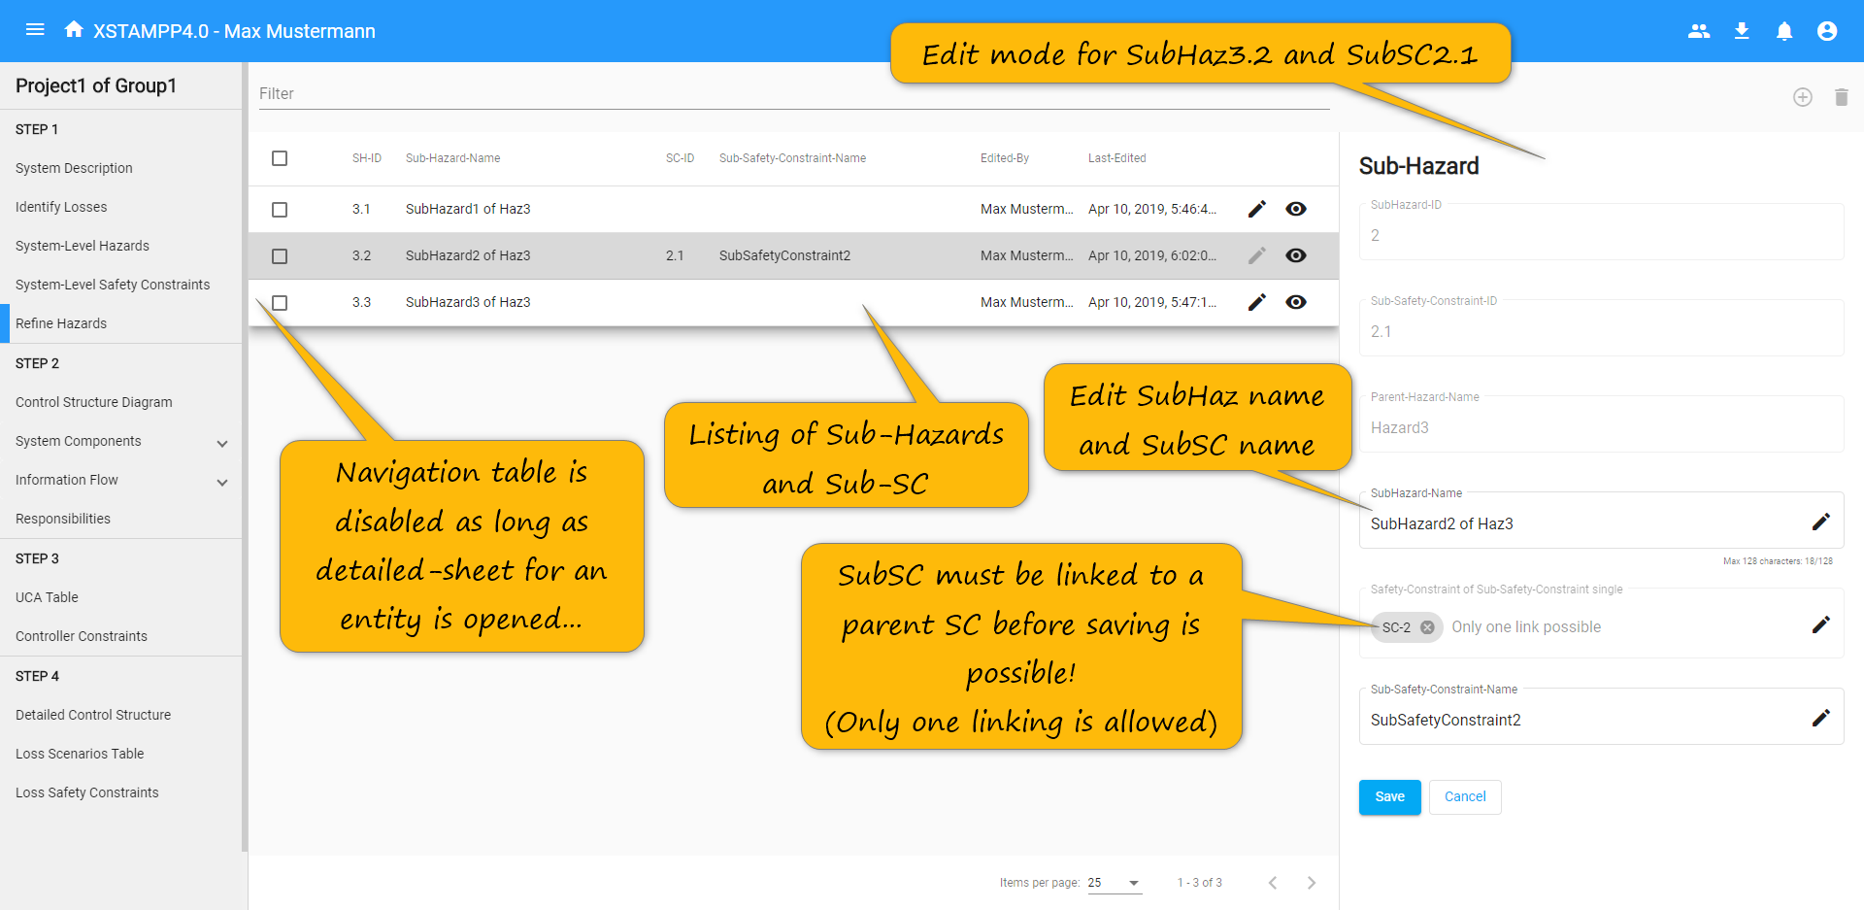
Refine Hazards View – Detailed Sheet
Click

Slide 17
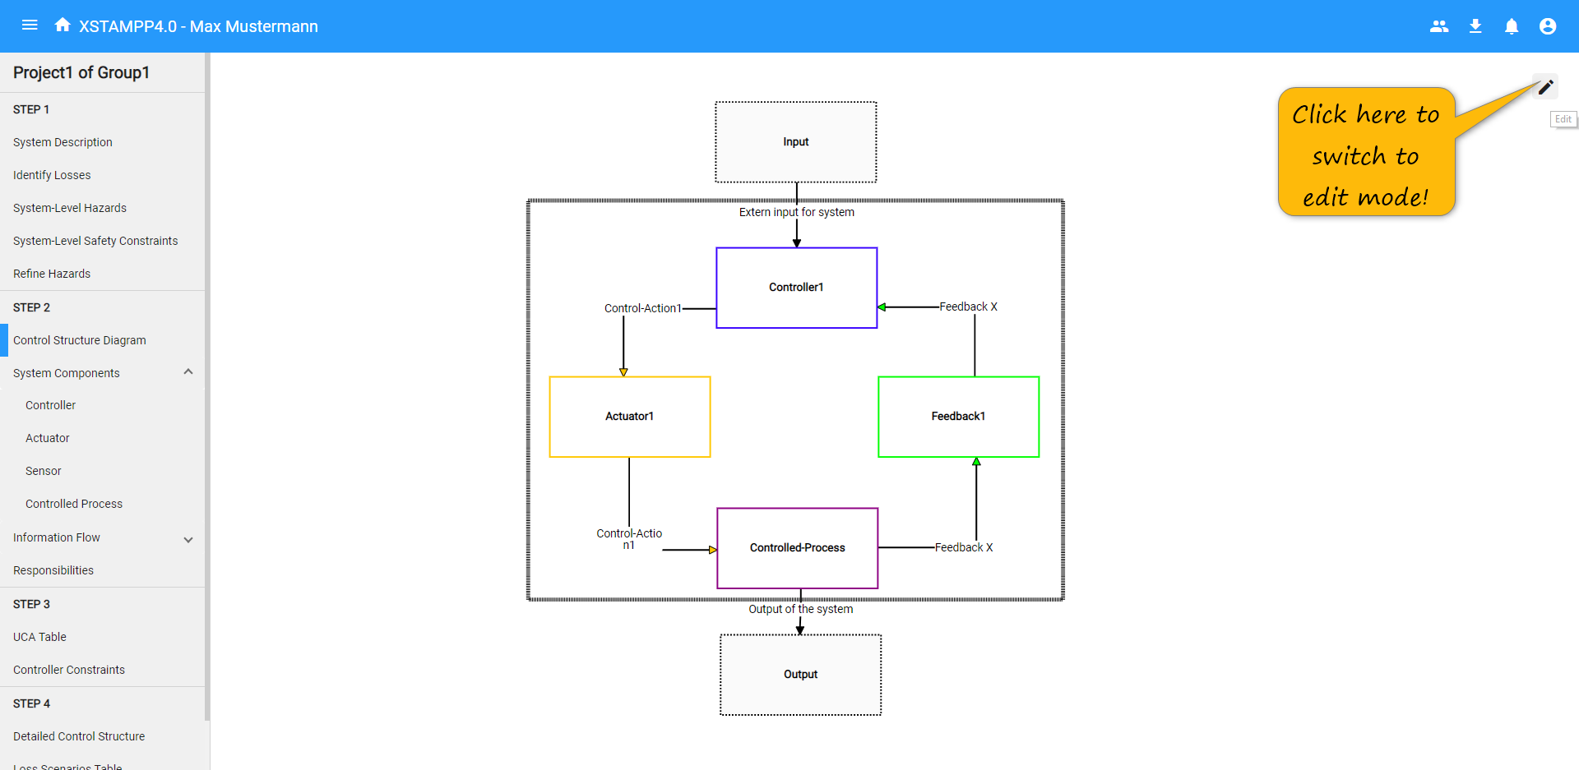
Control Structure View
Click

Slide 18
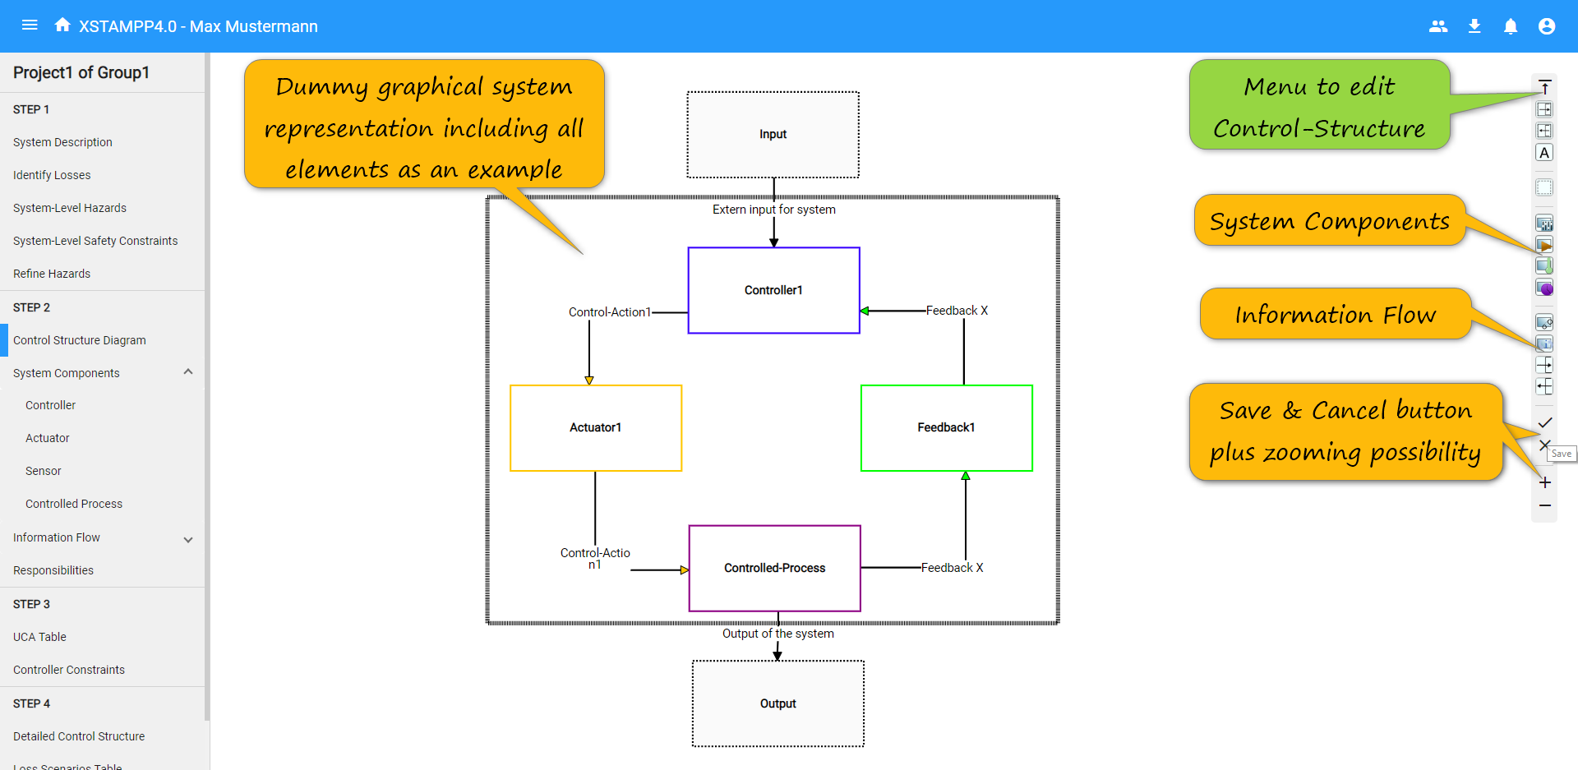
Control Structure View – Edit Mode
Click

Slide 19
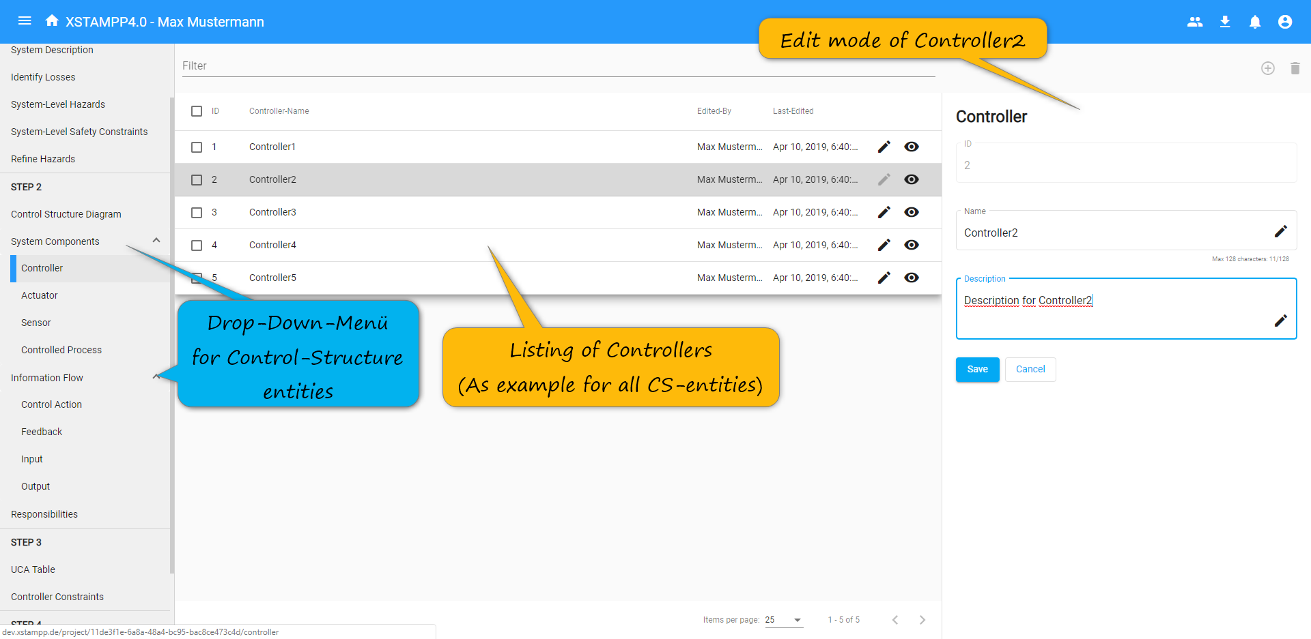
Controller View – Detailed Sheet
Click

Slide 20
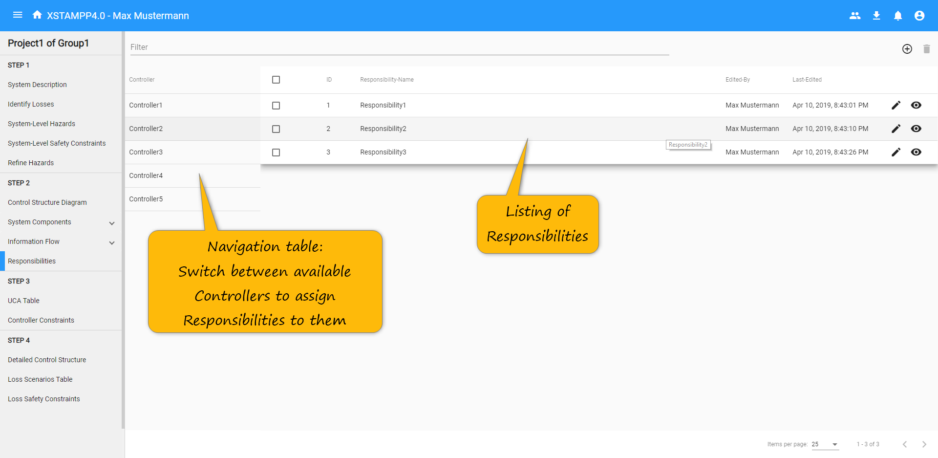
Responsibilities View
Click

Slide 21
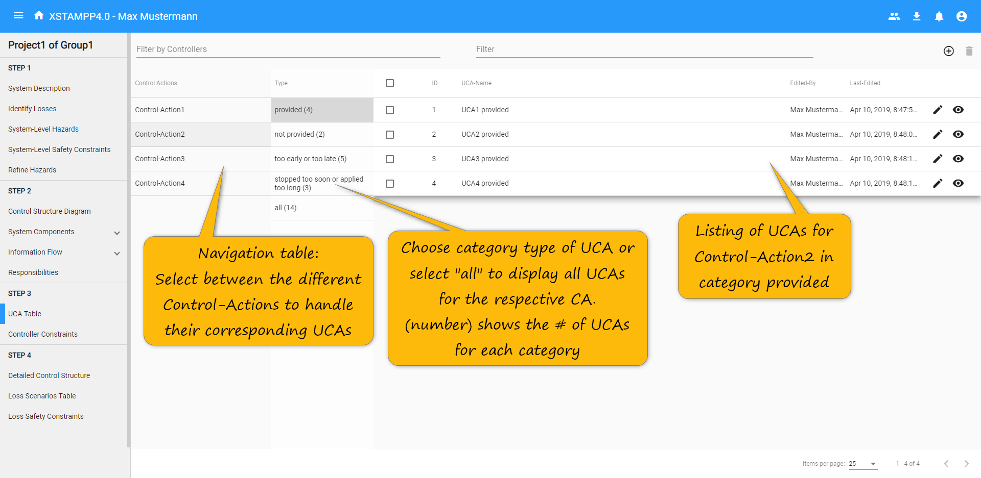
Unsafe-Control-Actions View
Click

Slide 22
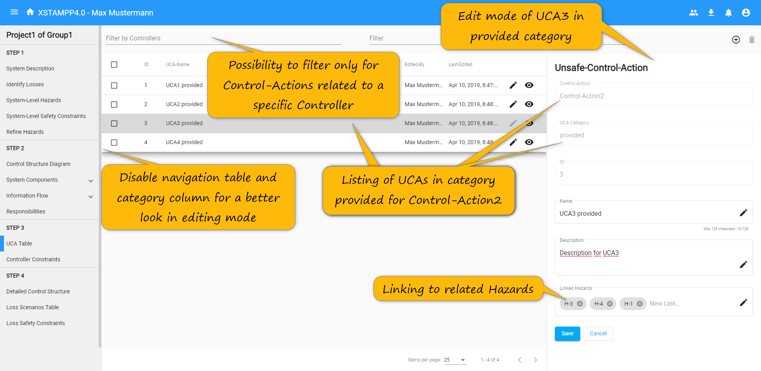
Unsafe-Control-Actions View – Detailed Sheet
Click

Slide 23
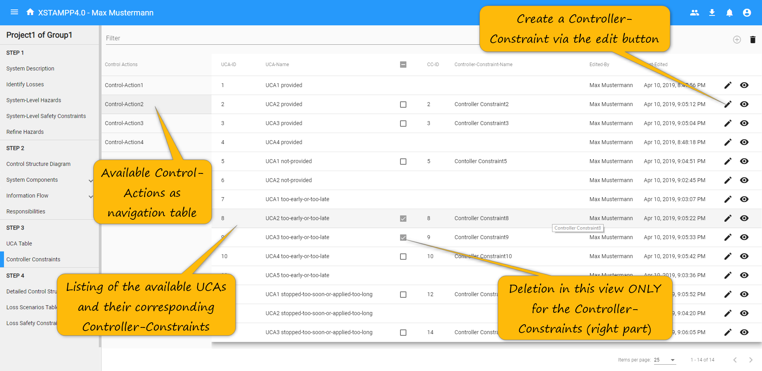
Controller-Constraints View
Click

Slide 24
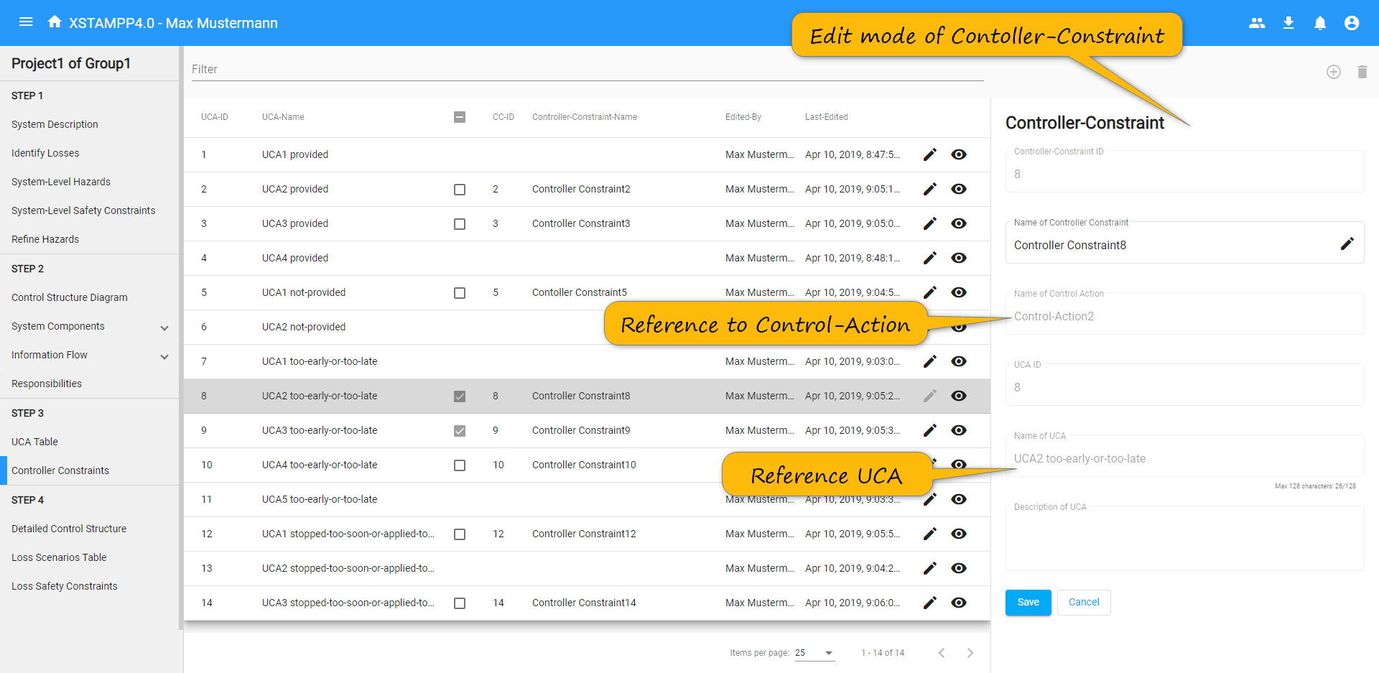
Controller-Constraints View – Detailed Sheet
Click

Slide 25
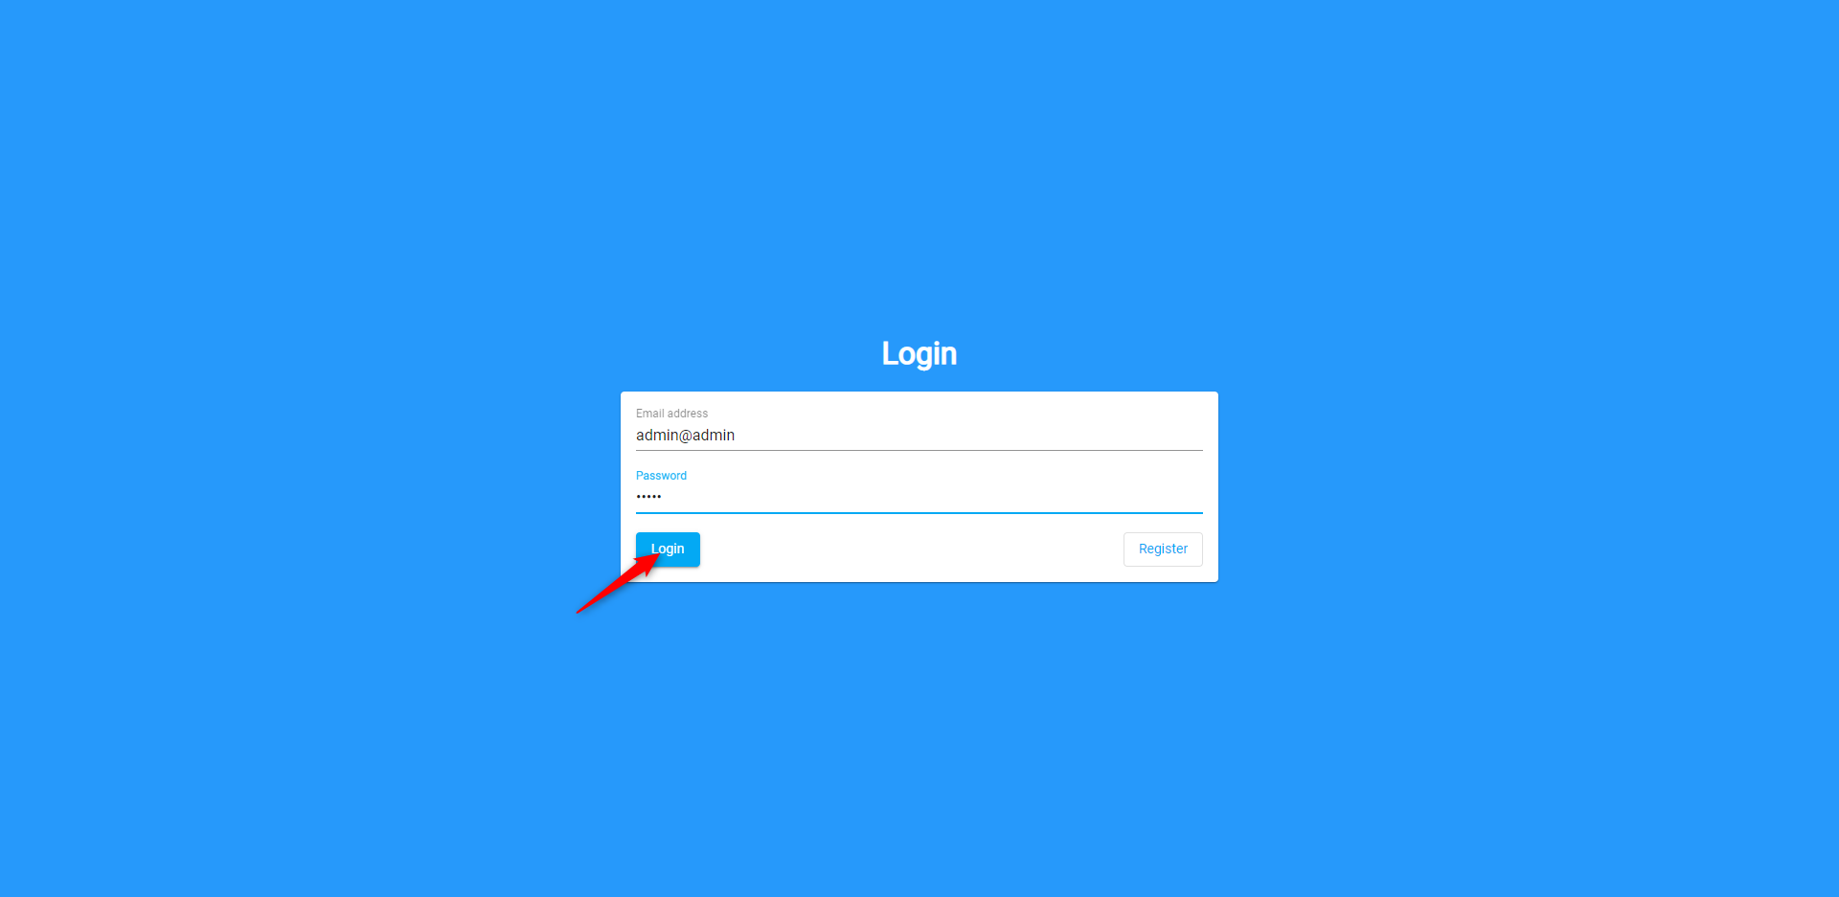
Login – SysAdmin

Slide 26
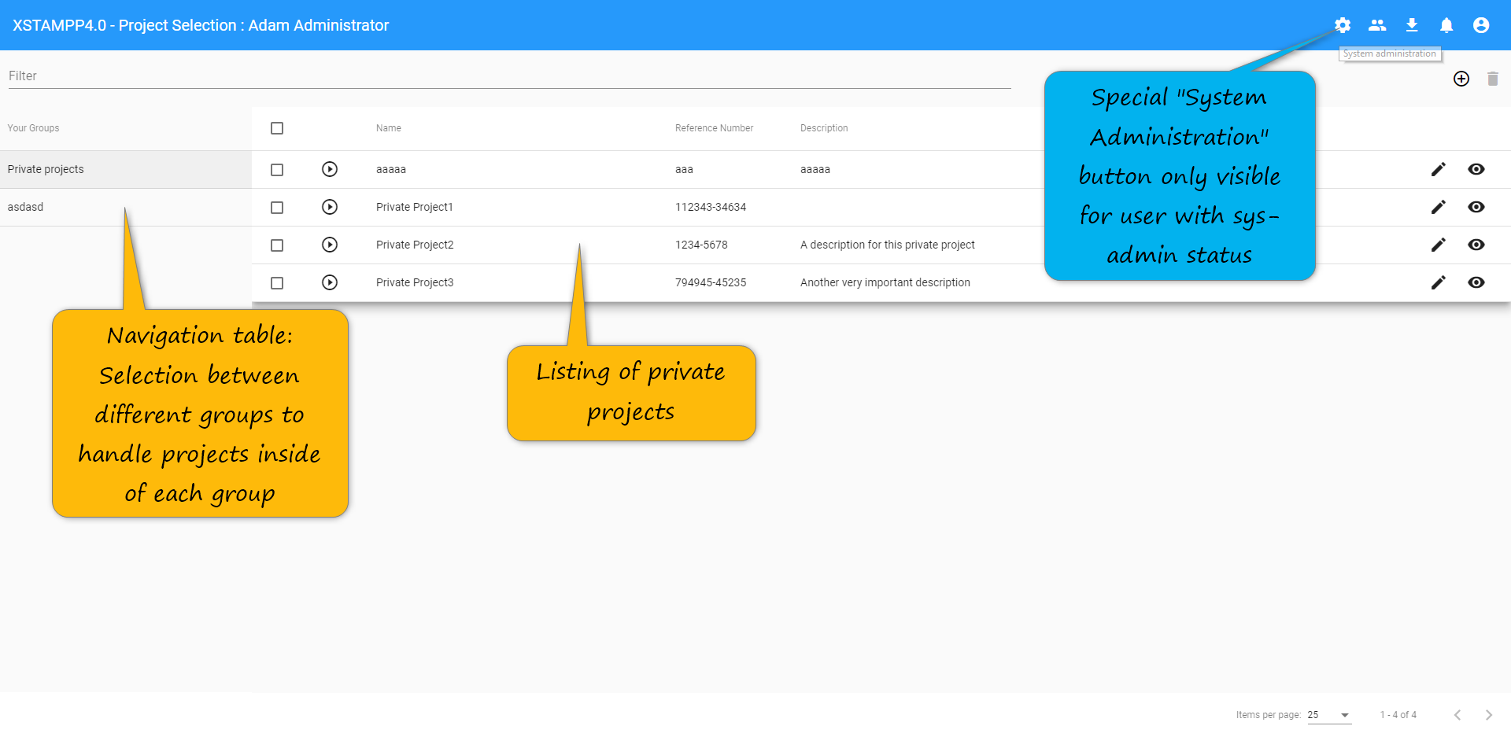
Project Selection View – SysAdmin
Click

Slide 27
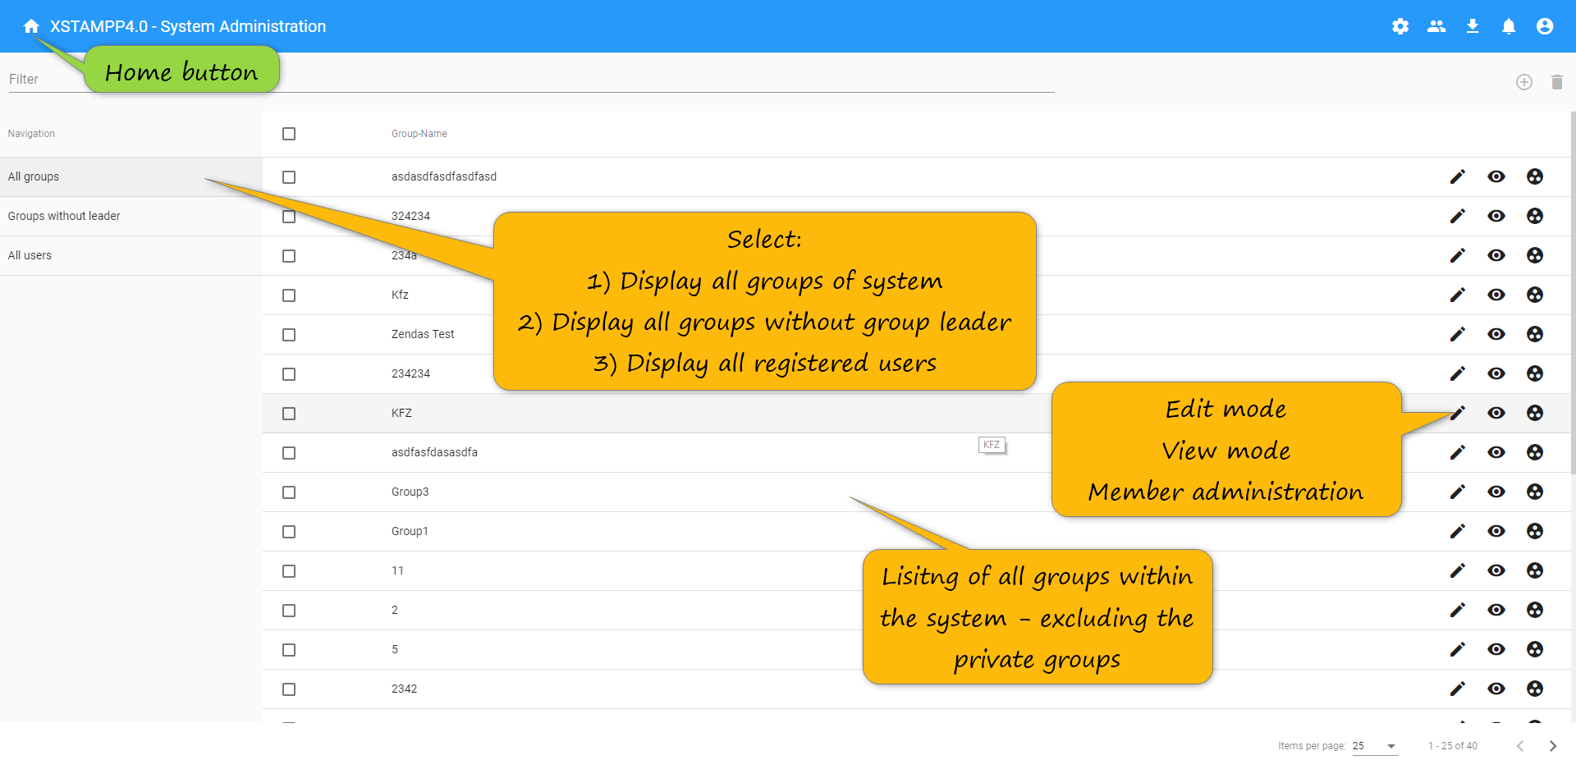
SysAdmin View - Groups
Click

Slide 28
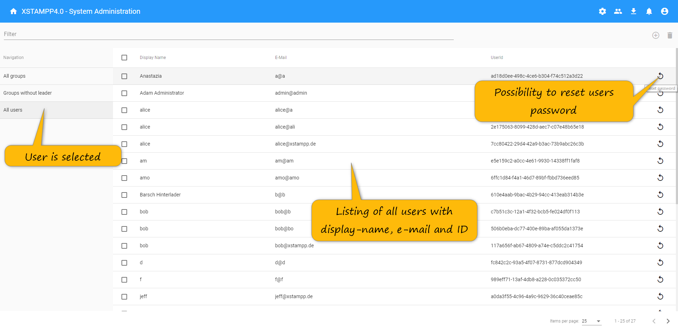
SysAdmin View – Users
Click

Slide 29
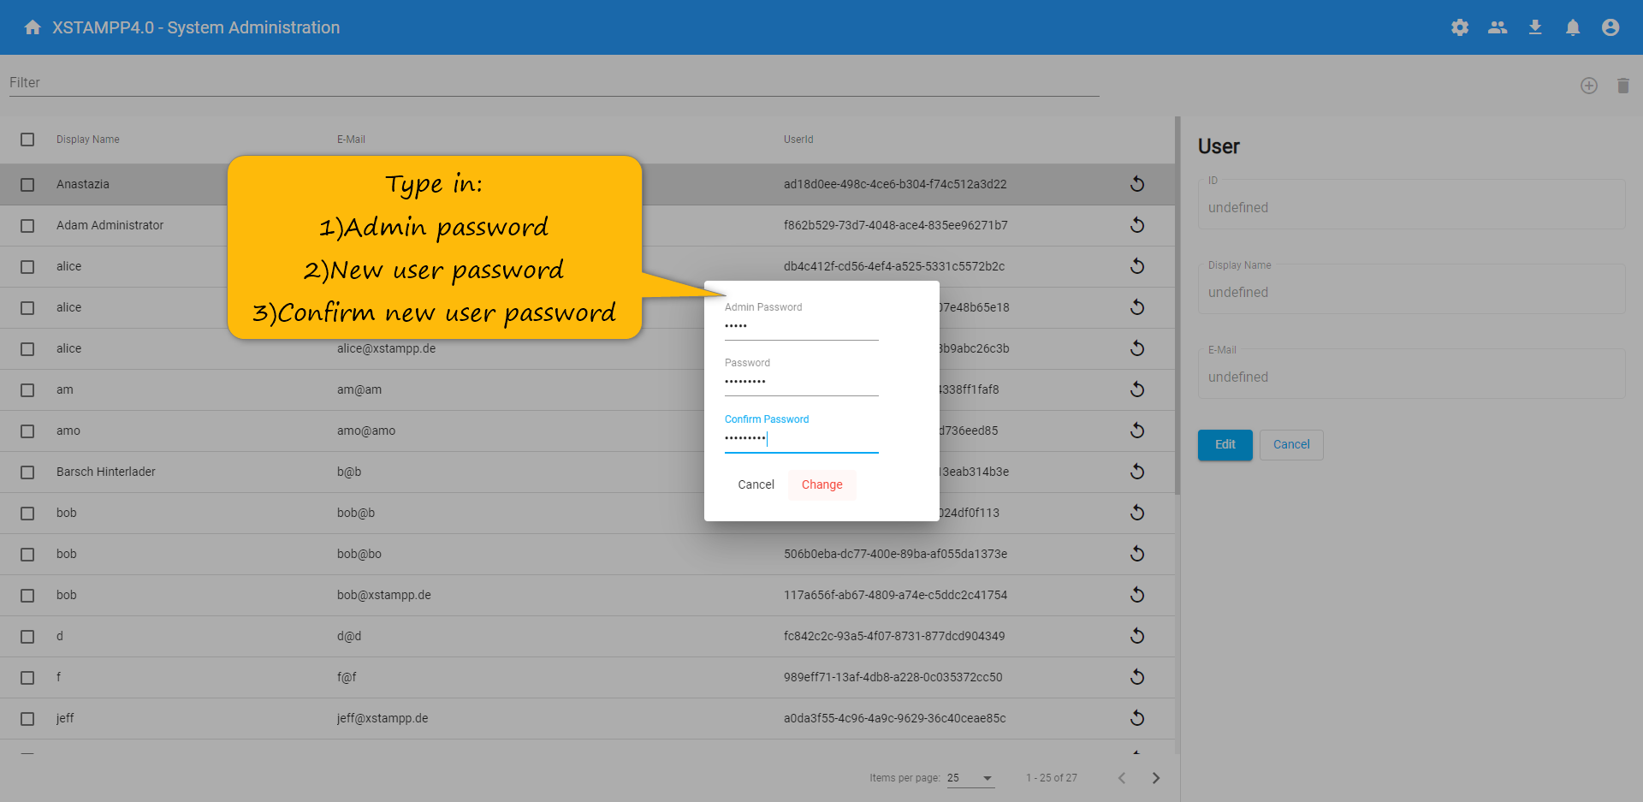
SysAdmin View – Users – Reset Password

