Slide 1
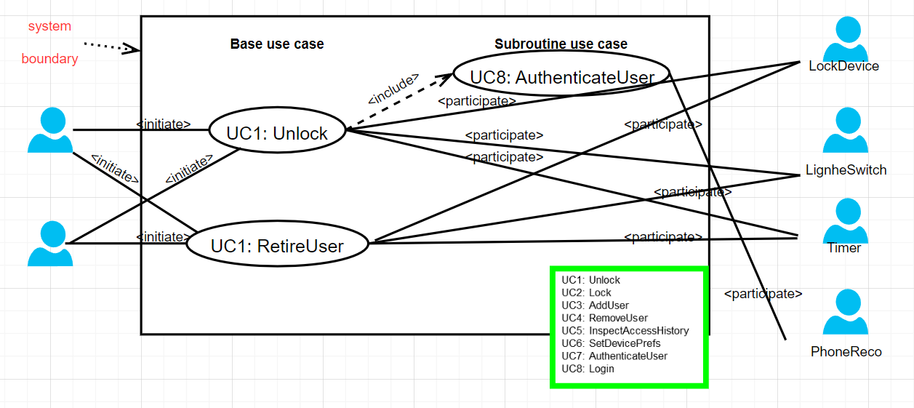
Use case diagram

Slide 2
Use Case 1: Unlock
REQ1: Keep door locked and auto-lock
REQ2: Lock when “LOCK” pressed
REQ3: Unlock when valid key provided
REQ4: Allow mistakes but prevent dictionary attacks
REQ5: Maintain a history log
REQ6: Adding/removing users at runtime
REQ7: Configuring the device activation preferences
REQ8: Inspecting the access history
REQ9: Filing inquiries
Use Case UC-1: |  |  | Unlock
Related Requirem’ts: |  |  | REQ1, REQ3, REQ4, and REQ5 stated in the table of REQs
Initiating Actor: |  |  | Any of: Tenant, Landlord
Actor’s Goal: |  |  | To disarm the lock and enter, and get space lighted up automatically.
Participating Actors: |  |  | LockDevice, LightSwitch, Timer
Preconditions: |  |  | • The set of phone information stored in the system database is non-empty. • The system displays the menu of available functions; at the door keypad the menu choices are “Lock” and “Unlock.”
Postconditions: |  |  | The auto-lock timer has started countdown from autoLockInterval.
Flow of Events for Main Success Scenario:
→ | 1. | Tenant/Landlord arrives at the door and selects the menu item “Unlock”
 | 2. | include::AuthenticateUser (UC-7)
← | 3. | System (a) signals to the Tenant/Landlord the lock status, e.g., “disarmed,” (b) signals to LockDevice to disarm the lock, and (c) signals to LightSwitch to turn the light on
← | 4. | System signals to the Timer to start the auto-lock timer countdown
→ | 5. | Tenant/Landlord opens the door, enters the home [and shuts the door and locks]

Slide 3
Subroutine «include» Use Case
Use Case UC-7: |  |  |  | AuthenticateUser (sub-use case)
Related Requirements: |  |  |  | REQ3, REQ4 stated in the table of REQs
Initiating Actor: |  |  |  | Any of: Tenant, Landlord
Actor’s Goal: |  |  |  | To be positively identified by the system (at the door interface).
Participating Actors: |  |  |  | AlarmBell, Police, PhoneReco
Preconditions: |  |  |  | • The set of phone information stored in the system database is non-empty. • The counter of authentication attempts equals zero.
Postconditions: |  |  |  | None worth mentioning.
Flow of Events for Main Success Scenario:
← | 1. | System prompts the actor for proximity of user’s phone using the Bluetooth network.
→ | 2. | Tenant/Landlord turns on the phone's Bluetooth and holds the phone close to the sensing zone on the screen.
← | 3. | System (a) verifies that the phone matching succeeds through PhoneReco, and (b) signals to the actor the phone matching success.
Flow of Events for Extensions (Alternate Scenarios):
2a. Tenant/Landlord failes to match the phone
← | 1. | System (a) detects error, (b) marks a failed attempt, and (c) signals to the actor
← |  | 1.a | System (a) detects that the count of failed attempts exceeds the maximum allowed number, (b) signals to sound AlarmBell, and (c) notifies the Police actor of a possible break-in
→ | 2. | Tenant/Landlord successfully matched the phone
 | 3. | Same as in Step 3 above
Notes:
添加了手机匹配，uc-1 unlock应该不怎么需要修改，主要修改sub use case UC-7 authenticateUser

Slide 4
Use Case 4: RetireUser
REQ1: Keep door locked and auto-lock
REQ2: Lock when “LOCK” pressed
REQ3: Unlock when valid key provided
REQ4: Allow mistakes but prevent dictionary attacks
REQ5: Maintain a history log
REQ6: Adding/removing users at runtime
REQ7: Configuring the device activation preferences
REQ8: Inspecting the access history
REQ9: Filing inquiries
Use Case UC-4: |  |  | RetireUser
Related Requirem’ts: |  |  | REQ6
Initiating Actor: |  |  | Landlord
Actor’s Goal: |  |  | To remove departed residents at runtime.
Participating Actors: |  |  | Tennant, database
Preconditions: |  |  | None worth mentioning . (But note that this use case is only available on the main computer and not at the door.)
Postconditions: |  |  | The modified data is stored into the database.
Flow of Events for Main Success Scenario:
→ | 1. | Landlord selects the menu item “ManageUser”
 | 2. | Landlord identification: Include Login (UC-8)
← | 3. | System (a)displays the options of activities available to the Landlord (including “AddUser"and “Retire User"), and (b) prompts the Landlord to make selection
→ | 4. | Landlord selects the activity “Retire User," and delete the data
← | 5. | System (a) delete the data on a persistent storage, and (b) signals completion

Slide 5
Acceptance Test Case for UC-1 Unlock
Test-case Identifier: | TC-1
Use Case Tested: | UC-1, main success scenario, and UC-7
Pass/fail Criteria: | The test passes if the user successfully matched the phone that is contained in the database, with less than a maximum allowed number of unsuccessful attempts
Input Data: | phone, door identifier
Test Procedure: |  | Expected Result:
Step 1. fail to match the phone and a valid door identifier |  | System beeps to indicate failure; records unsuccessful attempt in the database; prompts the user to try again
Step 2. successfully match the phone and door identifier |  | System flashes a green light to indicate success; records successful access in the database; disarms the lock device

Slide 6
Acceptance Test Case for UC-4 RetireUser
Test-case Identifier: | TC-4
Use Case Tested: | UC-1, main success scenario
Pass/fail Criteria: | The test passes if the removed tenant can’t unlock the previous lock with less than a maximum allowed number of unsuccessful attempts
Input Data: | The phone of removed tenant, door identifier
Test Procedure: |  | Expected Result:
fail to match the phone and a valid door identifier |  | System beeps to indicate failure; records unsuccessful attempt in the database; prompts the user to try again

