Slide 1

6. Algorithms
Subtitle
Notes:
NOTE:
To change the image on this slide, select the picture and delete it. Then click the Pictures icon in the placeholder to insert your own image.

Slide 2
Content
6.1 Concepts: input, output, processing
6.2 Three basic constructs
6.3 Algorithm representation
6.4 Search Algorithms: linear, binary

Slide 3
Objectives
After studying this chapter, the student should be able to:
Define an algorithm and relate it to problem solving.
Define three constructs—sequence, selection, and repetition—and describe their use in algorithms.
Describe UML diagrams and how they can be used when representing algorithms.
Describe pseudocode and how it can be used when representing algorithms.
List basic algorithms and their applications.
Describe the concept of sorting and understand the mechanisms behind three primitive sorting algorithms.
Describe the concept of searching and understand the mechanisms behind two common searching algorithms.
Define subalgorithms and their relations to algorithms.
Distinguish between iterative and recursive algorithms.
Notes:
Relate : liên hệ , concept: khái niệm

Slide 4
1-Concepts: input, output, processing

Slide 5
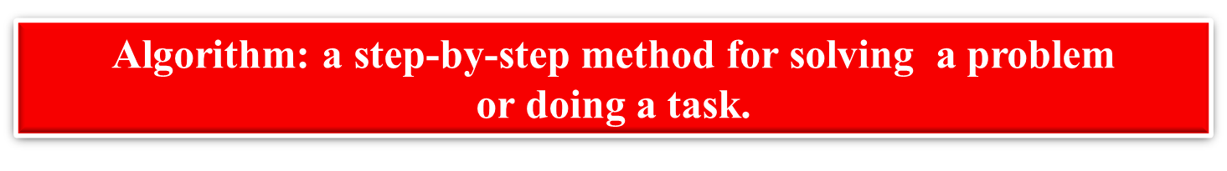
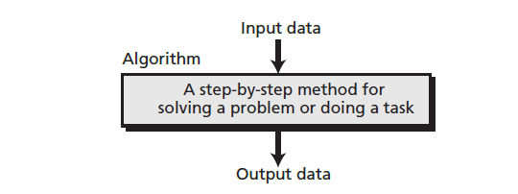
1. Informal definition
An informal definition of an algorithm is:
Figure 6.1 Informal definition of an algorithm used in a computer

Slide 6
Example
Problem:
Develop an algorithm for finding the largest integer among a list of positive integers (for example 12, 8, 13, 9, 11). The algorithm should be general and not depend on the number of integers.
Solution :
Step 1 In this step, the algorithm inspects the first integer (12). The algorithm defines a data item, called Largest, and sets its value to the first integer (12).
Step 2 The algorithm makes a comparison between the value of Largest (12) and the value of the second integer (8). It finds that Largest is larger than the second integer, which means that Largest is still holding the largest integer.
Step 3 The largest integer so far is 12, but the new integer (13) is larger than Largest. The value of Largest should be replaced by the third integer (13). The algorithm changes the value of Largest to 13 and moves to the next step.
Step 4 Nothing is changed in this step because Largest is larger than the fourth integer (9).
Step 5 Again nothing is changed because Largest is larger than the fifth integer (11).

Slide 7
Example (flow)
Notes:
B1: Khởi tạo giá trị Largest và gán với phần tử đầu tiên ( 12 )
B2: So sánh phần tử thứ 2 với biến Largest….tiếp tục với phần tử 3 4 5
B3: Phần tử thứ 3 > Largest -> gán phần tử 3 có giá trị 13 vào biến Largest

Slide 8
2. Refinement
This algorithm needs refinement to be acceptable to the programming community. There are two problems.
First, the action in the first step is different than those for the other steps.
Second, the wording is not the same in steps 2 to 5.
Redefine the algorithm to remove these two inconveniences by changing the wording in steps 2 to 5 to ‘If the current integer is greater than Largest, set Largest to the current integer’.
Figure 6.2 Find largest refined
Notes:
Refinement: sàng lọc

Slide 9
3. Generalization
Is it possible to generalize the algorithm? We want to find the largest of n positive integers, where n can be 1000, 1 000 000, or more.
Figure 6.3 Generalization of Find Largest

Slide 10
2 - Three basic constructs

Slide 11
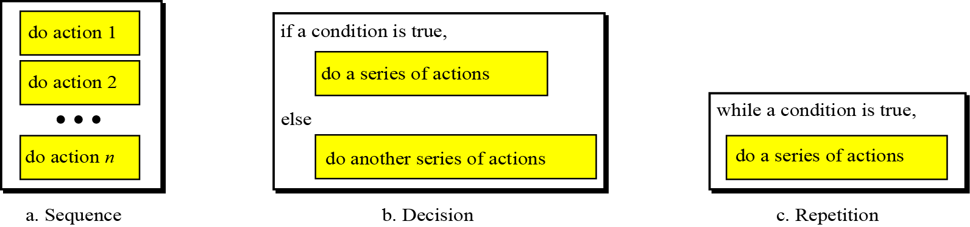
Introduction
Computer scientists have defined three constructs for a structured program or algorithm. The idea is that a program must be made of a combination of only these three constructs: sequence, decision, and repetition (Figure 8.6).
It has been proven there is no need for any other constructs. Using only these constructs makes a program or an algorithm easy to understand, debug, or change.
Figure 6.4 Three constructs

Slide 12
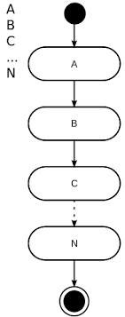
Sequence
The first construct is called the sequence.
An algorithm, and eventually a program, is a sequence of instructions, which can be a simple instruction or either of the other two constructs.
Figure 6.5 Sequence construct

Slide 13
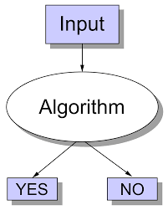
Decision
Some problems cannot be solved with only a sequence of simple instructions. Sometimes we need to test a condition.
If the result of testing is true, we follow a sequence of instructions:
if it is false, we follow a different sequence of instructions.
This is called the decision (selection) construct.
Figure 6.6 Decision construct

Slide 14
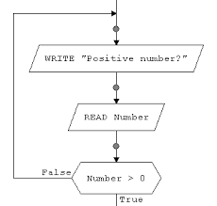
Repetition
In some problems, the same sequence of instructions must be repeated. We handle this with the repetition or loop construct.
Finding the largest integer among a set of integers can use a construct of this kind.
Figure 6.7 Repetition construct

Slide 15
3- ALGORITHM REPRESENTATION

Slide 16
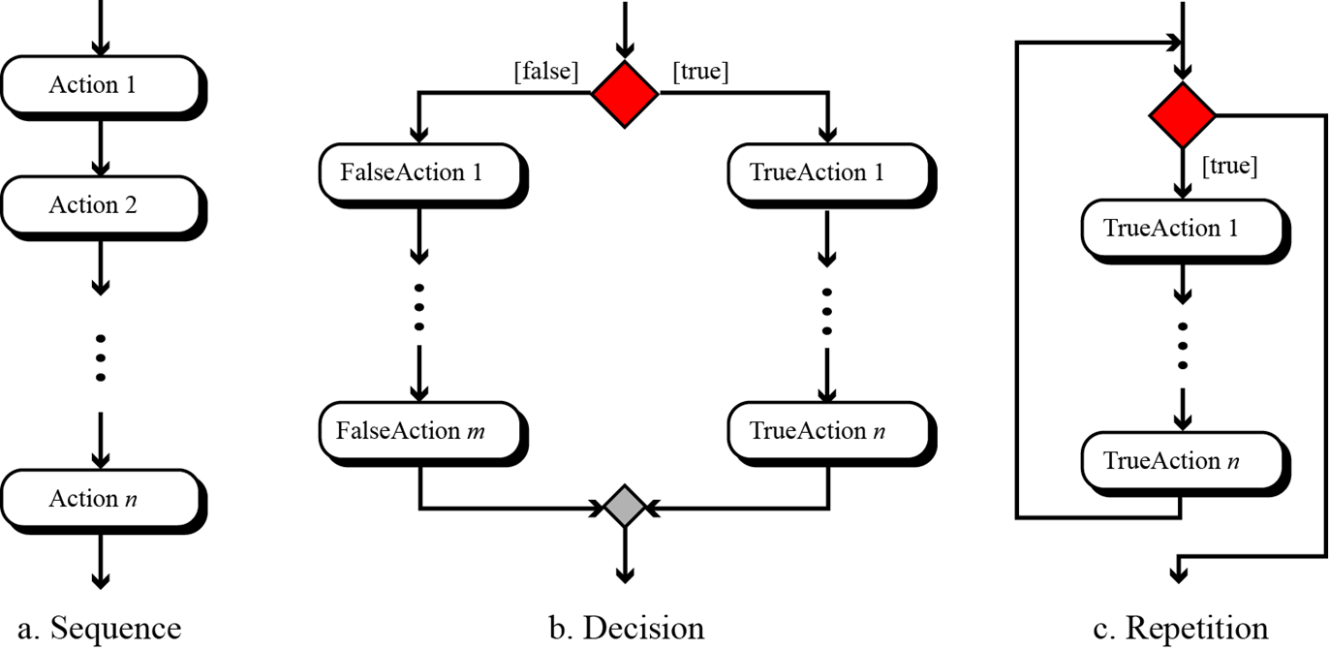
1. UML
Unified Modeling Language (UML) is a pictorial representation of an algorithm. It hides all the details of an algorithm in an attempt to give the ‘big picture’ and to show how the algorithm flows from beginning to end.
Figure 6.8 UML for three constructs
Notes:
Sequence : Tuần tự
Decision : Quyết định
Repetition : Sự lặp

Slide 17
2. Pseudocode
Pseudocode is an English-language-like representation of an algorithm. There is no standard for pseudocode—some people use a lot of detail, others use less. Some use a code that is close to English, while others use a syntax like the Pascal programming language
Figure 6.9 Pseudocode for three constructs

Slide 18
3. Example
Problem Write an algorithm in pseudocode that finds the sum of two integers.
Solution This is a simple problem that can be solved using only the sequence construct. Note also that we name the algorithm, define the input to the algorithm and, at the end, we use a return instruction to return the sum.
Figure 6.10 Pseudocode for Calculating the sum of two integers

Slide 19
4. BASIC ALGORITHMS

Slide 20
4.1 Summation
One commonly used algorithm in computer science is summation. We can add two or three integers very easily, but how can we add many integers? The solution is simple: we use the add operator in a loop
A summation algorithm has three logical parts:
1. Initialization of the sum at the beginning.
2. The loop, which in each iteration adds a new integer to the sum.
3. Return of the result after exiting from the loop.
Figure 6.11 UML for Calculating the sum of two integers
Notes:
Flowcharting : Lưu đồ

Slide 21
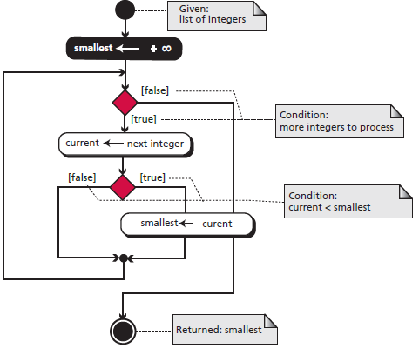
2. Smallest and largest
We discussed the algorithm for finding the largest among a list of integers at the beginning of this chapter. The idea was to write a decision construct to find the larger of two integers.
If we put this construct in a loop, we can find the largest of a list of integers.
Finding the smallest integer among a list of integers is similar, with two minor differences.
First, we use a decision construct to find the smaller of two integers.
Second, we initialize with a very large integer instead of a very small one.
Figure 6.12 UML for Finding the smallest data item
Notes:
Initialize : khởi tạo

Slide 22
3. Sorting
One of the most common applications in computer science is sorting, which is the process by which data is arranged according to its values. People are surrounded by data.
If the data was not ordered, it would take hours and hours to find a single piece of information. Imagine the difficulty of finding someone’s telephone number in a telephone book that is not ordered
Common sorting algorithms
Bubble/Shell sort:
Insertion sort
Selection sort
Quick sort
Merge sort
Notes:
Sắp xếp nổi bọt (Bubble Sort) là gì? Sắp xếp nổi bọt là một giải thuật sắp xếp đơn giản. Giải thuật sắp xếp này được tiến hành dựa trên việc so sánh cặp phần tử liền kề nhau và tráo đổi thứ tự nếu chúng không theo thứ tự
Insertion sort: Thuật toán sắp xếp chèn
Selection sort :sắp xếp chọn
Quick sort : sắp xếp nhanh
Merge sort: sắp xếp trộn

Slide 23
Selection Sort
In a selection sort, the list to be sorted is divided into two sublists—sorted and unsorted— which are separated by an imaginary wall. We find the smallest element from the unsorted sublist and swap it with the element at the beginning of the unsorted sublist.
After each selection and swap, the imaginary wall between the two sublists moves one element ahead, increasing the number of sorted elements and decreasing the number of unsorted ones.
Figure 7.1 Example of selection sort
Figure 6.13 Algorithm of selection sort
Notes:
Dưng bức tường ở vì trí đầu
CHọn ra phần tử lớn/nhỏ nhất đưa qua bức tường . Kết hợp swap vị trí với vị trí đầu sau bức tường

Slide 24
Bubble sorts
In the bubble sort method, the list to be sorted is also divided into two sublists—sorted and unsorted. The smallest element is bubbled up from the unsorted sublist and moved to the sorted sublist.
After the smallest element has been moved to the sorted list, the wall moves one element ahead, increasing the number of sorted elements and decreasing the number of unsorted ones.
Each time an element moves from the unsorted sublist to the sorted sublist, one sort pass is completed
Figure 6.14 Example of bubble sort
Notes:
Dựng bức tường chia phần tử đã sắp xếp & chưa được sắp xếp
Bubble nhanh hơn : ko cần bước swap . CHỉ cần chọn ra phần tử nhỏ nhất/lớn nhát trong “unsorted “ ồi chuyển qua bức tường “ sorted “

Slide 25
5- Search Algorithms: linear, binary

Slide 26
5.1 Searching
Another common algorithm in computer science is searching, which is the process of finding the location of a target among a list of objects. In the case of a list, searching means that given a value, we want to find the location of the first element in the list that contains that value.
There are two basic searches for lists: sequential (linear) search and binary search.
Sequential search can be used to locate an item in any list,
whereas binary search requires the list first to be sorted.
Notes:
Binary search ( cần list đã sorted )

Slide 27
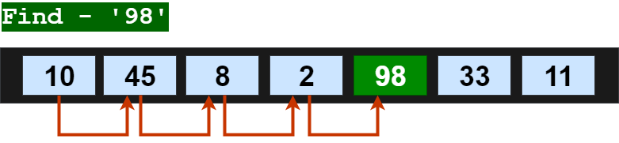
5.2 Linear Search
A linear search or sequential search is a method for finding an element within a list . It sequentially checks each element of the list until a match is found or the whole list has been searched.
A linear search runs in at worst linear time and makes at most n comparisons, where n is the length of the list. If each element is equally likely to be searched, then linear search has an average case of n+1/2 comparisons, but the average case can be affected if the search probabilities for each element vary.
Figure 6.15 Find ’98’ in list by linear search

Slide 28
Linear Search (Pseudocode)
Take the input array arr[] from user.
Take element(x) you want to search in this array from user.
Set flag variable as -1
LOOP : arr[start] -> arr[end]
if match found i.e arr[current_postion] == x then
Print “Match Found at position” current_position.
flag = 0
abort
After loop check flag variable.
if flag == -1
print “No Match Found”
STOP
Notes:
Pseudocode : mã giả Loop : vòng lặp
"abort" trong vòng lặp loop có thể có nghĩa là dừng vòng lặp loop ngay lập tức và thoát khỏi nó, bỏ qua các lệnh còn lại trong vòng lặp. Cách dừng vòng lặp này thường được sử dụng khi có một điều kiện nào đó được đáp ứng, và bạn muốn kết thúc vòng lặp ngay lập tức. Vd: lệnh break ;

Slide 29
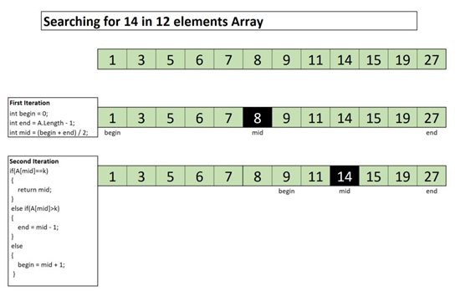
5.3 Binary Search
binary search, also known as half-interval search, logarithmic search, or binary chop, is a search algorithm that finds the position of a target value within a sorted array.
Binary search compares the target value to the middle element of the array.
If they are not equal, the half in which the target cannot lie is eliminated and the search continues on the remaining half, again taking the middle element to compare to the target value, and repeating this until the target value is found.
If the search ends with the remaining half being empty, the target is not in the array.
Figure 6.16 Find ’14’ in list by Binary search
Notes:
Element : phần tử/thành phần
Đk : input phải theo thứ tự
Lấy số middle : 8 là target value

Slide 30
Binary Search (Pseudocode)
Figure 6.17 Pseudocode for Binary search

