Slide 1
Slots 08-09-10 Modules and Functions
Modules -
C-Functions
Scope of a variable
Notes:
Purpose : Tổ chức code ( Chia thành những đoạn code nhỏ ) => Dùng đúng , dễ bảo trì
PP khác : OOP hướng đối tượng

Slide 2
Objectives
Naturally, people divide a complex job into some smaller and simpler jobs. Each sub-job is expressed using a verb.
Similarly, a program can be rather complex.
How to divide a program into simpler parts and how to use them?

Slide 3
Objectives
After studying this chapter, you should be able to:
Define a C- module or C-function?
Explain module’s characteristics
Implement C functions
Use functions?
Differentiate build-in and user-defined functions
Explain mechanism when a function is called
Analyze a problem into functions
Implement a program using functions
Understand extent and scope of a variable

Slide 4
Review
Logic constructs = Statements can be used in a program.
3 Basic constructs: Sequence, selection constructs (if, if…else, ?:), Iteration constructs (for/ while/ do … while)
Walkthrough: Code are executed by ourself, Tasks in a walkthrough: a record of the changes that occur in the values of program variables and listing of the output, if any, produced by the program.

Slide 5
Contents
What is a module?
Characteristics of modules
Hints for module identifying
C-Functions and Modules
How to Implement a function?
How to use a function?
What happen when a function is called?
How to analyze a problem into functions?
Implement a program using functions
Extent and Scope of a variable
Walkthroughs with Functions

Slide 6
1-What is a Module?
(Software)A portion of a program that carries out a specific small function and may be used alone or combined with other modules to create a program.
Natural thinking: A large task is divided into some smaller tasks.
To cook rice:
(1) Clean the pot (2) Measure rice (3) Washing rice (4) add water (5) Boil (6) Keep hot 10 minutes.
Notes:
Modules : Chia nhỏ rồi kết hợp.

Slide 7
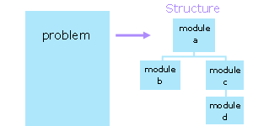
Modules: Structure Design
In designing a program, we subdivide the problem conceptually into a set of design units. We call these design units as modules. In subdividing the problem, we reduce the number of factors with which to deal simultaneously.
Some related modules can be put into a file
(You used it – stdio.h)

Slide 8
Structure Design: An example
Develop a program that will accept a positive integer then sum of it’s divisors is printed out.
Analyze | Code | Description
 | #include <stdio.h> | Use modules in this file
Divide the program into small tasks | int main { int n; int s; | Declare the main module and it’s data
1- Accept n | scanf(“%d”, &n); | Use a module scanf in the stdio.h
2- s = sum of it’s divisors | s = sumDivisors (n); | Module will be implemented
3- Print out s | printf(“%d”, s); | Use a module printf in the stdio.h
4- Pause the program | getchar(); | Use a module getchar in the stdio.h
 | }

Slide 9
2- Characteristics of Modules
Characteristics | Reason
It is easy to upgrade and maintain | It contains a small group of code lines for a SPECIFIC task.
It can be re-used in the same program | It has a identified name ( a descriptive identifier) and can be used more than one time in a program.
It can be re-used in some programs | if it is stored in an outside file (library file), it can be used in some programs.
All of them will be depicted in examples below.
Notes:
Dễ bảo trì , nâng cấp
Tái sử dụng

Slide 10
3- Module identifying: Hints
In a structured design
Each module has one entry point and one exit point,
Each module is highly cohesive (performs a single task – tính gắn kết cao ), code of a module focuses to the determined purpose and some related modules are put in one file.
Each module exhibits low coupling (sự phụ thuộc thấp). In the best case, modules are independent.
Notes:
2 tiêu chí đánh giá : high Cohesive ( tính gắn kết ) and low Coupling ( sự phụ thuộc )

Slide 11
Module identifying …
#include <stdio.h>
int n ;
Module for summing divisors of n
{ accept n
sum of it’s divisors
}
Lowly cohesive
An input operation in a processing module is not encouraged.
➔ All the code in a module focus to the purpose of the module
High coupling Some modules access a common data is not encouraged.
➔ All modules should be self-contained (independent)
Module for printing out divisors of n
{ accept n
Print out it’s divisors
}
int main ()
{ access n
}
Notes:
Ví dụ của High Coupling problem ( phụ thuộc )

Slide 12
Module identifying : Cohesion
Cohesion is a measure of the focus within a module.
A module performs a single task → highly cohesive.
A module performs a collection of unrelated tasks → low cohesion.
In designing a cohesive module, we ask whether a certain task belongs:
The reason to include it is that it is related to the other tasks in some particular manner.
A reason to exclude it is that it is unrelated to the other tasks.
How to identify modules: If you still use a verb to describe a task then a module is identified.
Notes:
Thể hiện module trong C bằng Hàm ( function )

Slide 13
Module identifying :Degrees of cohesion
Low cohesion – generally unacceptable
"coincidental-trùng lặp" - unrelated tasks → This module is not enough small → Separate smaller tasks in this task.
"logical- gom những việc liên quan lại" – This module contains some related tasks of which only one is performed - the module identifier suggests a choice → Separate them into separate smaller module, each smaller module for a choice.
"temporal-tạm thời" - multiple logically unrelated tasks that are only temporally related → Separate them into separate smaller module although they are temporal.
One module for two tasks:
- Sum divisors of the integer n
- Print out divisors of the integer n
In the case of the operation for summing of n is not used, this module can not be applied.

Slide 14
Module identifying : Degrees of cohesion
High cohesion – generally acceptable
"communicational" - the tasks share the same data - all tasks are carried out each time.
"sequential" - multiple tasks in a sequentially dependent relationship - output of one task serves as input to another task - the module identifier suggests an assembly line
"functional" - performs a single specific task - the module identifier suggests a precise verb phrase
Some modules share the common data can be accepted if they perform their tasks sequentially.

Slide 15
Module identifying : High Coupling
It's not advisable.
Coupling is a measure of the degree of interrelatedness of a module to its referring module(s).
A module is low in coupling if it performs its tasks on its own.
A module is highly coupled if it shares that performance with some other module including the referring module (It should not be used ).
In designing for low coupling, we ask what kind of data to avoid passing to the module.

Slide 16
Module identifying : Coupling classification
The data classifications include
"data" - used by the module but not to control its execution → Data in/dependant
"control" - controls the execution of the module → Control in/dependent
"external" - part of an environment external to the module that controls its execution
"common" - part of a global set of data
"content" - accesses the internals of another module
high
low

Slide 17
Module identifying : How to create them?
If you still use a verb to describe a task then a module is identified.
In practice:
list all of the tasks (verbs) that the program should perform to solve this problem
identify the modules (verbs) for the problem structure
check that each module is high in cohesion (each basic task is a module)
check that each module is low in coupling (modules are independent)

Slide 18
4- C-Functions and Modules
In C, we represent a module by a function.
A function may receive data and may return a value. Examples:
Print out divisors of the integer n → n is data is accepted by the function and no value is returned.
n =10 ➔ Print out values: 1, 2, 5
Sum of divisors of the integer n → n is data is accepted by the function and a value is returned. returned
n =10 ➔ 8 is the return value
The description of the internal logic of a function as the function's definition.

Slide 19
Function Definitions: 4 parts
Function header
returnType functionName (Type param1, Type param2, …)
{ <code> [return value; ] }
Function body
What is the result of the task
What is the name of the task?
To do this task, what are necessary data?
How does this task do?

Slide 20
Function syntax: Example
return DataType
Function Identifier
Parameters
double average (int a, int b, int c)
{ double result;
result = (a+b+c)/3. ;
return result;
}
Body:
Logical construct
Review
3.0 and 3. are the same
3.3500 = 3.35
3.30 = 3.3
3.0 = 3.
Review:
(a+b+c)/3 → integer
Review:
(a+b+c)/3.0 → double

Slide 21
Function syntax: void function
To identify a function that does not return any value, we specify void for the return data type and exclude any expression from the return statement:
Alternatively, we can omit the return statement altogether.
A function that does not return a value is called a subroutine or procedure in other languages.

Slide 22
void Function: Example
void printDivisors (int n)
{ int i;
for (i=1; i<= n/2; i++)
if (n%i==0) printf(“%d, “, i);
}
Cases in which void functions can be selected:
If you do this task, you realize that no value is needed after this task done.
In the function body, the essential statements are printing data out.

Slide 23
main function
The main() function is the function to which the operating system transfers control at the start of execution.
main returns a value to the operating system upon completing execution. C compilers assume an int where we don't provide a return data type.
The operating system typically accepts a value of 0 as an indicator of success and may use this value to control subsequent execution of other programs.
main() is the entry point of a C- program

Slide 24
5-How to implement a function?
State the task clearly: Verb + nouns (Objects)
Verbs:
Find,
Compute,
Count,
Check
int | long | ...
void
FunctionName( Type param1, Type param2 )
{
<steps of processing>
return [ Expression];
}
Others
Give values to the parameters;
Carry out the work with yourself;
Write down steps;
Translate steps to C;
A task is described clearly if the receiver does not need to ask any thing.

Slide 25
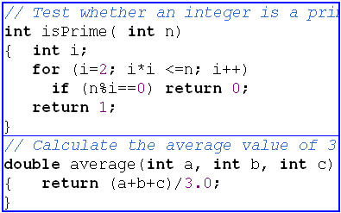
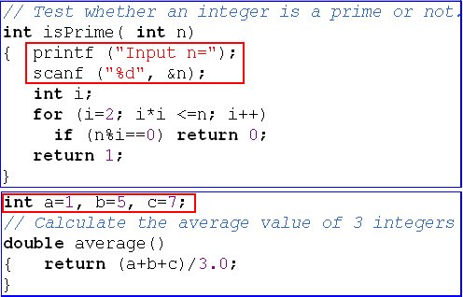
Evaluate some functions
This function contains a sub-task → low cohesive.
Better
Functions for testing will return 1 for true and 0 for false.
Common algorithm in testing is checking all cases which cause FALSE. TRUE is accept when no case cause FALSE
This function accesses outside data
→rather coupling
Notes:
isPrime : hàm kiểm tra xem là số nguyên tố hay không

Slide 26
6-How to use a function?
In C, you can use either the built-in library functions or your own functions.
If you use the built-in library functions, your program needs to begin with the necessary include file.
Syntax for using a function: functionName (arg1, arg2,…);
Distinguish parameters and arguments
Parameters: names of data in function implementation
Arguments: data used when a function is called

Slide 27
Demonstration 1
Develop a program that will perform the following task in three times:
Accept a positive integer.
Print out it's divisors →User-defined function.
Print out divisors of the positive integer n
n=10
i=1 → n%i → 0 → Print out i
i=2 → n%i → 0 → Print out i
i=3 → n%i → 1
i=4 → n%i → 2
i=5→ n%i → 0 → Print out i
void printDivisors ( int n)
{ int i;
for ( i=1; i<=n/2; i++)
if (n%i==0) printf ( “%d, “, i );
}
For i=1 .. n/2
if (n%i ==0) Print out i;

Slide 28
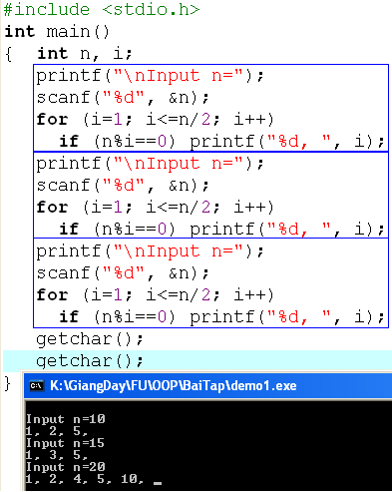
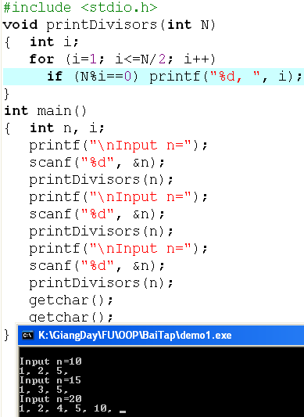
Demonstration 1
A function can be re-used.
parameter
Function Implementation
argument
Using function
What do you think if the program will perform this task 20 times?

Slide 29
Demonstration 2
Develop a program that will accept a positive integer then sum of it’s divisors is printed out.
Sum of divisors of the positive integer n
n=10, S=0
i=1 → n%i → 0 → S= 0+1 =1
i=2 → n%i → 0 → S=1+2=3
i=3 → n%i → 1
i=4 → n%i → 2
i=5→ n%i → 0 → S= 3+5=8
int sumDivisors ( int n)
{ int S=0, i;
for ( i=1; i<=n/2; i++)
if (n%i==0) S +=i;
return S;
}
S=0;
for i=1 .. n/2
if (n%i ==0) S+=i;
return S;

Slide 30
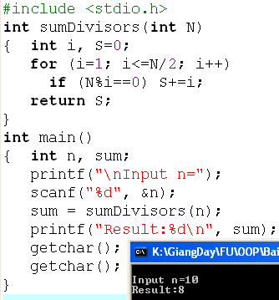
Demonstration 2
Code yourself

Slide 31
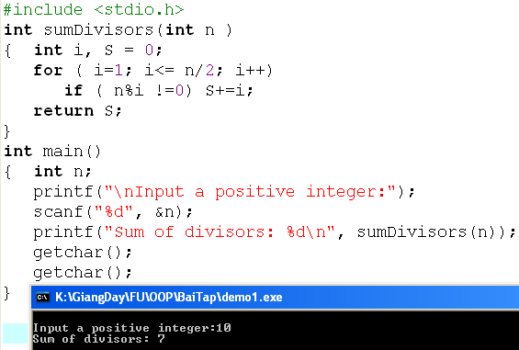
Demonstration 3
Functions help maintaining the code easier.
Error source.
N=10 → 1+2+5 = 8
7 Is printed out. WHY?

Slide 32
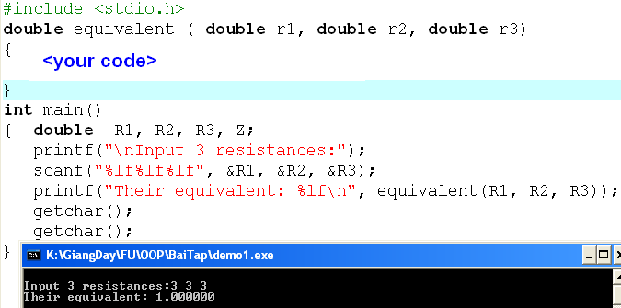
Demonstration 4
Develop a program that will accept 3 resistances of a paralleled circuit and their equivalent is printed out.
1/Z = 1/r1 + 1/r2 + 1/r3 → Z = . . .

Slide 33
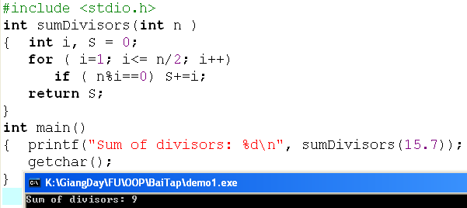
Coercion When a Function is Called
If there is a mismatch between the data type of an argument and the data type of the corresponding parameter, the compiler, wherever possible, coerces (sự ép kiểu) the value of the argument into the data type of the parameter.

Slide 34
Function Prototypes
Function prototypes describe the form of a function without specifying the implementation details → Function declaration is put at a place and it’s implementation is put at other.
When the program is compiled:
Step 1: The compiler acknowledges this prototype (return type, name, order of data types in parameters) and marks places where this function is used and continues the compile process.
Step 2: If the function is detected, the compiler will update the marks in the previous step to create the program. Else, an error is thrown.
returnType FuncName ( Type1 [ param1], Type2 [param2], . . . ) ;

Slide 35
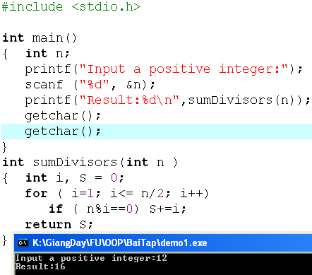
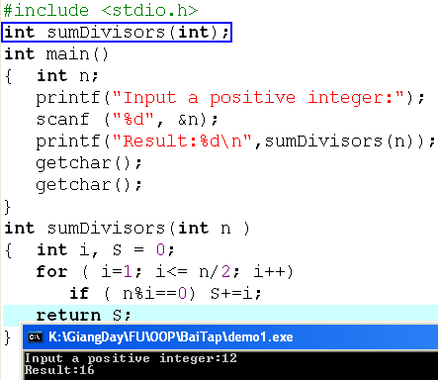
Function Prototypes…
OR
Prototype
The DEV C++ 4.9.9.2 compiler agrees user-defined functions which are implemented below the main function. Others, such as BorlandC++, do not.
It isn't recommended to take specific characteristics of the specific compilers. Use standard rules for making your program compiled easily in all compilers

Slide 36
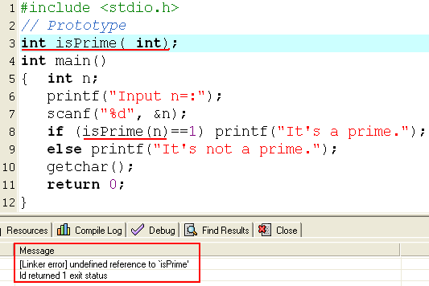
Function Prototypes…
Prototype: Acknowledge it
Use it. This position is marked.
But it’s implementation is missed!
→ Can not update marks → Error

Slide 37
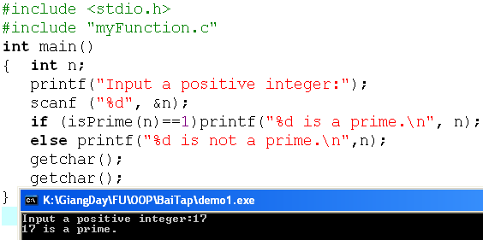
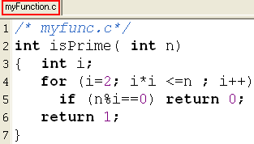
The #include Directive
We use the #include directive to instruct the compiler to insert a copy of the header file into our source code.
Syntax: #include "filename" //in user directory
#include <filename> // in system directory

Slide 38
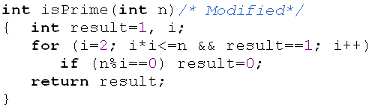
Evaluating the isPrime(int) function
2 exit points
➔ It is not recommended.
Structure of a program code should be organize in a manner so that it is understandable, testable and readily modifiable.
➔It consists of simple logical constructs, each of which has one entry point and one exit point.

Slide 39
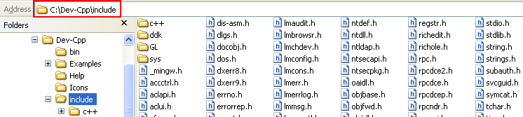
The #include Directive
System directory: The include directory of the select programming environment (such as Dev C++)

Slide 40
Programming Style
For style, we
declare a prototype for each function definition
specify the return data type in each function definition
specify void for a function with no parameters
avoid calling the main function recursively
include parameter identifiers in the prototype declarations
use generic comments and variables names so that we can use the function in a variety of applications without modifying its code

Slide 41
7-What happen when a function is called?
We use function calls to transfer execution control to functions. The syntax of a function call is
functionIdentifier (argument1,argument2,...);
Once a function finishes executing its own instructions, it returns control to the point immediately following the initiating call.

Slide 42
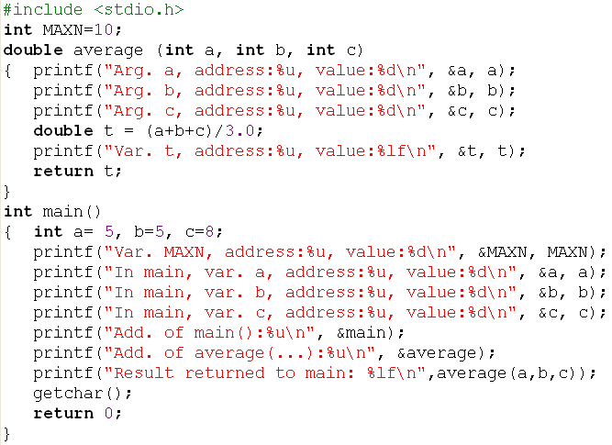
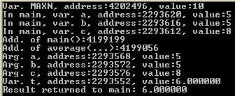
Memory Map when a function is called.
Data segment
4202496
MAXN=10
Code segment
Code of main()
4199199
Code of average()
4199056
HEAP
STACK
segment
2293620
a = 5
2293616
b = 5
2293612
c = 8
2293576
c = 8
2293572
b = 5
2293568
a = 5
2293552
t = 6.0000

Slide 43
Memory Map when a function is called.
Data segment
4202496
MAXN=10
Code segment
Code of main()
4199199
Code of average()
3
2
4199056
2293620
a = 5
4
3
1
b = 5
2293616
Mechanism for Calling function in C
1- Data of called function are allocated in the stack segment.
2- Copy values of arguments(calling function) to parameters (called function).
3- Control is moved to the called function and codes in the called function executes, result value of the called function is returned to the calling function and control is moved to the calling function
4- Remaining codes in the calling function execute.
2293612
c = 8
2
2293576
c = 8
2293572
b = 5
2293568
a = 5
2293552
t = 6.0000

Slide 44
Pass by value
C-language uses the “pass by value” only when passing arguments to called functions.
The function receives copies of the data supplied by the arguments in the function call (the compiler allocates space for each parameter and initializes each parameter to the value of the corresponding argument in the function call)
So, anything passed into a function call is unchanged in the caller's scope when the function returns → Parameters and arguments stored in different addresses → Although they have the same names, they are still different.
When a called function completes it’s task, it’s memory block, allocated, is de-allocated.

Slide 45
In-class Exercise
#include <stdio.h>
void swap( int a, int b)
{ int t;
printf("In swap, var. a, add.:%u, value:%d\n", &a, a);
printf("In swap, var. b, add.:%u, value:%d\n", &b, b);
printf("In swap, var. t, add.:%u, value:%d\n", &t, t);
t = a;
a = b;
b = t;
}
int main()
{ int x = 5, y = 7;
printf("In main, var. x, add.:%u, value:%d\n", &x, x);
printf("In main, var. y, add.:%u, value:%d\n", &y, y);
printf("Addr. of main(): %u\n", &main);
printf("Addr. of swap(...): %u\n", &swap);
swap (x, y);
printf("After swapping x and y\n");
printf("x=%d, y=%d\n", x, y);
getchar();
return 0;
}
A program for swapping two integers is implemented as this code.
Copy, paste, compile and run this program.
Draw memory map
Explain the result

Slide 46
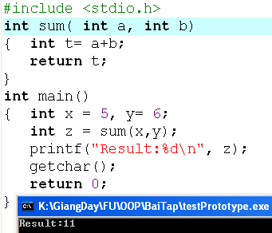
How does a return-function perform?
When a return-value function executes, a memory block is allocated to store the result of the function
b=6
a=5
2
11
t=11
1
3
x=5
y=6
z
1
Copy arguments to function’s parameters
Code of the function executes to determine the result
Copy the return value to the calling function
2
3

Slide 47
8-Analyse a program to functions
// library functions
#include <stdio.h>
void verb1 ( Type a)
{ }
int verb2(Type b)
{ ...... return 3*b; }
int main()
{ int a, b, c;
verb1(a); // gọi hàm
printf(“%d\n”, verb2(b) );
<suitable statements>
}
Pick
nouns
Variables a, b, c
(Suitable types)
Problem
Begin
Verb1 a ; // complex
Verb 2 b; // complex
Verb 3 c; // Simple
...
End.
Re-order
requirements
to get
a logical
order
(Algorithm)
Simple task:
Input/Output simple variables
→ Use library functions

Slide 48
9- Implement a program using functions
Develop a program that will print out the n first primes.
Analysis
Nouns: the integer n → int n
Verbs:
- Begin
- Accept n → simple
- Print n first primes → function
- End.
Analysis
Function print_n_Primes (int n)
int count = 0;
int value = 2;
while (count <n)
{ if ( value is a prime → function
{ count = count +1;
print out value; → simple
}
value = value +1;
}
Input: n=5
Output: 2, 3, 5, 7, 11

Slide 49
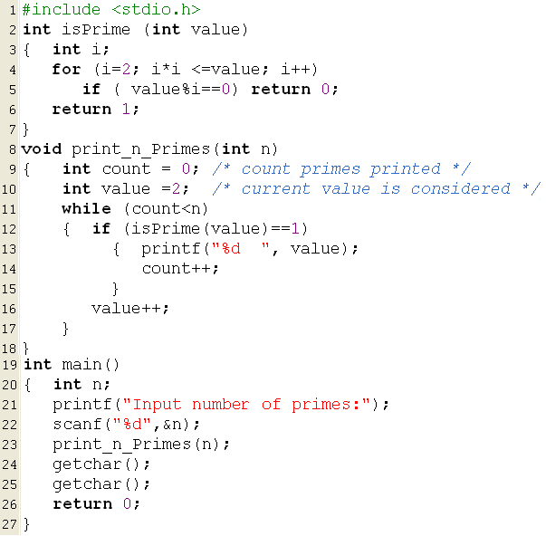
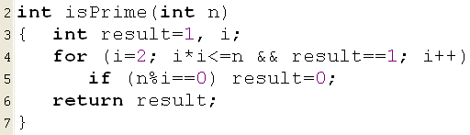
Implement a program using functions …
Develop a program that will print out n first primes.
Implement it.

Slide 50
Implement a program using functions …
Develop a program that will accept two positive integers then print out the greatest common divisor and the least common multiple of them.
Analysis
Nouns: 2 integers → int m,n
The greatest common divisor → int G
The least common multiple → int L
Verbs:
- Begin
- Accept m, n → simple
- G= Calculate the greatest common divisor of m,n → function gcd
- L = Calculate the least common multiple of m,n → function lcm
- Print out G, L → simple
- End.

Slide 51
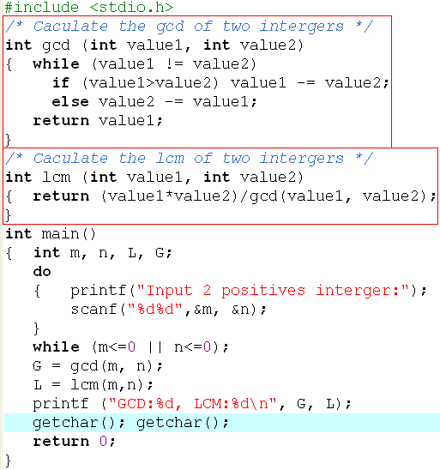

Implement a program using functions …
value1 | value2
14 | 62
 | 62-14 = 48
 | 48-14 = 34
 | 34-14 = 20
 | 20 -14 = 6
14-6 = 8 8-6=2
 | 6-2 = 4 4-2= 2

Slide 52
10- Extent and Scope of a variable
Extent of a variable: (tuổi thọ) Duration begins at the time the memory of this variable is allocated to the time this block is de-allocated.
Scope of a variable: (tầm vực) The code block between the line which this variable is declared and the close brace of this block. In it’s scope, the variable is visible ( means that accessing to this variable is valid).
Global Variables: (biến toàn cục) Variables declared outside of all functions → They are stored in the data segment. If possible, do not use global variables because they can cause high coupling in functions.
Local Variables: (biến cục bộ) Variables declared inside a function → They are stored in the stack segment.

Slide 53
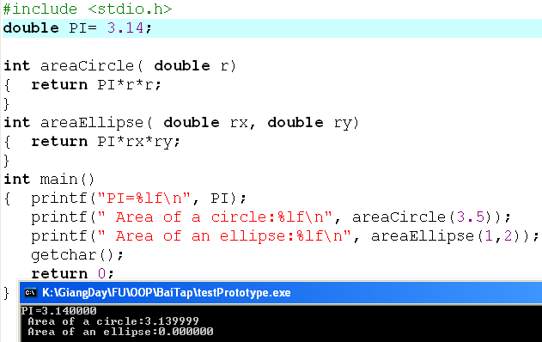
Extent of Variables: Time-View
Program terminates
rx
ry
r
Program
Starts

Slide 54
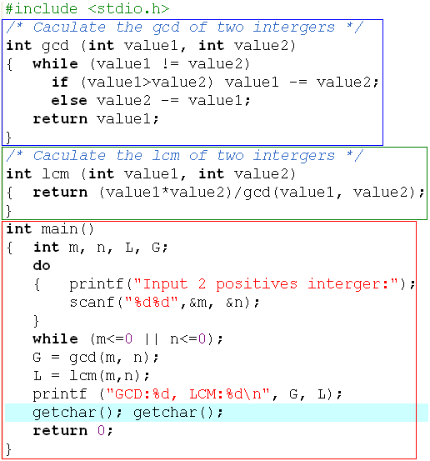
Scope of Variables: Code-View
Local variables of the function gcd include: memory containing return value (int), value1, value2
Local variables of the function lcm include: memory containing return value (int), value1, value2
Local variables of the function main include: memory containing return value (int), m., n, L, G

Slide 55
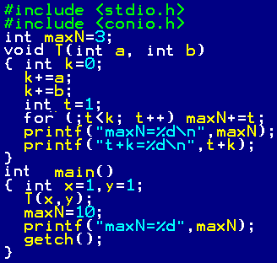
Scope of Variables: Code-View
maxN
a, b
k
t

Slide 56
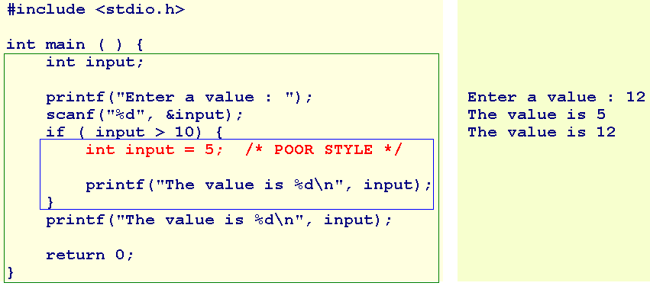
Extent and Scope of a variable: Visibility
Two variables have the same name (input) but they are different because the inner variable has the narrower scope than the outer variable → RULE: Local first, Global later

Slide 57
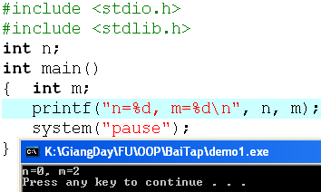
Extent and Scope of a variable: Visibility Values in non-initialized variables
Clearing all memory blocks of a program before the program is loaded may spend a significant time. So, the mechanism is usually used is clearing the data segment only, but the stack segment is not. As a result, if variables are not initialized, a global variable is 0 but a local variable contains a non predictable value.

Slide 58
11- Walkthroughs with Functions
Given the following function and a case of using it. What is the value of the variable t when the function terminates?
int f( int a, int b, int c)
{ int t= 2*(a+b-c)/5;
return t;
}
y=6 | x=5 | z=7 | f(a,b,c)
a | b | c | t
6 | 5 | 7 | 2*(6+5-7)/5 =1
int x = 5, y= 6, z= 7;
int t = 3*f(y,x,z);
t = 3*f(…) = 3*1 = 3

Slide 59
Summary
Module: A portion of a program that carries out a specific function and may be used alone or combined with other modules to create a program.
Advantages of modules: It is easy to upgrade and it can be re-used
C-function is a module
A function is highly cohesive if all it’s statements focus to the same purpose
Parameters make a function low coupling
4 parts of a function: Return type, function name, parameters, body
Syntax for a function:
returnType functionName ( Type param1, Type param2, …)
{ <<statements>
}

Slide 60
Summary
Steps for implementing a function:
State the task clearly, verb is function name, nouns are parameters
Verb as find, search, calculate, count, check → return value function will return value. Other verbs: void function
Give parameters specific values, do the work manually, write down steps done, translate steps to C statement
Simple tasks: input/output some single value → Basic task → Library functions
C-language uses the pass-by-value in passing parameters → The called function can not modify this arguments.
Simple tasks: input/output some single values → Basic tasks → Library functions
C-language uses the pass-by-value in passing parameters → The called function can not modify it’s arguments.

Slide 61
Summary
Function prototype is a function declaration but it’s implementation is put at another place.
Syntax for a function prototype:
returnType functionName ( parameterType,,,,)
Compiler will compile a program containing function prototype in three: Step 1: Acknowledges the function template and marks places where this function is called and step 2, update marks with function implementation if it is detected.
Use a system library function: #include<file.h>
Use user-defined function in outside file: #include “filename”
Extent of a variable begins at the time this variable is allocated memory to the time this memory is de-allocated.
Scope of a variable begins at the line in which this variable is declared to the closing brace containing it.

Slide 62
Thank you

Slide 63
Exercises
Write a C program that will accept a non-negative integer then print out whether this number is power of 2 or not.
Analysis
Variable: long n;
Operation: Check a long integer n whether it is power of 2 or not ( named isPower2 )
return ((n & (n-1))==0);
main function:
Do
accept n;
While (n<=0)
if (isPower2(n)==1) Print out “ It is power of 2”
else print out “ It is not power of 2”
n | n binary | n&(n-1)
1 | 0000 0001 | 0000 0001 0000 0000 0000 0000
2 | 0000 0010 | 0000 0010 0000 0001 0000 0000
4 | 0000 0100 | 0000 0100 0000 0011 0000 0000
8 | 0000 1000 | 0000 1000 0000 0111 0000 0000
16 | 0001 0000 | 0001 0000 0000 1111 0000 0000

Slide 64
Exercises
Write a C program that will
Accept 3 integers m, d, y that represent a date.
Print out they are valid or not.
Attention:
The February in a leap year will have 29 days.
If Y is a leap year then (Y%4==0 && Y%400 !=0) || (Y%100==0)
Write a C-program

Slide 65
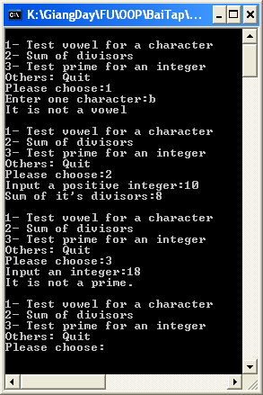
Program using menu for some tasks
Develop a C-program that allows user choose one task at a time:
1- Test whether a character is a vowel or not.
2- Print out sum of divisors of an integer.
3- Test whether an integer is a prime or not.

Slide 66
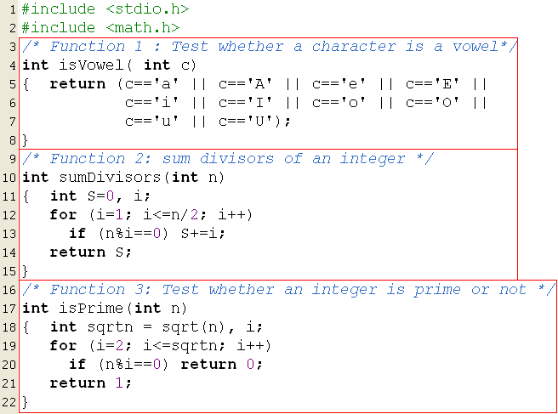
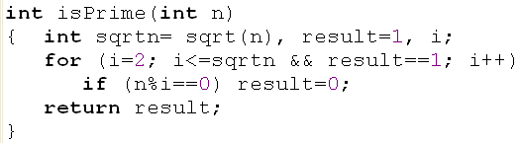
Program using menu for some tasks

Slide 67
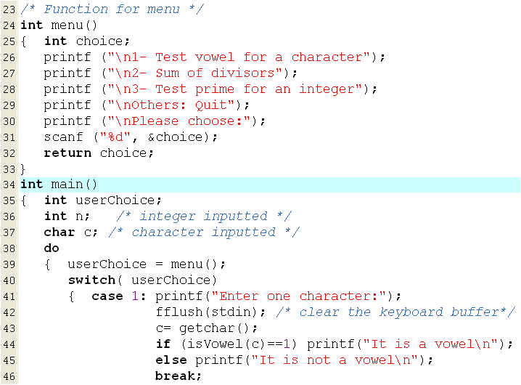
Program using menu for some tasks

Slide 68
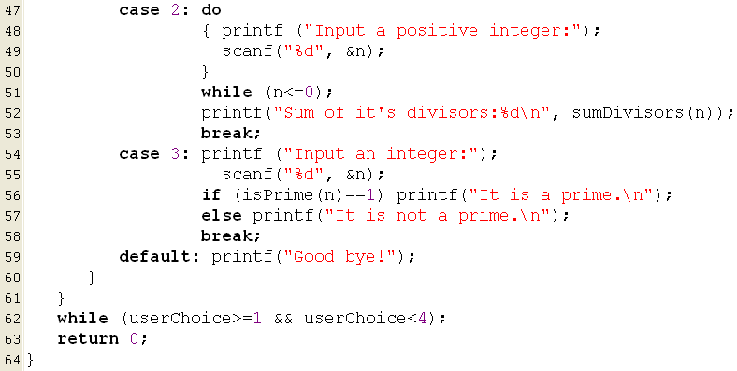
Program using menu for some tasks

