Slide 1
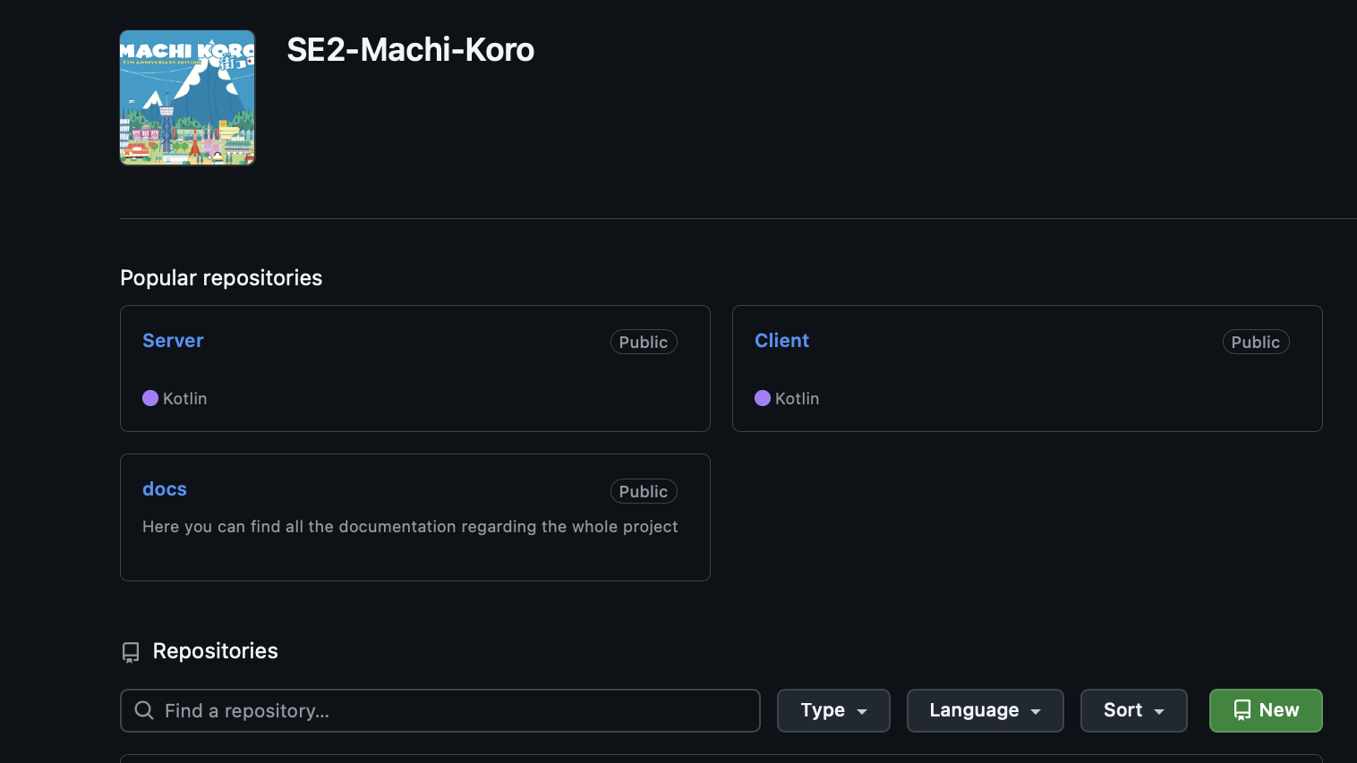
Machi Koro Sprint 3- Review
Team Bisasam

Slide 2
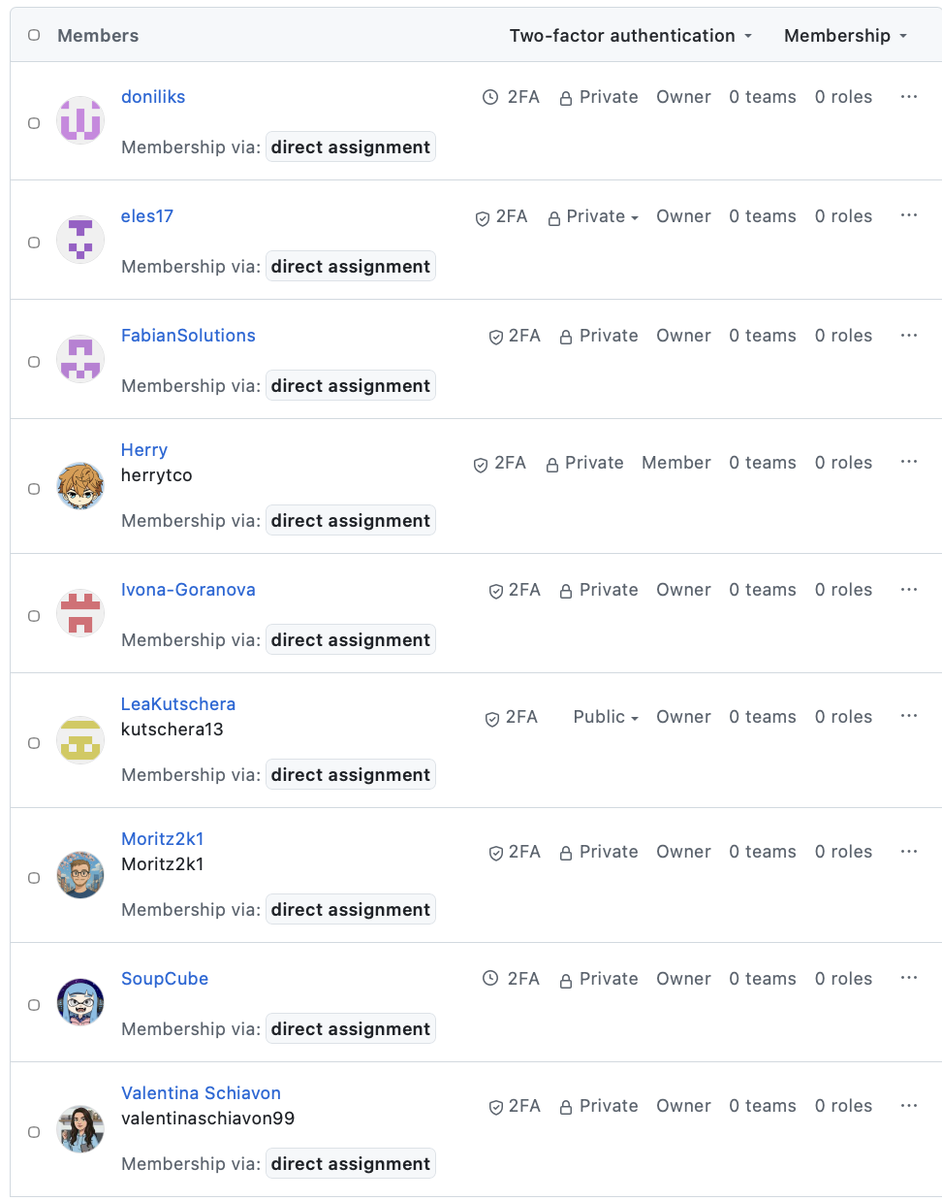
Team Bisasam
Danylo Lavrov => doniliks
Fabian Barrasch => FabianSolutions
Ivona Goranova => Ivona-Goranova
Lea Kandut => SoupCube
Lea Kutschera => LeaKutschera
Lev Starman => eles17
Moritz Gutschi => Moritz2k1
Valentina Schiavon => valentinaschiavon99

Slide 3

Sprint 1 Goal - RECAP
Project setup (Ci-Piplines, Sonar, Quality Gates, Websockets, Docker, Database, UML, User Stories, UI Sketches...)
Basic game loop
Game Initialization (minimal)
Dice Roll
Coin Gain
Buy Card
Turn Handling

Slide 4
Initial Sprint 2 Goal – RECAP
● First-level prototype. DONE
○ Alternatively: Basic game loop is functional. DONE
● Network communication between at least 2 players. DONE
● Game state recovery upon disconnection/reconnection. DONE
● Game state recovery upon failure/restart of the backend container. DONE
● Health endpoint implemented DONE
● Backend is automatically built as a container and deployed on the university server DONE
● Documentation DONE
○ Focus: Network protocol DONE

Slide 5
Sprint 3 Goal
Game fully playable
● API security
○ Endpoints must ensure that the player is authorised to call them (e.g. Player 1 must not make calls on behalf of Player 2, …)
● Documentation
○ Release management
○ Deployment.
● Cheat function integrated and included in the tutorial
● Set resource limits and update the Docker Compose file accordingly
● Error handling implemented correctly

Slide 6
Sprint 3 Goal
Game fully playable - YES
● API security - DONE
○ Endpoints must ensure that the player is authorised to call them (e.g. Player 1 must not make calls on behalf of Player 2, …) DONE
● Documentation
○ Release management DONE
○ Deployment. DONE
● Cheat function integrated and included in the tutorial DONE
● Set resource limits and update the Docker Compose file accordingly DONE
● Error handling implemented correctly DONE

Slide 7
What was achieved in Sprint 2
Core game loop:
Turn handling
Dice roll
Basic coin calculation
Card purchase (simplified rules)
Backend:
Game state management
Turn validation
State updates
WebSocket:
Backend real-time synchronization and broadcasts implemented
Client integration partially implemented
Remaining: full state updates from broadcasts, turn-flow actions, and two-player sync verification
Client:
Display game state (dice, coins, cards, active player)
Allow user interaction for core actions
UI:
Minimal functional screens (not polished)
Implement network communication between at least two players
Support game state recovery after player disconnection/reconnection
Support game state recovery after backend container failure or restart
Implement a health check endpoint
Automatically build the backend as a container and deploy it to the university server
Create documentation with a focus on the network protocol

Slide 8
How will we tackle the open challenges
Mostly UI fixes now and UX improvements
aligning with sketches for UI
making sure that the user
Still chat function to be added by Lea Kanduth

Slide 9

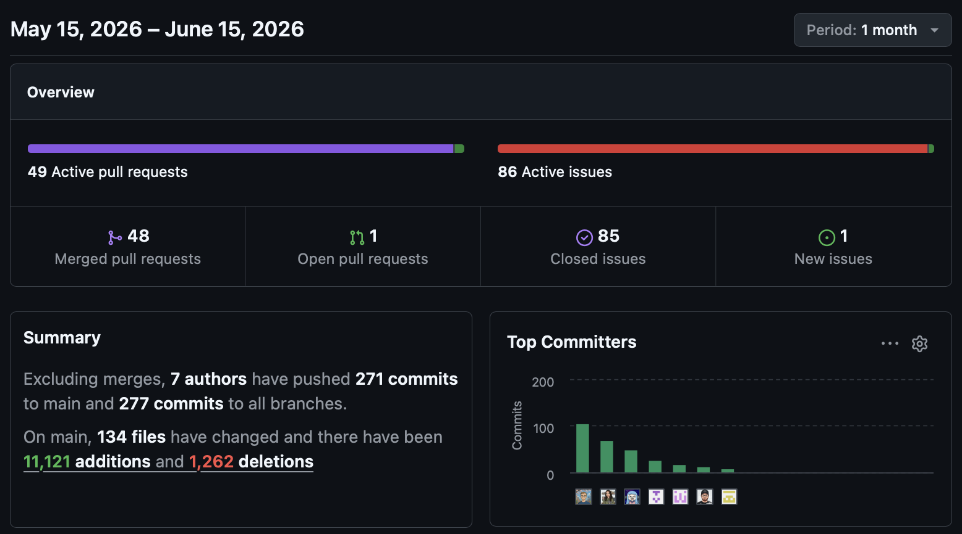
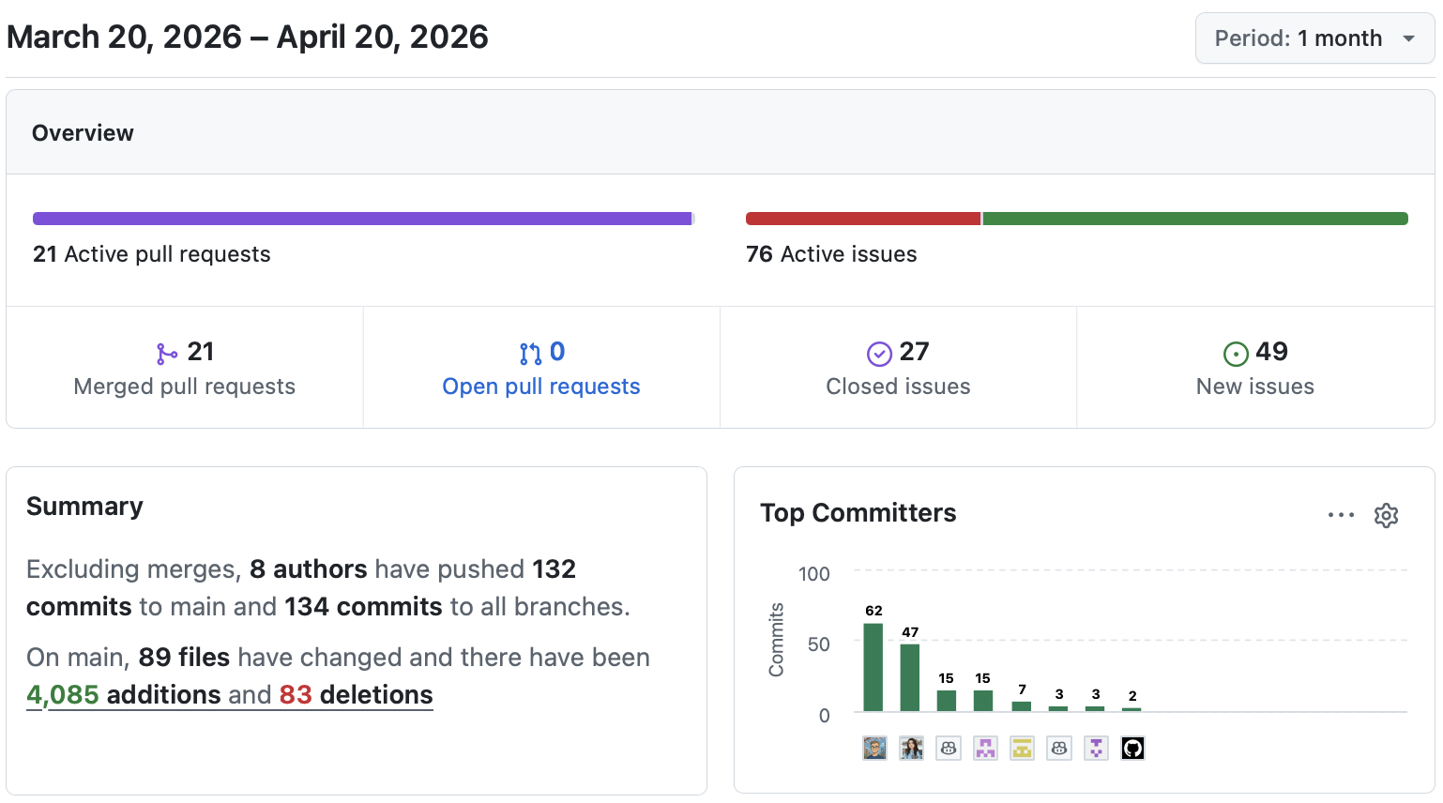
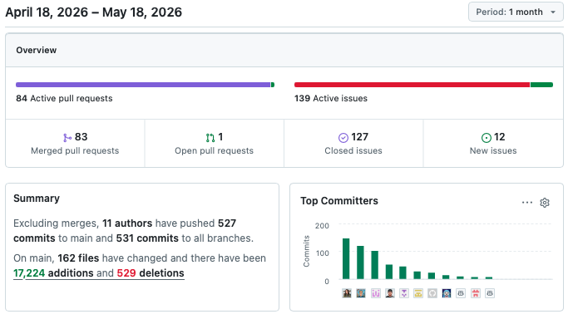
Server Activity

Slide 10

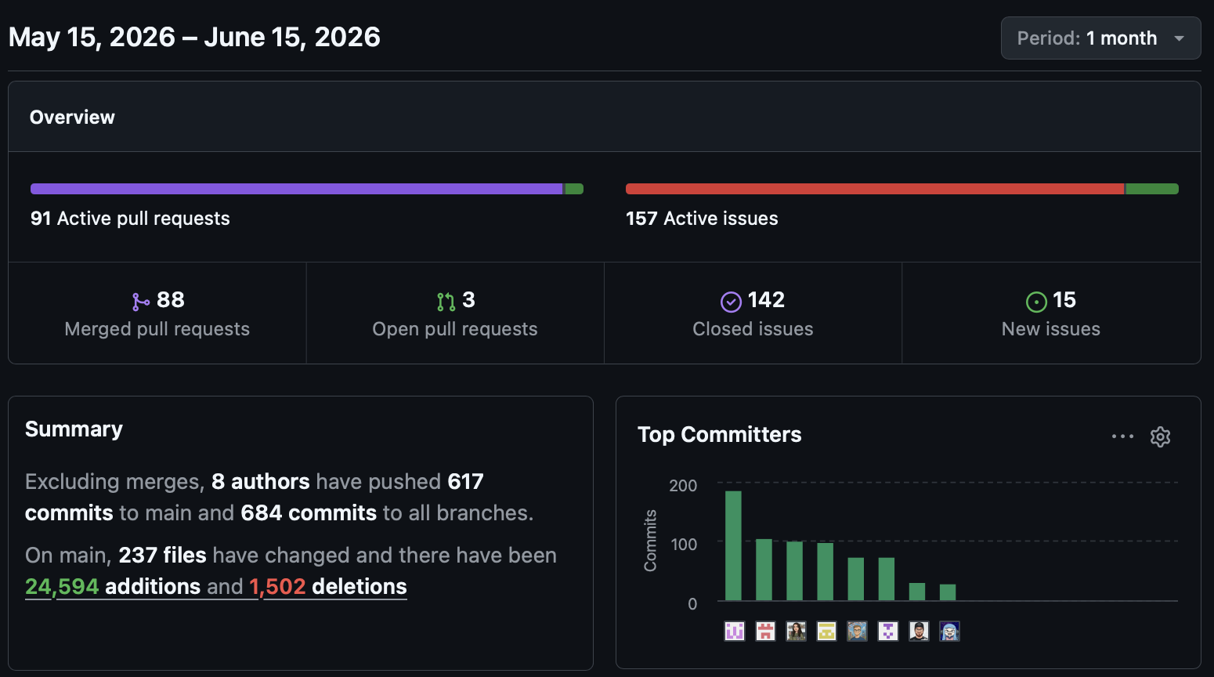
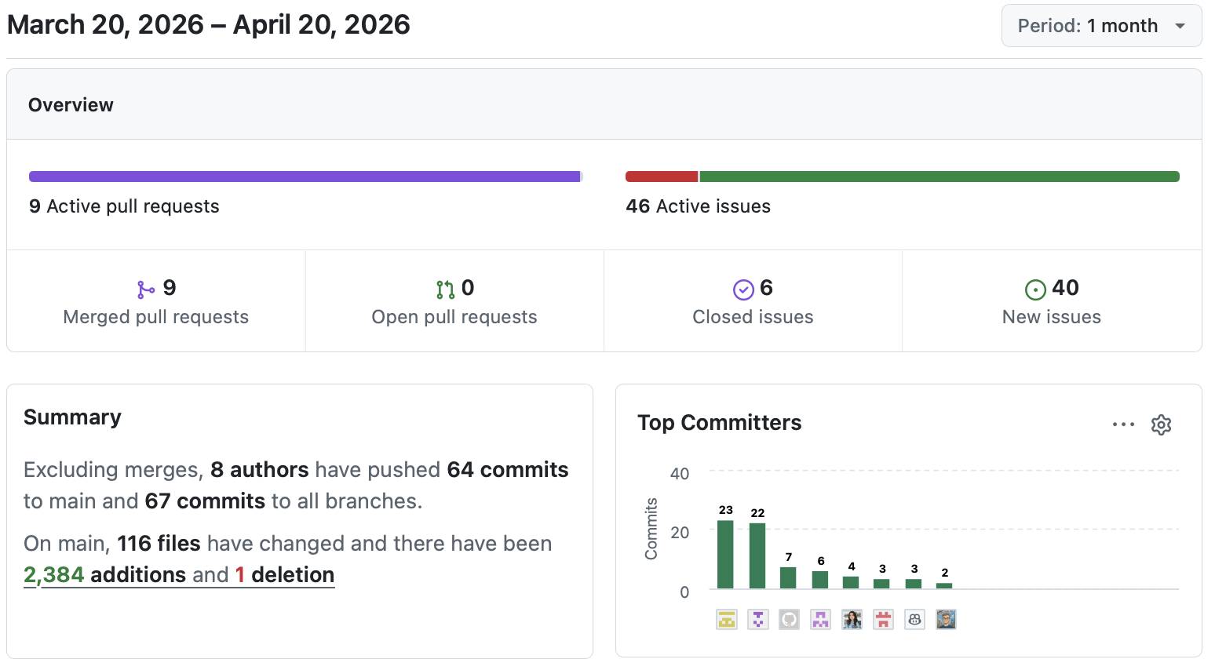
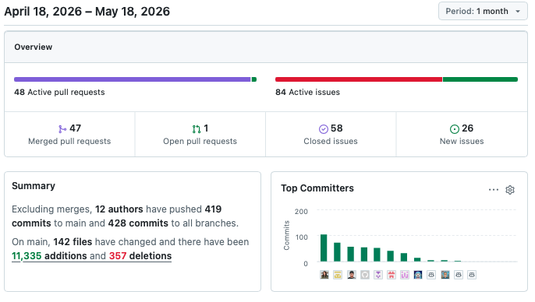
Client Activity

Slide 11
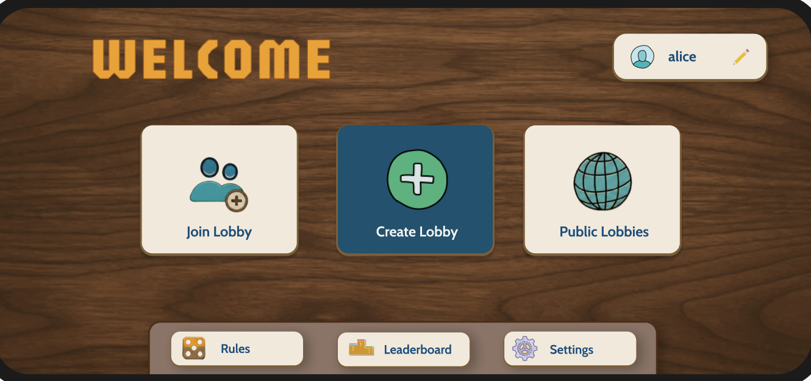
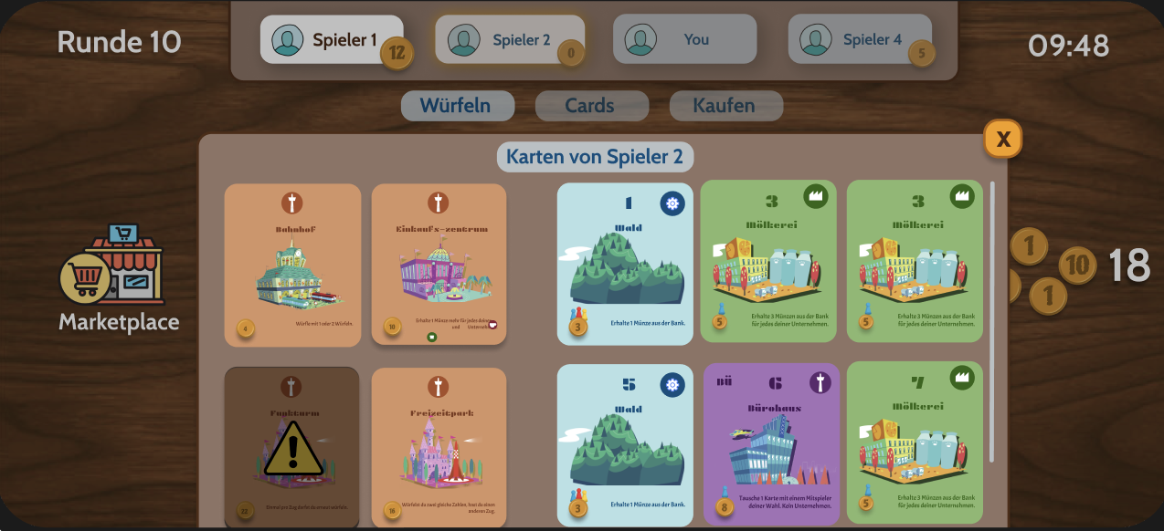
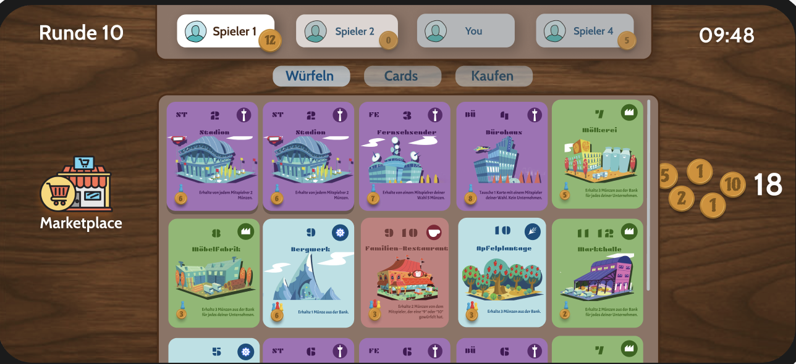
Working Demo – now for real

Slide 12
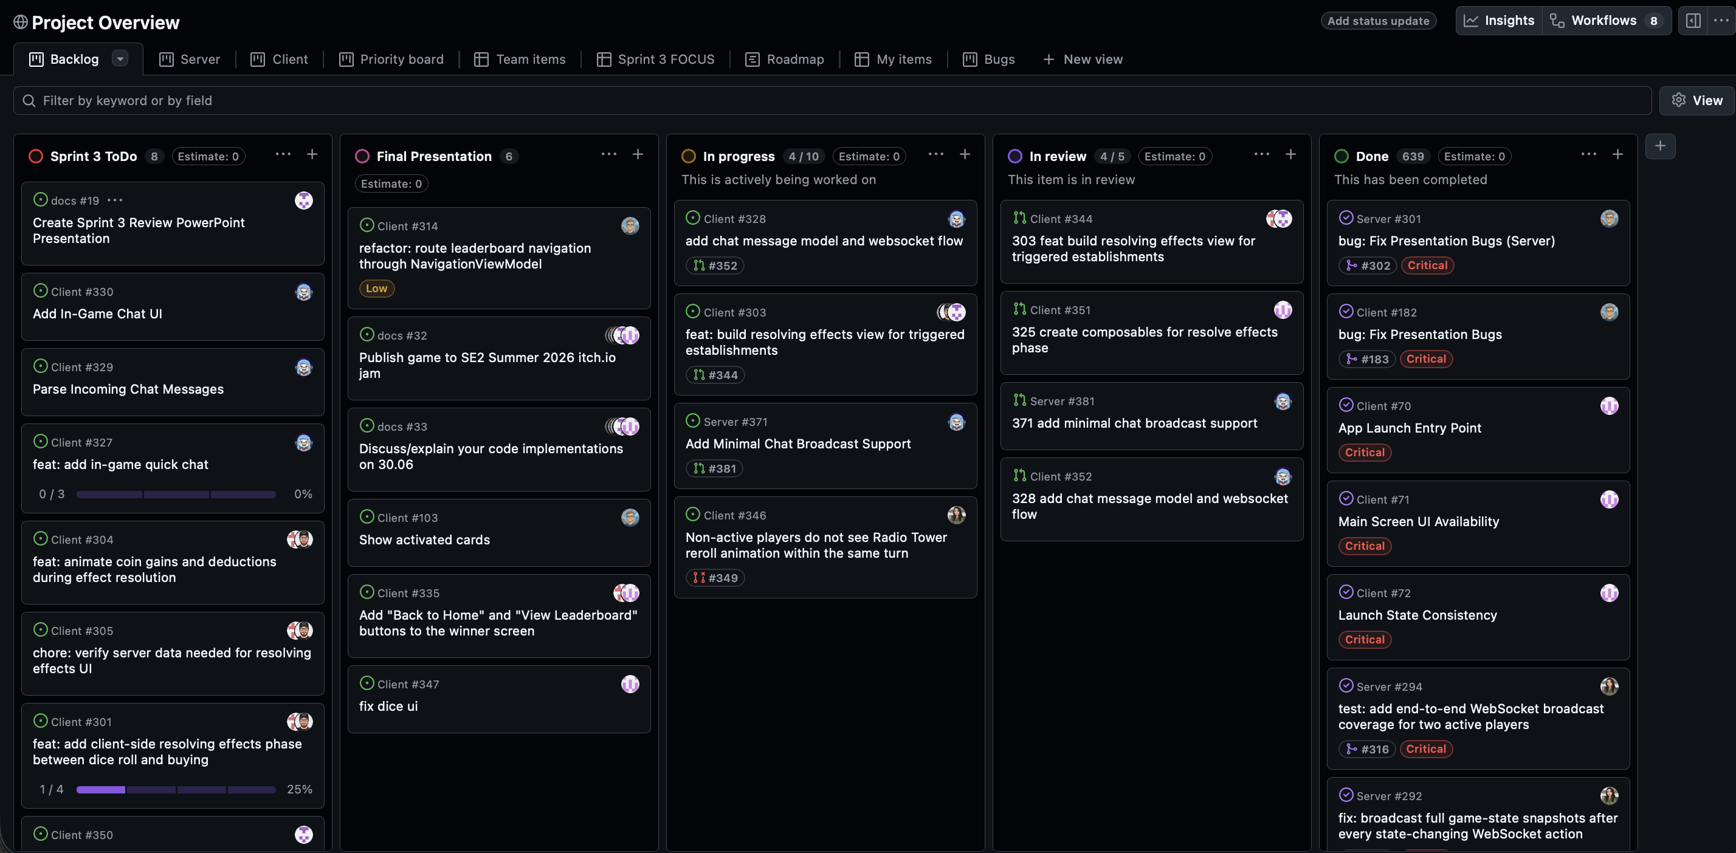
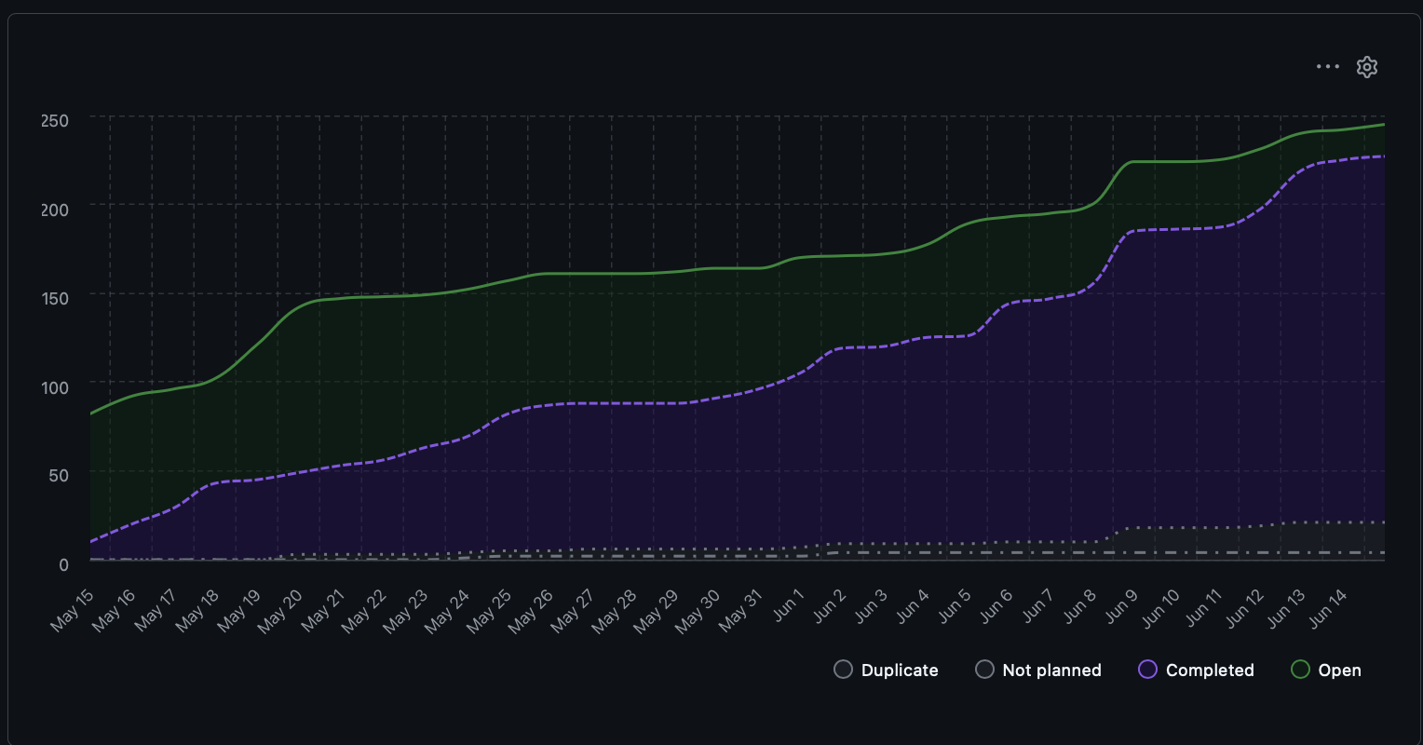
Project Overview
Project overview is in Server

Slide 13
Our questions
How we proceed with uplaoding the game to itchi.io?
When exactly do we have One-On-One meetings?

Slide 14

Thanks for your time. Let's go back merging!

