Slide 1
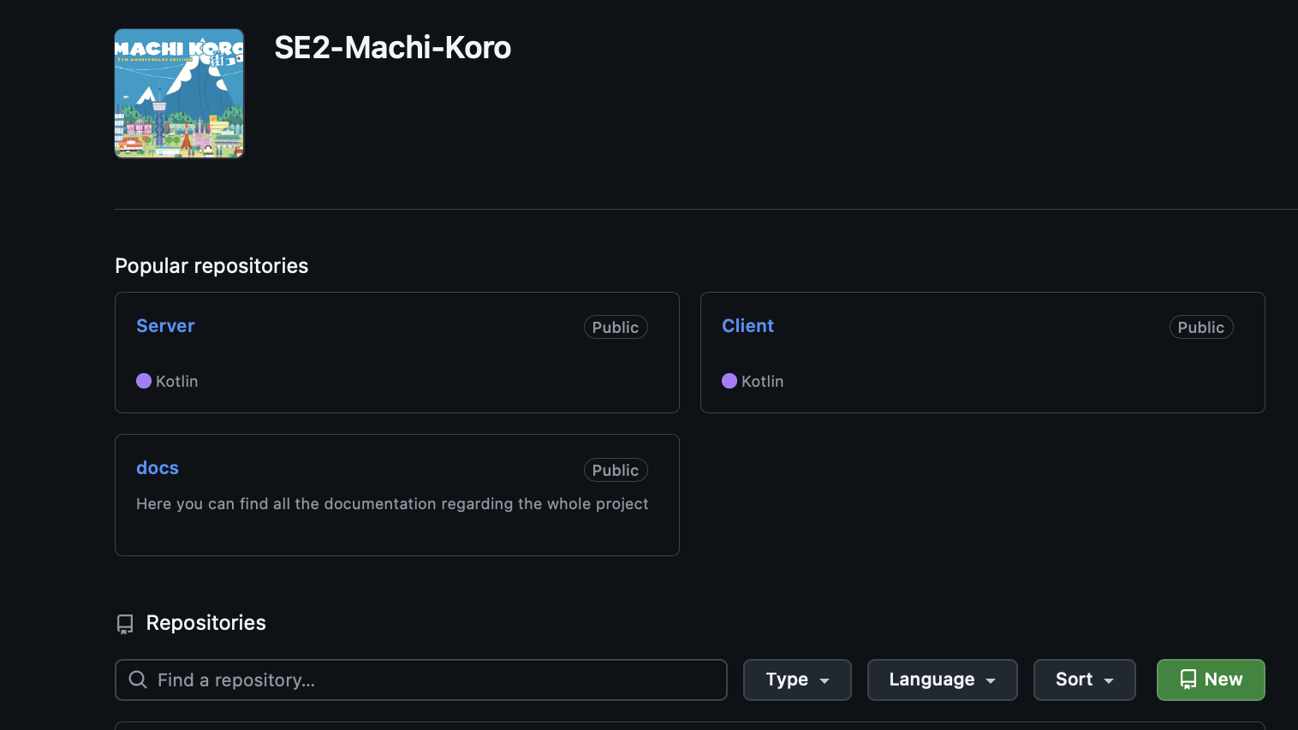
Machi Koro Sprint 1- Review
Team Bisasam

Slide 2
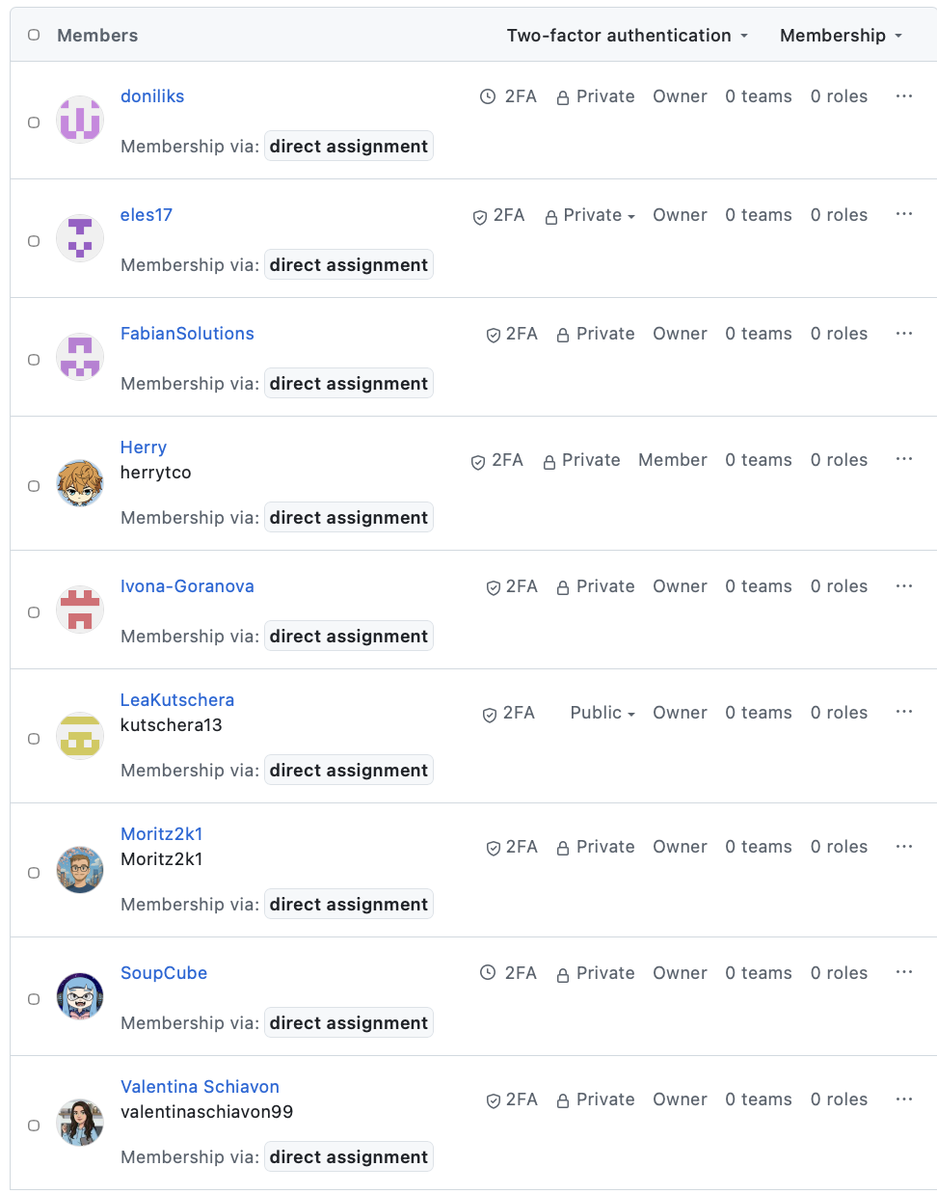
Team Bisasam
Danylo Lavrov => doniliks
Fabian Barrasch => FabianSolutions
Ivona Goranova => Ivona-Goranova
Lea Kandut => SoupCube
Lea Kutschera => LeaKutschera
Lev Starman => eles17
Moritz Gutschi => Moritz2k1
Valentina Schiavon => valentinachiavon99

Slide 3
Sprint 1 Goal
Project setup (Ci-Piplines, Sonar, Quality Gates, Websockets, Docker, Database, UML, User Stories, UI Sketches...)
Basic game loop
Game Initialization (minimal)
Dice Roll
Coin Gain
Buy Card
Turn Handling

Slide 4
What is not finished
Project setup (Ci-Piplines, Sonar, Quality Gates, Websockets, Docker, Database, UML, User Stories, UI Sketches… )
Build a Team environment and workflow
Basic game loop
Game Initialization (minimal)
Dice Roll
Coin Gain
Buy Card
Turn Handling

Slide 5
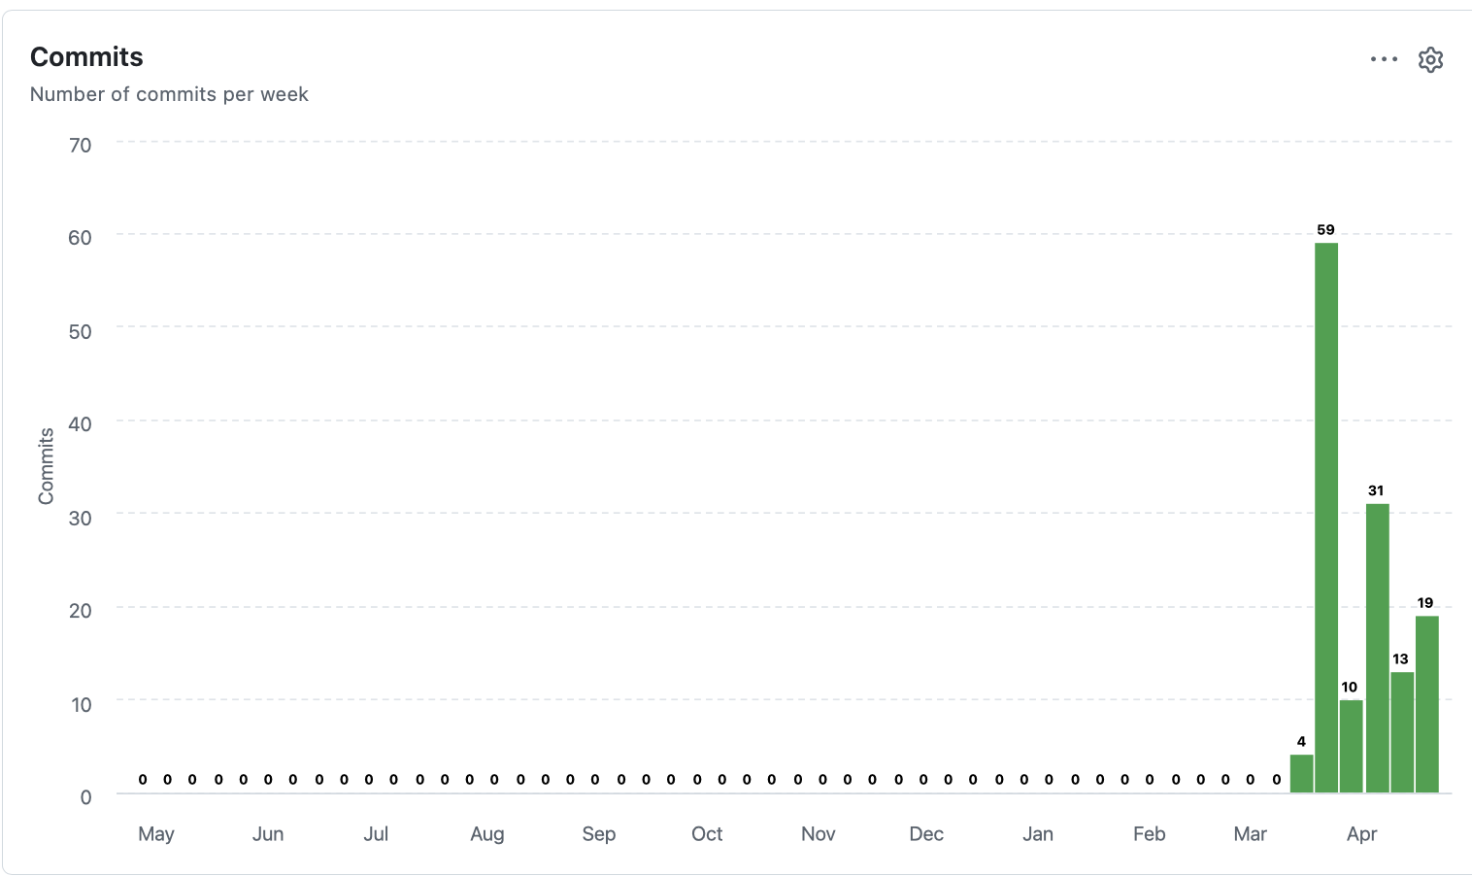
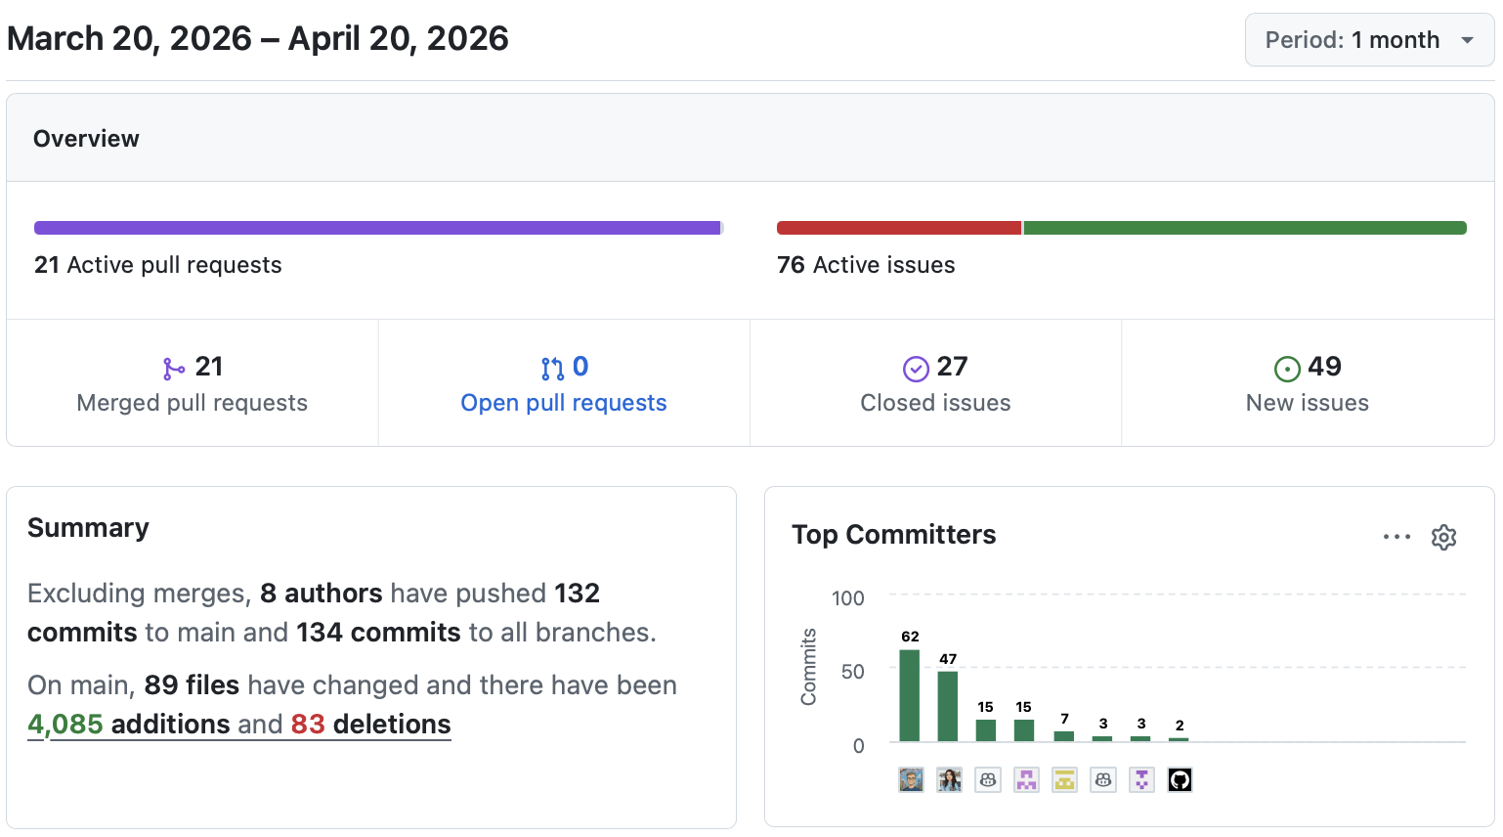
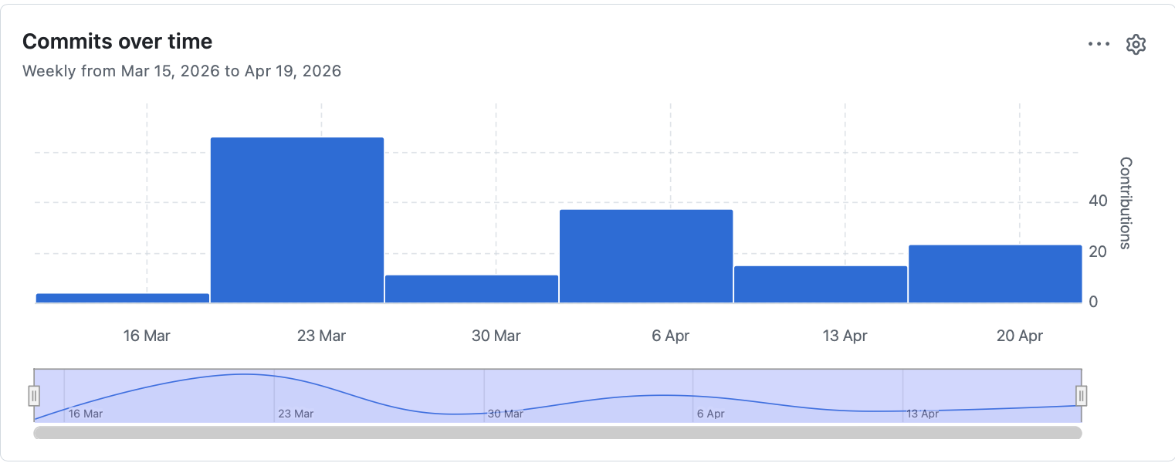
Server Activity

Slide 6
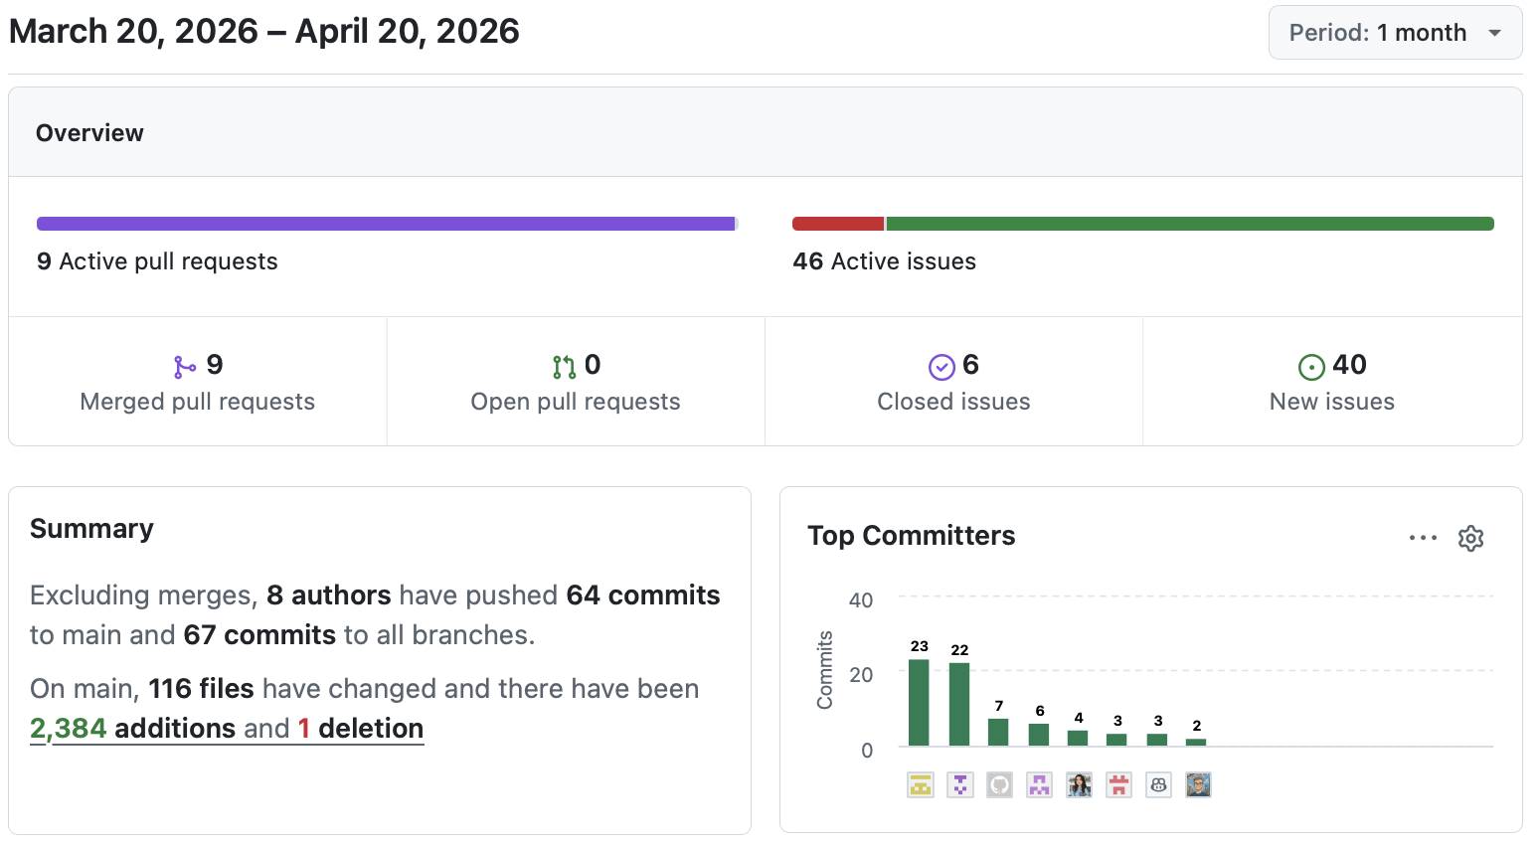
Client Activity

Slide 7
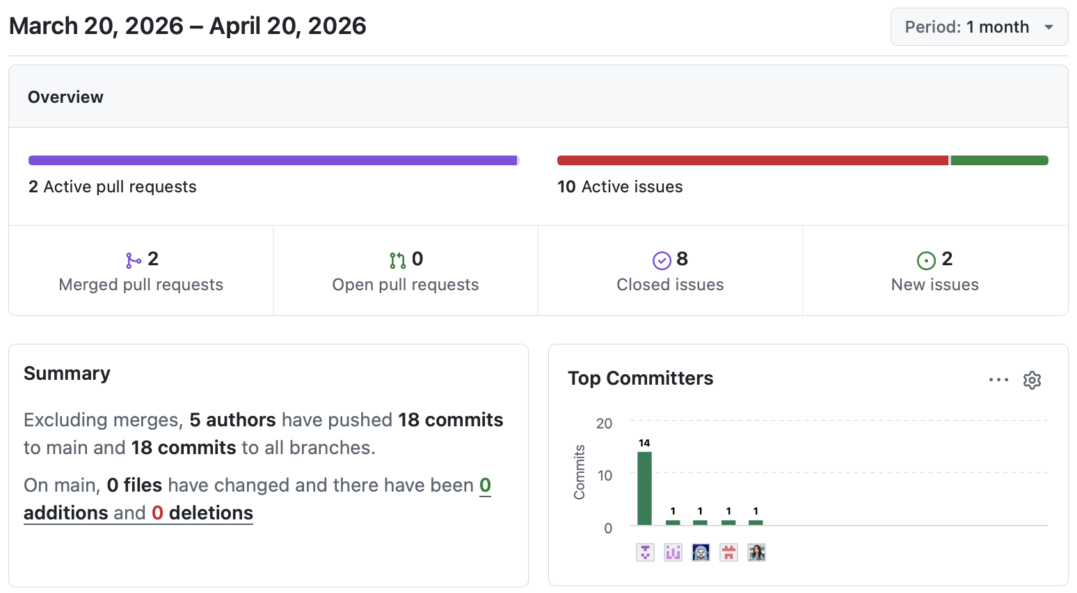
Docs Activity

Slide 8
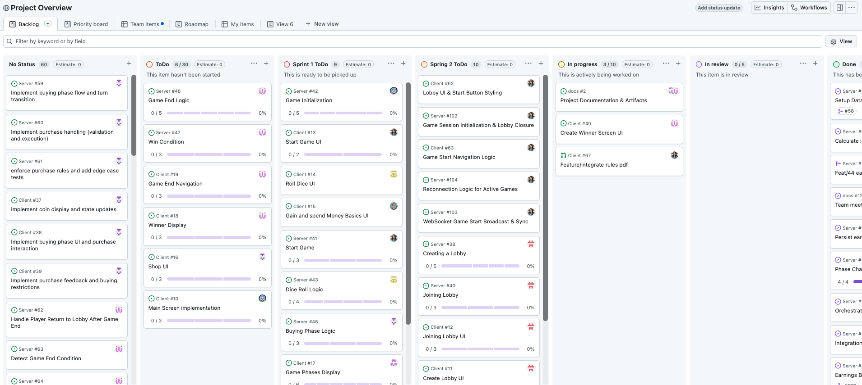
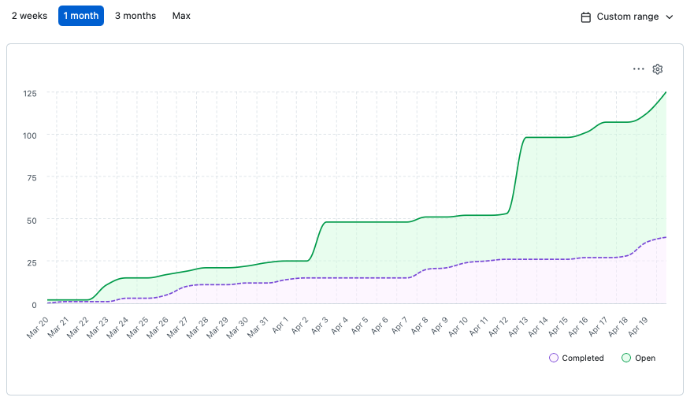
Project Overview
Project overview is in Server

Slide 9
Sprint 2 Goal
Core game loop:
Turn handling
Dice roll
Basic coin calculation
Card purchase (simplified rules)
Backend:
Game state management
Turn validation
State updates
WebSocket:
Real-time synchronization of game state
Broadcasting actions to all players
Client:
Display game state (dice, coins, cards, active player)
Allow user interaction for core actions
UI:
Minimal functional screens (not polished)
Join/Start game
Roll Dice
Receive coins
Buy a Card
Pass the turn

