Slide 1
Simple
Merge
Software Engineering 2018
Team #5

Slide 2
CONTENTS
1
Software Requirement Specification (SRS)
2
MVC Pattern
3
Algorithms
4
GitHub Projects
5
Implementation & Test
Software Engineering 2018
Team #5

Slide 3
SRS
- Introduction
Our program compares and merge text files.
User can compare words between two different files and merge them left to right (or right to left)
Also, our system also provides file saving and editing function.
Software Engineering 2018
Team #5

Slide 4
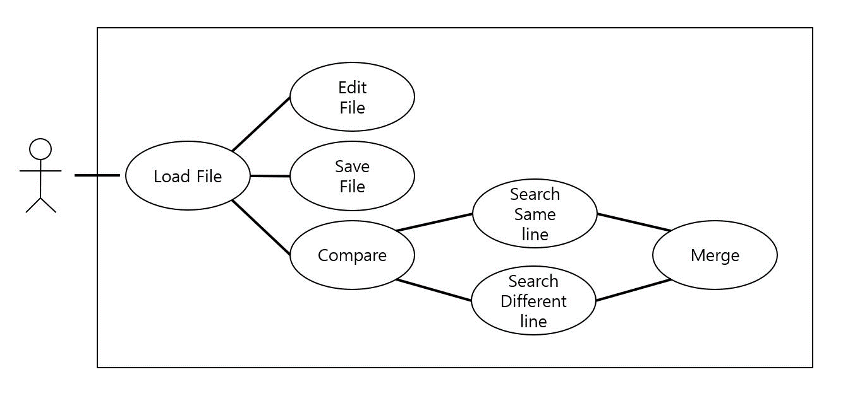
SRS
- Use Case Diagram
Software Engineering 2018
Team #5

Slide 5
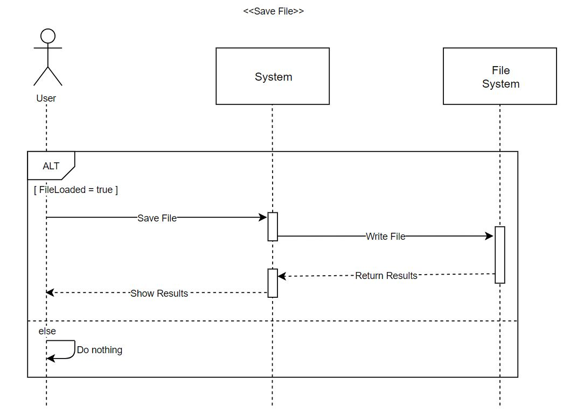
SRS
- System Sequence Diagrams : Save File
Load must be completed to execute Save
User can save file at any time
Software Engineering 2018
Team #5

Slide 6
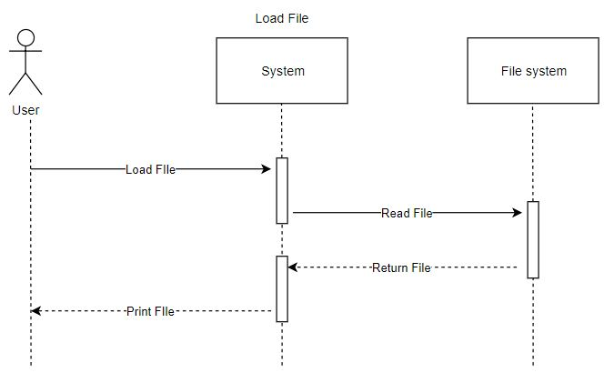
SRS
- System Sequence Diagrams : Load File
At least two files are needed
Compare button will be activated after user opens two text file successfully.
Software Engineering 2018
Team #5

Slide 7
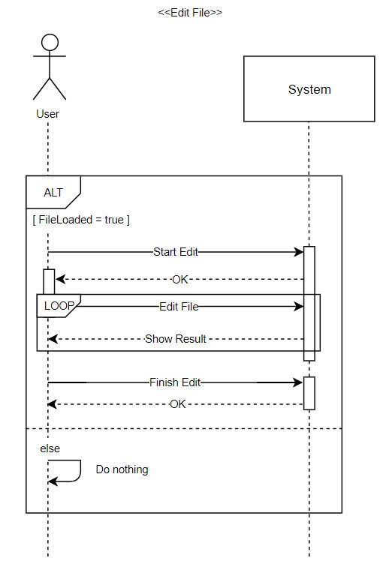
SRS
- System Sequence Diagrams : Edit FIle
If user presses a “Edit” button, the program allows user to edit the content of file.
When user clicks button again, the program disallow the user to edit the content
Software Engineering 2018
Team #5

Slide 8
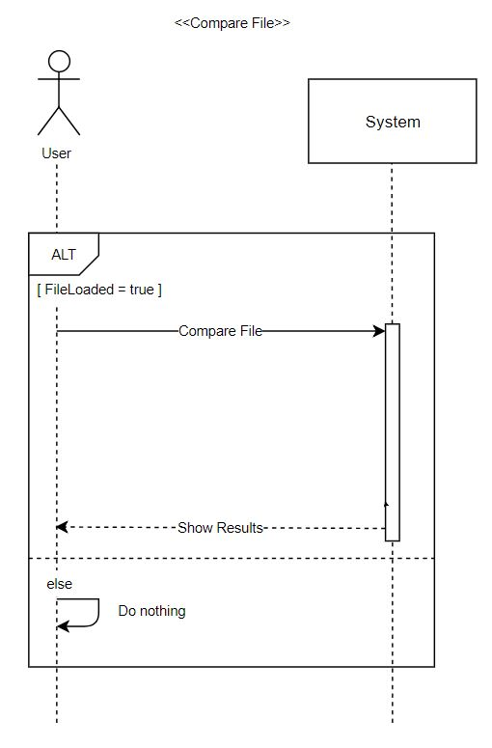
SRS
- System Sequence Diagrams : Compare Files
Load must be completed to execute Compare
Our system will compare two different files by using LCS Algorithm
Different parts will be highlighted.
Software Engineering 2018
Team #5

Slide 9
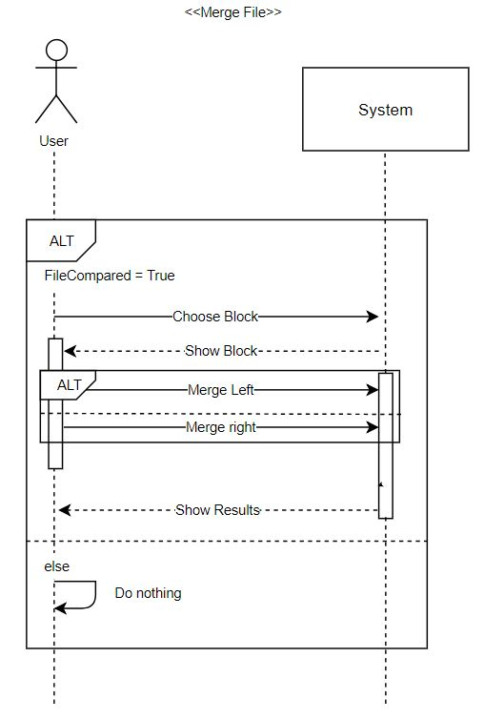
SRS
- System Sequence Diagrams : Merge Files
Compare must be completed to execute Merge
User can select which blocks to be merge by clicking “UP” or “Down” Button
Also, user can determine whether to merge from left to right or right to left.
Software Engineering 2018
Team #5

Slide 10
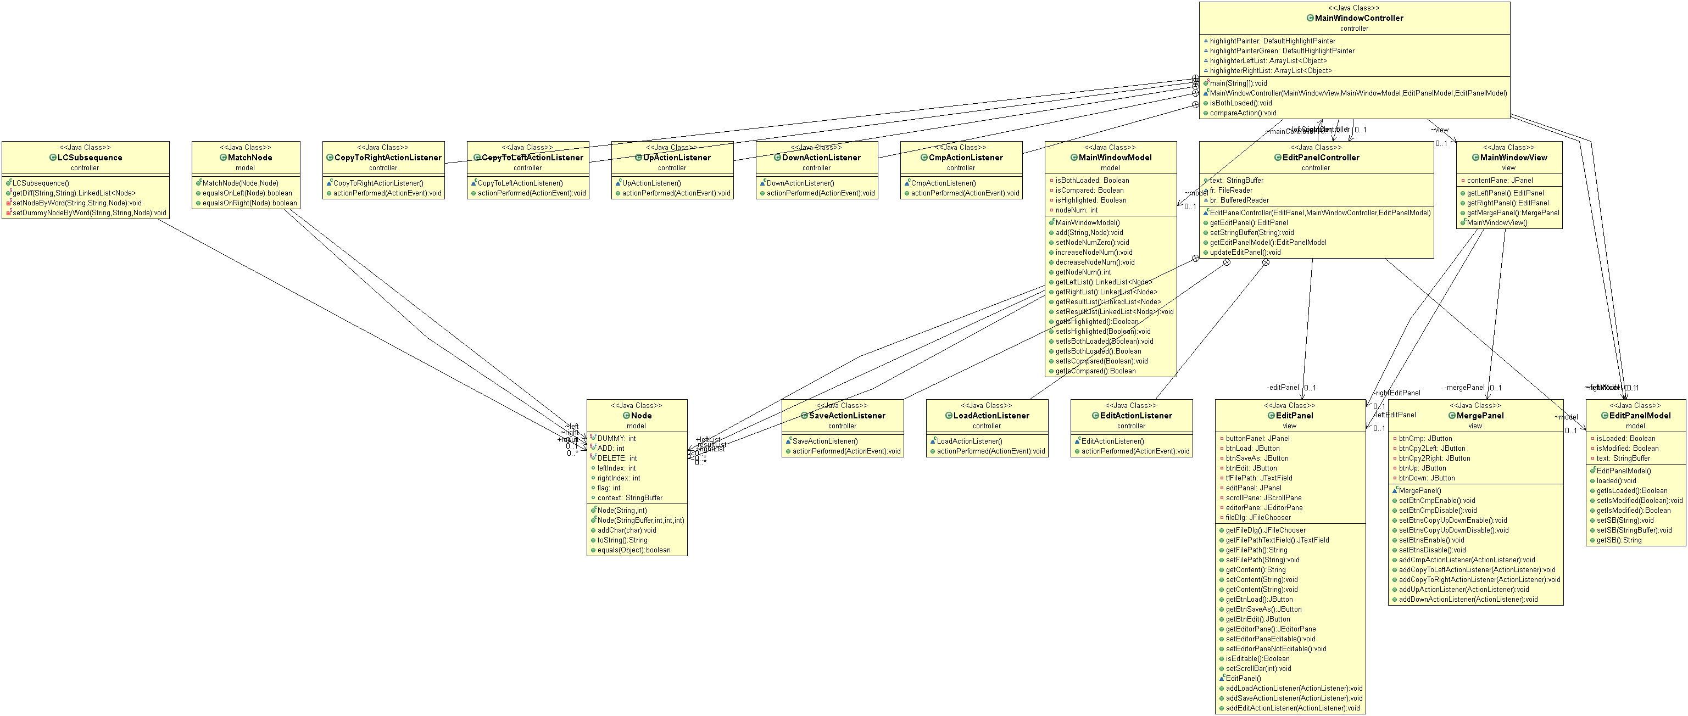
MVC Pattern
- Model / View / Controller
Software Engineering 2018
Team #5
Notes:
This is our team’s Class diagram.
And, we divided it into Model, View and Controller

Slide 11
Algorithms
- LCS Algorithm
Text File
<Node List>
Compare
LCS Algorithm
LeftIndex | RightIndex | Flag
0 | 0 | 1
1 | 18 | 1
20 | 54 | 1
23 | 72 | 2
Text File
Software Engineering 2018
Team #5
Notes:
We used LCS algorithm to compare two files.
After Comparing files, we created linked list of nodes that contains Left index, Right index and flag.

Slide 12
Algorithms
- Copy to Right
해당 노드는 왼쪽 패널에만 존재하므로 이 노드의 내용은 오른쪽 패널로 옮겨져야 합니다.
해당 노드는 오른쪽 패널에만 존재하므로 이 노드의 내용은 왼쪽 패널로 옮겨져야 합니다.
선택된 노드가 왼쪽일 경우,
선택된 노드가 오른쪽일 경우,
캐논남
파워포인트
템플릿
Head = 0 ~ right Index
Mid = node의 context
Tail = right Index + context 길이
~ file의 마지막
Head = 0 ~ left Index
Mid = “”
Tail = left Index ~ file의 마지막
Software Engineering 2018
Team #5

Slide 13
Algorithms
- Copy to Left
해당 노드는 왼쪽 패널에만 존재하므로 이 노드의 내용은 지워져야 합니다.
해당 노드는 오른쪽 패널에만 존재하므로 이 노드의 내용은 왼쪽 패널로 옮겨져야 합니다.
선택된 노드가 왼쪽일 경우,
선택된 노드가 오른쪽일 경우,
캐논남
파워포인트
템플릿
Head = 0 ~ left Index
Mid = node의 context
Tail = left Index + context 길이
~ file의 마지막
Head = 0 ~ left Index
Mid = “”
Tail = left Index ~ file의 마지막
Software Engineering 2018
Team #5

Slide 14
Algorithms
- After Copy to Right & Left
기존의 Highlight delete.
Compare()
Node 재생성
Highlight
Software Engineering 2018
Team #5

Slide 15


GitHub Project
Software Engineering 2018
Team #5
Notes:
Our team used GitHub and GitKraken
GitKraken helped us to use Git easily.

Slide 16
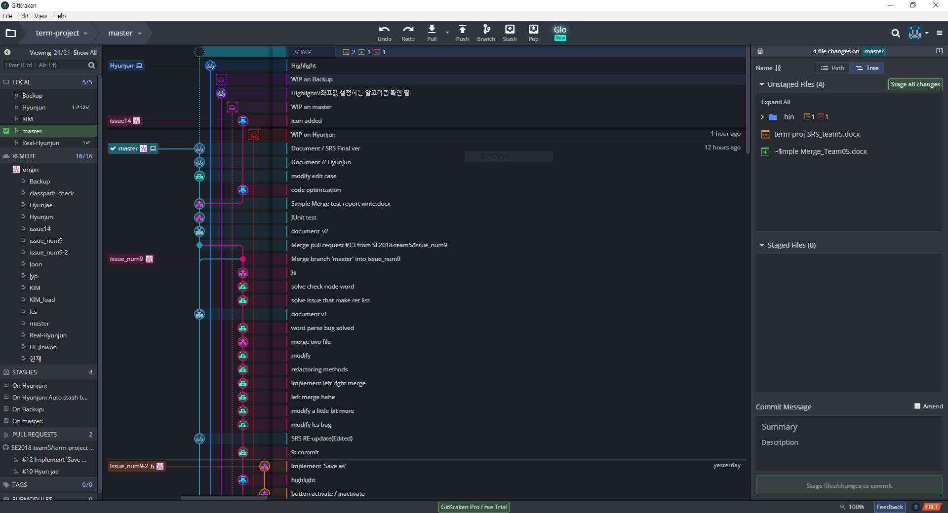
GitHub Project
Software Engineering 2018
Team #5
Notes:
As you can see on a screen, our team member pushed our code by function.

Slide 17
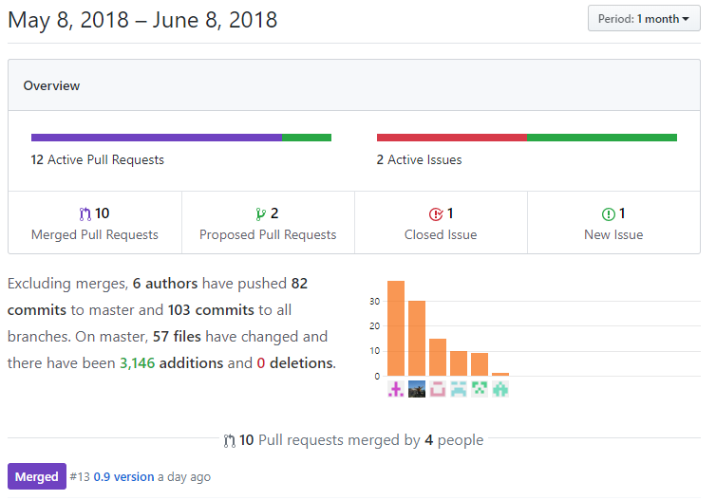
GitHub Project
Our team members implemented different functions on different branches.
When the implementation is completed to some extent, we merged our branches into a master branch
So we were able to easily manage the program by version.
Software Engineering 2018
Team #5

Slide 18
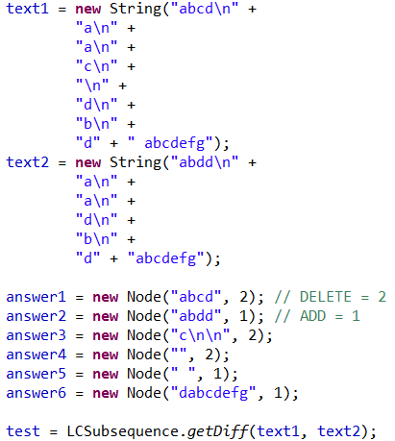
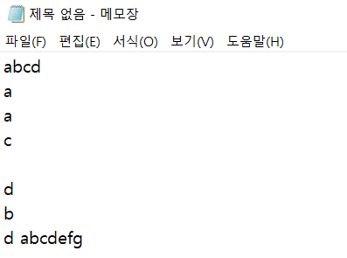
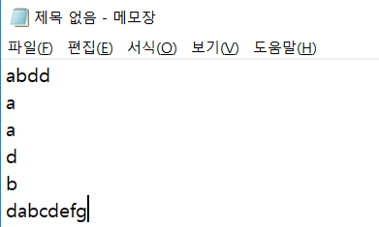
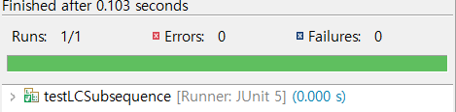
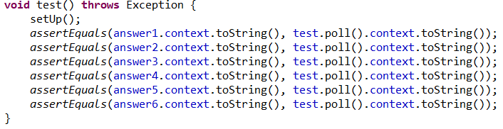
Implementation & Test
- Junit : Results
<Expected>
<Real Result>
Result
Software Engineering 2018
Team #5
Notes:
And, there are many Junit test cases as well, but we explained other Junit results on our Report.

Slide 19
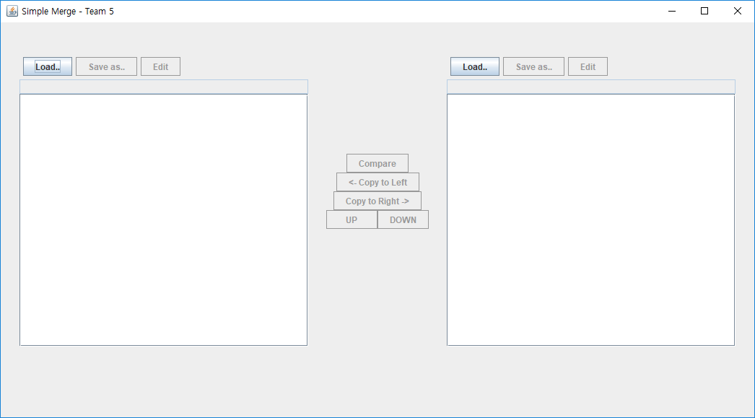
Implementation & Test
- Results
Software Engineering 2018
Team #5
Notes:
And, there are many Junit test cases as well, but we explained other Junit results on our Report.

Slide 20
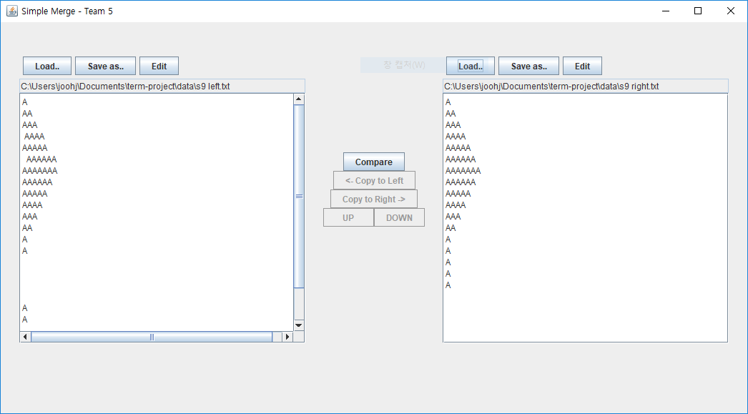
Implementation & Test
- Results
Software Engineering 2018
Team #5
Notes:
And, there are many Junit test cases as well, but we explained other Junit results on our Report.

Slide 21
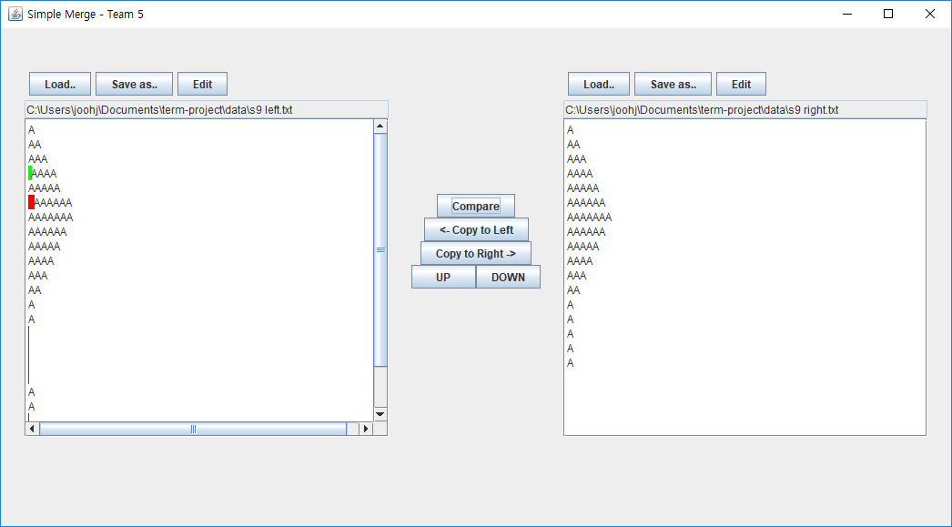
Implementation & Test
- Results
Selected Block
Unselected Block
Software Engineering 2018
Team #5
Notes:
And, there are many Junit test cases as well, but we explained other Junit results on our Report.

Slide 22
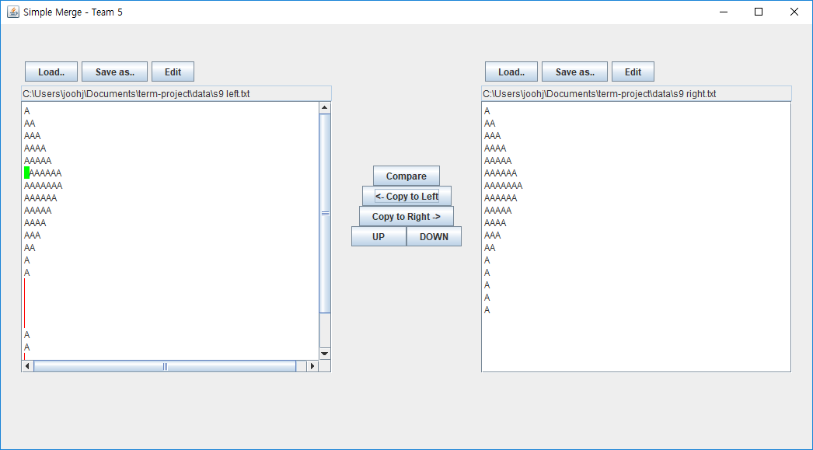
Implementation & Test
- Results
Merged!
Software Engineering 2018
Team #5
Notes:
And, there are many Junit test cases as well, but we explained other Junit results on our Report.

Slide 23
Questions?
Software Engineering 2018
Team #5
Notes:
And, there are many Junit test cases as well, but we explained other Junit results on our Report.

