Slide 1
MediShare
GROUP 4

Slide 2
Problem Definition & Background Information
Misuse of medication and paper waste are two of today's most serious issues.
The e-sağlık system has been in use since 2005. Even though it is an effective system, it has some shortcomings.

Slide 3
Objectives
-Keeping a record of the prescribed medication and recording it quickly in the system.
-Making sure that only authorized people can access the system, prescribe and monitor medication.
-Letting the user know about the intake frequency and side effects of the recorded medicines.
-Keeping the health record up-to-date by establishing a connection with electronic health systems.
-Preventing paper waste by reducing the labels used on medicines.
-Preventing medication use at the wrong time or not taking medication on time.
-Helping patients quickly and accurately find answers to their medical questions.

Slide 4
Functional Requirements
1.Prescription Management
2. Account Management
3. Medication Information
4. Medication Reminder System
5. Live Support System
6.Educational Resources
7. Premium Membership for Pharmaceutical Companies
8. QR Code Integration

Slide 5
Non-Functional Requirements
1.Security
2. Reliability
3. Scalability
4. Usability
5. Performance
6. Accessibility
7. Compliance
8. Integration with Electronic Health Systems
9. Customer Support
10. Access Control

Slide 6
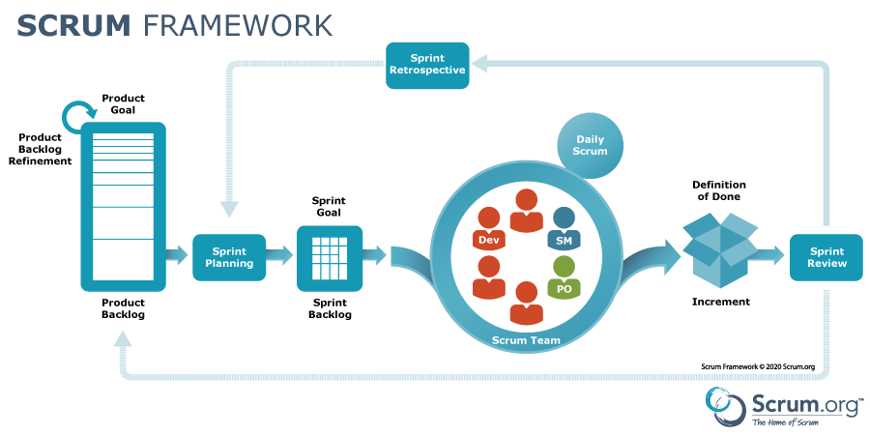
Process Model

Slide 7
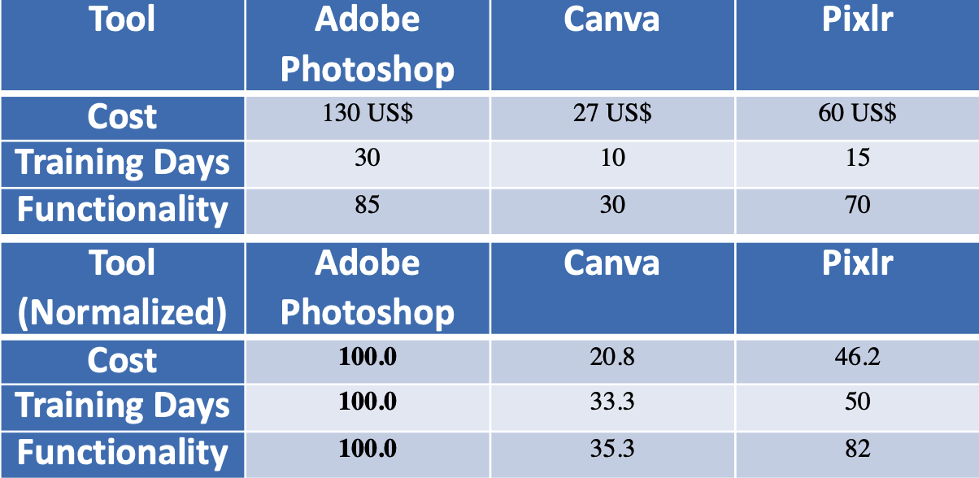
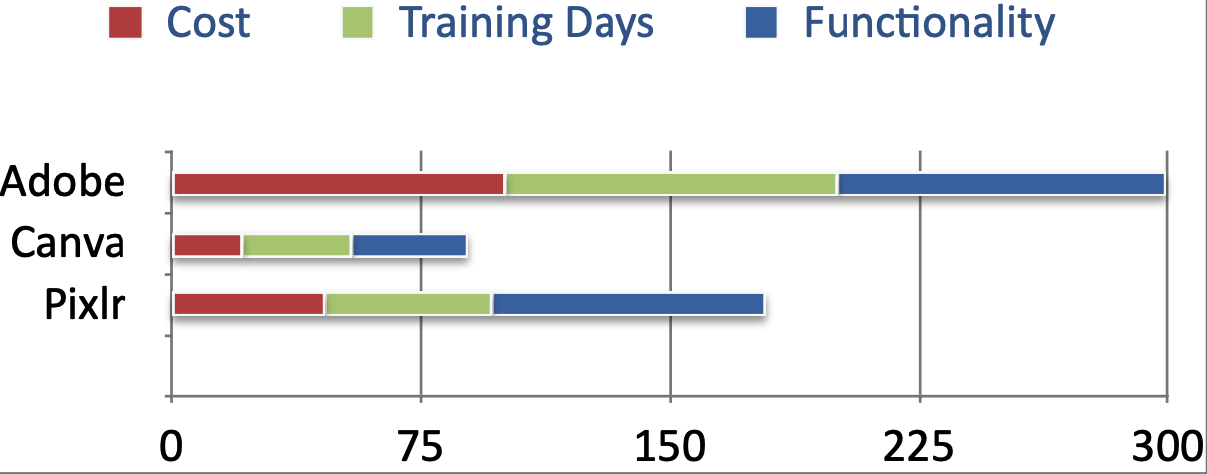
SOFTWARE TOOLS
User Interface and Illustration of Medicine Usage

Slide 8
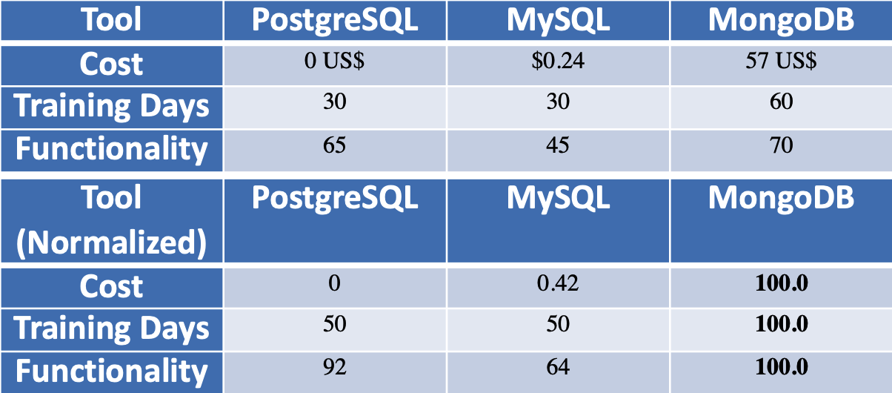
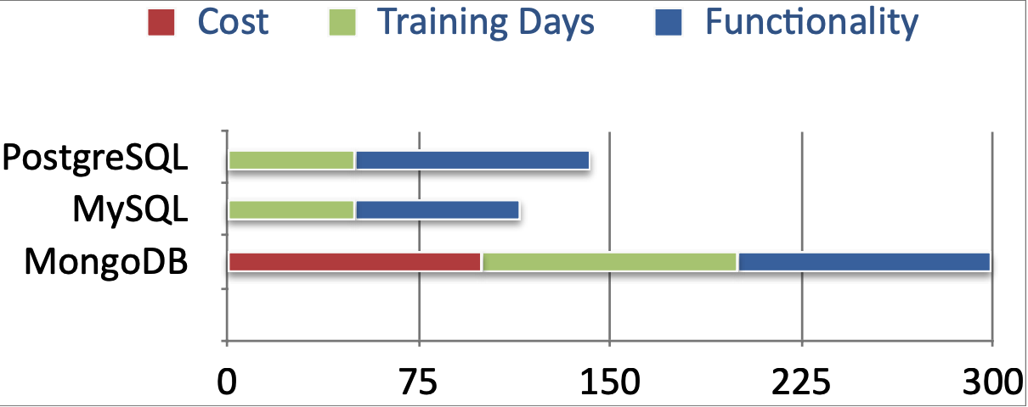
SOFTWARE TOOLS
Database Management

Slide 9
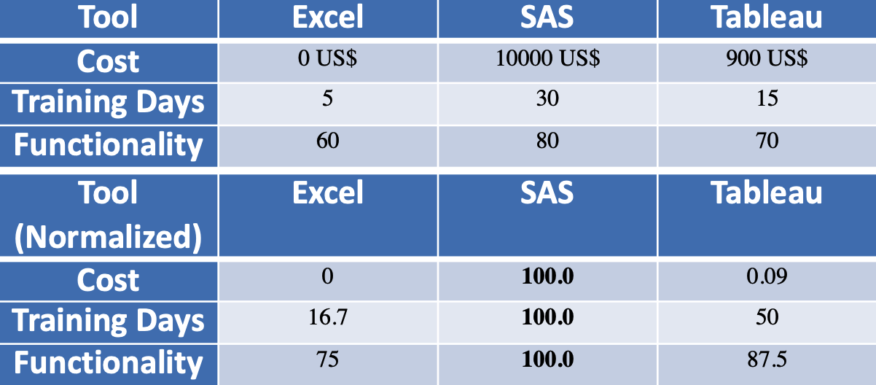
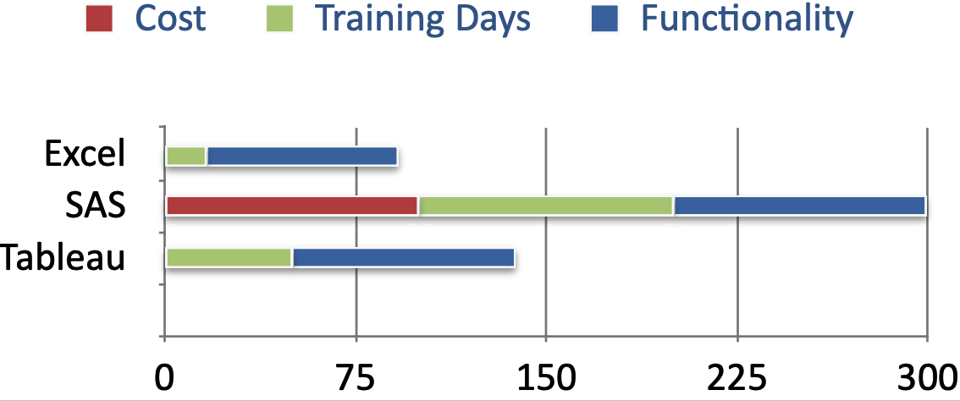
SOFTWARE TOOLS
Analytics and Reporting

Slide 10
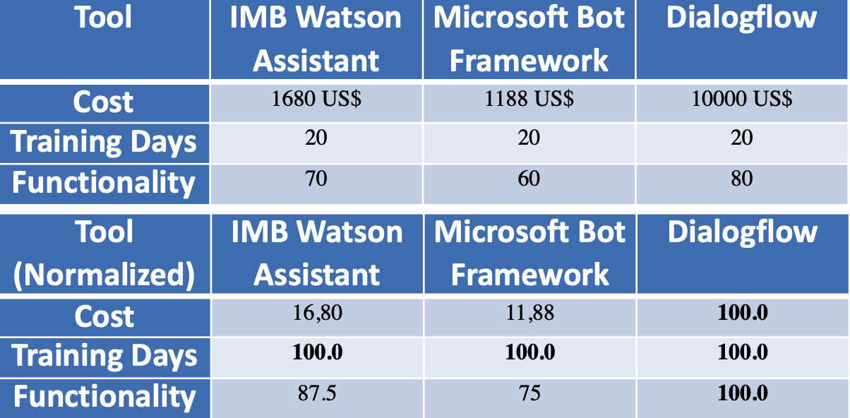
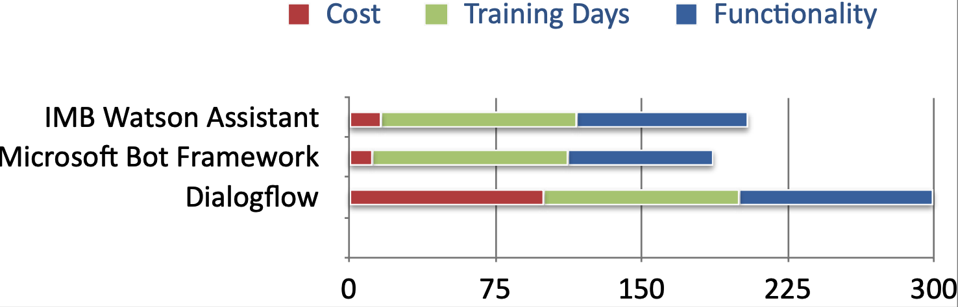
SOFTWARE TOOLS
Live Support

Slide 11
Software Measurements
1. Number of Tests 7. Time spent on sprint retrospective
2. Number of Errors 8. Number of Git Commits
3. Lines of Code 9. Stakeholder Reviews
4. Time Spent on Project
5.Number of Methods Added in that Sprint
6. Number of Added Requirements

Slide 12
Stakeholders
1.Doctors
2.Nurses
3.Hospital Receptionists
4.Patients
5.Patient Relatives
6.Pharmacists
7.Pharmaceutical manufacturers
8.Doctor Supervisors
9.Lawyers
10.Manufacturers’ Analysts
11.Developers
12.Government

Slide 13
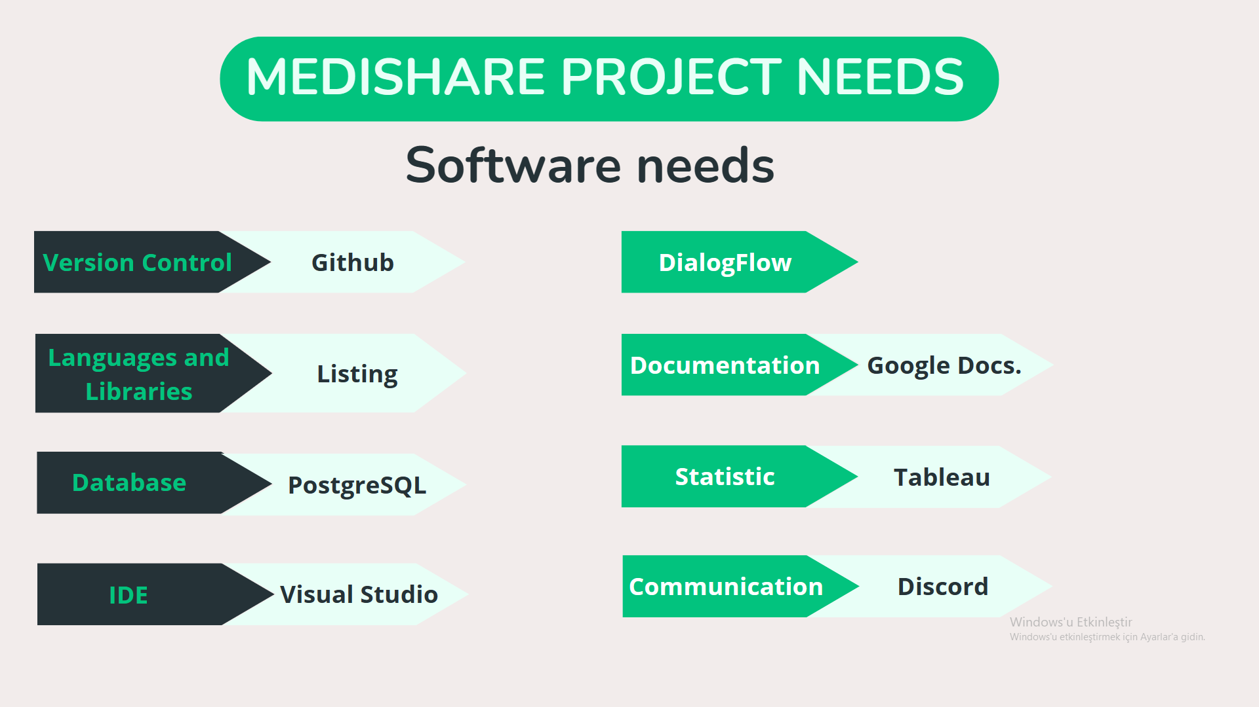

Slide 14
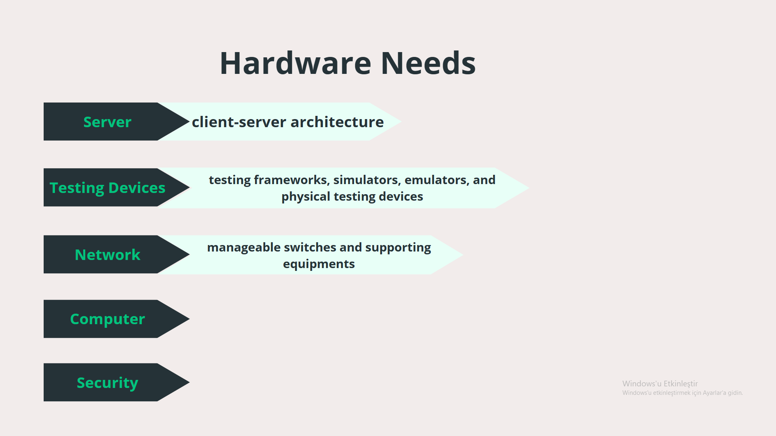

Slide 15
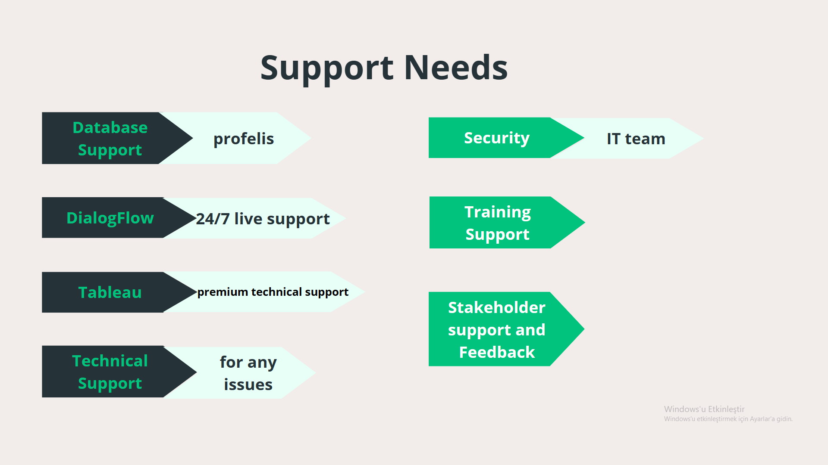

Slide 16
Risks
Testing
Data Loss
Rate of Bugs
Change in requirements
Budget
Integration with old systems
Design Complexity
Project Expansion
Change in Laws
Tools

Slide 17
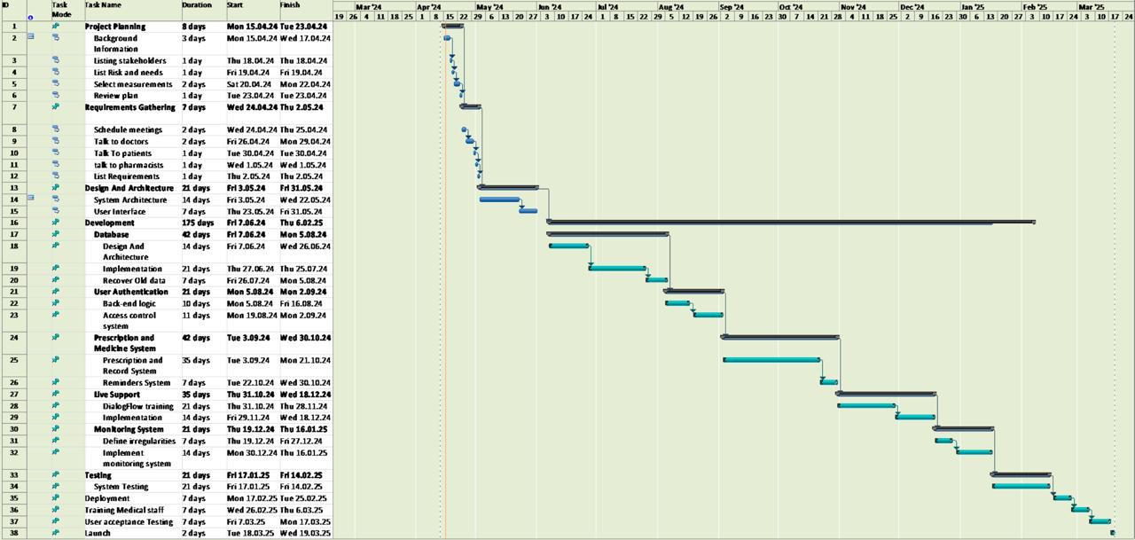
Gantt Chart

Slide 18
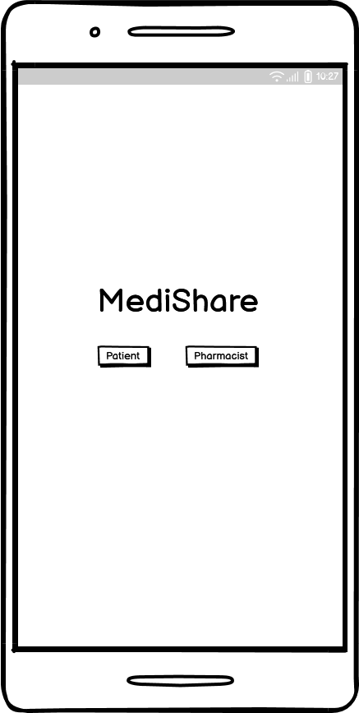
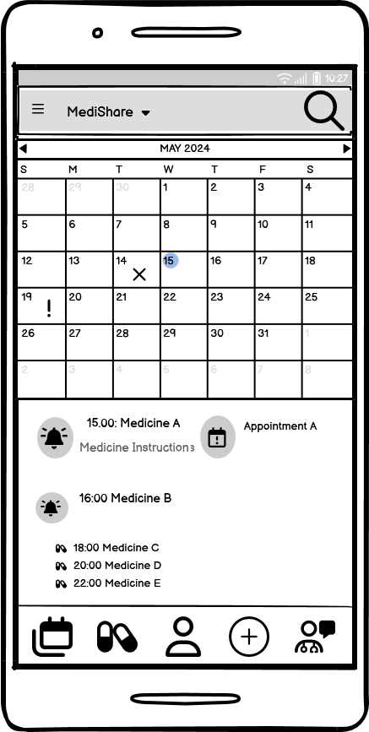
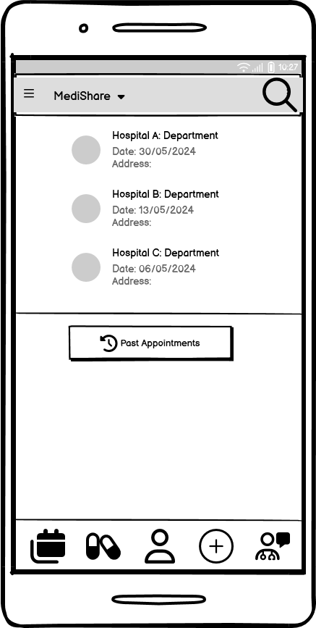

Slide 19
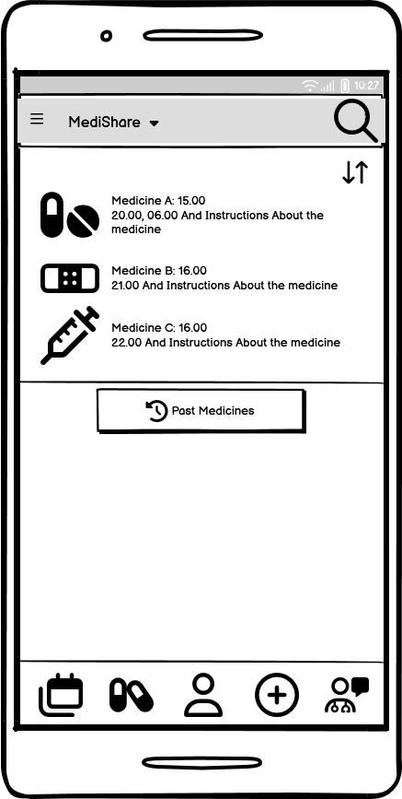
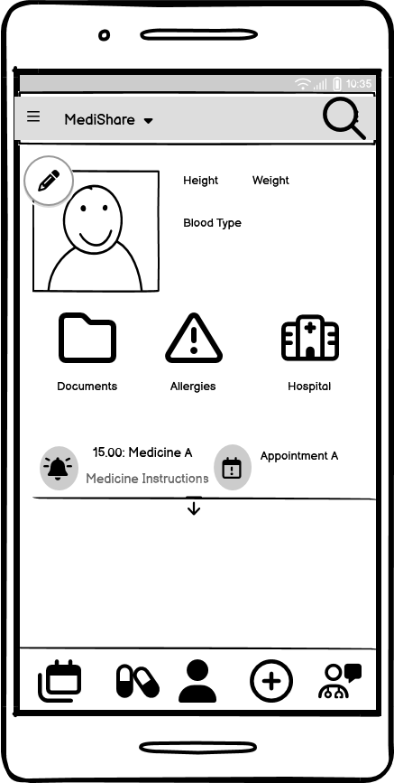
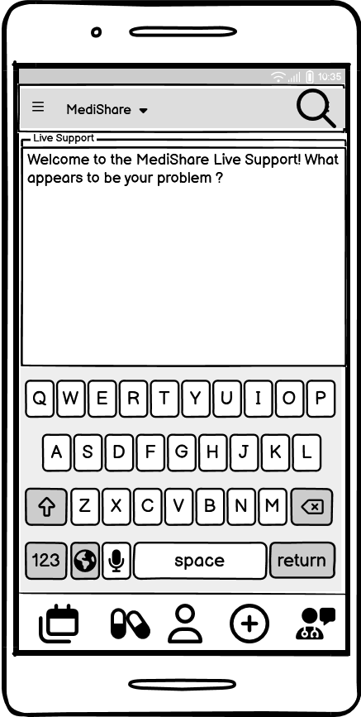

Slide 20
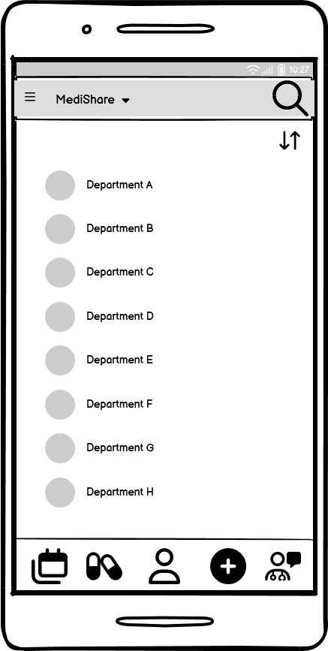
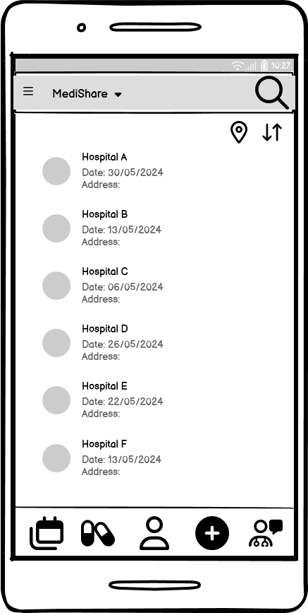

Slide 21
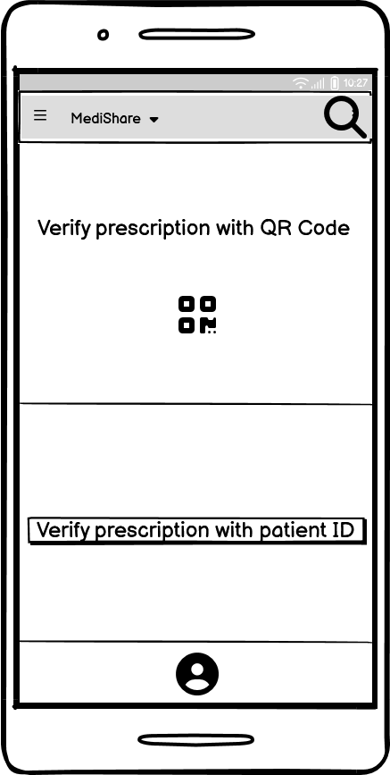
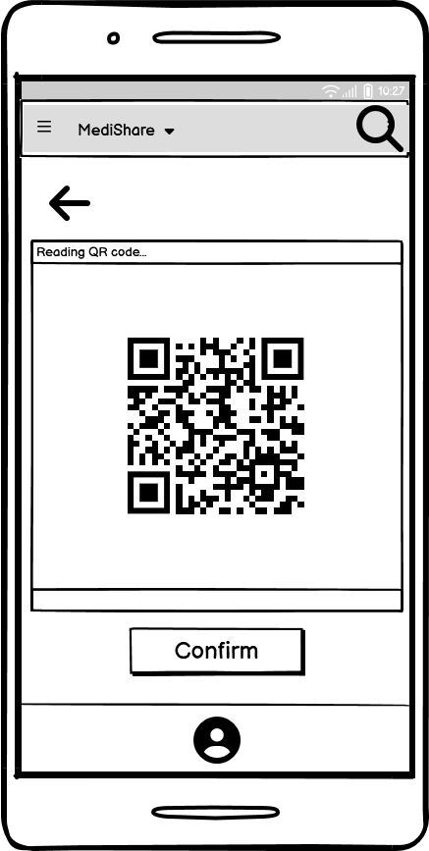
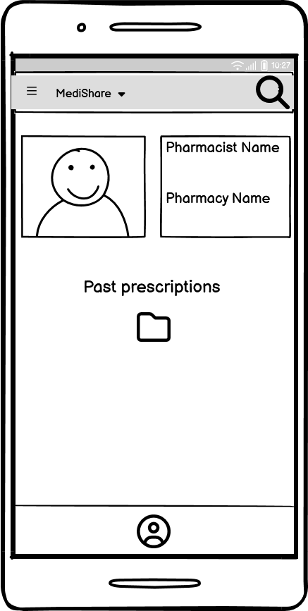

Slide 22
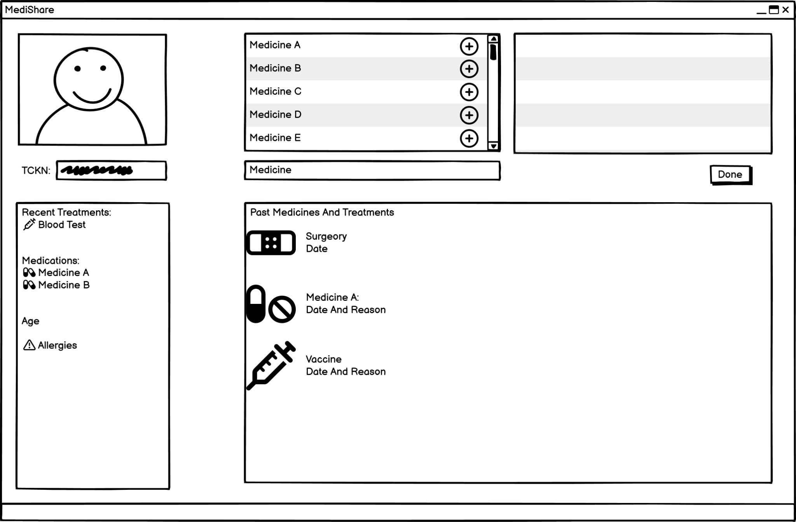

Slide 23
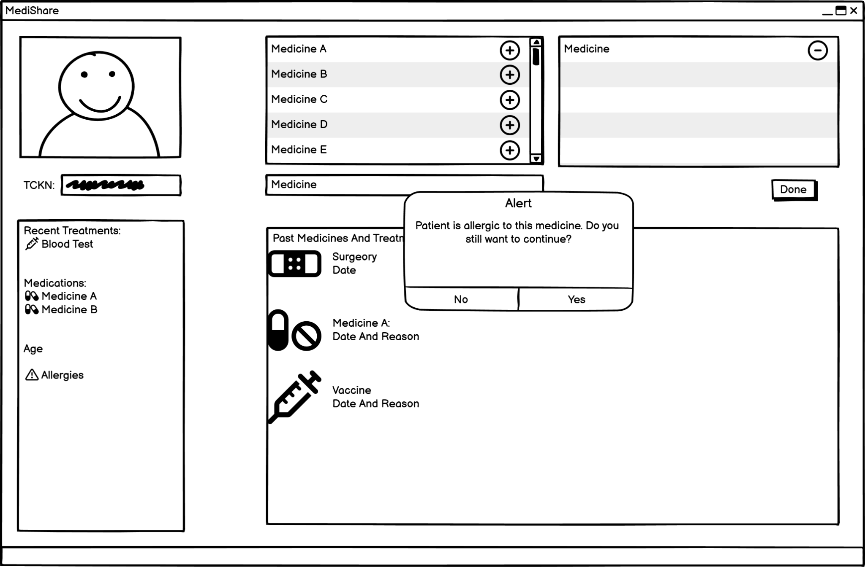

Slide 25
