Slide 1

Title of Presentation
Course Code – Course Name
List of Members Student Number – Name Surname

Slide 2
Following slides include examples for the things that you need to do&don’t

Slide 3
Good Slide Examples

Slide 4


SE 2226
Software Quality Assurance and Testing Project
Department:
Software Engineering
Lecturer:
Doç. Dr. Korhan Karabulut
Prepared By:
XXX- 20070000000
YYY - 20070000000

Slide 5
CONTENT or OUTLINE
Brief Introduction Part
Sub sections you have
About Your Project
Sub sections you have
Results/Future Work or Other Things
Sub sections you have
Questions & Discussion (Optional)

Slide 6

OVERVIEW
1. Problem Definition
3. Black Box Techinques
4. Unit Tests & Automated Testing
2. Application Analysis
(website)

Slide 7

INTRODUCTION / OUTLINE
Blackbox Testing
Equivalence Partitioning and Boundary Value Analysis
Use Case Testing
Whitebox Testing
Security Testing
Unit Testing

Slide 8


OVERVIEW
1
2
1.Problem Definition
2.Application Analysis
3.Test Cases
4.Automated tests
3
4
5
6
7
8
9

Slide 9
ATTENTION !!! ANY IMAGE/WORK YOU TAKE FROM A SOURCE HAS TO INCLUDE ITS LINK DIRECTLY BELOW THEM

Slide 10

Hepsiburada
Some description.
https://globalit.com.tr/wp-content/uploads/2022/10/1.png

Slide 11

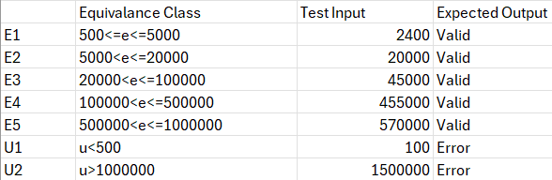

EQUIVALANCE TEST FOR FILTER
For the website's category section, we performed black box filter testing. During our white box testing, we identified some errors, which will be addressed in the conclusion section.

Slide 12

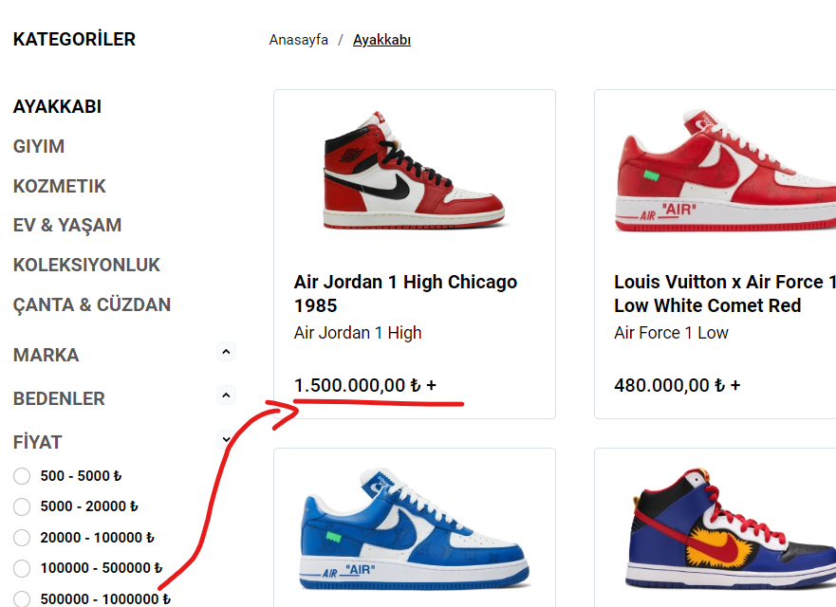
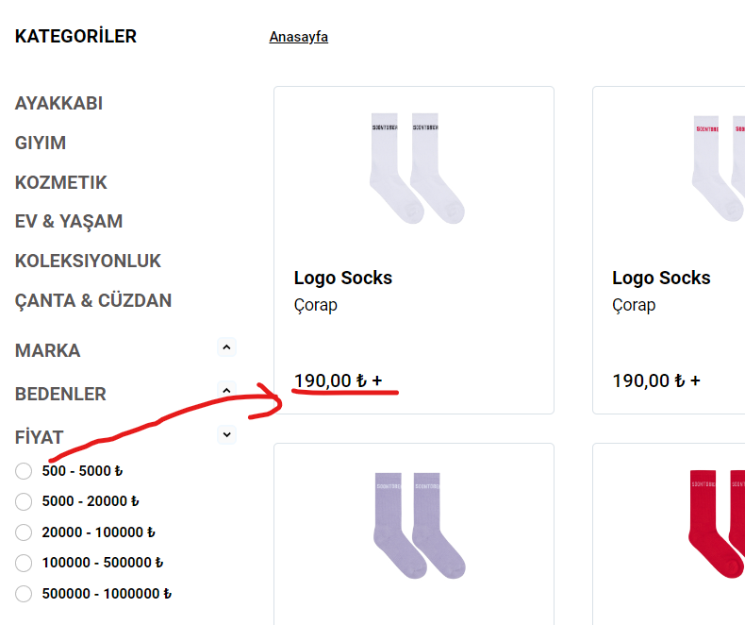
ERRORS
There is a filtering error in the website categories. According to the filters, there should be no products priced below 500 TL or above 1,000,000 TL. However, there are products that contradict this.

Slide 13
Boundary Value Analysıs for Updatıng Quantıty
Equivalence Class | Test Input | Expected Result | Actual Result
U (Below Min) | 0 | Error Message | Error Message
E (Min Boundary) | 1 | Quantity Updated | Quantity Updated
E (Normal Value) | 10 | Quantity Updated | Quantity Updated
E (Max Boundary) | 100 | Quantity Updated | Quantity Updated
U (Above Max) | 101 | Error Message | Error Message

Slide 14
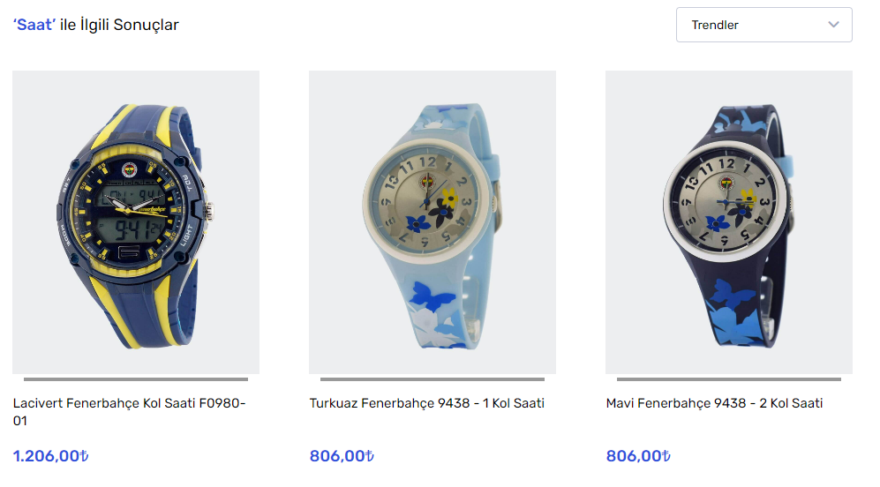
Search Product
When a search is made based on the given input, it determines whether the results given on the products page are relevant to the product.

Slide 15
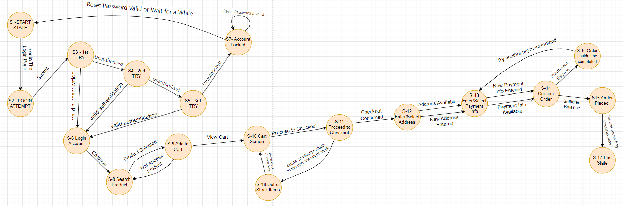
3
STATE TRANSITION TESTING
(Login and Purchase Products)

Slide 16
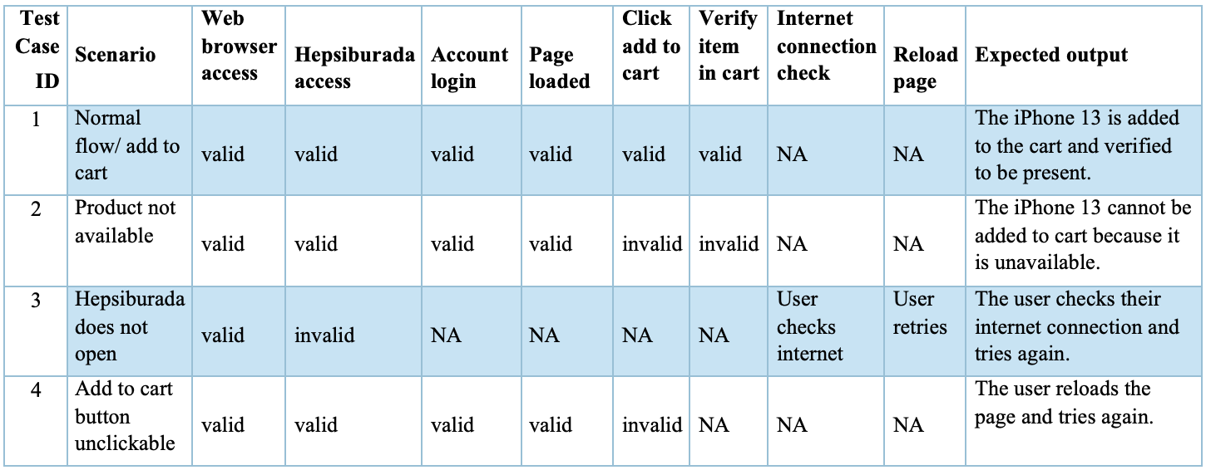
Test #1: Add product to cart
This use case testing table outlines scenarios and expected outcomes for users when adding a product to their cart on Hepsiburada.
Test is successful, it shows that the cart is full.
<number>

Slide 17
Bad Slide Examples

Slide 18
Boundary Value Analysis
Boundary value analysis focuses on testing boundaries between equivalence classes.
Equivalence Classes Test Input Expected Result Actual ResultU1: Below Lower Bound 0 Error message: "Value below minimum" Error message: "Value below minimum"E1: Lower Bound 1 Process accepted Process acceptedE2: Middle Value 150 Process accepted Process acceptedE3: Upper Bound 299 Process accepted Process acceptedU2: Above Upper Bound 300 Error message: "Value above maximum" Error message: "Value above maximum"

Slide 19
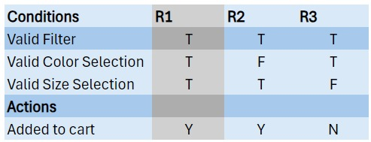
DeCISION TABLE FOR Add To cart
R1: Normal flow
R2: User doesn’t select color.
R3: User doesn’t select both color and size.

Slide 20

Test 6:
CHECKING PRODUCT VALUES
Brand,color,compatible devices, material…..
12

Slide 21
TEST SCENERIOUS
I tested this site using the test coverage method.
I created scenarios for Log In, Log Out, Purchase, Banned User, and Miss User, and otomated tested these scenarios using Selenium, Cucumber, Java, and Maven with the help of the Page Object Model.

Slide 22
THANK YOU FOR LISTENING ☺
(Final slide)

Slide 23
Additional/Optional Slides
You may need to show additional codes/screen shots etc.
Keep them here ın the case of need

