Slide 1
XML Data Model Visualization
Syltinsy P. Jenkins Palmer Young Abdullah Algahtania
COSC 729 Virtual Reality and Its Applications
Department of Computer Science Bowie State University Bowie, USA
Instructor: Dr. Sharad Sharma

Slide 2
Rationale
Data models are often represented as spreadsheet tables or XMI files
Relationships are sometimes visualized using UML and related software architecture tools
These are often flattened and limited views
An interactive 3D representation provides a new and different way of looking at and manipulating models
The immersive VR modality can foster interest in data architecture and data modeling

Slide 3
Goal and Objectives
To create an interactive 3D representation of a data model in a virtual environment.
Foster interest in data architecture and data modeling
Begin exploration of a new modality for manipulating data modeling
Demonstrate VR fundamentals through creation of an inviting and relaxing virtual environment
New Concepts
Additional manipulation of objects
Ability to read in and write out external files
Ability to read in data and represent visually
Requires to arrangement of the data nodes and links

Slide 4
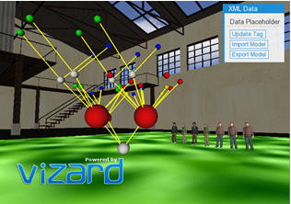
Project Description
The VR XML Data Model Visualization Project is a python based virtual reality project that:
Generates 3D tree-graph representation of XML data in
Includes an immersive and interactive virtual environment.

Slide 5
Software
System Requirements
Software required: Windows 10 OS
Hardware required: Keyboard and Mouse
Development Software
Vizard
Python
Sketchup
XML Element Tree APIs
Math libraries for trigonometric functions

Slide 6
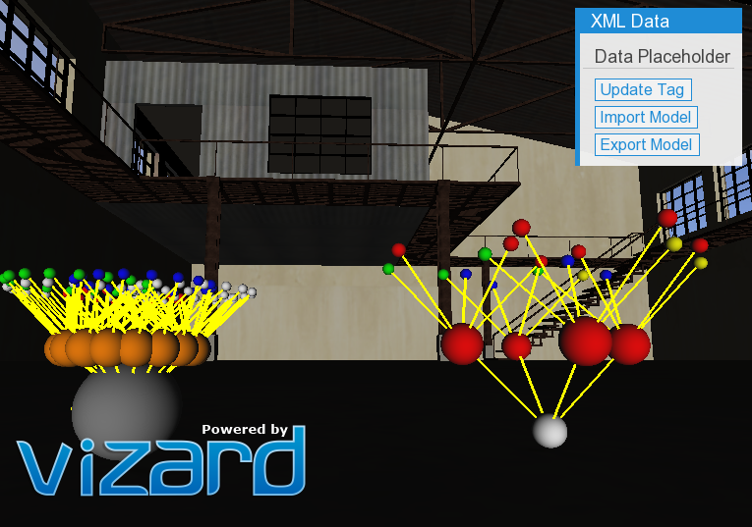
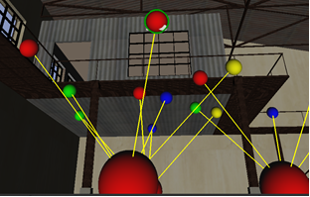
Modeling
Vision: Use of textures and 3D models to provide detailed information in the project.
Building setting with outdoors
XML Model – uses color and size to represent different data types
Sound:
Music for the setting
Animation:
Avatar animations
Grabber node interactions
Interactivity: Use at least three user-triggered events in the project.
UI Create node
Delete node
UI Import Model
UI Export Model
Keyboard trigger Avatar behaviors to

Slide 7
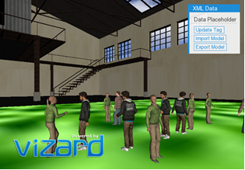
Demonstration

Slide 8
Future Application:
Include avatar representation of multiple users (requires network)
Allow multiple users to view the model
Allow multiple users to manipulate the model
Add new Hardware support
Oculus
Pinch glove

Slide 9
Future application: Data Model Training
Interactive guided tutorial on how to build data models in the 3D environment
Making the model more interactive and provide visual and haptic feedback when incorrect connections are made
Include a scoring mechanism

Slide 10
Future Application: Human Factors
Human factors opportunities for extended studies / future work
Node size shape & color
Link size shape and color
Measures – attentiveness
Duration of game play
Initial node selection

Slide 11
Conclusion
Basic demonstration of a 3D VR representation of XML data models 3-dimensional tree-graphs.
Multiple XML documents were imported and rendered as models in the virtual environment.
Exercised fundamentals of creating an immersive VR environment
On-screen prompts, sounds, VR sensors, timers, animations, and avatars
Recursion and trigonometric functions were used to create patterned structures
Color, links, and node sizes were used to illustrate differences in datatypes and relationships between nodes
VR is a good medium for gaining a new perspective on visualizing structure of data models.
The immersive environment makes data visualization more interesting not jut to the user, but also to the developers. Team members look forward to continuing this work.

Slide 12
References
Ms90Prod, Composer, Reggaeton vs Rap. [Sound Recording]. looperman. 2019.
B. Shneiderman, C. Plaisant, M. S. Cohen, S. M. Jacobs and N. Elmqvist, Designing the User Interface: Strategies for Effective Human-Computer Interaction, 6th ed., Hoboken, NJ: Pearson Education, Inc., 2017.
WorldViz, "Vizard 6 Documentation," WorldViz, 2019. [Online]. Available: https://docs.worldviz.com/vizard/latest/. [Accessed 17 April 2019].
Python Software Foundation, "The ElementTree XML API," Python Software Foundation, 18 March 2019. [Online]. Available: https://docs.python.org/2/library/xml.etree.elementtree.html. [Accessed 24 April 2019].
S. P. Sharad, "COSC 729: Virtual Reality and its Applications," Bowie State University, April 2019. [Online]. Available: http://www.cs.bowiestate.edu/sharad/. [Accessed 17 April 2019].

Slide 13
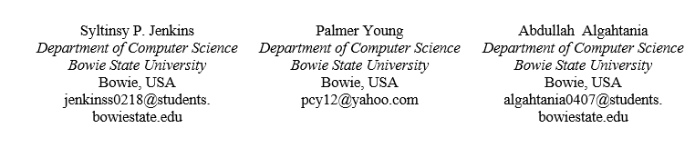
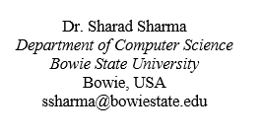
Questions ?
For more information, contact:

