Slide 1
COSC490 Spring 2011 Final Group Project
Michael Tice
Aaron Boothe
Daniel Riggs

Slide 2
3-Level Obstacle Course/Maze
Each member will design a separate level.
First person view (third person impractical: Explained later)
The end of one level will link to the next via anchor node.

Slide 3
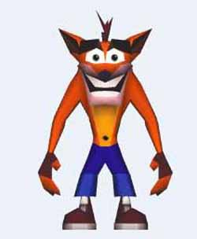
Modeling
Character modeling with Biped in
3Ds Max. (problems in VRML)
Moving obstacles – (moving boxes
that would knock the character off path)
Various cliffs / Narrow Passages –
(problems in VRML)
Obvious Sensor nodes – (make clickable objects ‘pop out’ / look obvious)

Slide 4
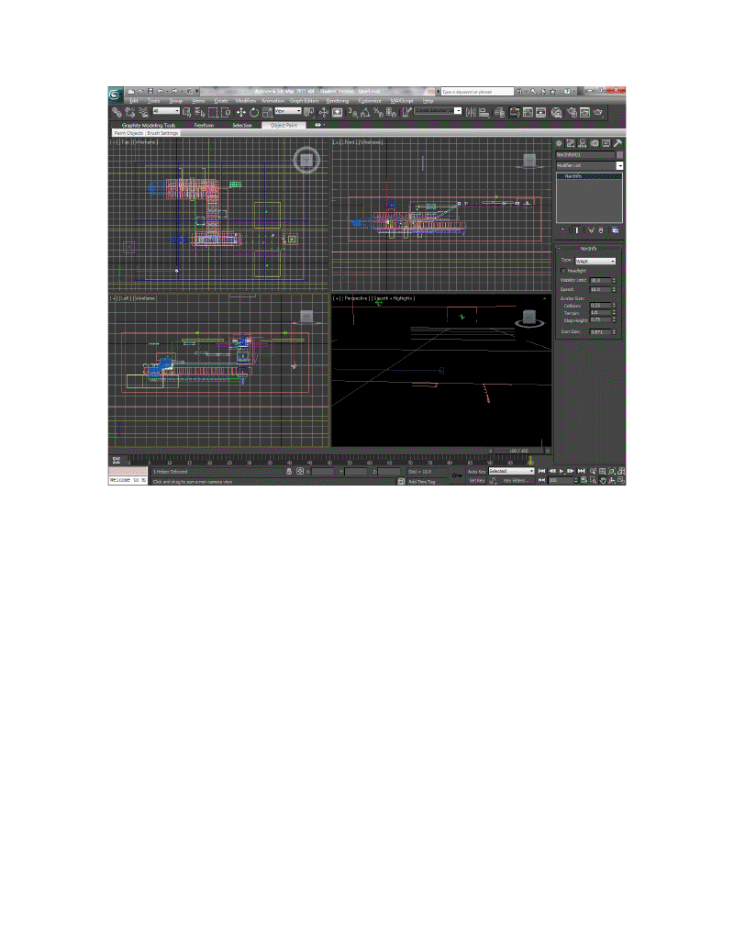
Screenshots

Slide 5
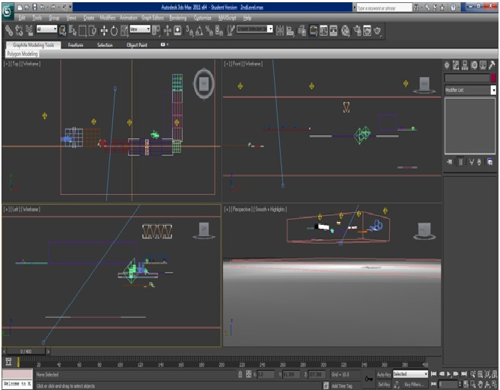
Screenshots

Slide 6
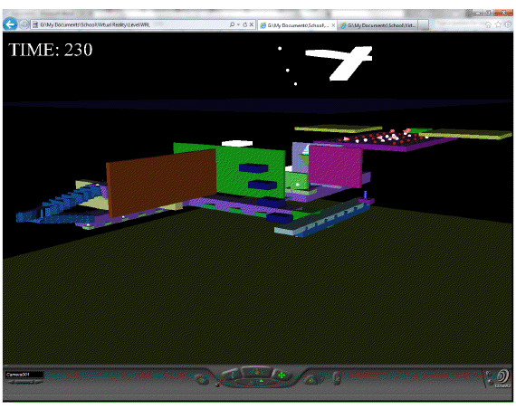
Screenshots

Slide 7
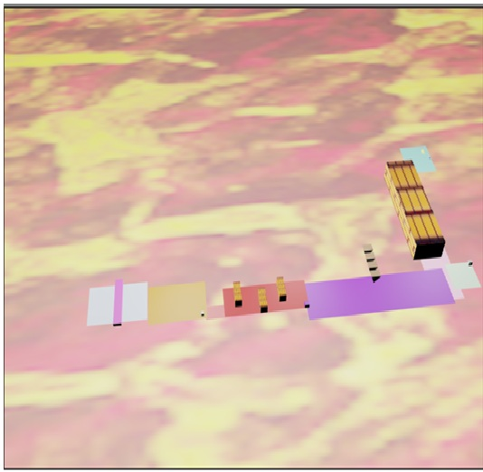
Screenshots

Slide 8
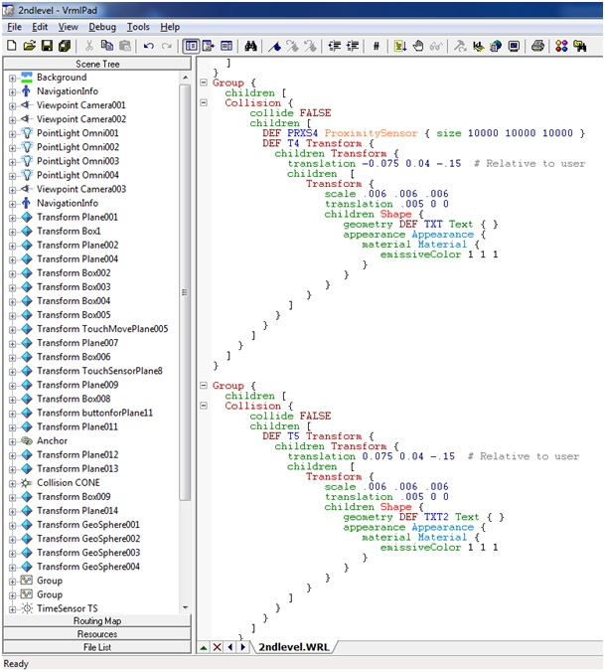
Screenshots

Slide 9
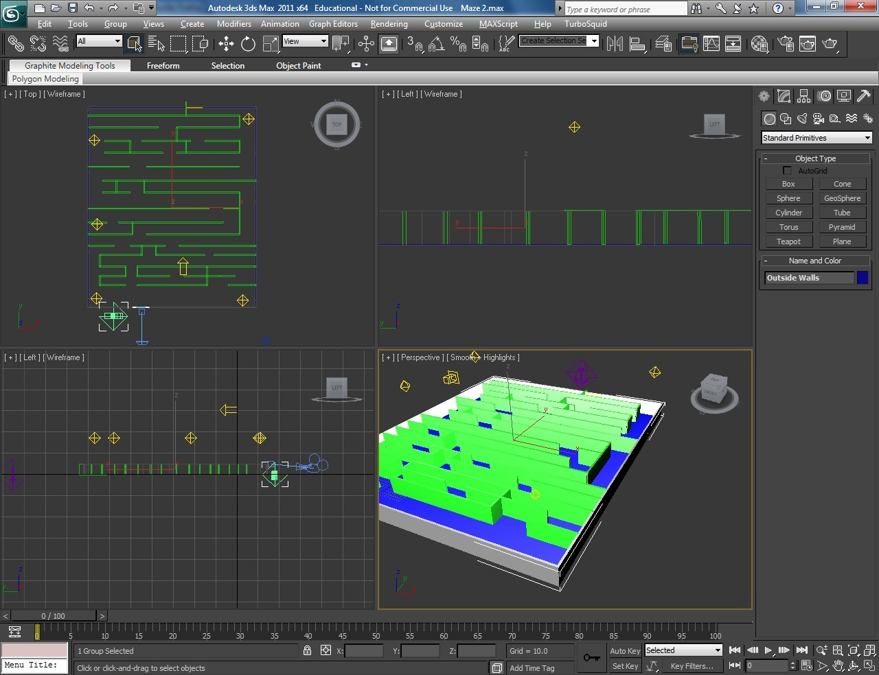
Screenshots

Slide 10
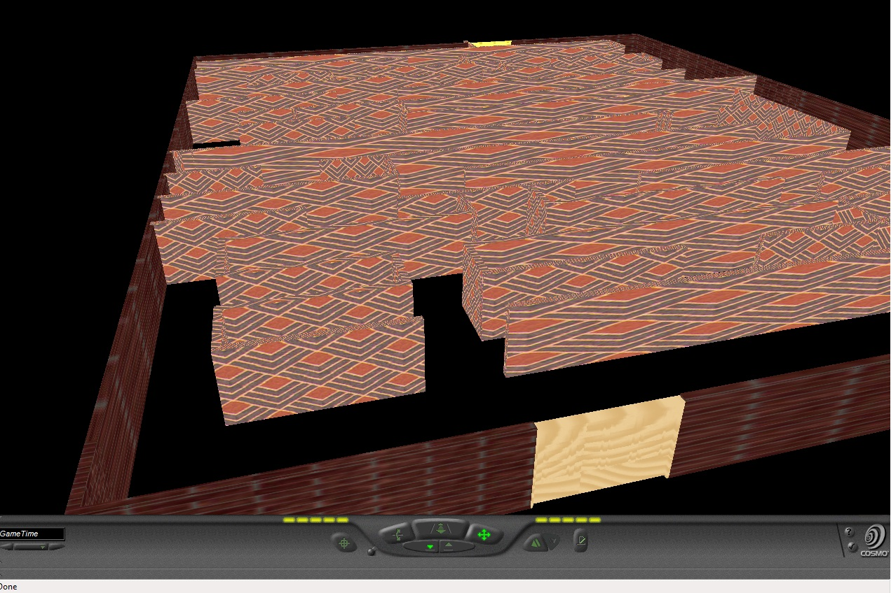
Screenshots

Slide 11
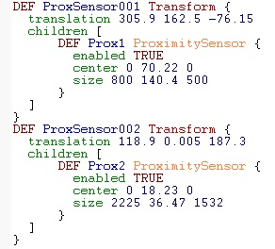
Sensors

Slide 12
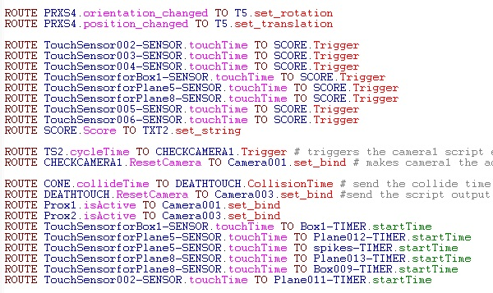
More about Sensors

Slide 13
Lights
Omni-directional lights.
Emissive lights from objects

Slide 14
Goals/Objectives
Collision Detection with objects
Falling/restarting level (dying)
Manipulating light sources
Character Movement (jumping, crouching, etc.)
(DNC)
Crowds with simple behavior that need to be avoided.
Teleporters. Objects that transport the player to a new location when interacted with. (DNC)

Slide 15
Why VR?
For an interactive game/maze VR is the perfect format to give the best experience for the user.
More visual stimulation as opposed to text-based games.
Feels more ”rewarding”

Slide 16
Problems in VRML
Collision Detection Physics not perfect & difficult to implement
Physics: Moving platform with character on it doesn’t function properly
Clipping issue with the way that the objects are rendered when there is no light source.
Timing/Scoring had to be created with objects/scripting to orient to the player(unnecessary processing, could affect performance in larger program)

Slide 17
Problems in VRML (cont.)
Player death – Unable to implement in Max, only possible with scripting/camera manipulation in VRML
No shadows in VRML!

Slide 18
Remaining problems
Character implementation (skin/animation/movement)
Improved character control/movement
Physics/interaction

Slide 19
Hardware/Software used
Intel Core 2 Quad 2.40 GHz 8GB
Windows 7 Enterprise
3D Studio Max
VrmlPad

Slide 20
Sources
www.lighthouse3d.com/vrml/tutorial/index.shtml
http://www.cs.bowiestate.edu/~sharad/vrlab/research.html (previous projects/research)
Google Images (for textures)

