Slide 1
Solar system exploration
Exploration of our Solar system
Member names: Michelle Snowden
Ruth Agada
Dr. Sharad Sharma
COSC 729.191 Final Project

Slide 2
Goals and Objectives
Create a virtual solar system that will:
learn detailed information about planets
Play with various objects
Move through the system

Slide 3
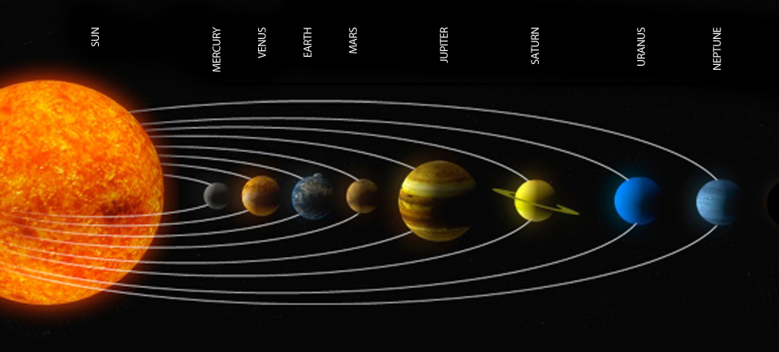
Modeling
The system below
Space station – with at least 3 rooms

Slide 4
Solar System
Objects: 8 planets including pluto and the sun
Image: sun and planet
Texture: for the sun and planets
Interpolator: orientation and rotation
Lights: spot and point

Slide 5
Space Station
Objects: station, chairs, tables, screens
Image: solar system
Texture: metallic surface
Anchor nodes
Touch Sensors

Slide 6
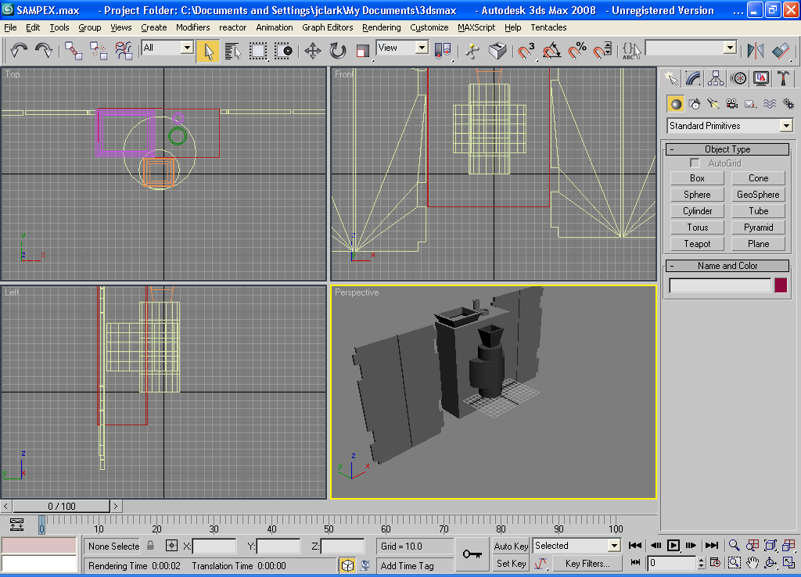
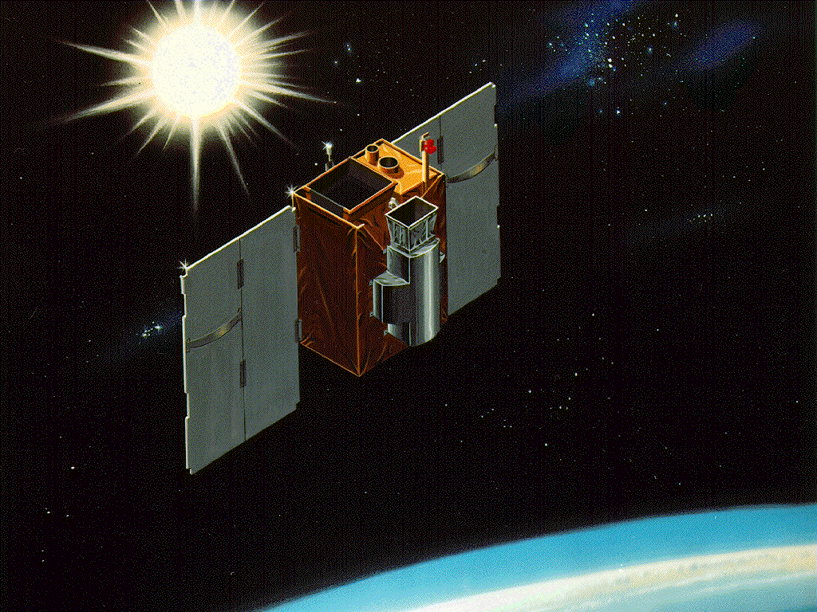
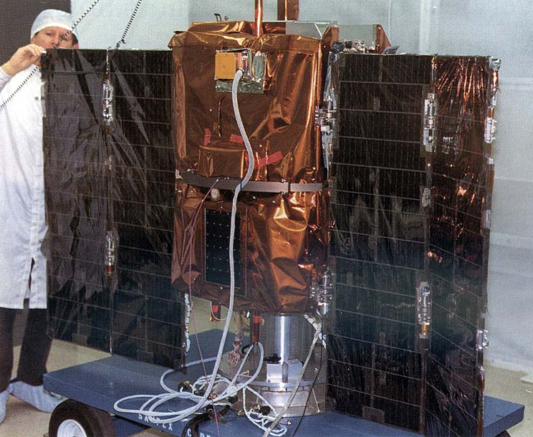
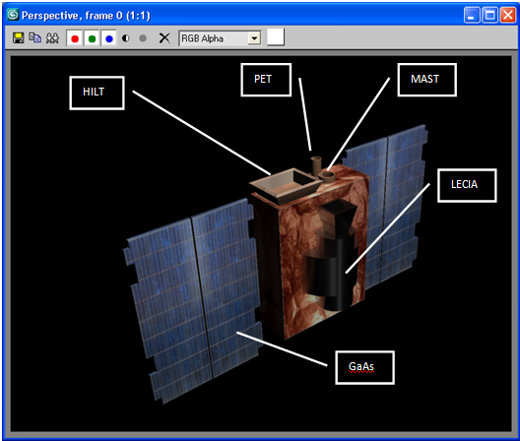
Modeling
3DS Max

Slide 7
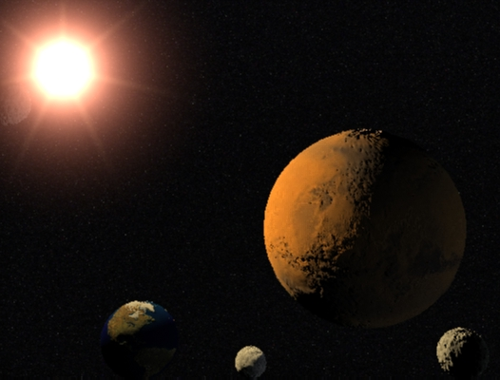
Solar System

Slide 8
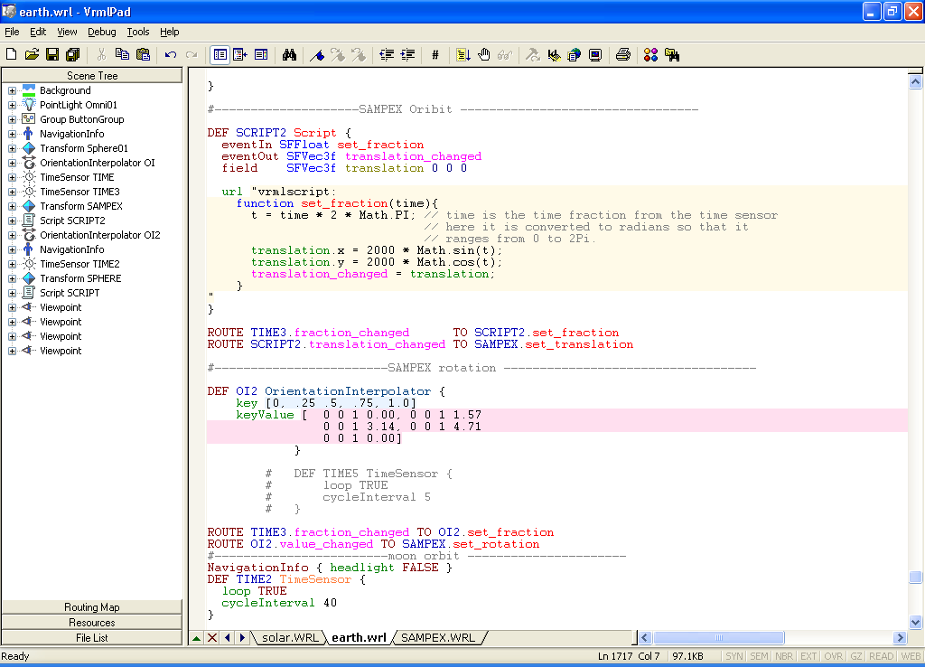
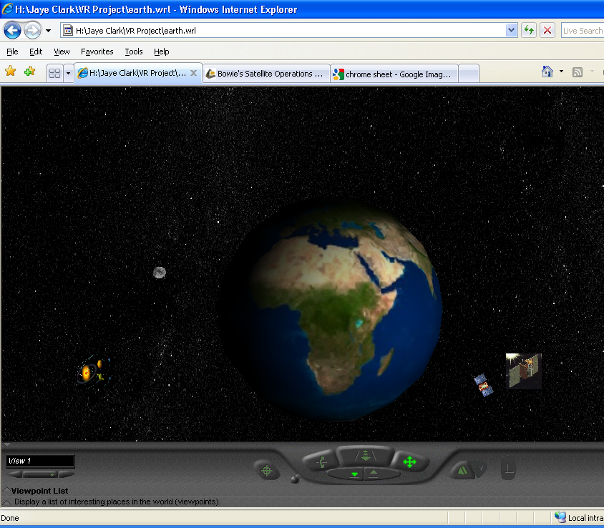
VRML
Satellite Orbit

Slide 9
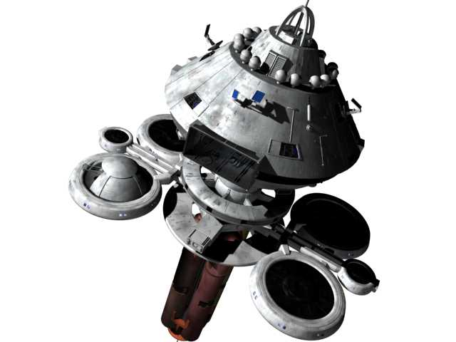
Space Station

Slide 10
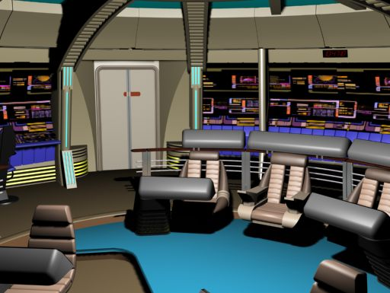
Control Room

Slide 11
Problems/Recommendations
Problems included
Loss of data and features in transitioning from 3DS Max to VRML
Time consumption for modeling planets and animating the Sun
Learning to create particle flow source
Recommendations
Completing animations for ground station transfers

Slide 12
Questions?

