Slide 1
LAB 3
Deepika Jakati
989501620

Slide 2
Lab 3 – Data Pipeline Architecture
IndexedDB: Local browser storage for sensor readings.
Neo4j: Graph database storing Farm → Device → Reading relationships.
MongoDB Lake: Central data lake combining Neo4j and IndexedDB data.
Node.js: Server scripts handle ingestion, enrichment, and insertion.

Slide 3
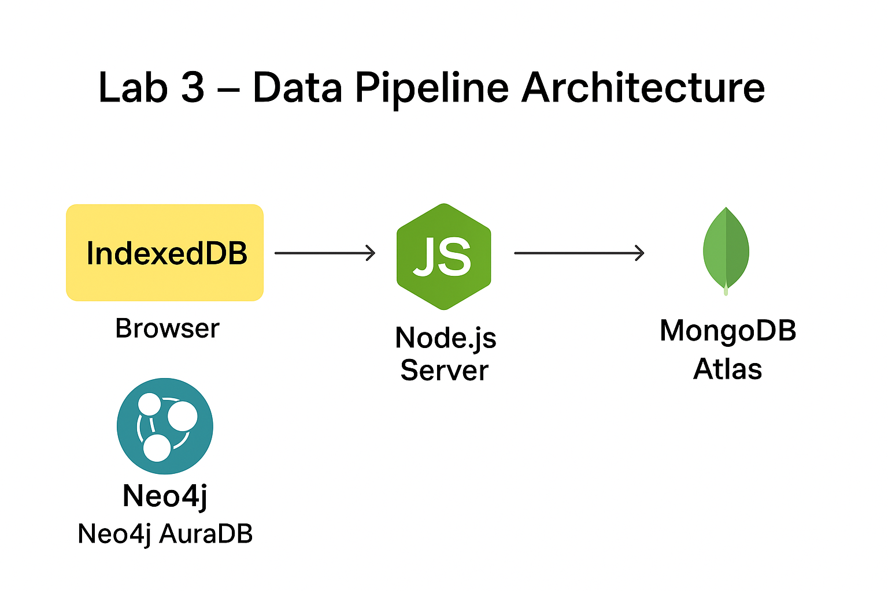
Challenges & Recommendations
Content (Bullets/Table):
Aspect | What Worked Well | What Did Not Work Well / Challenges
Neo4j → MongoDB Pipeline | Data mapping and ingestion worked | Cypher syntax errors initially blocked pipeline
IndexedDB Ingest | JSON enrichment & insertion smooth | Enforcing 10 docs per request caused validation errors
Environment Setup | dotenv allowed flexible configs | Missing/incorrect .env variables caused failures
General Recommendations | Always verify field names & types | Test queries in Neo4j console before scripts

Slide 4
Lessons Learned
Successes
Challenges
Combined data from multiple sources into a single MongoDB lake.
Used map projections in Neo4j to simplify document structure.
IndexedDB ingest server works with JSON payloads efficiently.
Template string errors in Node.js were tricky (backticks required).
Neo4j Cypher map projection syntax needed correction (f{.*} vs f{.}).
Environment variable management required careful attention (.env names).

