Slide 1
DBMS 2
Lab 3 – Rohan Jagdish Tilwani

Slide 2
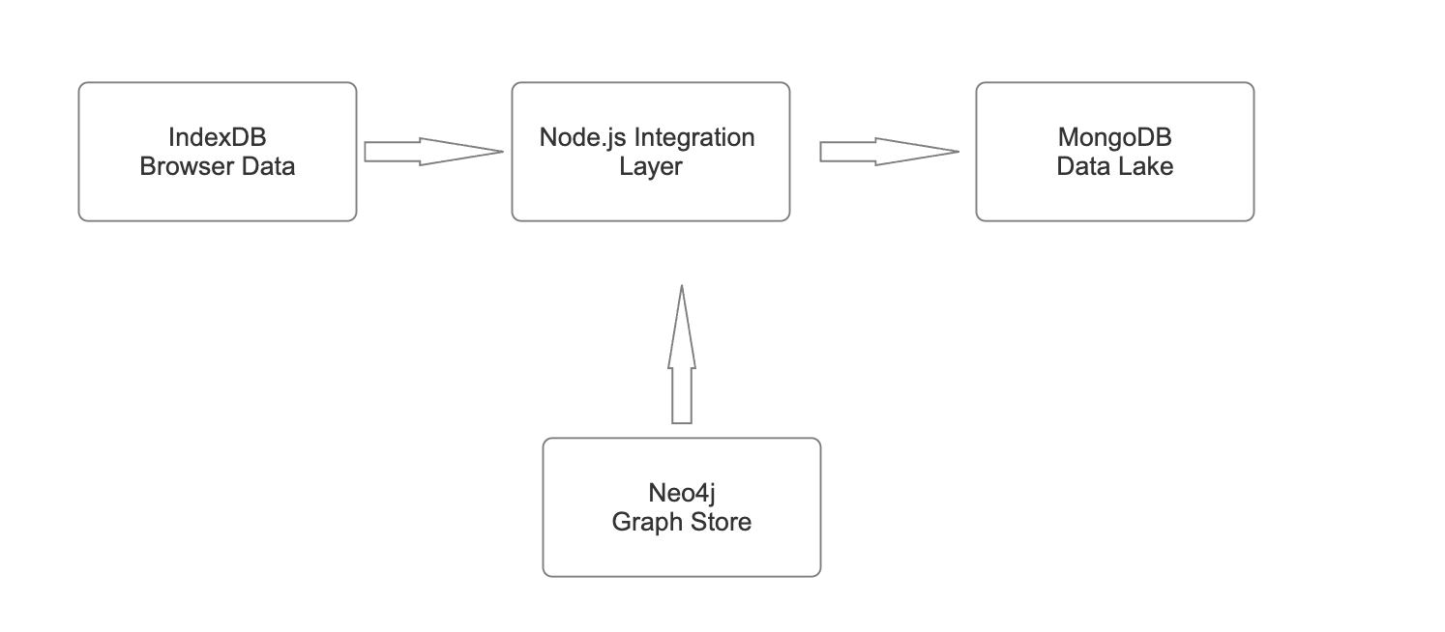
Multi-Database Flow: IndexedDB ↔ Neo4j → MongoDB Lake
Metadata Schema:
{sourceDB, ingestedAt (UTC), tags [array], syncType {partial|full}}
Design Notes:
Clear rectangular nodes and directional arrows.
Vertical and horizontal flow merged to emphasize integration hub (Node.js layer).
Node.js acts as middleware connecting both IndexedDB and Neo4j to MongoDB.

Slide 3
Reflections on Extending the Data Pipeline
Technical Insights:
Node.js Layer Control: Central API streamlined data communication.
Metadata Validation: Timestamp & source tracking prevented duplication.
Schema Mapping: Adapted Neo4j edges to MongoDB documents.
ETL Optimization: Async promises reduced latency and improved consistency.
Process Insights:
Debugging Workflow: Incremental testing minimized failure rates.
Version Control: Git-based iterations simplified pipeline evolution.
Documentation: Enhanced handoff clarity and maintainability.

Slide 4
Successes and Challenges
Strengths | Challenges
Node.js middleware integration was reliable | IndexedDB limited bulk operations
REST endpoints made testing easier | Neo4j–Mongo schema alignment was tedious
MongoDB handled semi-structured data well | Race conditions in event-based sync
Metadata logging improved auditability | Network latency during multi-sync
Modular ETL functions were reusable | Handling API timeouts on local runs

