Slide 1
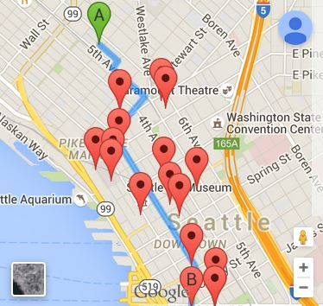
Route Finder
Jennifer O., Jessica P., Rosie G.
Mentors: Lucy L., Josh P.

Slide 2
What:
Shows locations along a route
Google Maps API
Why:
Uses
Google Maps doesn’t currently provide this

Slide 3
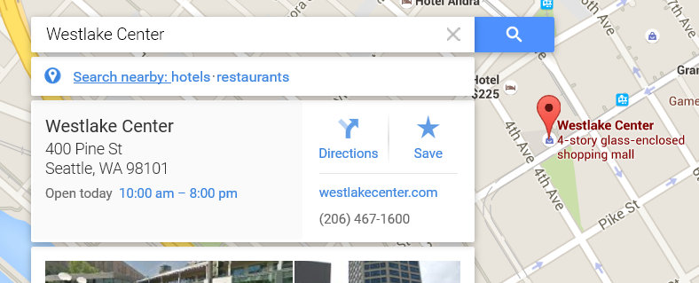
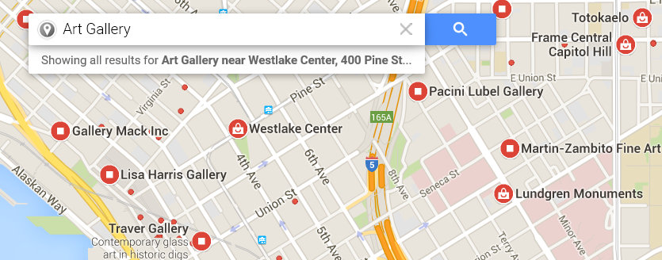

Slide 4
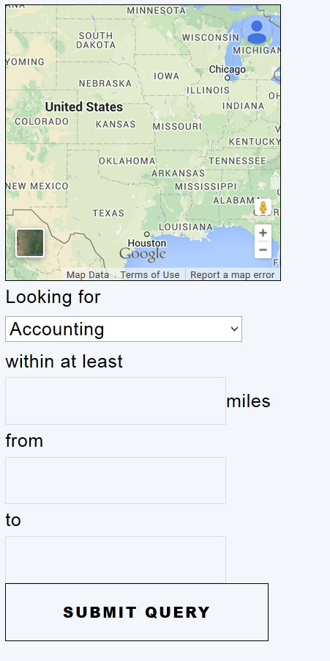
Demo:

Slide 5
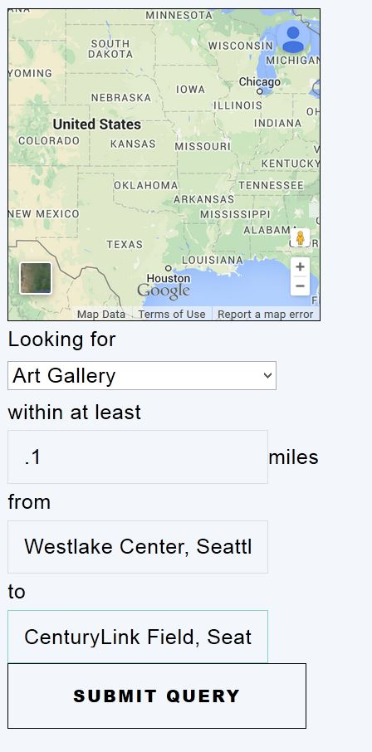

Slide 6
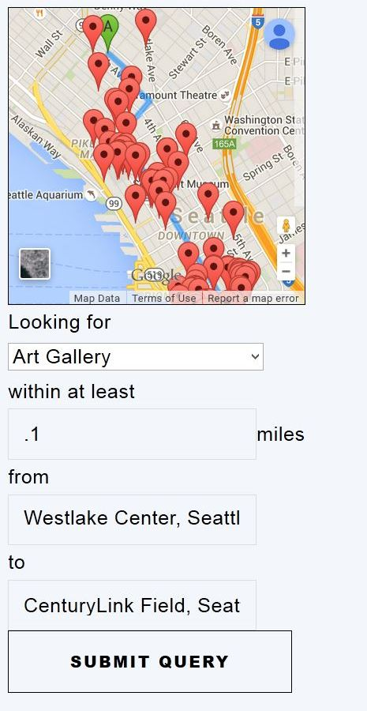
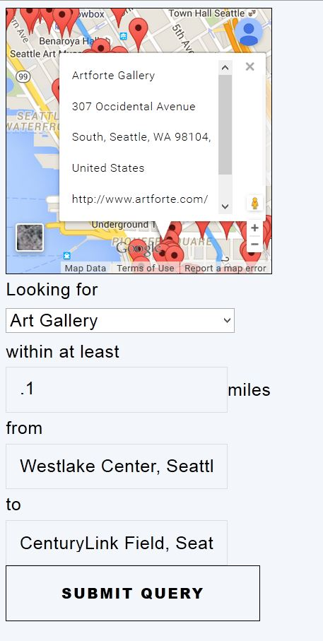

Slide 7
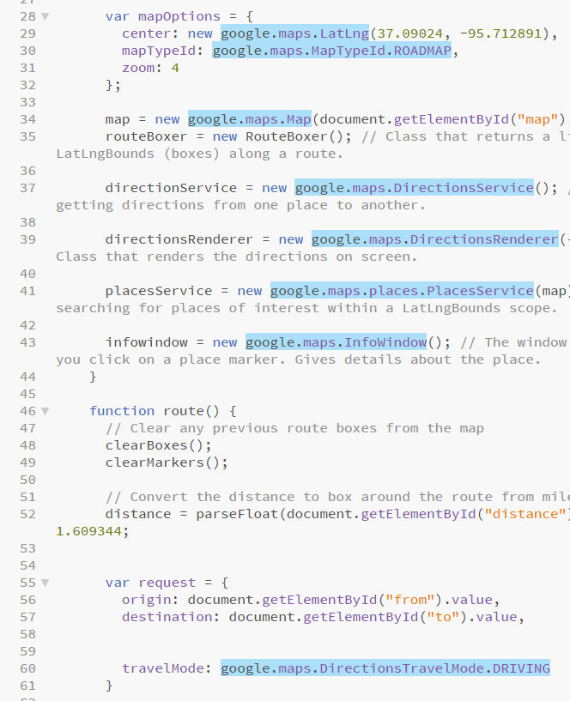
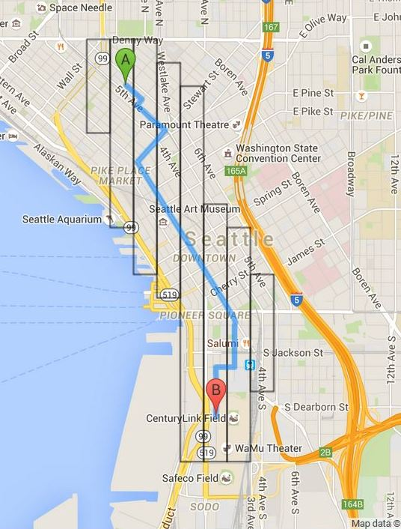
How it works:

Slide 8
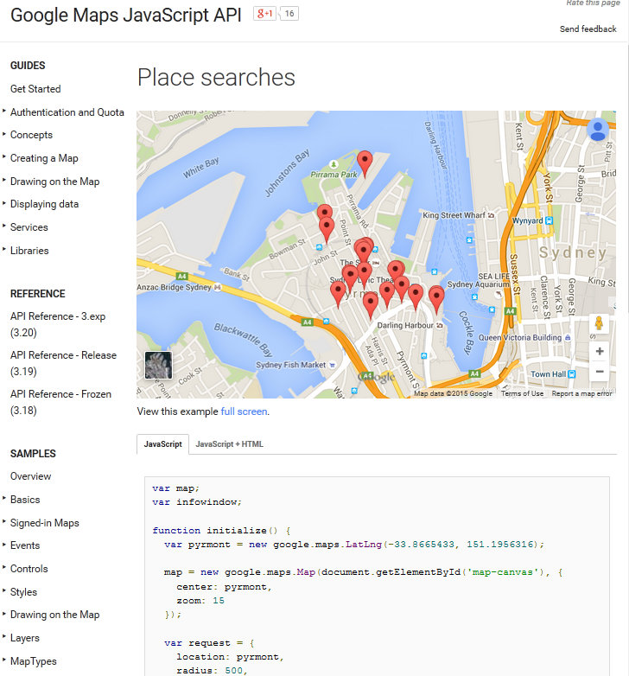
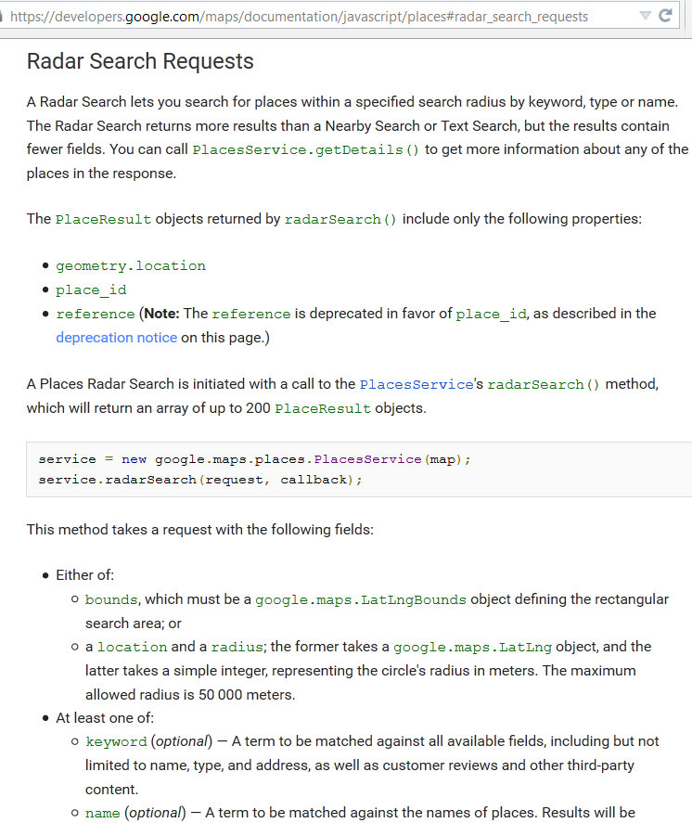
Process:

Slide 9
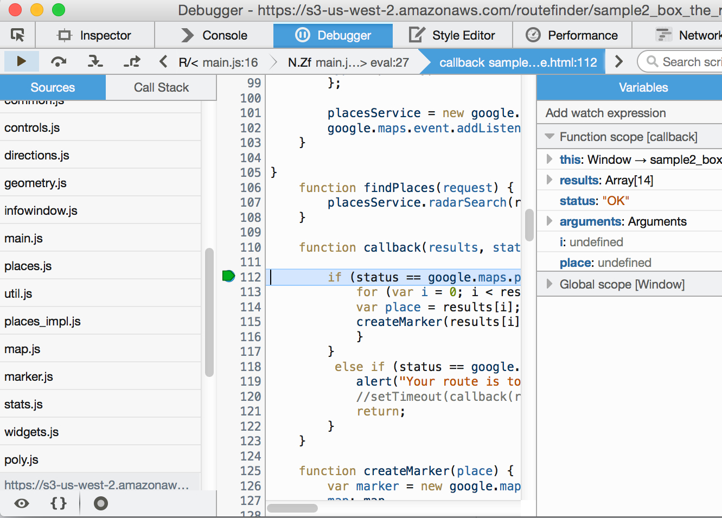
Challenges and troubleshooting
Working with an API
Limitations of the free API
Finding the right tools
Debugging

Slide 10
Try it yourself!
bit.ly/routefinder

