Slide 1


pySEAFOM Updates
March 2026

Slide 2
SEAFOM's Community-Driven Standard Fiber Optics Data Processing Library
Elevate Industry Standards
Establish a unified, community-driven approach for fiber optics data (pre)processing, ensuring everyone works from the same playbook.
Ensure Consistent Benchmarking
Enable reliable and transparent comparison of measurements and system performance across different vendors, datasets, and users.
Simplify Data Handling & Analysis
Provide a single, well-documented, and easy-to-install Python package (pySEAFOM) for all standard SEAFOM data handling and processing tasks.
Foster Collaboration & Innovation
Create a common, open-source platform for sharing best practices, validating methods, and collectively developing new analysis techniques.
Improve Reproducibility & Trust
Guarantee that reported performance parameters are calculated consistently, enhancing the credibility and comparability of results.
Reduce Redundant Efforts
Eliminate the need for individual organizations and researchers to develop and maintain their own disparate, and potentially inconsistent, processing scripts.
Accelerate Onboarding & Training
Lower the barrier to entry for new users and organizations working with SEAFOM’s recommended tests by providing standardized tools and clear documentation.
pySEAFOAM

Slide 3
Roadmap for Development & Adoption
Phase 1: Foundation & Data Ingestion
Identify and Prioritize Core Processing Algorithms
Develop Modular & Standardized Processing Scripts
Define Standardized Output Formats for Results & Parameters
Implement Unit & Integration Tests for Processing Scripts
Phase 3: Packaging, Documentation & Initial Release
Package pySeafom as a Python Library
Create Comprehensive Documentation
Develop Example Scripts & Jupyter Notebooks
Alpha/Beta Release & Wider Community Testing
Publish pySeafom to PyPI
Phase 4: Community Building, Adoption & Long-Term Evolution
Promote Adoption and Gather Feedback
Establish Clear Contribution Guidelines & Governance Model
Continuous Maintenance, Bug Fixes, and Updates
Foster a pySeafom User & Developer Community
Define a Standardized Internal Data Representation
Develop/Adapt Data Readers & Implement Unit Tests.
Establish Version Control & Initial Project Structure
Initial Community Review & Feedback Cycle
Phase 2: Core Processing Script Development & Standardization

Slide 4
GitHub Access Levels
All Repo Admins:
OTM+ Streeting Committee
SEAFOM Github Organization
Public
Governance
pySEAFOM
Admins/Owners
Guilherme, Cicero, Peter, Peyman
Maintainers/Developers
Vendor reps
Public
DFOS_Data_Model
Admins/Owners
Stefan
Maintainers/Developers
Sean, PF

Slide 5
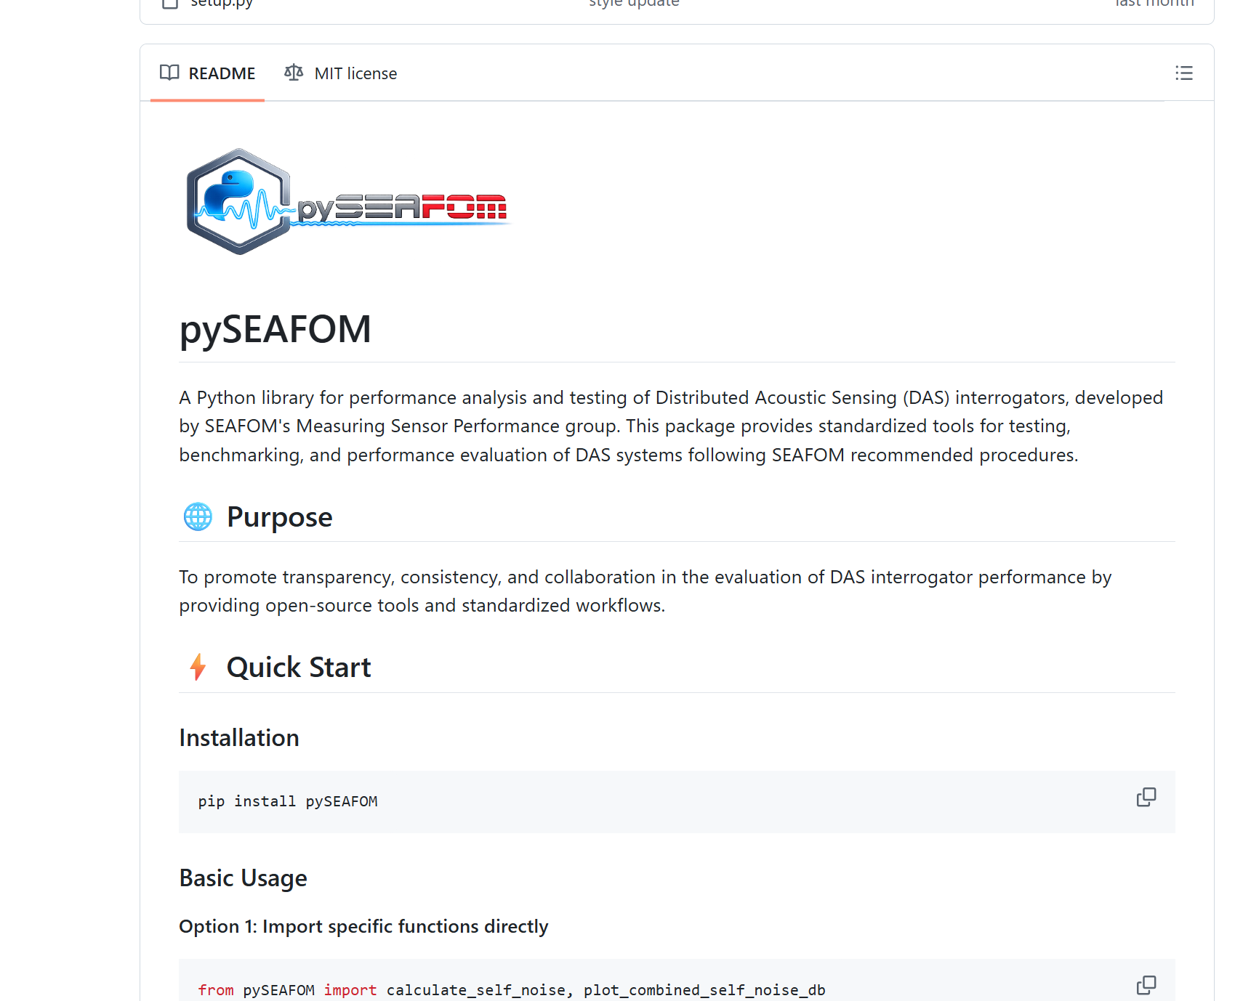
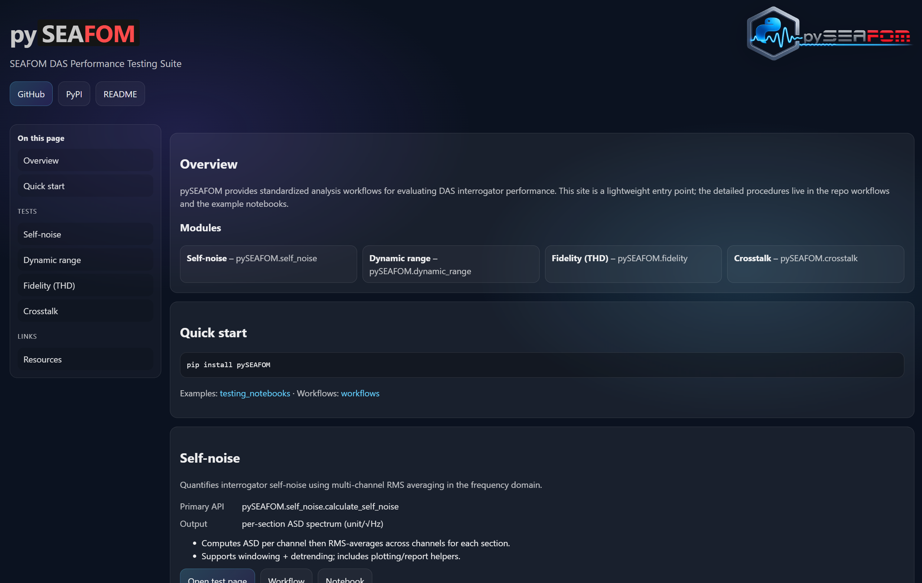
Repository and Documentation
https://github.com/SEAFOM-Fiber-Optic-Monitoring-Group/pySEAFOM

Slide 6

Modules so far
pySEAFOM
Dynamic Range
✓
Frequency Response
✓
Spatial Resolution
✓
Self Noise ✓
Loss Budget
✓
Fidelity
✓
Cross Talk
✓
LF DAS
New module requirements
Core implementation
API doc
Workflow walkthrough
Validation notebook

Slide 7
Business Process Flow
Install the processing package
pip install pySEAFOM (or integrate the repo into your environment)
Prepare input data
Load and format acoustic data into the required 2D array (channels × samples)
Run core compute functions
Call the library’s feature‑extraction and processing functions
Generate outputs
Use the module’s plotting and reporting functions to produce graphs, metrics, and analysis artifacts

Slide 8
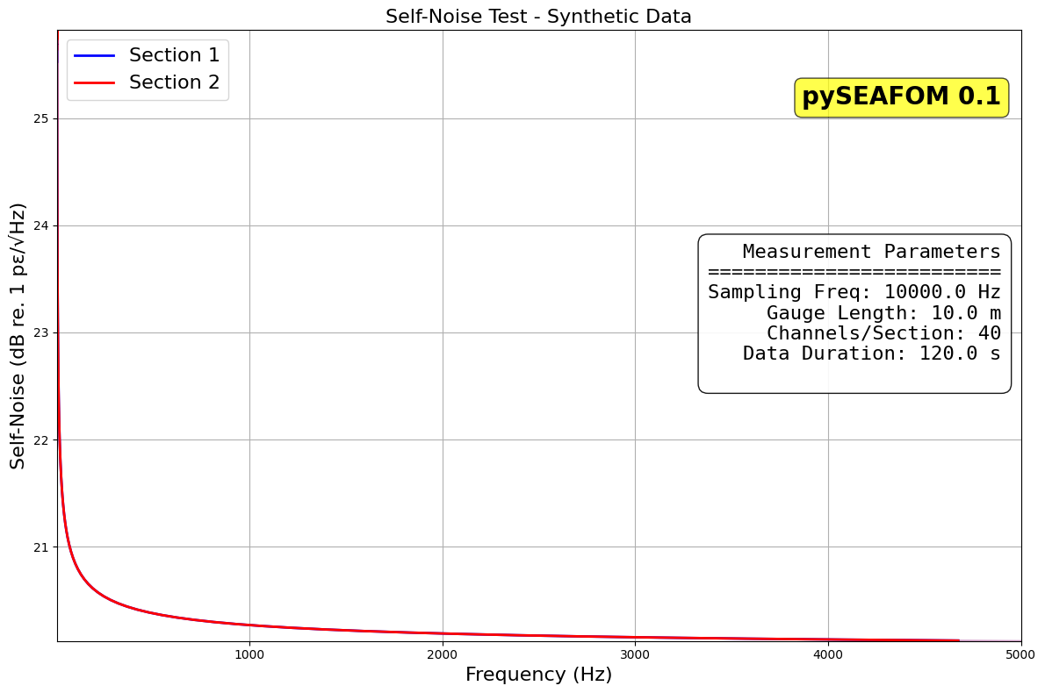
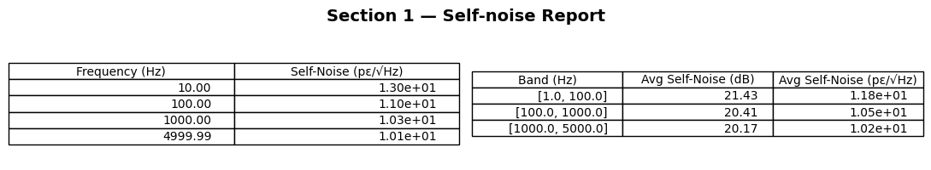

Sample Output Template

Slide 9
Sample Output Template

Slide 10
Back up

Slide 11
Governance
Main branch protection rules:
Require pull request reviews
Required number of approvals: 2
Dismiss stale pull requests
Require status checks to pass
Require branches to be up to date
Include administrators
Admins (@pyseafom-admins):
Can merge to protected branches
Can review pull requests
Full write access
Maintainers/Developers (@pyseafom-developers):
Can create branches
Can submit pull requests
Cannot merge to main
Contributors: public
Can fork repository
Can submit pull requests
Need review approval
Contributing Guidelines
Fork (branch) the repository
Create feature branch
Make changes
Run tests
Submit pull request
Wait for review
Code Review Requirements
2 approvals needed
All tests must pass
Follow style guide
Pull Request Template
## Description
What changes does this PR introduce?
## Testing
- [ ] Unit tests added
- [ ] Integration tests run
- [ ] Manual testing completed
## Reviewer Checklist
- [ ] Code follows style guide
- [ ] Documentation updated
- [ ] Tests pass
Issue Templates
name: Bug Report
description: File a bug report
body:
- type: markdown
attributes:
value:
- type: input
id: description
attributes:
label: Description
placeholder: What happened?
validations:
required: true

Slide 12
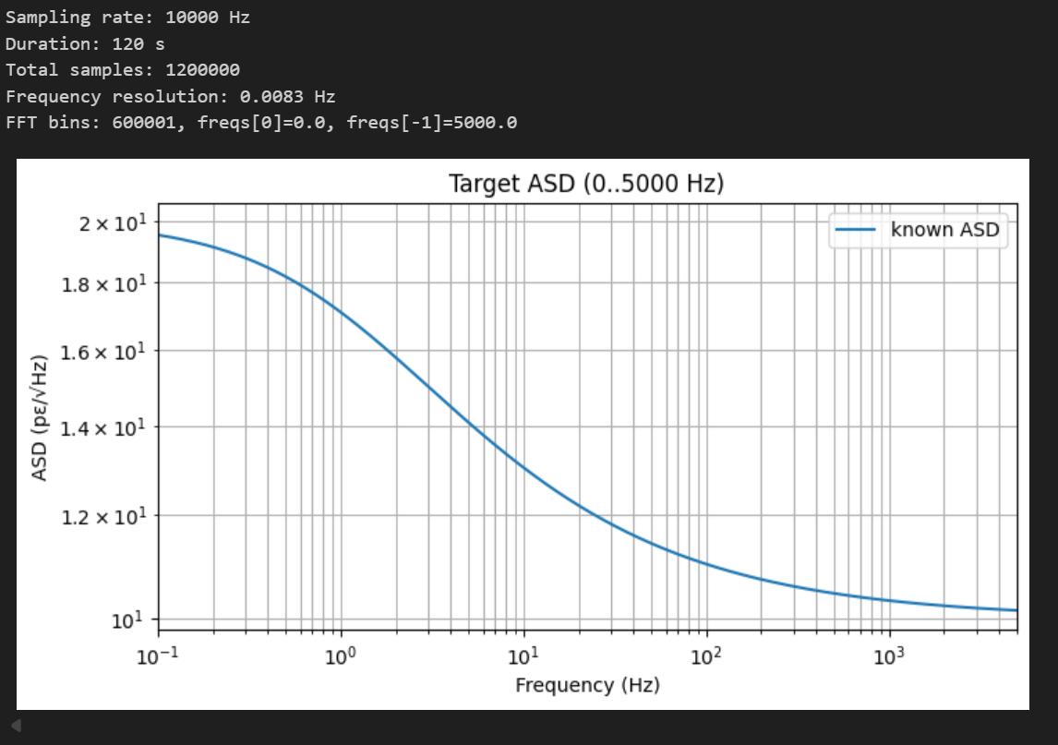
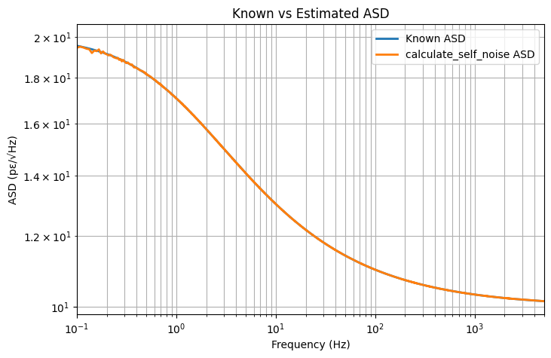
Validation; Synthetic Case

