Slide 1

Learning Methods Autonomous Driving

Slide 2
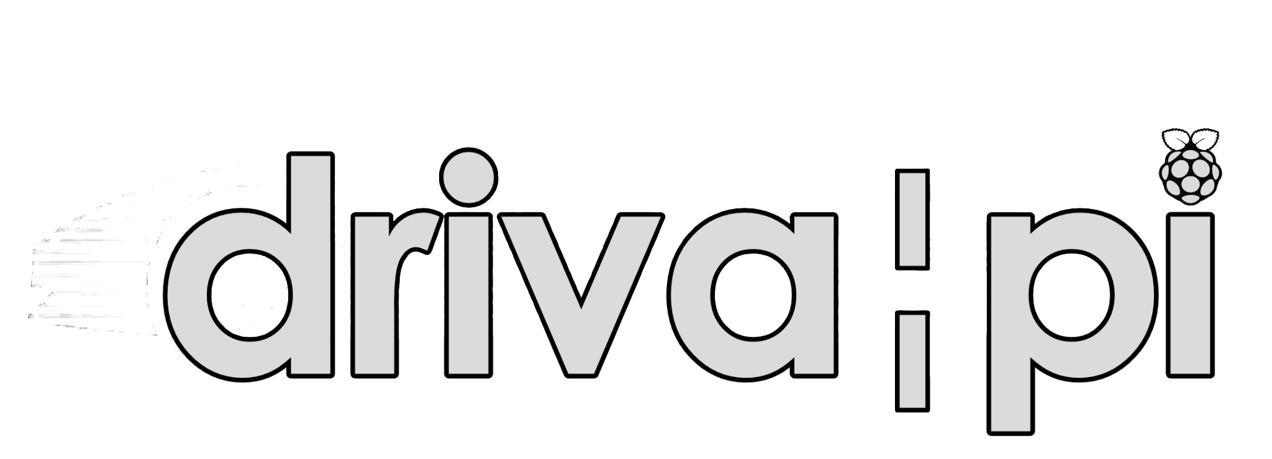
Overview
Imitation Learning
Learn from human errors
Reiforcement Learning
Learn from trial and error
Dataset Aggregation
Iterative data collection

Slide 3
Imitation Learning Supervised learning from human demonstrations
✓ Advantages
No reward function required — learns directly from labeled data Fast and intuitive — leverages existing human driving datasets Produces natural, human-like driving behavior Works end-to-end: raw sensor input → actions Easy to scale with more human driving data
✗ Disadvantages
Distribution shift — errors compound when the agent diverges from training states Performance limited by demonstration quality Struggles with rare edge cases underrepresented in data Cannot surpass human-level performance Requires large amounts of labeled demonstration data

Slide 4
Reinforcement Learning Agent learns via reward signals through trial and error
✓ Advantages
Can surpass human-level performance given enough training Learns optimal strategies, not just imitation Naturally handles sequential decision-making Can discover novel and creative driving strategies Works in simulated environments without human supervision
✗ Disadvantages
Requires careful, complex reward function design Sample inefficient — needs millions of interactions to converge Sim-to-real gap: policies trained in simulation may fail in reality Safety concerns: exploration leads to dangerous behaviors Difficult to train for rare but critical scenarios

Slide 5
Dataset Aggregation Iterative algorithm that addresses imitation learning's distribution shift
✓ Advantages
Directly solves the distribution shift problem of IL Collects data in states the agent actually visits Iterative improvement — gets better with each round More data-efficient than pure IL over time Combines strengths of IL with online data collection
✗ Disadvantages
Requires ongoing human supervision during training Expensive — human experts must label new states repeatedly Not safe to deploy in the real world during training Convergence can still be slow and unpredictable Complexity increases with each aggregation round

Slide 6
Side-by-Side Comparsion
Criteria | Imitation Learning | Reinforcement Learning | Dataset Aggregation
Needs reward fn | No | Yes | No
Data Source | Human Demos | Self-exploration | Human + agent data
Distribution Shift | Severe | N/A | Largely Resolved
Performance Ceiling | Human-Level | Beyond Human | Near human-level
Training Cost | Low | Very High | Medium
Safety during Training | High | Low | Medium

