Slide 1






e-commerce
DEPARTMENT OF COMPUTER SCIENCE AND ENGINEERING
U23CS491-B24-28-CSE-A
Java Programming
Project Phase 1
PLATFORM
Console Based Java File Handling Project
ABINIVESH M
LATERAL ENTRY 1
II CSE A
Page 1

Slide 2

Hardware Requirements
Standard Laptop or Desktop Computer
System Requirements
Software Requirements
Visual Studio Code or Other IDEs.
JRE
Page 2

Slide 3

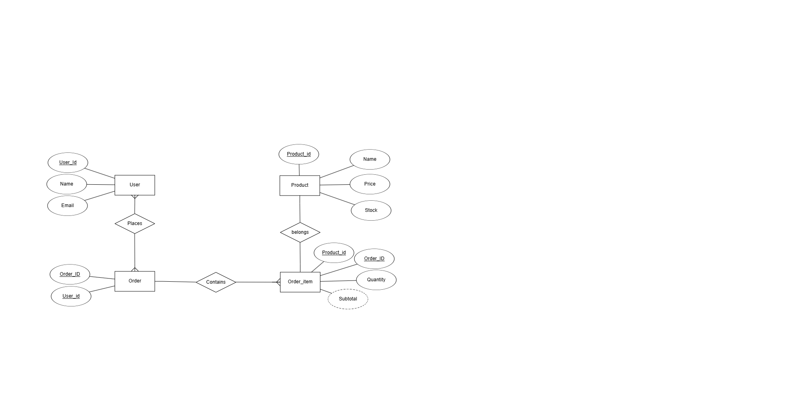
ER Diagram and Flow
Page 3

Slide 4



Entities and Relationships Overview
1. User
UserID (PK)
Name
Email
Relationship: A User can place many Orders
2. Product
ProductID (PK)
Name
Price
Stock
Relationship: A Product can be included in many OrderItems
Page 4

Slide 5
3. Order
OrderID (PK)
UserID (FK → User)
[Contains many OrderItems]
Relationship: An Order belongs to one User
One Order has multiple OrderItems
4. OrderItem
OrderID (FK → Order)
ProductID (FK → Product)
Quantity
Subtotal (derived)
Acts as a bridge in the many-to-many relationship between Order and Product
Page 5

Slide 6


Packages Used:
java.util – for collections and data structures
java.io – for reading/writing data to files
Environment: Console-based application
Page 6

Slide 7


Main Components:
User.java – Represents customers
Product.java – Represents products in stock
Order.java – Represents customer orders
OrderItem.java – Represents individual items in an order
ECommerceApp.java – Main application and logic handler
System Architecture
Page 7

Slide 8


Features Includes
1. Add User
Inputs name, ID, and email
2. Add Product
Inputs name, ID, price, and stock
3. Place Order
Select user → Select product(s) → Save order with subtotal
4. View Orders
Displays order details from saved file
Page 8

Slide 9


No GUI (console-only)
No concurrency or validation of unique IDs
Limited product filtering/search
Limitations
Page 9

Slide 10


Successfully simulated e-commerce transactions
Practiced object-oriented programming and file I/O
Modular design using separate class files
Conclusion
Page 10

Slide 11


Thank You
Page 11

