Slide 1
5. Model Skill assessment
Filipe Fernandes
Goals:
Quick and easy model-observation online comparison tool
help visualize how the various SECOORA modeling efforts (SABGOM, UF, USF, and NCSU) compare with the latest data available from SECOORA/SOS/NDBC
Model and observations are automatically discovered providing information beyond usual control/calibration point

Slide 2
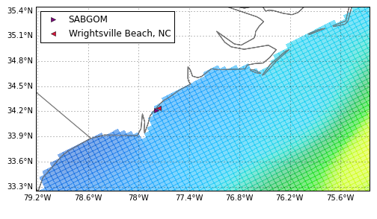
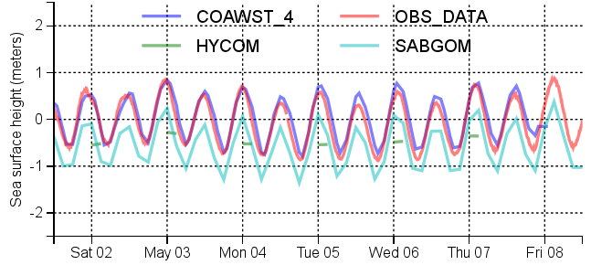
5. Model Skill assessment
Filipe Fernandes
Find model-observation with 4 km radius
Interpolate to 30 min time-series
Compare the model elevation to NAVD88 datum (Bias)
Calculate Pearson correlation (Skill)
Reject when there is not enough data to compare (HYCOM time resolution is too low)
 | COAWST4 | HYCOM | SABGOM
Bias | 0.09 | -0.39 | -0.51
Skill | 0.95 | NA | 0.98

