Slide 1


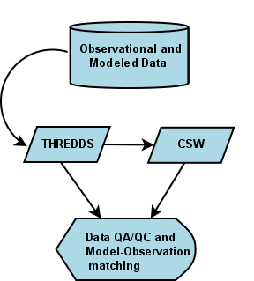
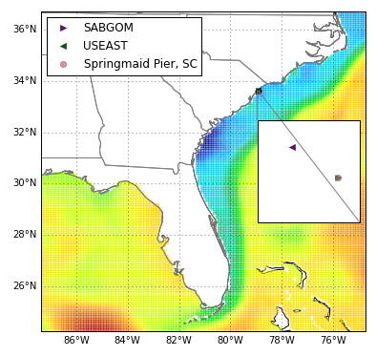
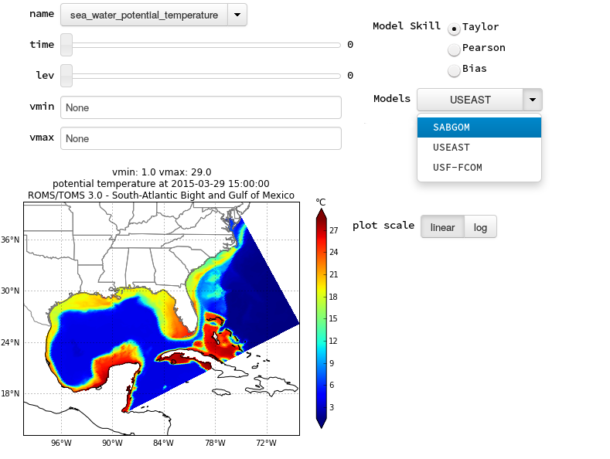
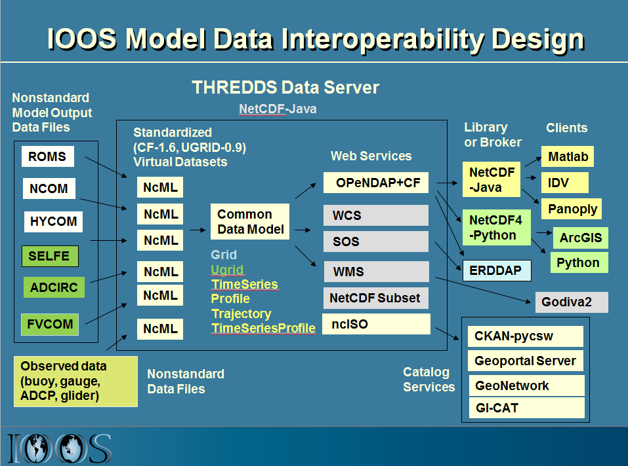
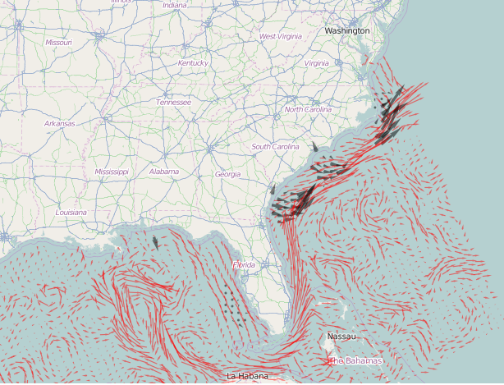
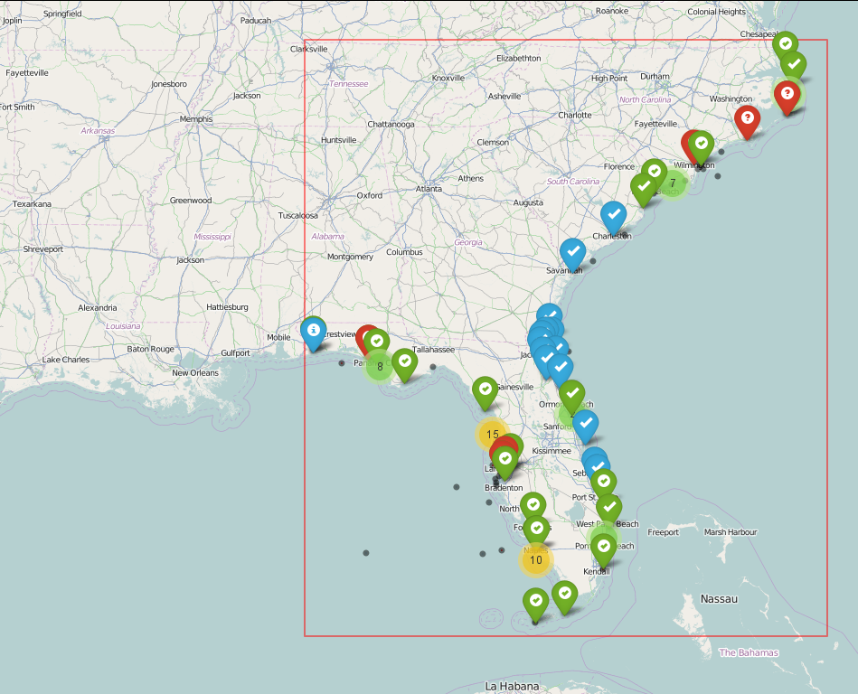
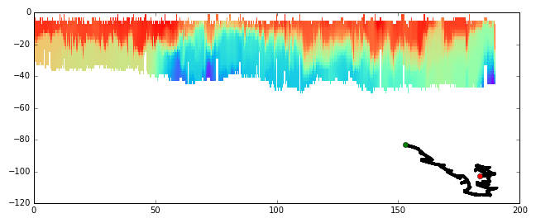
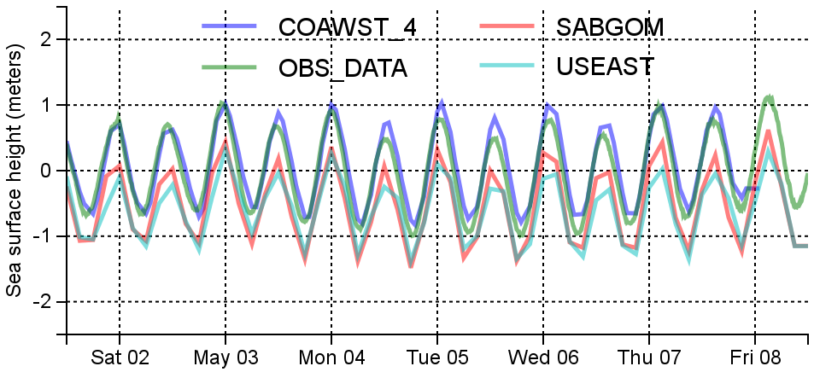
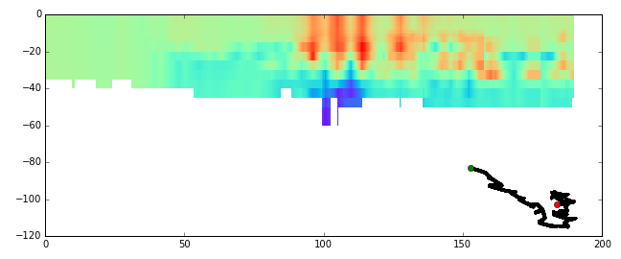
Southeast Coastal Ocean Observing Regional Association
An end-to-end Workflow for Assessing Sea Surface Temperature, Salinity and
Water Level Predicted by Coastal Ocean Models
Filipe Fernandes, Richard Signell², Vembu Subramanian³, and Debra Hernandez³
²USGS, Woods Hole, MA
³Southeast Coastal Ocean Observing Regional Association (SECOORA), Charleston, SC
  The Observed and Modeled time-series are interpolated or sub-sampled,
  depending on the original resolution, to a 30-min resolution. The model skill (and bias for SSH) are then computed via a linear correlation (Pearson). The final version of the online tool will let the user choose between RMS, Event-driven skill, and Taylor diagrams (to compare different models all together.)
  To assess the performance of SECOORA ocean forecast models the simulations need to be compared with data. Finding what models and data exist at a certain point in time and space has historically been challenging because this information is held and distributed by numerous providers in different formats.
  Accessing data has been challenging because ocean models produce terabytes of information. While it is usually stored in binary data formats like HDF or NetCDF, ocean observations are often stored in scientific data formats or in databases.
  To solve this problem, the Southeast Coastal Ocean Observing Regional Association (SECOORA) has been building a distributed information system based on standard IOOS-supported web services for discovery and access.
Data acquisition flow. Both modeled and observations are queried via CSW. However, SECOORA platforms observations are fetched directly via SECOORA THREDDS catalog.
Model-observation matching
User interface for the Model Skill online tool.
Coming soon…
HF Radar
currents
Schematic of the IOOS Coastal and Ocean Modeling Testbed (COMT) model data interoperability design. J. Mar. Sci. Eng. 2014, 2(1), 194-208; doi:10.3390/jmse2010194
In order to find the models and data we use a CSW catalog for discovery and access. We search for data endpoints as SOS, DAP, and NDBC. SECOORA data is handle separately via direct access to the THREDDS catalog to ensure all SECOORA buoys available are found.
Using automatic discoverable data we create weekly time-series of Sea Surface Temperature (SST), Sea Surface Salinity (SSS), and Sea Surface Height (SSH) comparisons of modeled and observed data.
Thanks to the metadata rich Common Data Models (CDM) we are able to match every observation to a model point in space and time.
For now SST, SSS, and SSH are fetched and processed into time-series, sampled at every 30 min. The models are assessed via a linear Pearson correlation.
Analysis and visualization is performed with NumPy and Pandas for the skill and time-series handling, and Folium to create interactive maps. The entire workflow is shared as in IPython Notebooks.
Interactive web-map displaying all the observations and models found. Every dot , when clicked, show a time-series together with the model-data comparison. (See figure below.)
Glider track
Acknowledgements
We would like to thank SECOORA for the funding support. We
would also like to thank the contributions of members of
NOAA/IOOS, and Principal investigators.
Virtual Glider track
(USEAST)

