Slide 1
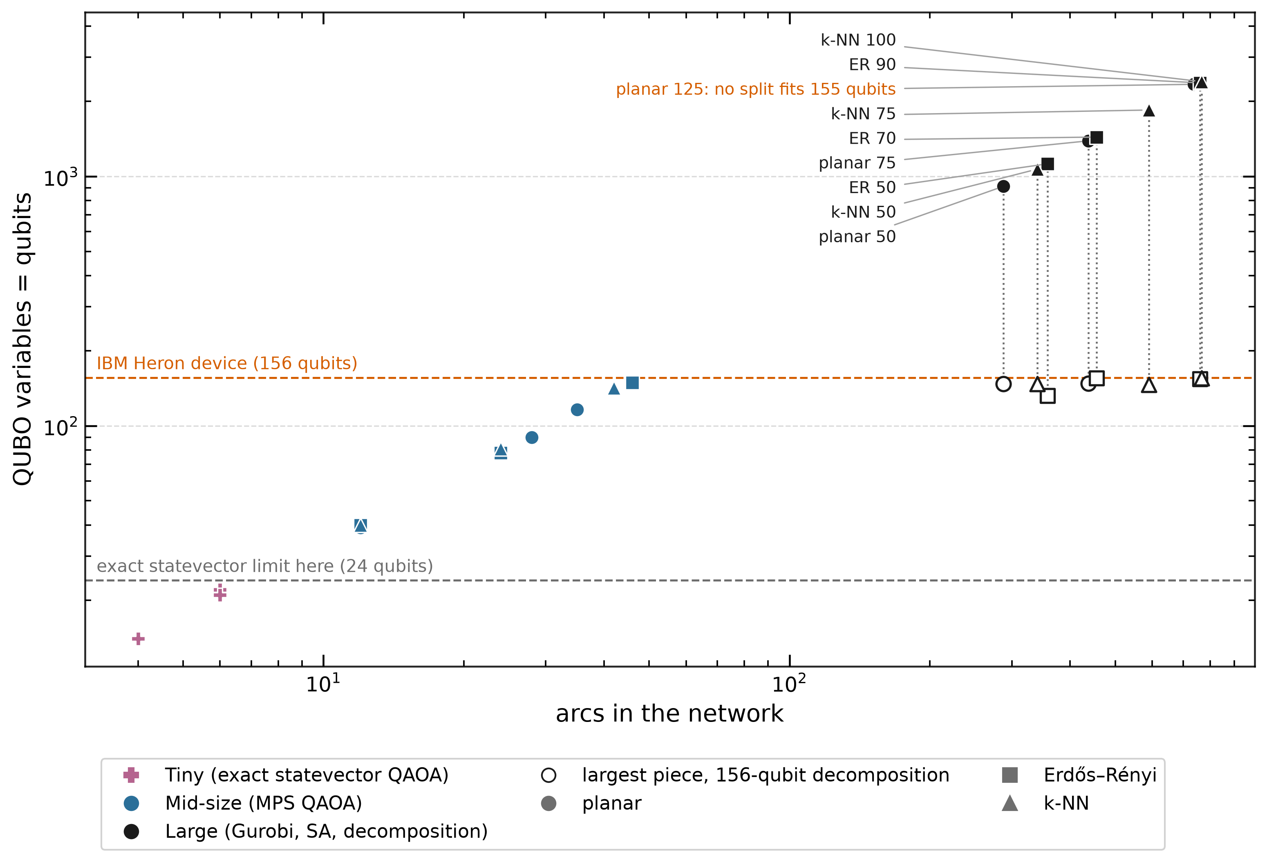
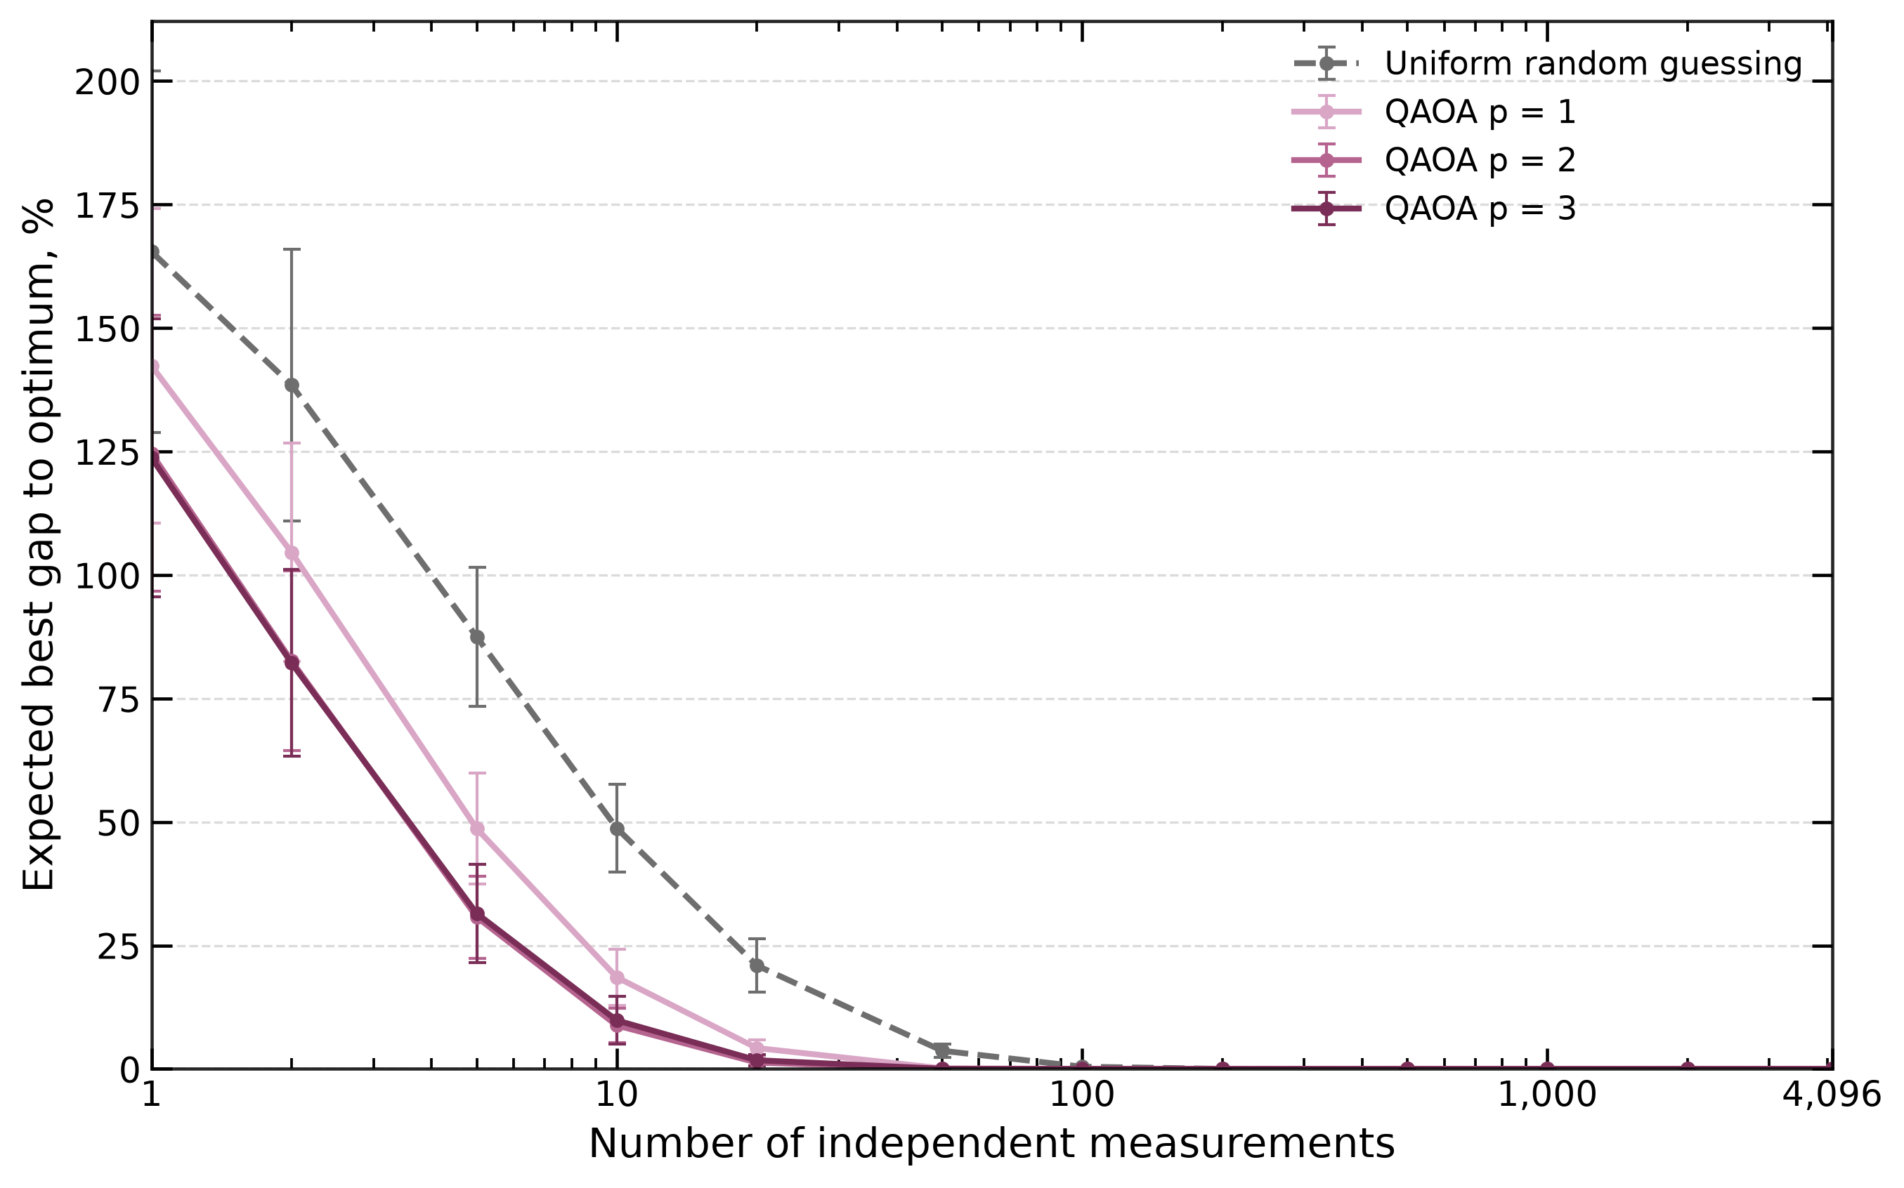
Implementing Quantum Approximate Optimization Algorithm
Remove links under a fixed budget to minimize the flow that remains.
Problem sizes and device limits
Expected best cut after N measurements
10 measurements: 9% gap (depth 2), 49% (random).
Statevector prediction; 6 tiny cases; mean ± SEM.

Slide 2
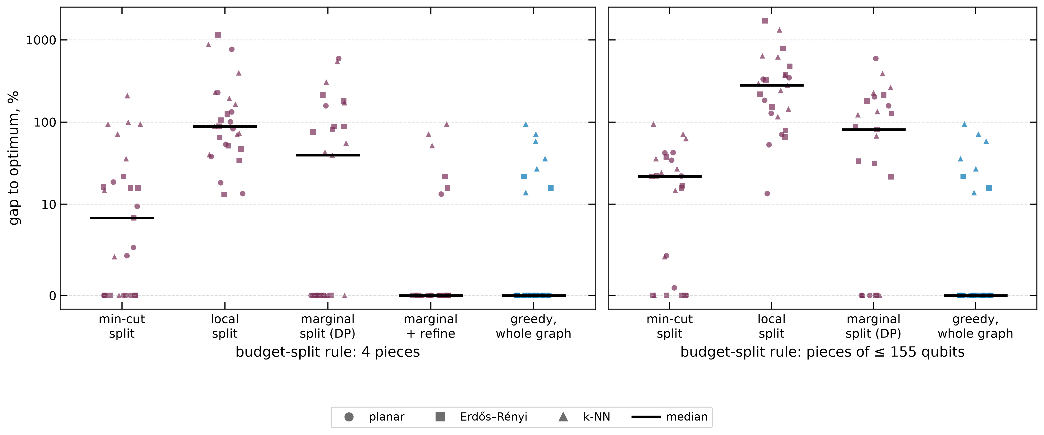
Decomposition-Based Refinement
Validate penalties → partition → allocate budget → solve pieces → refine cuts
Four pieces + refinement: optimal in 21/27 cases. Device-sized pieces: 22% median gap with the best split rule.
27 cases, 50–125 nodes; exact piece solves. Gurobi solves all quickly; SA + repair never beats greedy.

Slide 3
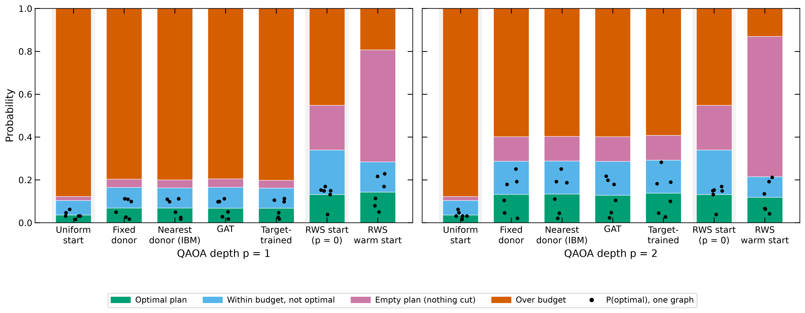
Parameter Setting Strategies
Fixed, nearest, GAT and trained angles give similar outcomes.
At p = 2, RWS assigns 66% probability to the empty plan.

