Slide 1
Quantum Preconditioning Using Gurobi For Constrained optimization
Anurag Ramesh
Maxime Dupont
Bhuvanesh Sundar
David E. Bernal Neira

Slide 2
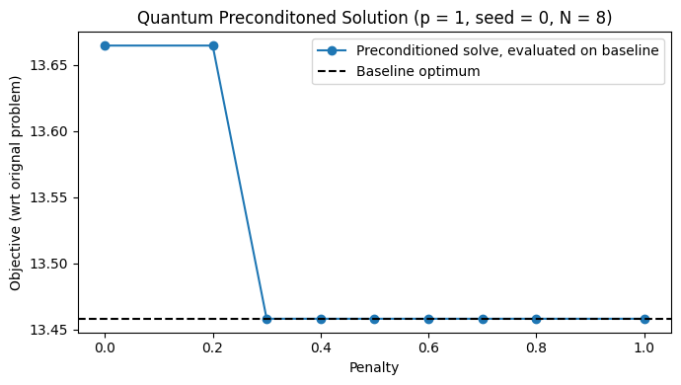
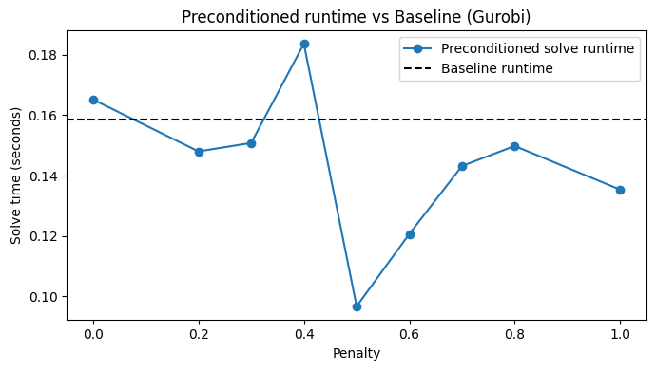
1/28/2026
Solve QP/Baseline with Gurobi: N = 8, seed = 0, p = 1

Slide 3
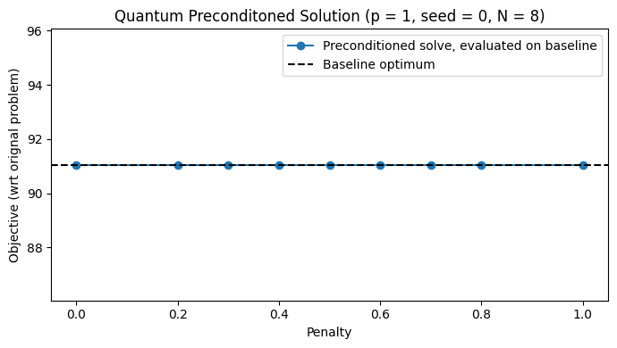
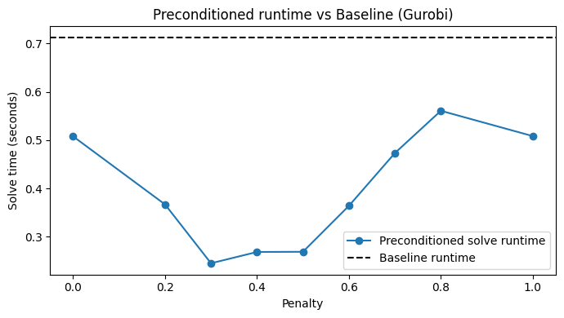
1/28/2026
Solve QP/Baseline with Gurobi: N = 20, seed = 0, p = 1

Slide 4
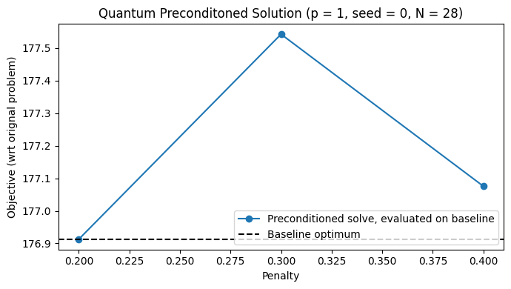
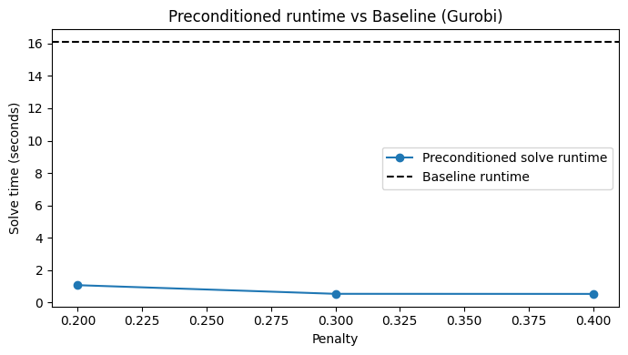
1/28/2026
Solve QP/Baseline with Gurobi: N = 28, seed = 0, p = 1

Slide 5
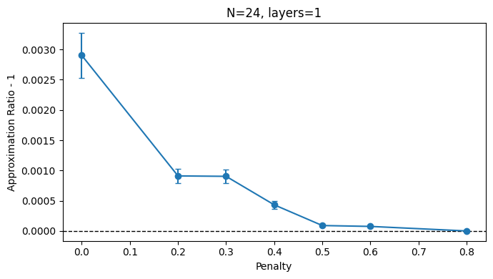
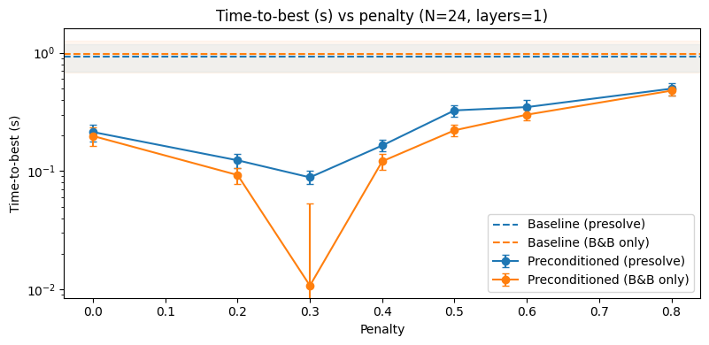
2/25/2026
Solve QP/Baseline with Gurobi: N = 24, all instances (50), p = 1

Slide 6
2/25/2026
Solve QP/Baseline with Gurobi: N = 24, all instances (50), p = 1

Slide 7
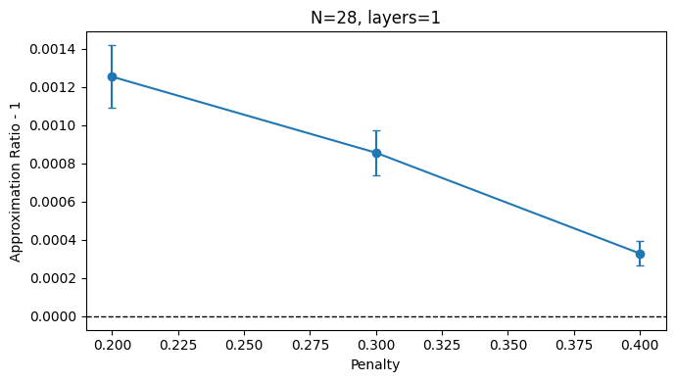
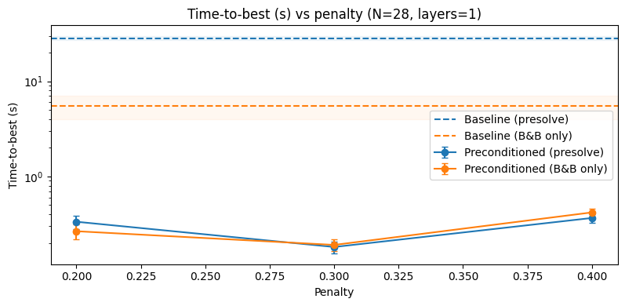
2/25/2026
Solve QP/Baseline with Gurobi: N = 28, all instances (50), p = 1
Time to best Solution

Slide 8
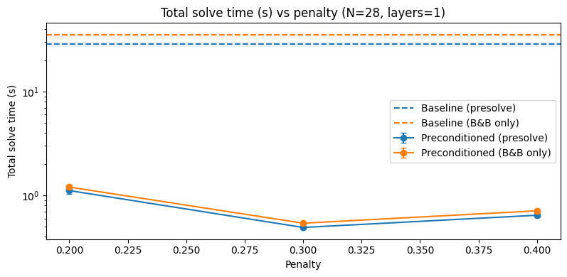
2/25/2026
Solve QP/Baseline with Gurobi: N = 28, all instances (50), p = 1
With Optimality Guarantee
Time to best Solution

Slide 9
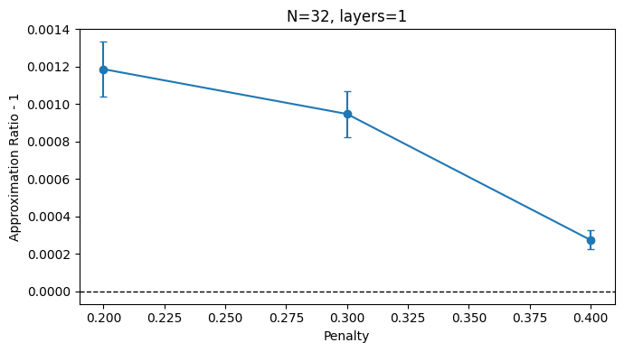
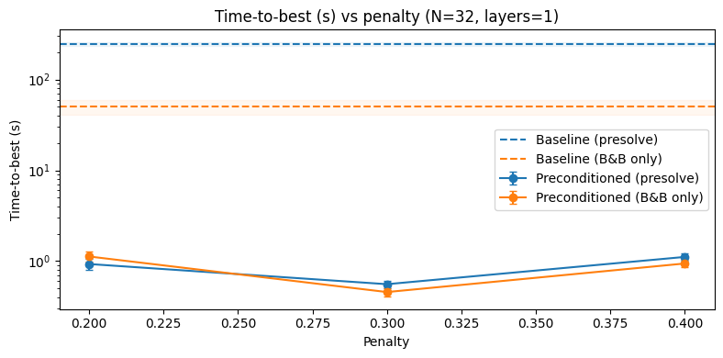
2/25/2026
Solve QP/Baseline with Gurobi: N = 32, all instances (50), p = 1
Time to best Solution

Slide 10
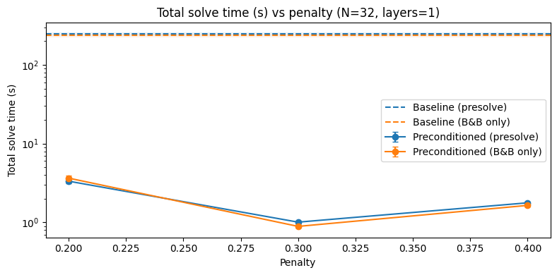
2/25/2026
Solve QP/Baseline with Gurobi: N = 32, all instances (50), p = 1
With Optimality Guarantee
Time to best Solution

Slide 11
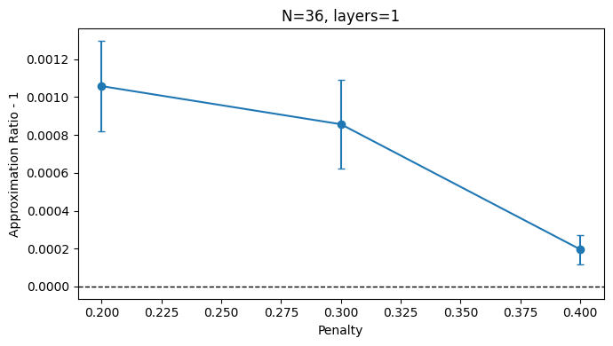
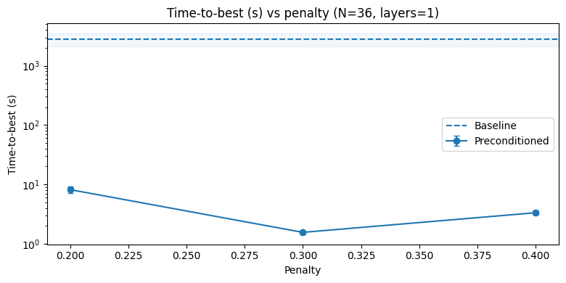
2/25/2026
Solve QP/Baseline with Gurobi: N = 36, all instances (50), p = 1

Slide 12

3/12/2026
What are the guarantees of the preconditioning?
Can one use a dual to produce $W_{ij}$ surrogates?

Slide 13
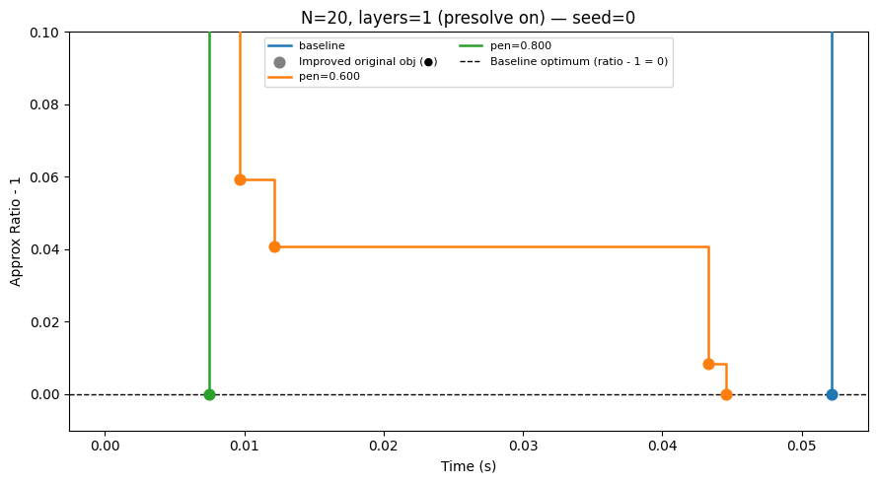
3/12/2026
Solve QP/Baseline with Gurobi: N = 20, all instances, p = 1

Slide 14
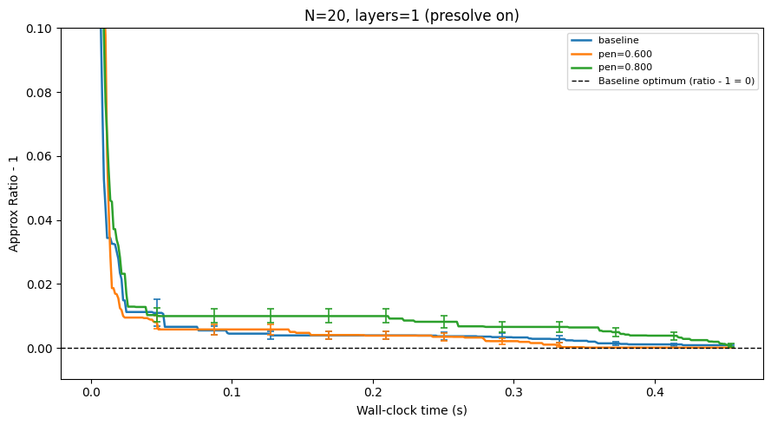
3/12/2026
Solve QP/Baseline with Gurobi: N = 20, all instances, p = 1

