Slide 1

Architecture of a Data Warehouse
A beginner's guide to how modern data warehouses are structured — layer by layer, from raw data to business insights.

Slide 2

What Is a Data Warehouse?
A data warehouse is a centralized repository that stores large volumes of structured, historical data from multiple sources — purpose-built for analysis and reporting, not day-to-day operations.
The concept was defined by Bill Inmon in 1990, who described four essential characteristics that distinguish a true data warehouse:
Why It Matters
Operational systems (like order processing or customer management) are optimized for speed and transactions. A data warehouse separates analytical workloads from those systems, enabling teams to run complex queries without slowing down production.
Result: organizations can make data-driven decisions confidently, backed by clean, historical, and integrated data.
Subject-Oriented
Integrated
Time-Variant
Non-Volatile
Organized around key business topics like sales, finance, or customers
Consolidates data from diverse source systems into a consistent format
Stores historical snapshots so trends can be analyzed over time
Data is read-only once loaded — stable and never overwritten

Slide 3
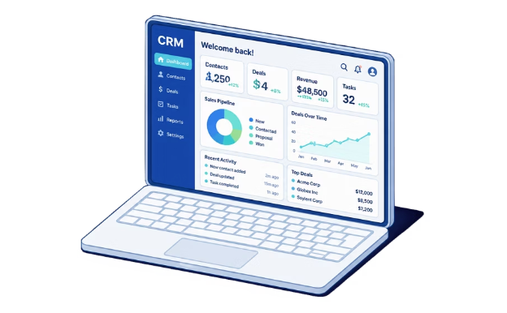
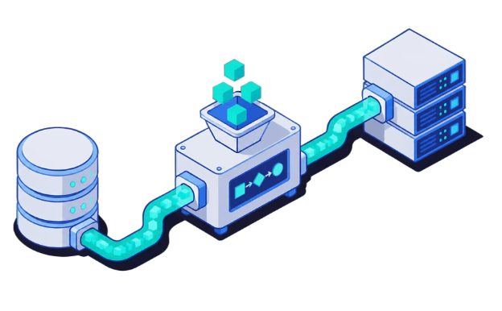
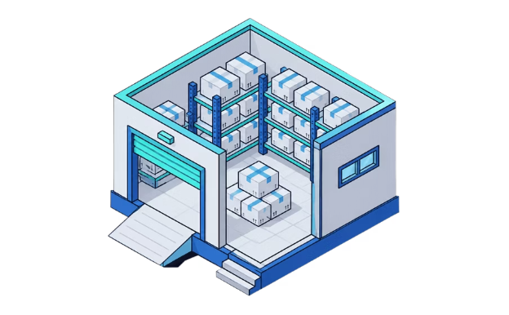
Layer 1: Data Sources & Ingestion
Every data warehouse begins by collecting raw data from the systems where it originates. This first layer is all about what feeds the warehouse and how that data arrives.
Source Systems
Ingestion Methods
Data Staging Area
CRM, ERP, flat files, web logs, APIs, and external databases — these are the raw inputs that supply the warehouse with business data.
Batch loading runs scheduled ETL jobs at set intervals. Real-time streaming tools like Kafka and Kinesis deliver data continuously as events occur.
A temporary landing zone where raw data is held before any transformation takes place — keeping source systems completely unaffected.

Slide 4

Layer 2: ETL Pipeline — Transform & Load
Extract
Data is pulled from heterogeneous sources in its original format — databases, files, APIs, and more.
Transform
Load
Transform
Cleanse, dedupe, standardize, apply rules.
Push clean data to the warehouse.
This is where the heavy lifting happens: cleansing errors, deduplicating records, standardizing formats, applying business rules, and resolving conflicts between sources.
Load
Clean, structured data is pushed into the central warehouse. A full load is used for initial setup; incremental loads handle ongoing updates efficiently.
Extract
ELT Shift
Pull raw data from source systems.
Load first, then transform in cloud warehouses.
Modern Shift: ELT
Cloud-native warehouses like Snowflake and BigQuery increasingly favor ELT — loading raw data first and transforming it inside the warehouse using its own compute power.
The ETL pipeline is the engine of the data warehouse — it moves data from raw and messy to clean and analysis-ready.

Slide 5
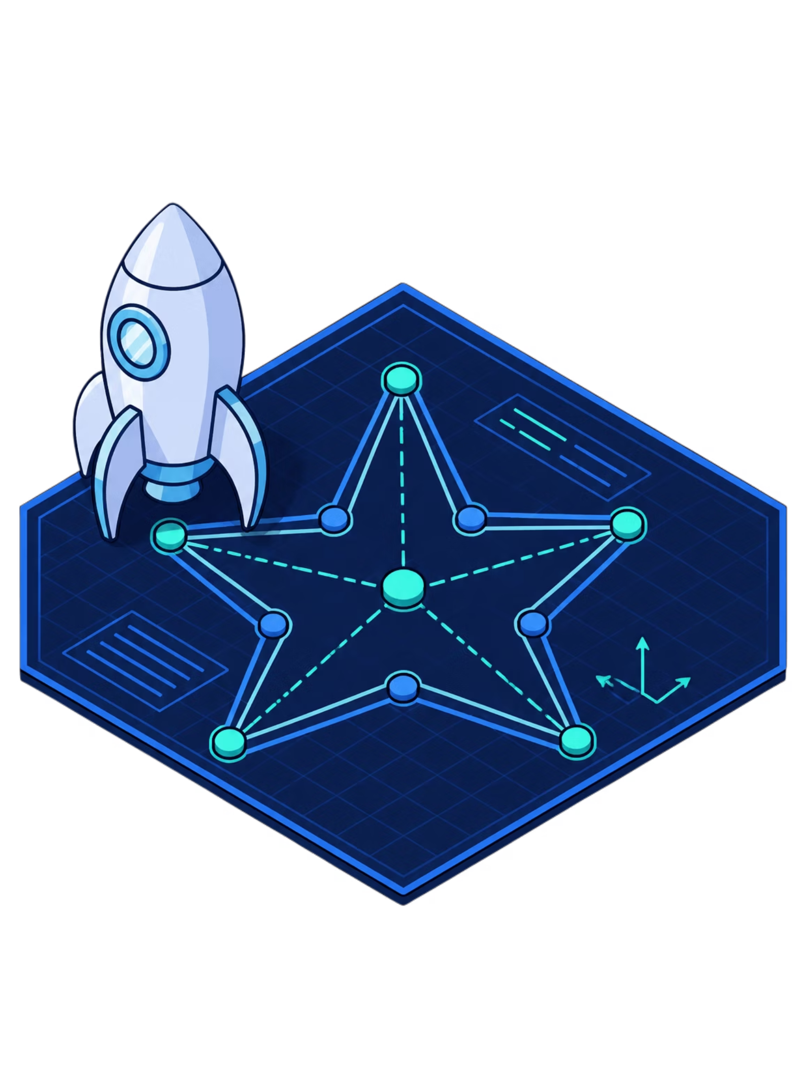


Layer 3: Storage — The Core Warehouse
This is where the cleaned, integrated data lives. The storage layer is organized around two key table types and carefully chosen schema designs.
Fact Tables
⭐ Star Schema
Store measurable business events — sales, transactions, clicks — with numeric metrics and foreign keys linking to dimensions.
Fact table at the center, dimension tables branching outward. Simple and fast for queries — the most common choice for beginners.
❄️ Snowflake Schema
Dimension Tables
Dimension tables are further normalized into sub-dimensions. Saves storage but adds query complexity — better for large, complex warehouses.
Provide context: who, what, when, where — customers, products, dates, and locations that describe each fact.

Slide 6




Layer 4: Data Marts & Reporting
The final layer is where data reaches the people who need it. This is the consumer-facing end of the warehouse architecture.
Data Marts
OLAP Cubes
Reporting & BI Tools
Subject-specific subsets of the warehouse — for example, a Sales Mart or Finance Mart. Individual teams get faster, focused query performance without touching the full warehouse.
Pre-aggregated, multidimensional structures that allow analysts to slice and dice data across dimensions like time, region, and product for rapid exploration.
BI platforms like Tableau, Power BI, and Looker connect to this layer to deliver interactive dashboards, ad-hoc queries, and scheduled reports to end users across the organization.
The full journey: Raw data enters through sources → is cleaned via ETL → stored in the warehouse → surfaced through marts and BI tools as actionable insights.

