Slide 1

WELCOME
TO MY PRESENTATION ON PANDAS

Slide 2
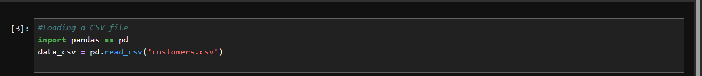
Exercise.1
Loading CSV

Slide 3
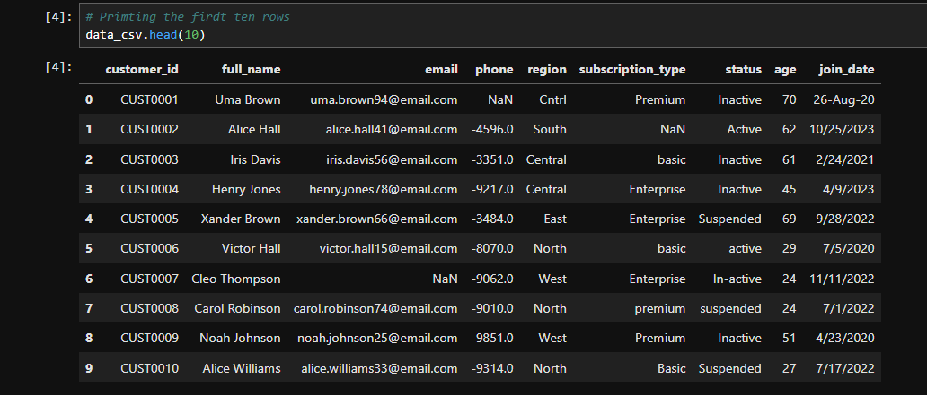
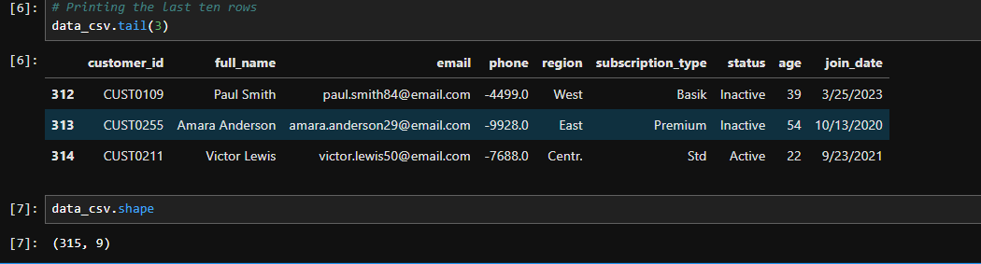
Accessing records in the file
File_name. head()
File_name.tail()

Slide 4
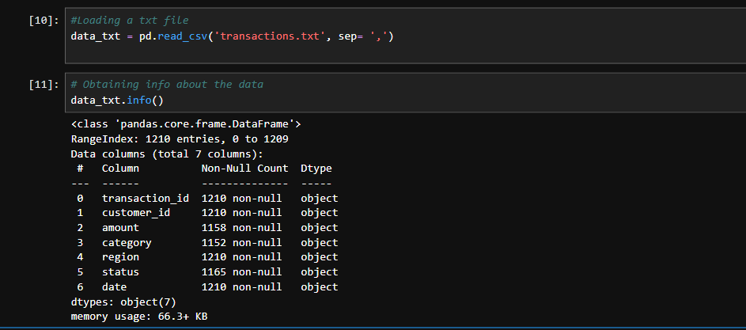
Exercise 2- Loading TXT Files Using CSV method and getting some information

Slide 5
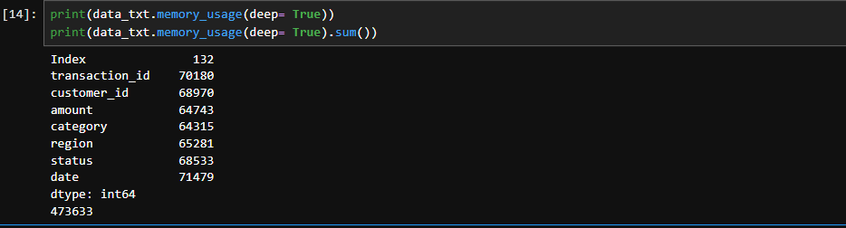
Checking Memory Usage
.memory_usage(deep=True)

Slide 6
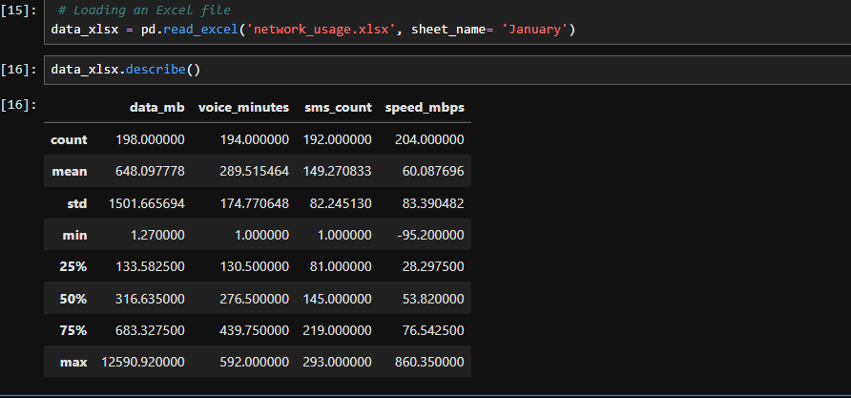
Loading An Excel File And Describing it’s features
Pd.read_excel(‘ filename ’, sheet_name= ‘column_name’)
Filename.describe()

Slide 7

Loading A .JSON File
Method 1- Simple JSON (most common)

Slide 8
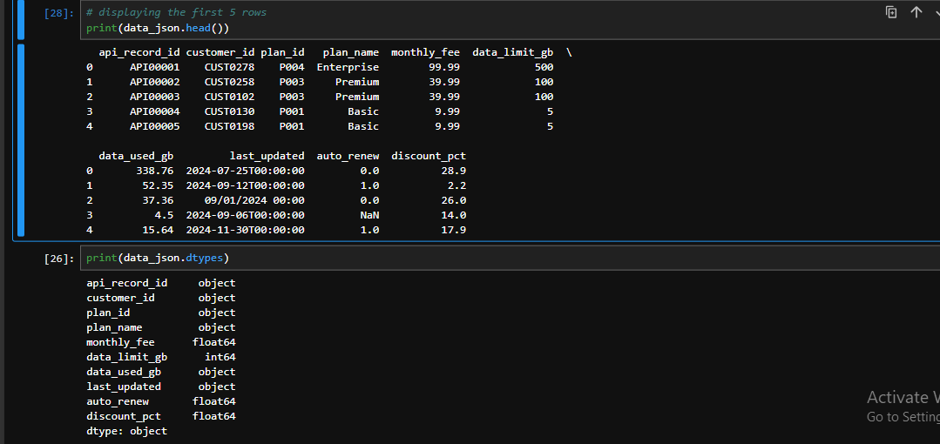
. filename.head() & filename.dtypes()

Slide 9
Method 2- Nested JSON ( using JSON + JSON normalize)

Slide 10
displaying the first 5 rows and record types

Slide 11
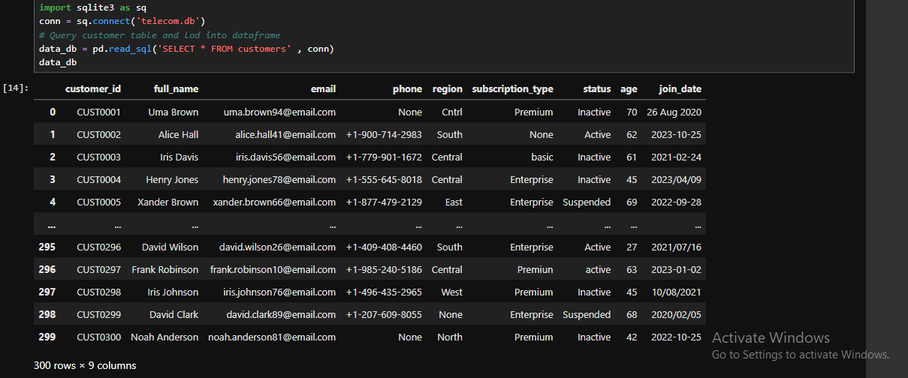
Loading A .db File (SQL Database)
Method 1- Loading an entire table

Slide 12
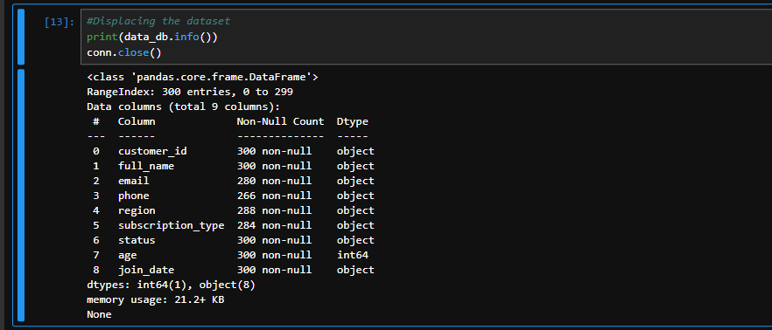
Displacing dataset’s information .info() & .close()

Slide 13
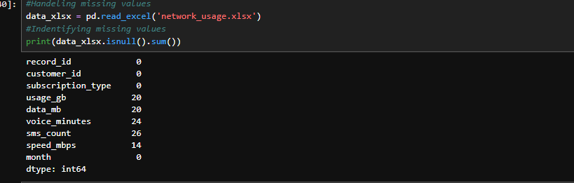
Handling Missing Values
.isnull()

Slide 14
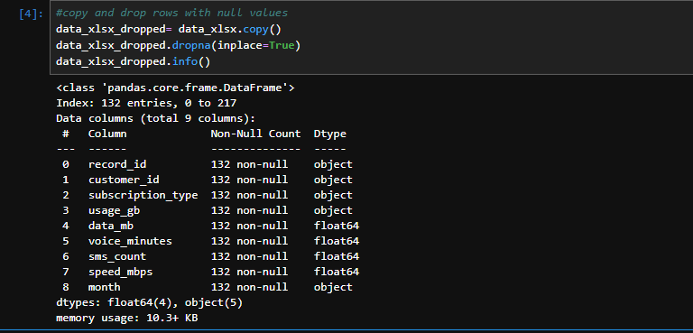
Copy and drop rows with null values
.copy() , .dropna() and .fillna()

Slide 15
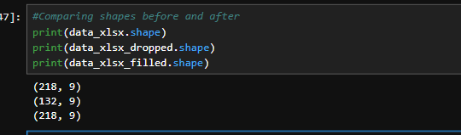
Viewing The Differences

Slide 16
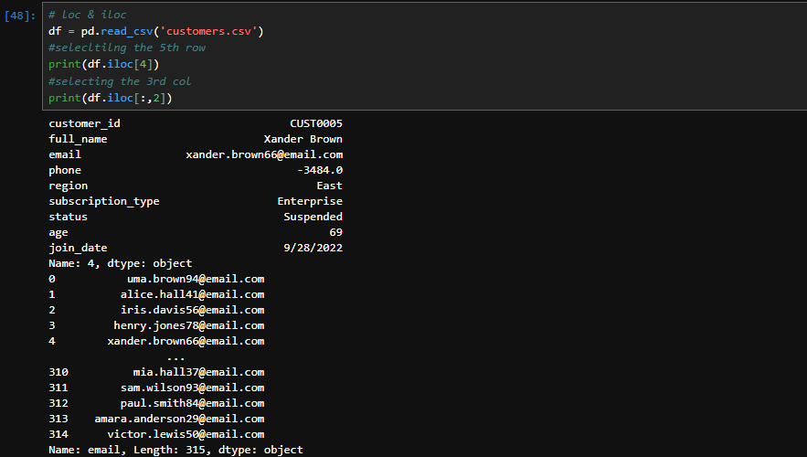
.iloc[ ] And .loc[ ]

Slide 17
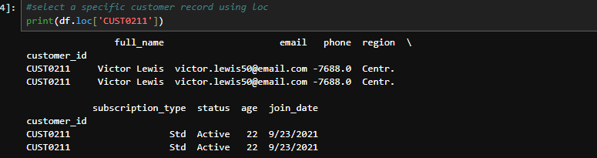
.loc[ ]

Slide 18
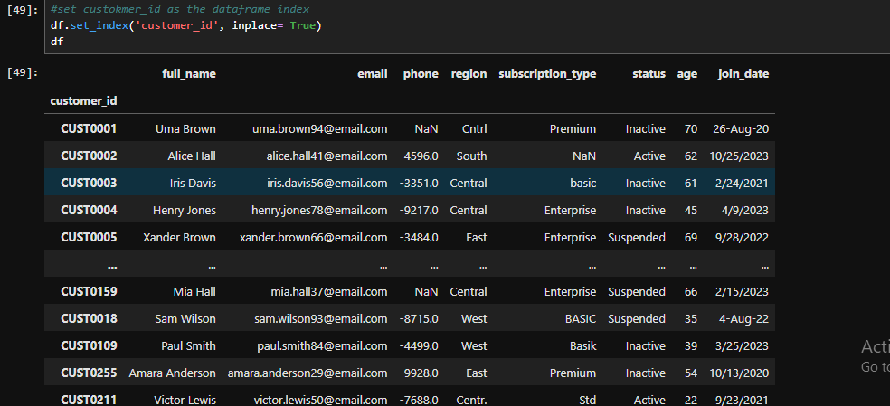
Setting Indexes ( .set_index() )

Slide 19
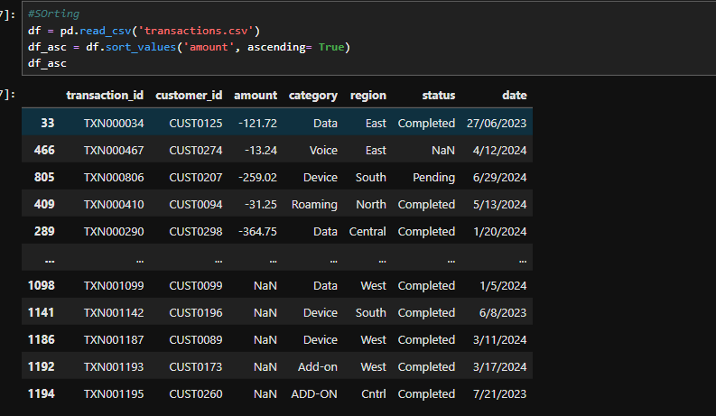
Sorting
.sort_values(‘sort_by’)

