Slide 1




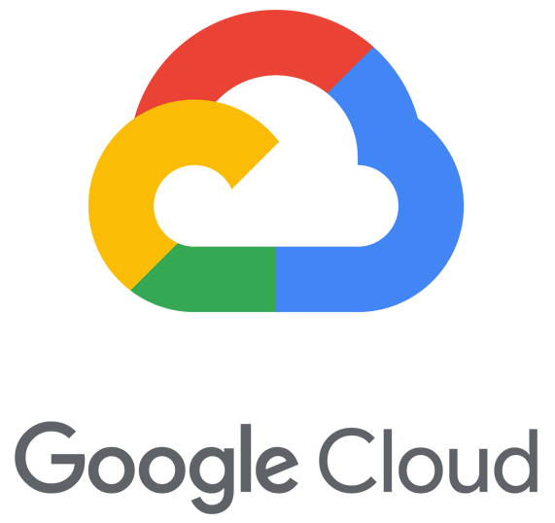

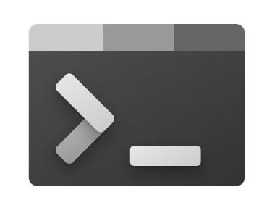
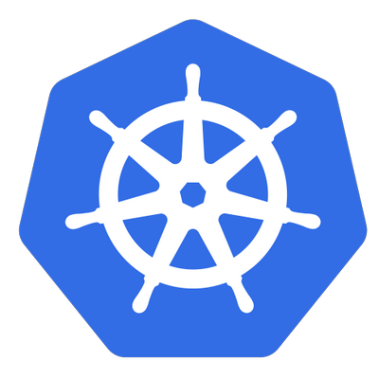


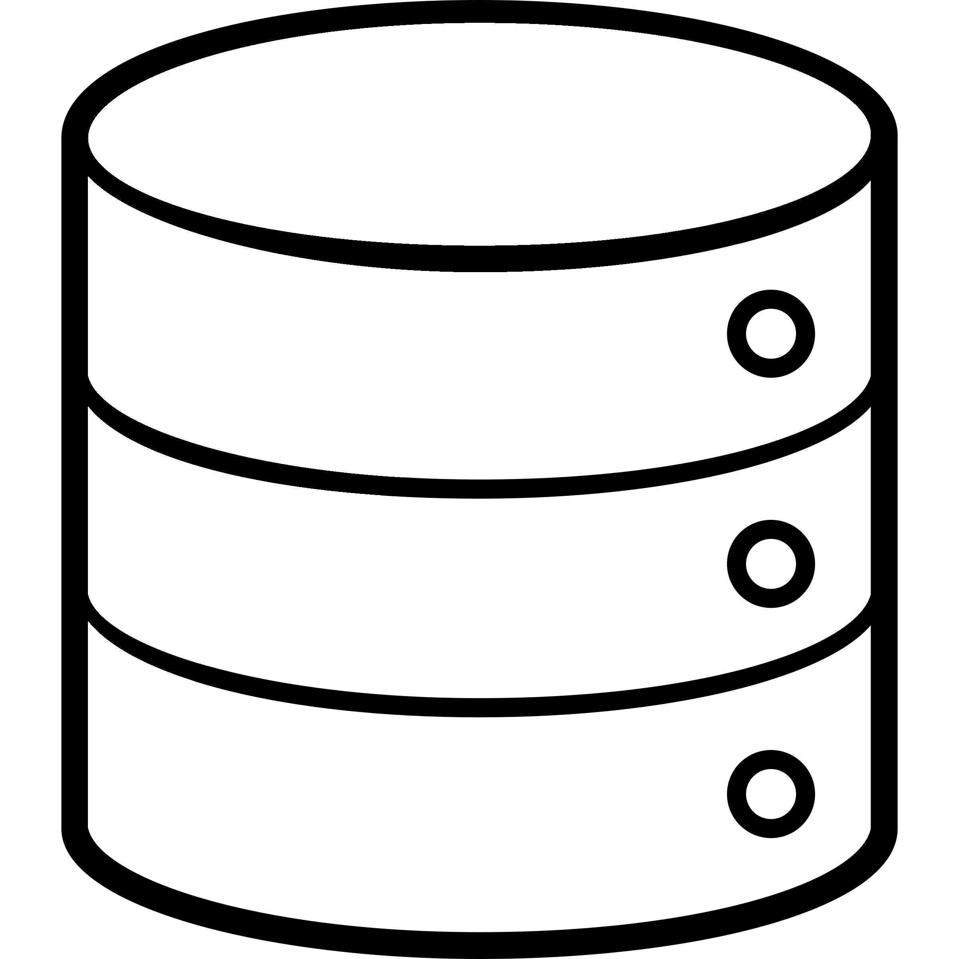






Control plane k8s
Custom Dashboard
App Service Cluster`s
user
Cluster
Deploy
Deploy Pipeline
App Service Cluster`s
Web Terminal
App Cluster
Monitoring
APP
APP
APP
APP
APP
Cluster - n

Slide 2

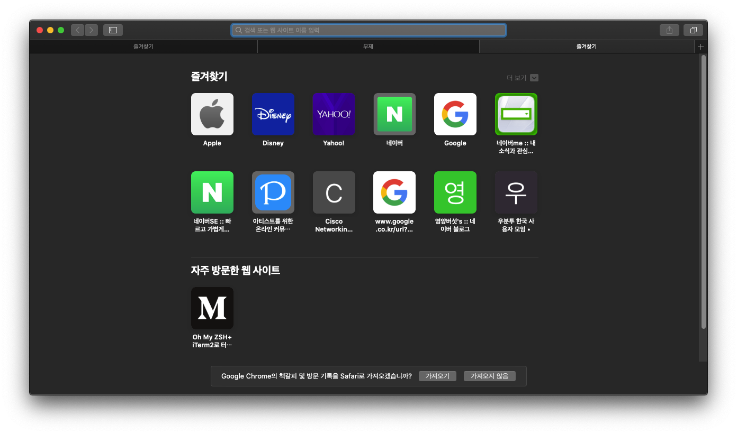


user
Control Container
Custom Dashboard
Dashboard Tab
Deploy
& Control
Data
Dashboard
Dashboard
Data & Control
Contents
Data
Dashboard out
Data
App Service Clusters
Deploy
Local Server or Cloud Vendors
App Service Clusters
Logging & Metric
APP
Logging
Cloud Vendors
APP
APP
APP
APP
Data
Metric
Data
Data
App Service
Clusters

