Slide 1







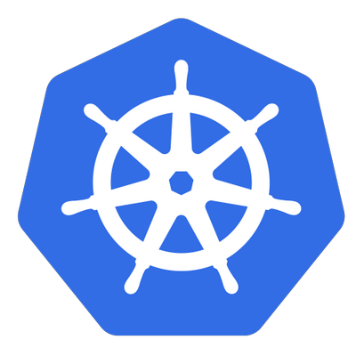


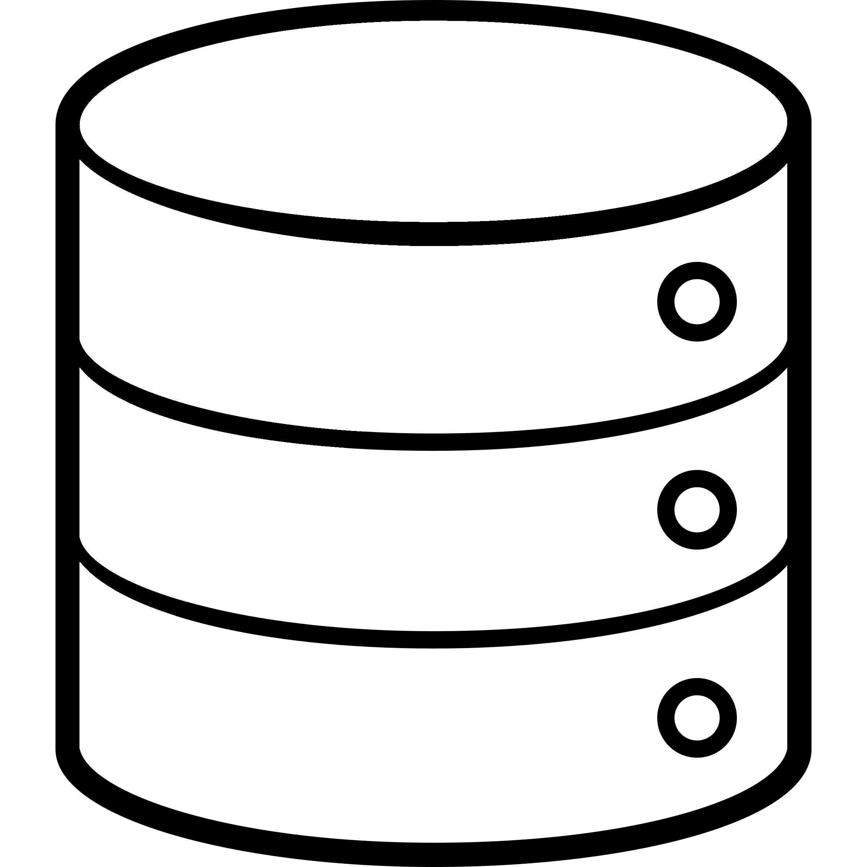






Control plane k8s
Custom Dashboard
App Service Cluster`s
user
Cluster
Deploy
Deploy Pipeline
App Service Cluster`s
Web Terminal
App Cluster
Monitoring
APP
APP
APP
APP
APP
Cluster - n

